Slide 1
SOIS Services
Version 5, 2016 April 5 Meeting

Slide 2
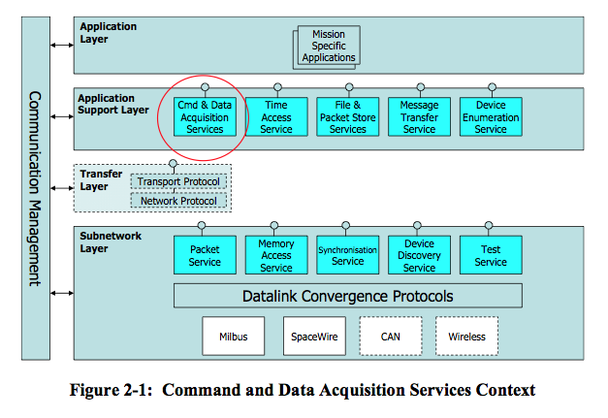
Layered View
This is the traditional diagram that summarizes SOIS services in layers of a protocol stack.

Slide 3
Functional Group Summary
Applications
SOIS services can be categorized in five functional groups, all of which are accessible to applications.
Data Distribution applies various technologies to deliver the latest data to applications and distribution of data among processing nodes, such as partitions, processors, and vehicles. Intra- and inter-processor communications.
Device & Access Services provide services used by applications to do device access, memory, and packet services.
Vehicle Manifest provides a description of onboard devices and their interfaces, described in more detail by Yonghui.
Device Content Services is a set of spacecraft-oriented services that resembles the POSIX file system and time services.
Communication Protocols provide access and a common interface for the underlying physical communication subnets.
Data Distribution
Vehicle Manifest
Device & Access Services
Device Content Services
Communication Protocols

Slide 4
Data Distribution
Applications
Data Distribution
SOIS provides one technology for distribution of data. Applications that use this service must make their own models of latency and trends in measurements.
Message Transfer Service is a publish/subscribe message bus, for use by applications separated from devices in time and space.
Intra- and inter-processor communications
<<use>>
Message Transfer Service
<<use>>
Communication Protocols

Slide 5
Device & Access Services
Applications
Applications can interact with the communication protocols at any depth on the protocol stack.
Device Data Pooling Service is based on the idea of a “current values table” in memory shared by applications.
The Device Virtualization Service provides a view of device data that includes functional interfaces and engineering units. Portable applications use this service.
The Device Access Service provides native interfaces of devices. Device-specific applications, such as housekeeping telemetry, use this service.
The Packet Service provides a datagram model for communicating with a device.
The Memory Access Service provides a memory model for communicating with a device.
The Subnetwork Test Service facilitates testing of devices.
(The Device Data Pooling, Device Virtualization, and Device Access Services appear in the Layered View as a part of the Command and Data Acquisition Services.)
Device Data Pooling Service
<<use>>
Device Virtualization Service
Device Access Service
<<use>>
Packet Service
Memory Access Service
Subnet Test Service
Communication Protocols
<<use>>

Slide 6
Device Access Service: Acquisition
Device Virtualization Service
Device Data Pooling Service
Applications
or
or
Requests identify user who submitted request, so an indication can be returned.
Requests may be tagged with a transaction identifier in order to associate the request with its corresponding indication.
Result metadata returned in an indication indicate the success or reason for failure.
AcquireFromDeviceRequest
AcquireFromDeviceIndication
Device Access Service
PacketSendRequest
(if needed)
ReadRequest
MemoryAccessResultIndication
PacketReceiveIndication
or
PacketFailureIndication
Packet Service
Memory Access Service

Slide 7
Device Access Service: Commanding
Device Virtualization Service
Applications
Device Data Pooling Service
or
or
Commands identify user who submitted command, so an indication can be returned.
Requests may be tagged with a transaction identifier in order to associate the request with its corresponding indication.
Result metadata returned in an indication indicate the success or reason for failure.
CommandDeviceRequest
CommandDeviceIndication
Device Access Service
WriteRequest
Or
ReadModifyWriteRequest
PacketSendRequest
Packet Service
Memory Access Service

Slide 8
Device Virtualization Service: Acquisition
Applications
Device Data Pooling Service
or
Requests identify user who submitted request, so an indication can be returned.
Requests may be tagged with a transaction identifier in order to associate the request with its corresponding indication.
Result metadata returned in an indication indicate the success or reason for failure.
AcquireFromDeviceRequest
AcquireFromDeviceIndication
Device Virtualization Service
AcquireFromDeviceRequest
AcquireFromDeviceIndication
Device Access Service
PacketSendRequest
(if needed)
ReadRequest
PacketReceiveIndication
or
PacketFailureIndication
MemoryAccessResultIndication
Packet Service
Memory Access Service

Slide 9
Device Virtualization Service: Commanding
Applications
Device Data Pooling Service
or
Commands identify user who submitted command, so an indication can be returned.
Requests may be tagged with a transaction identifier in order to associate the request with its corresponding indication.
Result metadata returned in an indication indicate the success or reason for failure.
CommandDeviceRequest
CommandDeviceIndication
Device Virtualization Service
CommandDeviceRequest
CommandDeviceIndication
Device Access Service
WriteRequest
Or
ReadModifyWriteRequest
PacketSendRequest
Packet Service
Memory Access Service

Slide 10
Device Data Pooling Service: Acquisition
Applications
ReadSamplesRequest
Requests identify user who submitted request, so an indication can be returned.
Requests may be tagged with a transaction identifier in order to associate the request with its corresponding indication.
An acquisition order defines sampling parameters.
A request may specify the number of samples to be read.
Result metadata returned in an indication indicate the success or reason for failure.
ReadSamplesIndication
AcquisitionIndication
Device Data Pooling Service
AcquireFromDeviceRequest
AcquireFromDeviceRequest
AcquireFromDeviceIndication
AcquireFromDeviceIndication
Device Virtualization Service
Device Access Service

Slide 11
Device Data Pooling Service: Starting or Stopping Acquisition
Applications
Requests identify user who submitted request, so an indication can be returned.
Requests may be tagged with a transaction identifier in order to associate the request with its corresponding indication.
An acquisition order defines sampling parameters.
Result metadata returned in an indication indicate the success or reason for failure.
StartAcquisitionRequest
StopAcquisitionRequest
StartAcquisitionIndication
StopAcquisitionIndication
Device Data Pooling Service

Slide 12
Device Data Pooling Service: Adding or Removing Acquisition Order
Applications
AddAcquisitionOrderRequest
RemoveAcquisitionOrderRequest
Requests identify user who submitted request, so an indication can be returned.
Requests may be tagged with a transaction identifier in order to associate the request with its corresponding indication.
An acquisition order defines sampling parameters.
Result metadata returned in an indication indicate the success or reason for failure.
Asynchronous acquisition indication flag requests that asynchronous acquisition indications be sent while sampling.
AddAcquisitionOrderIndication
RemoveAcquisitionOrderIndication
Device Data Pooling Service

Slide 13
PacketService
Device Access Service
Applications
Requests identify sender of packet, so an indication can be returned.
Requests identify receiver of packet, so the packet can be delivered to the receiver.
Failure metadata returned in an indication indicates the reason for failure.
Requests may specify quality of service.
Requests may specify their importance in system, unless channel is present, in which case this is importance within channel.
Requests may identify a channel, which is the end-to-end resource for reserved or guaranteed service classes.
or
PacketSendRequest
PacketReceiveIndication
PacketFailureIndication
Packet Service

Slide 14
MemoryAccessService Reading
Device Access Service
Applications
Requests identify user who submitted request, so an indication can be returned.
Requests identify the data system where the memory is located.
Requests may be tagged with a transaction identifier in order to associate the request with its corresponding indication.
Requests may specify a class of memory.
Result metadata returned in an indication indicate the success or reason for failure.
Requests may specify their importance in system, unless channel is present, in which case this is importance within channel.
Requests may identify a channel, which is the end-to-end resource reservation for communication.
Requests may optionally provide identity of user, so memory provider can determine whether authorized to perform operation.
or
ReadRequest
ReadIndication
Memory Access Service

Slide 15
MemoryAccessService Writing
Device Access Service
Applications
Requests identify user who submitted request, so an indication can be returned.
Requests identify the data system where the memory is located.
Requests may be tagged with a transaction identifier in order to associate the request with its corresponding indication.
Requests may specify a class of memory.
Requests may include a mask, which indicates which bits to change and which to leave unchanged.
Result metadata returned in an indication indicate the success or reason for failure.
Requests may specify their importance in system, unless channel is present, in which case this is importance within channel.
Requests may identify a channel, which is the end-to-end resource reservation for communication.
Requests may request a MemoryAccessResultIndication.
Requests may optionally provide identity of user, so memory provider can determine whether authorized to perform operation.
Requests may specify to check data for errors in transmission before writing to memory.
or
ReadModifyWriteRequest
WriteRequest
MemoryAccessResultIndication
Memory Access Service

Slide 16
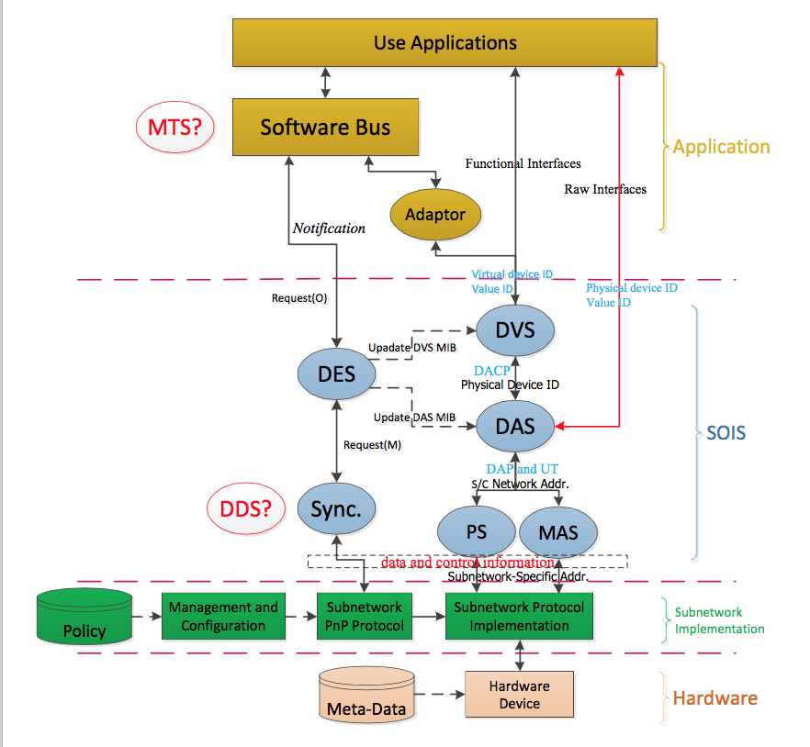
Vehicle Manifest Services
Vehicle Manifest
Services
Provide “plug and play” functions for device discovery, device virtualization, and standardized device access.
Device Enumeration Service (DES) provides table of device names and virtual / physical identifiers
Device Discovery Service (DDS) searches sub-net(s) for devices, recognizes changes to device and sub-net accessibility, provides notifications
Device Virtualization Service (DVS) provides virtual device interface, hides physical device mapping
Device Access Service (DAS) provides direct physical device access when needed
Packet Service (PS) provides means to read / write packets to devices
Memory Access Service (MAS) provide means to read write data to memory
Management Information Base (MIB) stores data about devices in a common format
All rely on underlying Communication Protocols, sub-network services, and devices

Slide 17
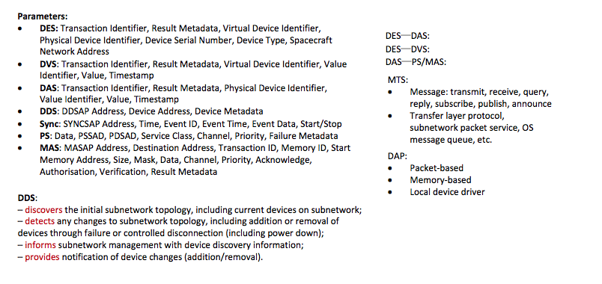
Plug and Play Function descriptions

Slide 18
Device Content Services
Applications
Device Content Services
<<use>>
The operating system abstraction function provides three services.
The File and Packet Store Services are actually two services described together. The File Services provide access to the file system of an onboard computer. The Packet Store Service provides an interface that applications can use to store and to retrieve packets of data.
The Time Access Service provides a variety of alarm and metronome functions, correlated with a central onboard time reference.
The Synchronization Service provides a basic model of events in time, and implements the correlation of time presented by the Time Access Service.
File and Packet Store Services
Time Access Service
Synchronization Service
<<use>>
Communication Protocols

Slide 19
Communication Protocols
Data Distribution
Device & Access Services
Device Content Services
<<use>>
Data Distribution
SOIS provides a Communication Protocol sub-layer that provides a common interface to on-board sub-nets of various types. The Datalink Convergence layer provides a common service interface that adapts the underlying sub-net technologies.
Data Distribution services use this layer to exchange data among applications and processors.
Device & Access services use this layer to provide device access.
Device Content services use this layer to access the devices they serve.
Datalink Convergence Layer
<<use>>
Subnet Protocols (MilBus, SpaceWire, CAN, Wireless, …

Slide 20
Service | Function | Interface/Primitive
Device Enumeration Service (DES) | Provides table of device names and virtual / physical identifiers – Management of existing devices – Management and user notification of added devices – Management and user notification of removed devices | AddDevice DeviceFoundIndication DeviceLostIndication EnumerateDevices QueryDevices RemoveDevice
Device Discovery Service (DDS) | Searches sub-net(s) for devices, recognizes changes to device and sub-net accessibility, provides notifications -discovers initial topology -detects changes to topology -informs management with discovery information -provides notification | DeviceDiscovery DeviceDiscoveryIndication DeviceDiscoveryLoss
Device Virtualization Service (DVS) | Provides functional device interface, hides physical device mapping – Commanding – Data Acquisition | AcquireFromDevice CommandDevice
Device Access Service (DAS) | Provides direct physical device access when needed – Acquire value from device – Command a device | AcquireFromDevice CommandDevice
Packet Service (PS) | Provides means to read / write packets from/to devices providing packet delivery over a single subnetwork | PacketFailureIndication PacketReceiveIndication PacketSend
Memory Access Service (MAS) | Provides means to read write data to memory providing direct access to device memory | MemoryAccessResultIndication Read ReadModifyWrite Write
Message Transfer Service (MTS) | Provides a standard service for mediating the transfer of discrete data (messages) between onboard software users in a distributed onboard system – send a discrete message; – receive the next queued discrete message; – send a query message and receive a reply message back. – multicast a discrete message (publish-subscribe); – broadcast a discrete message (announce). | Announce AssertInvitation AssertSubscription CancelInvitation CancelSubscription Publish Query Register Reply Send Unregister

Slide 21
Service | Function | Interface/Primitive
Time Access Service (TAS) | Provides timing functions – metronome – timer | Alarm CancelAlarm CancelMetronome Metronome Time
Device Data Pooling Service (DDPS) | Allows multiple readers of device data to share the data obtained in a single transfer. Allows periodic refreshing of data. | AcquisitionIndication AddAcquisitionOrder ReadSamples RemoveAcquisitionOrder StartAcquisitions StopAcquisitions
Synchronization | Provides capability to respond to events. | Event Time
Subnetwork Test | Provides capability to execute a self-test function of a device. | Test
Management Information Base (MIB) | Stores data about devices and their configuration.

Slide 22
Service | Function | Interface/Primitive
File Access Service (FAS) | Provides file system functions -file management -file data access | ChangeDir CloseFile CopyFile CreateDir CreateFile DeleteDir DeleteFile FileSeek FileStatus FindFile GetCurrentDir ListDir ListLockedFiles LockFile MoveFile OpenFile ReadFromFile RenameDir UnlockFile WriteToFile
Packet Store | Provides capability to store and to retrieve packets. | ClearPacketStore CreatePacketStore CreateSelection DeletePacketStore DumpPackets FreePackets GetPacketStoresInfo PacketStoreStatus ReadPackets SelectiveDumpPackets SelectiveFreePackets SelectiveReadPackets SetPacketStorePosition WritePackets

Slide 23
Symmetrical Communication
All communications are supported by intelligent data systems able to implement a full SOIS protocol stack.
This scenario is typically used for communication between application software supported by a processor and associated resources, for example for message exchange using the SOIS message transfer service.

Slide 24
Asymmetrical Communication between Application Layers
The controlled device is directly connected to a standard spacecraft Physical and Data Link layer and has sufficient capability to implement SOIS-defined Subnetwork Layer services.

Slide 25
Asymmetrical Communication to Subnet Layer
The controlled device is connected directly to a Data Link and has no capability to implement the SOIS protocol stack.
This is typical of sensors and actuators where the interface provides only for reading and writing register values.
This example requires an asymmetric method of communication whereby the SOIS capabilities resident in the controlling data system must take full responsibility for the controlled device.
The SOIS subnetwork services which operate in this mode are the Synchronisation Service, the Memory Access Service, the Test Service and the Device Discovery Service.

