Slide 1
SOIS Services
Version 4, 2016 March 1 Teleconference

Slide 2
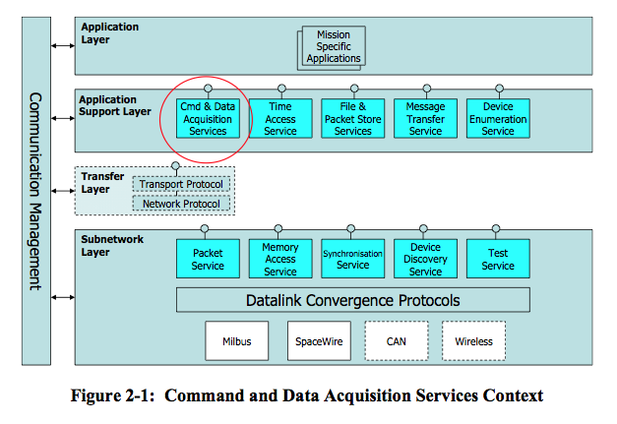
Layered View
This is the traditional diagram that summarizes SOIS services in layers of a protocol stack.

Slide 3
Functional GroupSummary
Applications
SOIS services can be categorized in five functional groups, all of which are accessible to applications.
Data Distribution applies various technologies to deliver the latest data to applications and distribution of data among processing nodes, such as partitions, processors, and vehicles. Intra- and inter-processor communications.
Device & Access Services provide services used by applications to do device access, memory, and packet services.
Vehicle Manifest provides a description of onboard devices and their interfaces, described in more detail by Yonghui.
Device Content Services is a set of spacecraft-oriented services that resembles the POSIX file system and time services.
Communication Protocols provide access and a common interface for the underlying physical communication subnets.
Data Distribution
Vehicle Manifest
Device & Access Services
Device Content Services
Communication Protocols

Slide 4
Data Distribution
Applications
Data Distribution
SOIS provides one technology for distribution of data. Applications that use this service must make their own models of latency and trends in measurements.
Message Transfer Service is a publish/subscribe message bus, for use by applications separated from devices in time and space.
Intra- and inter-processor communications
<<use>>
Message Transfer Service
<<use>>
Communication Protocols

Slide 5
Device & Access Services
Applications
Applications can interact with the communication protocols at any depth on the protocol stack.
Device Data Pooling Service is based on the idea of a “current values table” in memory shared by applications.
The Device Virtualization Service provides a view of device data that includes functional interfaces and engineering units. Portable applications use this service.
The Device Access Service provides native interfaces of devices. Device-specific applications, such as housekeeping telemetry, use this service.
The Packet Service provides a datagram model for communicating with a device.
The Memory Access Service provides a memory model for communicating with a device.
The Subnetwork Test Service facilitates testing of devices.
(The Device Data Pooling, Device Virtualization, and Device Access Services appear in the Layered View as a part of the Command and Data Acquisition Services.)
Device Data Pooling Service
<<use>>
Device Virtualization Service
Device Access Service
<<use>>
Packet Service
Memory Access Service
Subnetwork Test Service
Communication Protocols
<<use>>

Slide 6
Device Access Service: Acquisition
Device Virtualization Service
Device Data Pooling Service
Applications
or
or
DASAP: Device Access Service Access Point is user of DAS.
Transaction: associates request with indication.
Result metadata: success or reason for failure
AcquireFromDeviceRequest
DASAP addr,
Transaction id,
Device id,
Value id
AcquireFromDeviceIndication
DASAP addr,
Transaction id,
Value,
Result metadata,
Timestamp (optional)
Device Access Service
PacketSendRequest
(if needed)
ReadRequest
PacketReceiveIndication
or
PacketFailureIndication
MemoryAccessResultIndication
Packet Service
Memory Access Service

Slide 7
Device Access Service: Commanding
Device Virtualization Service
Device Data Pooling Service
Applications
or
or
DASAP: Device Access Service Access Point is user of DAS.
Transaction: associates request with indication.
Result metadata: success or reason for failure
CommandDeviceRequest
DASAP addr,
Transaction id,
Device id,
Value id,
Value
CommandDeviceIndication
DASAP addr,
Transaction id,
Result metadata
Device Access Service
WriteRequest
Or
ReadModifyWriteRequest
PacketSendRequest
Packet Service
Memory Access Service

Slide 8
Device Virtualization Service: Acquisition
Device Data Pooling Service
Applications
or
DVSAP: Device Virtualization Service Access Point is user of DVS.
Transaction: associates request with indication.
Result metadata: success or reason for failure
AcquireFromDeviceRequest
DVSAP addr,
Transaction id,
Device id,
Value id
AcquireFromDeviceIndication
DVSAP addr,
Transaction id,
Value,
Result metadata,
Timestamp (optional)
Device Virtualization Service
AcquireFromDeviceRequest
AcquireFromDeviceIndication
Device Access Service

Slide 9
Device Virtualization Service: Commanding
Device Data Pooling Service
Applications
or
DVSAP: Device Virtualization Service Access Point is user of DVS.
Transaction: associates request with indication.
Result metadata: success or reason for failure
CommandDeviceRequest
DVSAP addr,
Transaction id,
Device id,
Value id,
Value
CommandDeviceIndication
DVSAP addr,
Transaction id,
Result metadata
Device Access Service
CommandDeviceRequest
CommandDeviceIndication
Packet Service

Slide 10
Device Data Pooling Service: Acquisition
Applications
ReadSamplesRequest
DDPSAP addr,
Transaction id,
Acquisition order id,
Read history size
ReadSamplesIndication
DDPSAP addr,
Transaction id,
Result metadata,
Samples
DDPSAP: Device Data Pooling Service Access Point is user of DDPS.
Transaction: associates request with indication.
Acquisition order defines sampling parameters.
Read history size is number of samples to be read.
Result metadata: success or reason for failure
AcquisitionIndication
DDPSAP addr,
Acquisition order id,
Result metadata
Device Data Pooling Service
AcquireFromDeviceRequest
AcquireFromDeviceIndication
Device Virtualization Service
Device Access Service

Slide 11
Device Data Pooling Service: Starting Acquisition
Applications
DDPSAP: Device Data Pooling Service Access Point is user of DDPS.
Transaction: associates request with indication.
Acquisition order defines sampling parameters.
Result metadata: success or reason for failure
StartAcquisitionRequest
DDPSAP addr,
Transaction id,
Acquisition order id,
First acquisition time
StartAcquisitionIndication
DDPSAP addr,
Transaction id,
Result metadata
Device Data Pooling Service

Slide 12
Device Data Pooling Service: Stopping Acquisition
Applications
DDPSAP: Device Data Pooling Service Access Point is user of DDPS.
Transaction: associates request with indication.
Acquisition order defines sampling parameters.
Result metadata: success or reason for failure
StopAcquisitionRequest
DDPSAP addr,
Transaction id,
Acquisition order id
StopAcquisitionIndication
DDPSAP addr,
Transaction id,
Result metadata
Device Data Pooling Service

Slide 13
Device Data Pooling Service: Adding Acquisition Order
Applications
DDPSAP: Device Data Pooling Service Access Point is user of DDPS.
Transaction: associates request with indication.
Acquisition order defines sampling parameters.
Result metadata: success or reason for failure
Asynchronous acquisition indication flag requests that asynchronous acquisition indications be sent while sampling.
AddAcquisitionOrderRequest
DDPSAP addr,
Transaction id,
Device value list,
Acquisition interval,
History size,
Asynch acquisition indication flag
AddAcquisitionOrderIndication
DDPSAP addr,
Transaction id,
Result metadata,
Acquisition order id
Device Data Pooling Service

Slide 14
Device Data Pooling Service: Removing Acquisition Order
Applications
RemoveAcquisitionOrderRequest
DDPSAP addr,
Transaction id,
Acquisition order id
RemoveAcquisitionOrderIndication
DDPSAP addr,
Transaction id,
Result metadata
DDPSAP: Device Data Pooling Service Access Point is user of DDPS.
Transaction: associates request with indication.
Acquisition order defines sampling parameters.
Result metadata: success or reason for failure
Asynchronous acquisition indication flag requests that asynchronous acquisition indications be sent while sampling.
Device Data Pooling Service

Slide 15
PacketService
Device Access Service
Applications
or
PSSAP: Packet Source Service Access Point is sender of packet.
PDSAP: Packet Destination Service Access Point is receiver of packet.
Failure metadata: reason for failure
Service class: quality of service
Priority: importance in system, unless channel is present, in which case this is importance within channel
Channel: the end-to-end resource for reserved or guaranteed service classes
PacketReceiveIndication
PSSAP addr,
PDSAP addr,
Service class,
Channel,
Data
PacketSendRequest
PSSAP addr,
PDSAP addr,
Service class,
Priority,
Channel,
Data
PacketFailureIndication
PSSAP addr,
PDSAP addr,
Failure metadata
Packet Service

Slide 16
MemoryAccessService Reading
Device Access Service
Applications
or
MASAP: Memory Access Service Access Point is user of DAS.
Destination: the data system where the memory is located
Transaction: associates request with indication.
Memory: a class of memory
Result metadata: success or reason for failure
Priority: importance in system, unless channel is present, in which case this is importance within channel
Channel: the end-to-end resource reservation for communication
Authorization: optionally provides identity of user, so memory provider can determine whether authorized to perform operation
ReadRequest
MASAP addr,
Destination addr,
Transaction id,
Memory id,
Start memory addr,
Size,
Priority,
Channel,
Authorization
ReadIndication
MASAP addr,
Destination addr,
Transaction id,
Memory id,
Start memory addr,
Size,
Priority,
Channel,
Data,
Result metadata
Memory Access Service

Slide 17
MemoryAccessService Writing
Device Access Service
Applications
or
MASAP: Memory Access Service Access Point is user of DAS.
Destination: the data system where the memory is located
Transaction: associates request with indication.
Memory: a class of memory
Mask indicates which bits to change and which to leave unchanged.
Result metadata: success or reason for failure
Priority: importance in system, unless channel is present, in which case this is importance within channel
Channel: the end-to-end resource reservation for communication
Acknowledge requests a MemoryAccessResultIndication.
Authorization: optionally provides identity of user, so memory provider can determine whether authorized to perform operation
Verification requests checking data for errors in transmission before writing to memory.
ReadModifyWriteRequest
MASAP addr,
Destination addr,
Transaction id,
Memory id,
Start memory addr,
Size,
Mask,
Priority,
Channel,
Data,
Acknowledge,
Authorization,
Verification
WriteRequest
MASAP addr,
Destination addr,
Transaction id,
Memory id,
Start memory addr,
Size,
Priority,
Channel,
Data,
Acknowledge,
Authorization,
Verification
MemoryAccessResultIndication
MASAP addr,
Destination addr,
Transaction id,
Memory id,
Start memory addr,
Size
Result metadata
Memory Access Service

Slide 18
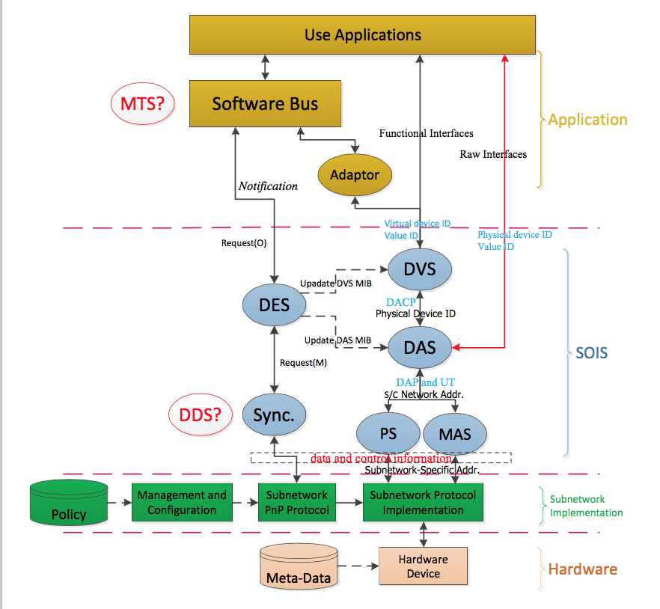
Vehicle Manifest Services
Vehicle Manifest
Services
Provide “plug and play” functions for device discovery, device virtualization, and standardized device access.
Device Enumeration Service (DES) provides table of device names and virtual / physical identifiers
Device Discovery Service (DDS) searches sub-net(s) for devices, recognizes changes to device and sub-net accessibility, provides notifications
Device Virtualization Service (DVS) provides virtual device interface, hides physical device mapping
Device Access Service (DAS) provides direct physical device access when needed
Packet Service (PS) provides means to read / write packets to devices
Memory Access Service (MAS) provide means to read write data to memory
Management Information Base (MIB) stores data about devices in a common format
All rely on underlying Communication Protocols, sub-network services, and devices

Slide 19
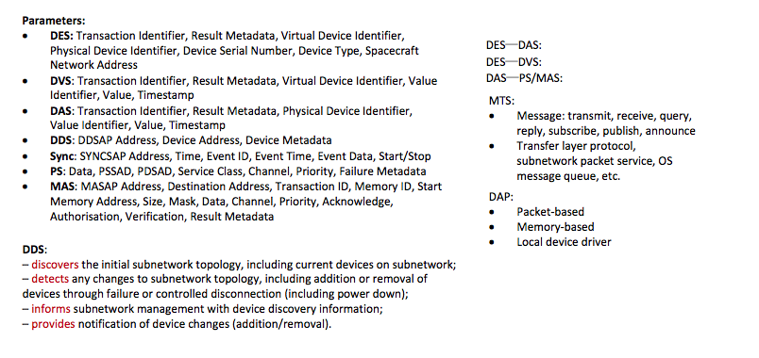
Plug and Play Function descriptions

Slide 20
Device Content Services
Applications
Device Content Services
<<use>>
The operating system abstraction function provides three services.
The File and Packet Store Services are actually two services described together. The File Services provide access to the file system of an onboard computer. The Packet Store Service provides an interface that applications can use to implement delay-tolerant networking.
The Time Access Service provides a variety of alarm and metronome functions, correlated with a central onboard time reference.
The Synchronization Service provides a basic model of events in time, and implements the correlation of time presented by the Time Access Service.
File and Packet Store Services
Time Access Service
Synchronization Service
<<use>>
Communication Protocols

Slide 21
Communication Protocols
Data Distribution
Device & Access Services
Device Content Services
Data Distribution
SOIS provides a Communication Protocol sub-layer that provides a common interface to on-board sub-nets of various types. The Datalink Convergence layer provides a common service interface that adapts the underlying sub-net technologies.
Data Distribution services use this layer to exchange data among applications and processors.
Device & Access services use this layer to provide device access.
Device Content services use this layer to access the devices they serve.
<<use>>
Datalink Convergence Layer
<<use>>
Subnet Protocols (MilBus, SpaceWire, CAN, Wireless, …

Slide 22
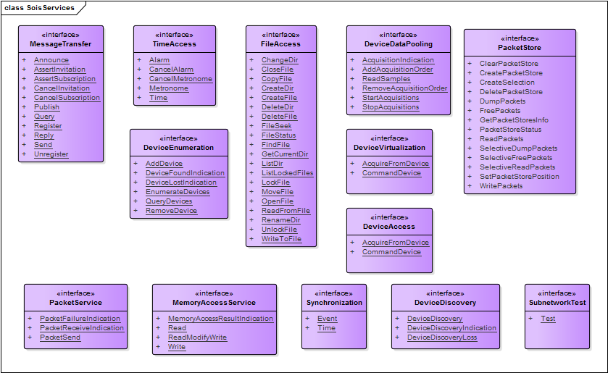
SOIS Service Interfaces
This diagram summarizes the service interfaces provided by SOIS.

