Slide 1
SOIS Services
Version 3, with post 19 Jan 2016 Telecon mods

Slide 2
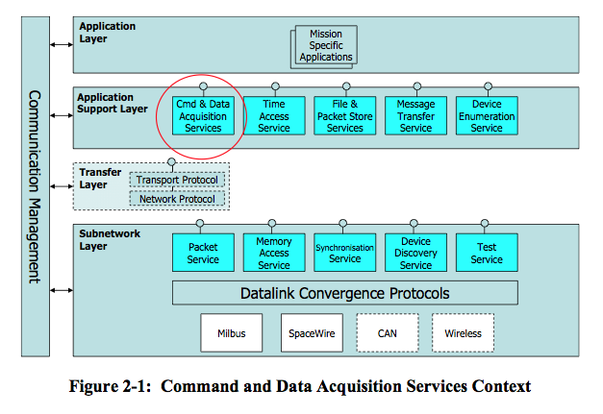
Layered View
This is the traditional diagram that summarizes SOIS services in layers of a protocol stack.

Slide 3
Functional GroupSummary
Applications
SOIS services can be categorized in five functional groups, all of which are accessible to applications.
Data Distribution applies various technologies to deliver the latest data to applications and distribution of data among processing nodes, such as partitions, processors, and vehicles. Intra- and inter-processor communications.
Device & Access Services provide services used by applications to do device access, memory, and packet services.
Vehicle Manifest provides a description of onboard devices and their interfaces, described in more detail by Yonghui.
Device Content Services is a set of spacecraft-oriented services that resembles the POSIX file system and time services.
Communication Protocols provide access and a common interface for the underlying physical communication subnets.
Data Distribution
Vehicle Manifest
Device & Access Services
Device Content Services
Communication Protocols

Slide 4
Data Distribution
Applications
Data Distribution
SOIS provides one technology for distribution of data. Applications that use this service must make their own models of latency and trends in measurements.
Message Transfer Service is a publish/subscribe message bus, for use by applications separated from devices in time and space.
Intra- and inter-processor communications
<<use>>
Message Transfer Service
<<use>>
Communication Protocols

Slide 5
Device & Access Services
Applications
Applications can interact with the communication protocols at any depth on the protocol stack.
Device Data Pooling Service is based on the idea of a “current values table” in memory shared by applications.
The Device Virtualization Service provides a view of device data that includes functional interfaces and engineering units. Portable applications use this service.
The Device Access Service provides native interfaces of devices. Device-specific applications, such as housekeeping telemetry, use this service.
The Packet Service provides a datagram model for communicating with a device.
The Memory Access Service provides a memory model for communicating with a device.
The Subnetwork Test Service facilitates testing of devices.
(The Device Data Pooling, Device Virtualization, and Device Access Services appear in the Layered View as a part of the Command and Data Acquisition Services.)
Device Data Pooling Service
<<use>>
Device Virtualization Service
Device Access Service
<<use>>
Packet Service
Memory Access Service
Subnetwork Test Service
Communication Protocols
<<use>>

Slide 6
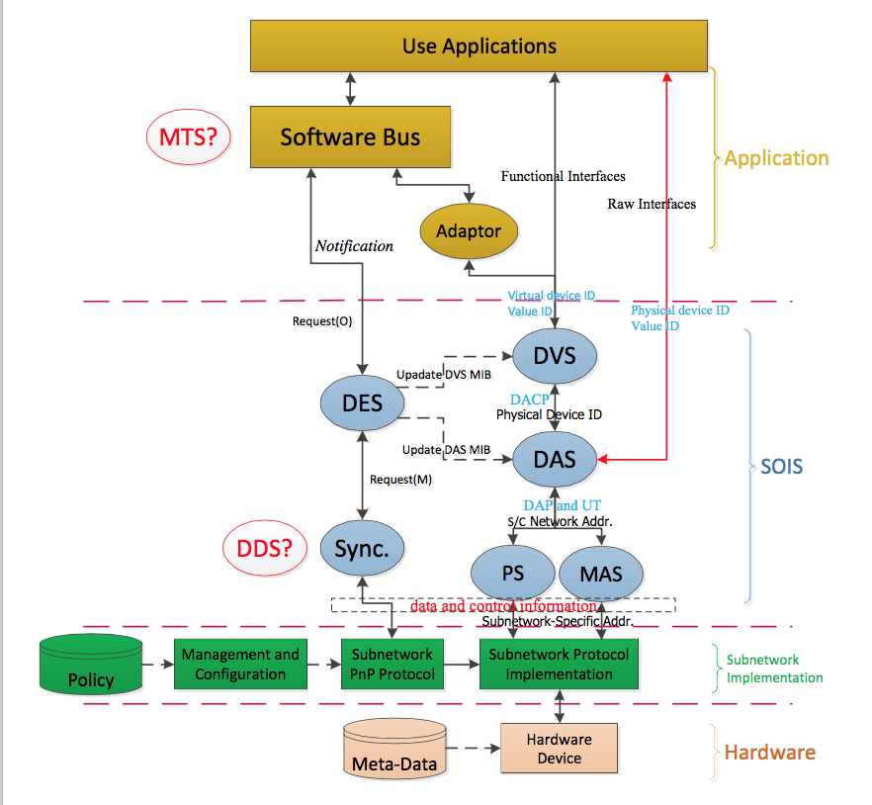
Vehicle Manifest Services
Vehicle Manifest
Services
Provide “plug and play” functions for device discovery, device virtualization, and standardized device access.
Device Enumeration Service (DES) provides table of device names and virtual / physical identifiers
Device Discovery Service (DDS) searches sub-net(s) for devices, recognizes changes to device and sub-net accessibility, provides notifications
Device Virtualization Service (DVS) provides virtual device interface, hides physical device mapping
Device Access Service (DAS) provides direct physical device access when needed
Packet Service (PS) provides means to read / write packets to devices
Memory Access Service (MAS) provide means to read write data to memory
Management Information Base (MIB) stores data about devices in a common format
All rely on underlying Communication Protocols, sub-network services, and devices

Slide 7
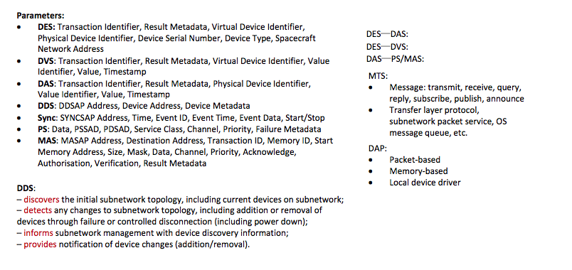
Plug and Play Function descriptions

Slide 8
Device Content Services
Applications
Device Content Services
<<use>>
The operating system abstraction function provides three services.
The File and Packet Store Services are actually two services described together. The File Services provide access to the file system of an onboard computer. The Packet Store Service provides an interface that applications can use to implement delay-tolerant networking.
The Time Access Service provides a variety of alarm and metronome functions, correlated with a central onboard time reference.
The Synchronization Service provides a basic model of events in time, and implements the correlation of time presented by the Time Access Service.
File and Packet Store Services
Time Access Service
Synchronization Service
<<use>>
Communication Protocols

Slide 9
Communication Protocols
Data Distribution
Device & Access Services
Device Content Services
Data Distribution
SOIS provides a Communication Protocol sub-layer that provides a common interface to on-board sub-nets of various types. The Datalink Convergence layer provides a common service interface that adapts the underlying sub-net technologies.
Data Distribution services use this layer to exchange data among applications and processors.
Device & Access services use this layer to provide device access.
Device Content services use this layer to access the devices they serve.
<<use>>
Datalink Convergence Layer
<<use>>
Subnet Protocols (MilBus, SpaceWire, CAN, Wireless, …

Slide 10
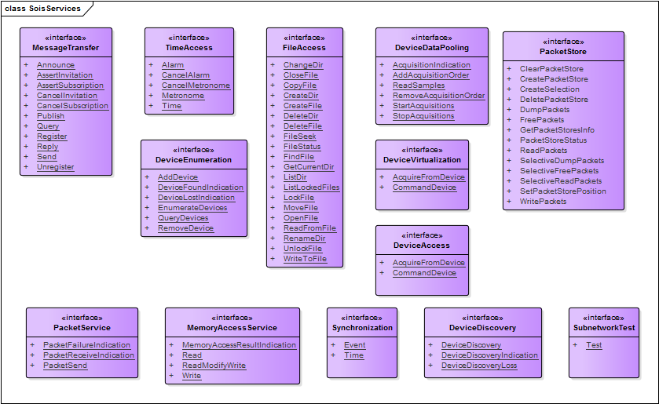
SOIS Service Interfaces
This diagram summarizes the service interfaces provided by SOIS.

