Slide 1
SOIS Services

Slide 2
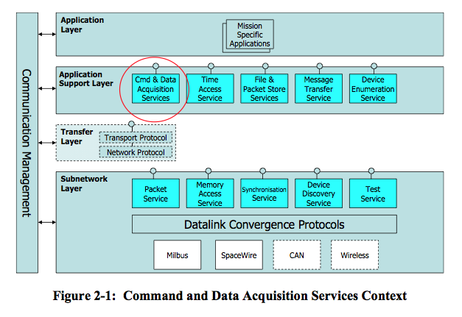
Layered View
This is the traditional diagram that summarizes SOIS services in layers of a protocol stack.

Slide 3
Functional Summary
Applications
SOIS services can be categorized in four functional areas, all of which are accessible to applications.
Data Distribution applies various technologies to deliver the latest data to applications.
Communication Protocols provide the means for distribution of data among processing nodes, such as partitions, processors, and vehicles.
Vehicle Manifest provides a description of onboard devices and their interfaces, described in more detail by Yonghui.
Operating System Abstraction is a set of spacecraft-oriented services that resembles the POSIX concept.
Data Distribution
Vehicle Manifest
Communication Protocols
Operating System Abstraction

Slide 4
Data Distribution
Applications
Data Distribution
SOIS provides two technologies for distribution of data. Applications that use these services must make their own models of latency and trends in measurements.
Message Transfer Service is a publish/subscribe message bus, for use by applications separated from devices in time and space.
Device Data Pooling Service is based on the idea of a “current values table” in memory shared by applications.
(The Device Data Pooling Service appears in the Layered View as a part of the Command and Data Acquisition Services.)
Message Transfer Service
Device Data Pooling

Slide 5
Communication Protocols
Applications
Communication Protocols
Applications can interact with the communication protocols at any depth on the protocol stack.
The Device Virtualization Service provides a view of device data that includes functional interfaces and engineering units. Portable applications use this service.
The Device Access Service provides native interfaces of devices. Device-specific applications, such as housekeeping telemetry, use this service.
The Packet Service provides a datagram model for communicating with a device.
The Memory Access Service provides a memory model for communicating with a device.
The Subnetwork Test Service facilitates testing of devices.
(The Device Virtualization and Device Access Services appear in the Layered View as a part of the Command and Data Acquisition Services.)
Device Virtualization Service
Device Access Service
Packet Service
Memory Access Service
Subnetwork Test Service

Slide 6
Operating System Abstraction
Applications
Operating System Abstraction
The operating system abstraction function provides three services.
The File and Packet Store Services are actually two services described together. The File Services provide access to the file system of an onboard computer. The Packet Store Service provides an interface that applications can use to implement delay-tolerant networking.
The Time Access Service provides a variety of alarm and metronome functions, correlated with a central onboard time reference.
The Synchronization Service provides a basic model of events in time, and implements the correlation of time presented by the Time Access Service.
File and Packet Store Services
Time Access Service
Synchronization Service

Slide 7
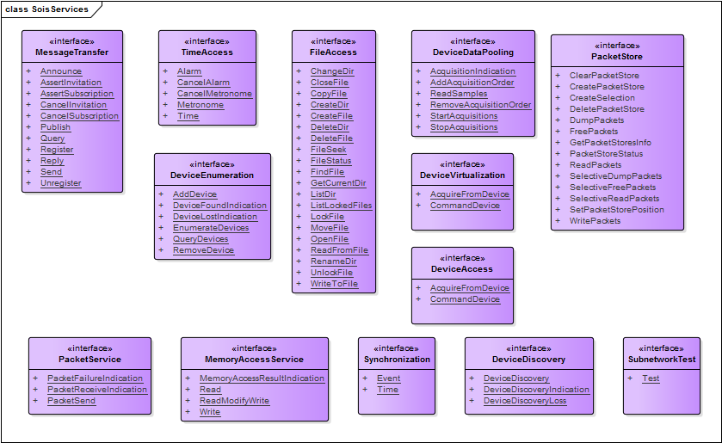
SOIS Service Interfaces
This diagram summarizes the service interfaces provided by SOIS.

