Slide 1
CCSDS Reference Architecture Evaluation
10 Nov 2015
Peter Shames
(with notes from 10 Nov 15 meeting)

Slide 2
Agenda
Review 7 Oct 2015 telecon results
Scope, approach, content
Review MO & Nav materials provided after the telecon
Showing alignment revisions
Review (briefly) existing SCCS-ADD and MOIMS alignment agreement
Review existing MOIMS and SOIS functional descriptions and alignment
Include one ESA proposed integration approach
Discuss open issues and next steps

Slide 3
CCSDS Reference Architecture Telecon, 7 Oct 15
Attendees: Peccia, Merri, Suess, Barton, Sarkarati, Smith, Wilmot, Champsavior, Shames
Agenda:
Discuss scope of work
Discuss proposed approach for the WG efforts
Discuss whether the identified content starts to present an adequate coverage of what is needed
Discuss schedule for coordinated meetings during the Fall session in Darmstadt
Scope of Work
Agreement that the existing SCCS-ADD/ARD provides an adequate model of the underlying data transfer services, especially for space comms
Some concern stated that they focus on space communication and do not provide adequate coverage of terrestrial comms
Suggestion that the initial phase of the work should focus on MOIMS on the ground and SOIS in space. The second phase would address the MOIMS / SOIS interfaces in space.
Statement that there is a plan to address the MOIMS / SOIS interfaces at the upcoming meeting
Concern that all of the MOIMS topics be covered by the model, including nav, data archive, robotics, mission planning
Probable need to cover MO aspects of voice and video, although this was not touched upon

Slide 4
CCSDS Reference Architecture Telecon, 7 Oct 15
Proposed approach for WG efforts
Recognition that this is just a part of the overall SAWG program of work
Acknowledgement that the SAWG needs to have agency and area contributors, especially from MOIMS and SOIS, and from ESA, CNES, and NASA at a minimum
Tentative agreement on a phased approach, with assumption that the MOIMS / SOIS discussions will address any spacecraft on-board boundary changes. Assume for now that the boundary is as stated in the MOIMS / SOIS MOU.
Agreement to gather scenarios and other use case materials
Agreement to leverage as much existing material from WG and agency studies as can be made available
Agreement to focus on coverage for MOIMS & SOIS Blue and Magenta Book materials, with emphasis on interoperability
Agreement that we should leverage any existing agency study / analysis materials that we can all be allowed to see, but that the outcome of this work must be “CCSDS level” and agency neutral

Slide 5
CCSDS Reference Architecture Telecon, 7 Oct 15
Coverage of identified content
Content is a quite complete coverage of what has been published in CCSDS to date
Leveraging existing SCCS-ARR / ARD is acceptable for space comms, other “data transfer” layers will need to be shown terrestrially
Nav and archiving are missing from the package
There is an agreed need for scenarios and use case views
There is an agreed need for a “leveled” set of functional decomposition materials across all of the MOIMS and SOIS topics, these are currently uneven and scant at best
There is an agreed need for an improved set of (detailed enough) functions with clearly identified interfaces (tied to standards) and for views of related and interconnected functional groups like (tracking, nav, comm planning, mission planning)
Schedule for meetings
Due to other work commitments the group agreed to one (or possibly two) “end of day” working meetings during the CCSDS working sessions
The Doodle poll agreed on Tuesday night
The SAWG BoF responded to the CESG conditions on 20 October, no response yet from ADs except to say “wait 30 days”
Action Items
Nestor Peccia to provide ESA study materials (if possible)
Mehran Sarkarati to provide ESA MOIMS / SOIS trade study options (if possible)
Johnathan Wilmot to provide NASA SOIS (Blue / Magenta) analysis materials (if possible)
Peter Shames to produce a next version of the integrated set, merging what is provided by the others (if anything)

Slide 6
Recent MO & Nav Diagram Evaluation
Use provided MO services (Nestor) & Nav service (Nav WG) diagrams
Edit them minimally for clarity and consistency so traceability is clear
For now the diagrams remain in their original, and inconsistent, styles
Show how they relate to each other and to CSS services
Attempt to clarify and discriminate among:
Data structures and formats
Functions (and groupings)
Service interfaces

Slide 7
ODM
SOCs / PIs
FDS
NAV Data
SM
NAV Data
Tracking
Data (TD)
C
S
T
S
/
S
L
E
Planning Requests
Mission Schedule
TDM
ODM, ADM,
PRM
SMM, ADM, ODM, CDM
Comm
Service
Request
NAV Data
TM
MO M&C Services
MO Mission Data Product Distribution
Parameter Processing
TM Processing
Mission
Planning
Service
Request
MO Planning Data
TC
MO Data Services
Manual
Execution
TC Processing
MO M&C Data
MO Automation Data
Procedure Execution
Monitored
Data (MD)
Command Verification
MO File Data
MO Scheduling Data
Service
Ctrl (SC)
Schedule Execution
Ground
Station
Resource
Planning
Activity / Parameter / event / Packet Monitoring
S/C Schedule Report
Event Driven Execution
Missing
SOIS
SM
SSI
S
M
On Board Schedule Management
Command Releaser
MO M&C Data
MO Planning
Data
Planning Request Processing
MO Scheduling Data
MO Automation Data
S/C Schedule
Mission Automation Planning Schedule
Planning Engine
MO Scheduling Data
MO Automation Services
Procedure Processing
Procedure Generation
Schedule Generation
P&S
Services
MO Automation Data
ODM, EVM, SMM
FDS
Modified for
Consistency
NAV Data
MO Automation Data
Procedure Data

Slide 8
Notes on Revised MOC with MO Services diagram
Provides view of the MO, FDS, & CSS interactions, showing major functional groups and external interfaces (“grey boxes” show groups of functions), exchanged data structures are shown as green boxes)
All data transfers are shown as data, not as “services”; data exchange structures and formats must be standardized for interoperability
Service Interfaces are explicitly shown associated with the functions that provide them
Five MOIMS Service groups shown: Navigation (FDS), Monitor & Control (M&C), Automation, Planning & Scheduling (P&S), MO Data Services
Data archiving, auditing, and Robotics etc are not shown for now
Not all service interfaces on functional groups are shown
CSS Services (SM, CSTS, SLE) are shown explicitly as service providers
Not all of the service requests nor data flows to/from the SOC / PI are shown (mission planning & automation requests, commands, science data, archival data, etc, etc)
FDS to MO interactions are shown on a separate Nav WG chart (with edits)
NOTE: most of the service interfaces could continue to be mission specific (as now), or converted to an MO Service framework, or just use TGFT- like services, or …

Slide 9
FDS
Flight Dynamics Team Processes
ODM
Conjunction
Assessment
S/C
Fncs
Navigation
CDM
SMM
SM
SMM
Orbit
Det
C
S
T
S
Mnvr
ODM
CDM
Trk Stn
Fncs
EVM, SMM
TDM
EVM
SMM,
ADM,
PRM
ADM
NHM
CDM
Att
Det
SLE
ODM, EVM
SMM
TLM Data
Commands
SMM, ADM, ODM
ADM
ODM
PRM
Sched
Mission
S/C Ops
Fncs
Uses Generic File Transfer
Commands
Science
PRM
Cmd Gen
M&C
P&S
Navigation Working Group w/ GFT Services
N.B. Nav stds are all interoperable data format specs
Mission S/C Ops Team Processes

Slide 10
Notes on Revised Flight Dynamics (FDS) Services diagram
Provides view of the separate FDS to MO interactions, showing major interfaces (“circles” are functions, types of data structures are named on connectors)
All data transfers are shown as data, not as “services”; data exchange formats must be standardized for interoperability
Service Interfaces are explicitly shown associated with the functions that provide them, but they may not offer explicit service interfaces
Navigation (FDS) services are shown, using the functions and data structure standards defined in the Nav WG diagram (Richon v 4.2)
CSS Services (SM, CSTS, SLE) are shown explicitly as service providers
All of the elements are re-named, where needed, to produce a consistent functional view; teams and processes are separately indicated
NOTE: most of the service interfaces could continue to be mission specific (as now), or converted to an MO Service framework, or just use TGFT- like services (as shown)

Slide 11
SCCS-ARD (CCSDS 901x1m1) - Figure 7-4:
SSI Secure End-to-End Forward: SSI Agency Supporting SSI Agency
SSI
SSI
SSI
Space User Node
Earth-Space
Link Terminal
Earth User Node
CMD
MOIMS SM&C
Apps
Space File Application
Bundle Agent (Router/S&F)
Space Msg
Application
SBSP
SBSP
File Secure
BP
BP
CMD
AMS
CFDP
LTP
User File Application
MOIMS SM&C
Apps
SBSP
ENCAP
User Msg
Application
BP
AOS/TC
File Secure
LTP
Mux F-Frame
Production
AMS
CFDP
ENCAP
SBSP
AOS/TC
VC X
VC X
F-Frame
BP
To VC X
TCP
TCP
C & S
C & S
IPSEC
IPSEC
RF & Mod
RF & Mod
IP
IP
Ground-Space
CCSDS Protocols
Terrestrial
WAN
Notes:
12/12/12: New slide from Peter. Figure title in document is shown above. PPT original figure title is “SSI Secure Single Link Cross Support – Forward
(File, Frame & Message all DTN)
11

Slide 12
Cross Support / Mission Operations Interactions using Standard SLE / SM Services
ABA
ESLT
Earth User
Node
Service
Management (SM) Interface (I/F)
SM&C MO Applications
(MAL Compliant)
Service Management Processing
(Scheduling)
User Service Management Application
(Planning & Scheduling)
Planning
Schedule
Execution
SM over HTTP
Service Management Processing
(Monitor Data)
User Service Monitor Data Processing
Monitor &
Control
Flight
Dynamics
MD-CSTS over TCP
SLE F-CLTU
Processing
User F-CLTU Application
(CLTU Processing)
MAL & Transport Adapter for SPP
F-CLTU over TCP
SLE RCF
Processing
(Frame De-Muxing)
User Application
(Packet Processing)
R-CF over TCP
TD-CSTS
Processing
(Real-time Radiometric Data)
User RCF Application
(Frame Processing)
User Radiometric
Data Processing
TD-CSTS over TCP
Service
Delivery (SD)
Interfaces
Notes:
I changed the lines here from dashed to solid.
7/25: Changed to ESLT now that the term is defined before this graphic.
Note that Earth-Space Link Terminals, while shown here, isn’t mentioned in the document until section 3. In part, that’s why I’ve not adjusted the term to show as “ESLT”.

Slide 13
Mission Operations Services Overview (from MOSC 520x0g3)
SOIS lives in here
(not shown)
CSS (SLE, CSTS, CSSM) and
SLS (link, coding, modulation)
live in here (not shown)

Slide 14
Mission Operations Functions (& Sub-functions, partial)

Slide 15
Service Proxy Description (from MOSC 520x0g3)
Where a function is on-board, a ground-based proxy function may manage the interface with ground-based functions. Such a proxy can:
Encapsulate legacy or proprietary interfaces on the space-ground interface;
Manage discontinuity in the space-ground link;
Provide information persistence (storage and retrieval of history).

Slide 16
Example Distribution of Mission Operations Functions

Slide 17
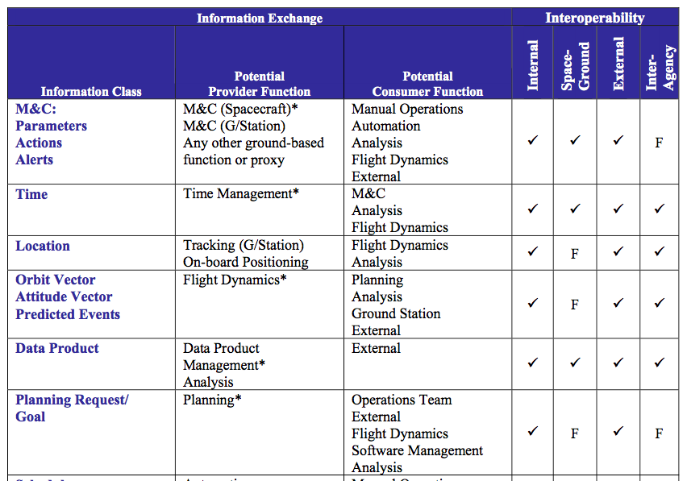
Mission Operation Information—Types and Usage (potential exchanges, partial & incomplete)
􏰁 indicates an interface that is currently exposed.
F indicates an interface that could be exposed in the future.

Slide 18
Relationship of Mission Operations Services to Other CCSDS Standards

Slide 19
SOIS Service Architecture Focus on C&DA (from 876x0r0)
MOIMS SM&C O/B Services
are some of these

Slide 20
“Plug and Play” View of SOIS Architecture (from 850x0g1)
SM&C MO Applications
(MAL Compliant)
MAL
MTS / AMS?

Slide 21
ESA SM&C / SOIS Future Architecture (from EGOS-GEN-SMCSOIS-TN-1001 1)
SOIS
CSS (SLE, CSTS, CSSM) and
SLS (link, coding, modulation) live in here

Slide 22
Open Issues
Scenarios and Use Cases
MOIMS functions, their interactions, and information exchanges (internal & external) must be factored into the Reference Architecture
SOIS functions, their interactions, and information exchanges (internal & external) must be factored into the Reference Architecture
How MOIMS and SOIS functions interact, and how they relate to underlying comm services (CSS, SLS, SIS, SEA) must be factored into the Reference Architecture

Slide 23
What’s next?
Adopt existing SCCS-ADD / ARD for space comms, identify other “data transfer” layers terrestrially
Focus on coverage for MOIMS & SOIS Blue and Magenta Book materials and [FUTURE] work, with emphasis on interoperability
Mission Planning and archiving are missing from the package (get experts to provide any missing functional blocks)
Gather scenarios and other use case materials
Gather existing material from WG and agency studies as can be made available
Leverage any existing agency study / analysis materials that we can all be allowed to see, but that the outcome of this work must be “CCSDS level” and agency neutral
Agree on the level of useful detail for the diagram set (functional groups)
Create a “leveled” set of functional decomposition and interaction materials across all of the MOIMS and SOIS topics, these are currently uneven
Create an improved set of (detailed enough) functions with clearly identified interfaces (tied to standards) and with views of related and interconnected functional groups like (tracking, nav, comm planning, mission planning)

Slide 24
Meeting Notes
Agree to initially model SM&C/MOIMS on the ground and SOIS in space
The issue of suitability of MOIMS in R/T space environment will be evaluated separately
Not all SM&C functions are specified, even as groups.
Agree to show these with only high level functions and interfaces, and mark as [FUTURE]
Agree to provide at least one expert from each of MOIMS & SOIS to work with SEA to develop initial diagram set
The Nav (FDS) diagram seems to be about the right level of detail for any functional group
Focus will be on external / service interfaces of each functional group
Agree that external interfaces and data specs should be tied to existing of future standards
Agree to use RASDS for diagrams, for consistency with existing SCCS-ADD materials
ESA provided a paper from earlier ExoMars study that has some useful materials on functions and protocol mappings

Slide 25
CCSDS Navigation Working Group Terms
NOTE: Exchanges may be predicted future data or
reconstructed actual data, depending on the message type
Messages
ADM = Attitude Data Message
CDM = Conjunction Data Message
EVM = Events Message
NHM = Navigation H/W Message
ODM = Orbit Data Message
PRM = Pointing Request Message
SMM = Spacecraft Maneuver Message
TDM = Tracking Data Message
Functions
Att Det = Attitude Determination function
Cmd Gen = Command Generation function
Mission S/C Team = Spacecraft Team function
Mnvr = Maneuver Design function
Orbit Det = Orbit Determination function
S/C = Spacecraft
Sched = Scheduling function
Science = Science function
Trk Stn = Tracking Station

