Slide 1

CCSDS Engineering Steering Group (CESG):
report to the
CCSDS Management Council (CMC)
concerning the Fall 2014 Technical Plenary
Joint CMC-CESG Meeting
BSI, London, UK
Hosted by UKSA
18 November 2014

Slide 2
SYSTEMS ENGINEERING
(SE) AREA
Peter Shames (AD)
Takahiro Yamada (DAD)
Notes:
2

Slide 3
System Engineering Area (SEA)
Objective
  Guide overall CCSDS architecture for space mission communications, operations, and cross-support
  Support the CESG in evaluating consistency of all area programs of work with the defined architecture
  Create cross-cutting working groups and BOFs as required to progress the work of CCSDS
Focus
  Define reference architectures for describing space mission communications, operations, and cross-support standardization
  Coordinate and collaborate with other areas about architectural choices and options
  Define standards for cross cutting topics such as security and discrete architecture frameworks, and for those that cross cut multiple layers of protocols
  Support other working groups and BoFs that are addressing cross cutting issues
SEA Working Groups
  Security Working Group
  Delta-DOR Working Group
  Timeline Data Exchange Birds of a Feather (WG to be proposed)
  System Architecture BoF (WG to be restarted and expanded to related topics)
  XML Standards and Guidelines (XSG) Special Interest Group (to complete & close)
  Space Assigned Numbers Authority (SANA) Steering Group (operational)
Notes:
3

Slide 4
SE Area Report
B. Meeting Demographics
 | Plenary | SANA SG | Security | D-DOR | SAWG
ASI
CNES | 1 |  | 1 | 1
CNSA
CSA
DLR | 1 |  | 2
ESA | 4 | 2 | 3 | 1 | 3
INPE
JAXA | 1 |  |  | 1 | 1
NASA | 8 | 2 | 4 | 1 | 2
RFSA | 1 |  |  | 1
UKSA |  |  | 1
Other |  | 2 |  |  | 4
TOTAL | 16 | 6 | 11 | 5 | 10
Meeting Duration | 1 | 0.5 | 1.5 | 4.5 | 4
Agency Diversity | 6 | 2 | 5 | 5 | 3+2

Slide 5
  Systems Engineering Area Report
  Security WG
  Goals:
  Develop Security overview, threat assessment, security architecture framework & related standards
  Current focus: key management, link, network,& physical layer security, threat / risk assessment updates
  Working Group Status:
  Link layer security: co-chair SDLS, joint development of link layer approach and key management, developing separate key management MB as well, evaluating DTN and EUMetsat
  Network layer security: testing IP security, evaluating DTN bundle security
  Starting evaluation of application layer security (SPP) and physical layer security approaches
  Planning revision of Threat GB, considering secure SW initiative, setting future projects for MO, CSS, and USLP security studies
  Held discussions with SDLS & DTN
  The Algorithms GB is in CESG polling
  Five agencies (NASA, ESA, CNES, DLR, UKSA) participated in the Sec WG
  Resolution: Recommendation that cloud based environment set up to facilitate security end-to-end testing
Notes:
5
5

Slide 6
  Systems Engineering Area Report
  Delta-DOR WG
  Goals:
  Develop Delta Differential One-way Ranging (Delta-DOR) service
  Coordinate with work in other WGs (SLS/RF&M, CSS/CSTS, MOIMS/Nav, CSS/SM, SEA/SANA, GFT BoF)
  Develop integrated service, interoperability points (interfaces) and related standards
  Working Group Status:
  Delta-DOR Raw Data Exchange Format (RDEF) Blue Book and Delta-DOR Green Book published.
  Major success: Zodiac developed D-DOR compliant open loop receiver, ESA validated it in lab and with Rosetta, India has used it operationally and JPL validated the results
  Delta-DOR Quasar Catalog MB drafted, Operations Magenta Book v2 to be initiated.
  Planning new projects:
    Three year revision of D-DOR Ops MB with new service request and quantitative criteria
    Revision of GB with new signal structure discussion
    Planning new Delta-DOR implementation architecture MB and/or signal structures BB (with RF&M)
  CSSM coordination, expect D-DOR to be covered by next version of Service Management BB, no new issues, no discussion at this meeting.
  Three agencies (NASA, ESA, JAXA) have standard D-DOR svcs. Russia, China, and India are developing the standardized capability too, this has been fostered by D-DOR WG interactions
Notes:
6
6

Slide 7
Systems Engineering Area
  Timeline Data Exchange BoF
  Goals of Fall Technical Meeting:
  Review, discuss, and plan future work
  Status:
  Draft Charter has been edited; needs one final set of edits before submission
  Discussed how to progress the work within CCSDS
  TDE wishes to ensure that the work has a CCSDS presence
    It appears that this work provides a data exchange format with unique features that other WGs have identified as being of value (especially Nav, SM)
    Propose development of a WG with only one product, a TDE Orange Book data format
    Combined NASA / ESA team believes that a draft OB can be produced by the Spring meeting and completed by next fall
  Work to date is focused Measurement Timeline and did not yet cover Activity or other Timeline types
  Planning for technical telecons and possible face-to-face meetings
  Resolution: TDE BoF wishes to request permission to become a WG with one specific product, a TDE Orange Book
Notes:
7
7
----- Meeting Notes (11/17/14 06:28) -----
Timeline is a sensitivity for ESA, they mean command sequence

Slide 8
  Systems Engineering Area Report
System Architecture BoF (SAWG restart)
Goals:
Create CCSDS Reference Architecture for CMC (“cartoon” and formal model) 1.5 WY
Develop a formal ontology for CCSDS and related XML schema guidelines 2+ WY
Refresh Reference Architecture for Space Data Systems (RASDS) 1-2 WY
Develop a process for sustaining the reference architecture, ontology and schema 0.5 WY
BoF Status:
Discussed CCSDS Reference Architecture, two possible initial approaches were discussed. Propose doing it in 2 stages, initial quick “cartoon” form and a more accurate, modeled, SysML version, and reviewed with WGs, CESG & CMC. Need agreement on approach before work is initiated.
Discussed development of a formal ontology (terms, cleaned up definitions, sources, and especially relationships) from the existing CCSDS Glossary (SANA version). Agreement that this would improve overall CCSDS standards once developed and integrated into WG processes. Interest & support from two outside sources: ECSS and SC14.
Discussed refresh of RASDS MB (overdue for 5 year review). Agreement on value of adding three new viewpoints: service, operations, and physical. Interest from two sources: CCSDS and users, and SC14. Agreement that developing a SysML/UML annex would be useful.
Discussed development of XML style & structure guidelines, integration of the formal ontology terms in the development of improved schema, and content and structure validation tools. New source of support: API Academy
Resolution: SAWG wishes to restart and develop this set of standards and guidelines. Some external resources appear to be available, but agency involvement is sought.
Notes:
8
8

Slide 9
CCSDS Ref Arch, Option 2
Show stacks of standards and relationships
Each protocol element maps directly to one or more standards
Relations ships are explicit, show requires / provided service & interfaces
May be mapped to WG as a separate (and flexible) step
Applications layer (MOIMS & SOIS) should be built on top of this and use it
ABA
ABA
ABA
ABA Space User Node
ABA Earth-Space
Link Terminal
ABA Earth
User Node
CMD
To VC Y
CMD
VC Y
To VC X
VC X
User File Application
Space File Application
User SPP
Application
Space SPP
Application
File Secure
File Secure
CFDP
CFDP
SPP
SPP
F-Frame
Production
SDLS
SDLS
AOS/TC
AOS/TC
F-Frame
F-Frame
TCP
VC X&Y
TCP
VC X&Y
C & S
VC X&Y
C & S
IPSEC
IPSEC
RF & Mod
RF & Mod
IP
IP
Ground-Space
CCSDS Protocols
Terrestrial
WAN
Notes:
12/12/12: New slide from Peter. Original slide figure title is “ABA Secure Single Link Cross Support – Forward
File, Frame & Packet”; however, the figure title in the document is “ABA Secure End-to-End Forward: ABA Agency Supporting ABA Agency”
9

Slide 10
CCSDS Ref Arch, Option 2
Example: Mission Operations / SOIS Interfaces
Space User
Node
Earth User
Node
SM&C MO Applications
(MAL Compliant)
SM&C MO Applications
(MAL Compliant)
Space
Link
Flight
Dynamics
Control
Space
Schedule
Execution
Mission
Planning
Mission
Schedule
Execution
Space
Monitor &
Control
Mission
Monitor &
Control
Flight
Dynamics
MAL & Transport Adapter for SOIS
SOIS Application Support Services
SOIS Applications
(FW Compliant)
MAL & Transport Adapter for SPP, or whatever
SOIS Subnetwork Layer Services
Spacecraft Subnets & Devices
User
File/Packet
Processing
RadiometricProcessing
(Real-time)
Frame
Processing
User
Frame Processing
User Radiometric
Processing
SCCS-ADD Fwd / Ret Space Link Services
SPP over TM/TC/AOS
Notes:
I changed the lines here from dashed to solid.
7/25: Changed to ESLT now that the term is defined before this graphic.
Note that Earth-Space Link Terminals, while shown here, isn’t mentioned in the document until section 3. In part, that’s why I’ve not adjusted the term to show as “ESLT”.

Slide 11
CCSDS Ref Arch, Option 2
Example: Cross Support / Mission Operations Interfaces
ABA
ESLT
Earth User
Node
Service
Management (SM)
Interface (I/F)
SM&C MO Applications
(MAL Compliant)
Service Management Processing
(Network Scheduling)
User Service Management Application
(Planning & Scheduling)
Mission
Planning
Mission
Schedule
Execution
SM over HTTP
Service Management Processing
(Monitor Data)
User Service Monitor Data Processing
Mission
Monitor &
Control
Flight
Dynamics
MD-CSTS over TCP
SLE F-CLTU
Processing
User F-CLTU
Application
(CLTU Processing)
MAL & Transport Adapter for SPP
F-CLTU over TCP
SLE RCF
Processing
(Frame De-Muxing)
User Application
(Packet Processing)
R-CF over TCP
TD-CSTS
Processing
(Real-time Radiometric Data)
User RCF
Application
(Frame Processing)
User Radiometric
Data Processing
TD-CSTS over TCP
Service
Delivery (SD)
Interfaces
Notes:
I changed the lines here from dashed to solid.
7/25: Changed to ESLT now that the term is defined before this graphic.
Note that Earth-Space Link Terminals, while shown here, isn’t mentioned in the document until section 3. In part, that’s why I’ve not adjusted the term to show as “ESLT”.

Slide 12
  Systems Engineering Area Report
  XML Standards & Guidelines SIG
  Goals:
  Create CCSDS standards and guidelines for the creation and use of XML Schema
  Relevant for work in other WGs (CSS/SM, MOIMS/SM&C, Nav, DAI, SOIS/ASS)
  Develop agreed standards for CCSDS namespace and use, XML content, management and versioning policies, and eventually, XML style & schema construction
  Special Interest Group (SIG) Status:
Poorly attended working meeting, two agencies, two working groups, and Secratariat were represented
Presented final CCSDS namespace RFC, an approach to namespace use and versioning, and the draft SANA registry management and XML policy YB
Agreement among the SIG members on overall approach, RFC, and policy
  RFC draft is complete as is revised draft CCSDS XML governance policy, will be submitted for CESG and then CMC review (within 1 month)
  These documents are to be reviewed by the CESG, approved by the CMC and then submitted to the IETF for publication
  NASA / JPL presented a first cut at an XML Guideline based on ESA, Google & XML-DEV inputs
  General consensus that this is a possible approach, but work is to be completed in the restarted SAWG
  Resolution: XML SIG wishes to publish the XML RFC & Policy and then close. Future work on XML guidelines and validation tools to be done in restarted SAWG
Notes:
12
12

Slide 13
  Systems Engineering Area Report
SANA Operations & SANA Steering Group (SSG)
Goals:
  Operate the Space Assigned Numbers Authority (SANA)
  Support CCSDS WG use of the registry functions
Operations Status:
  SANA and web site operational, thirty-two (32) approved registries, seven (7) candidate registries not yet approved, most waiting on final Blue Book publication.
  SANA is now official CCSDS SCID MACAO, and agency rep registry, handles all assignments. All relevant publications have bene updated to reflect change.
  Discussed SCID registry and operations handover issues, they have been resolved, but there are 6 remaining SCID overlaps (see SANA report)
  RESTful programmatic interface for all SANA registries is available now, needs further vetting as a production capability.
  Changes to SANA and SSG presence on CCSDS web site have been done.
Notes:
13
13
----- Meeting Notes (11/17/14 06:55) -----
Put description on SANA website of the programmatic interface

Slide 14
SEA Issues & Concerns
SEC WG
  Security credentials MB to be added to the list of work
  Many mailing lists are open to the world and provide access to the list of members in each ML, turn it off?
  Mailing list admin interface is not HTTPS, it is in the clear
D-DOR
  Continuing concern that the Generic File Transfer may be too complicated and/or affect their on-going operations
  Considering development of a simple D-DOR XML service request, should align with (current & future) SM to extent possible, no progress
TDE BoF
  Propose a quick WG to develop an Orange Book and then close
  Does not overlap in any way with SM&C services framework, separable effort
XSG SIG
  Concern that the resources to accomplish this work have not been made available
  Produce XML RFC and policy then close the SIG
  Move XML guidelines work into restarted SAWG along with validation tools and CCSDS wide ontology efforts (core & domain)
Notes:
----- Meeting Notes (11/17/14 07:04) -----
GFT needs input from D-DOR
D-DOR service request is from MOC to multiple GS

Slide 15
SEA Planned Resolution Summary
SEC WG
    Resolution: Recommendation that cloud based environment set up to facilitate security end-to-end testing (joint with SLS, AWS is $15/mo)
D-DOR
  None.
TDE BoF
    Resolution: TDE BoF wishes to request permission to become a WG with one specific product, a TDE Orange Book.
SAWG BoF
    Resolution: SAWG wishes to restart and develop the identified set of standards and guidelines. Some external resources appear to be available, but agency involvement is sought.
XSG SIG
    Resolution: XML SIG wishes to publish the XML RFC & Policy and then close. Future work on XML guidelines and validation tools to be done in restarted SAWG.

Slide 16
SEA Response to CMC
The standards on security architecture and D-DOR will be completed by 2016. No other standards are currently approved beyond 2016. Goals achieved? Have been extended by WGs
SEA plan of work does contain approved documents for XML schemas although this is needed in all areas, in particular CS, MOIS and SOIS. Is this an issue? Plan to cover in restarted SAWG if resources are provided by CMC.
SEA midterm focus (2017) is on timeline exchange (overlap with MO M&C / MAL). Issue to be resolved. Propose a data format Orange Book in ASN.1 or other standard syntax.
SEA long term plan is to standardise time services; this was discussed a long time ago in CMC but no decision yet. A decision is needed in order to ensure resource availability. Open issue until requirements and resources are identified.
Goal #7 CCSDS Standards Reference Architecture is a project not approved. This project is considered as high priority and should be started asap. This decision should be taken by the CMC in the very near future. Plan to cover in restarted SAWG if resources are provided by CMC
Security: key management BB is behind schedule and should terminate 2017. Is this an issue for other WGs (e.g.: interdependency with SLS / SDLS)? Issue is being worked collaboratively with SLS.
XML SIG is still a SIG while standards should be produced within 2 years: is there an issue as the WG(s) is (are) still to be created? Propose publication of RFC & Policy then closing SIG. Standards will be covered in SAWG.
Only Security and DDOR are approved WGs/Projects; Timelines and XML SIG could / should start soon, while not yet present in the FW. See 3 and 7.
In this context, is it wise to authorize the new Architecture activities (goals 3 and 7) which, in the past have always suffered a lack of resources, in the proposed schedule? See 2, 5, & 7, these will be started if resources are provided. Some external resources identified.
Where are the priorities? Is there a risk to delay or interfere with one or the other of the approved / engaged activities? Lack of assigned resources carries risk of delay.
Security and DDOR WGs have no activities identified as part of FP beyond 2016. Is it anticipated that all goals will then be achieved and the group has no further activity ? See 1.

Slide 17
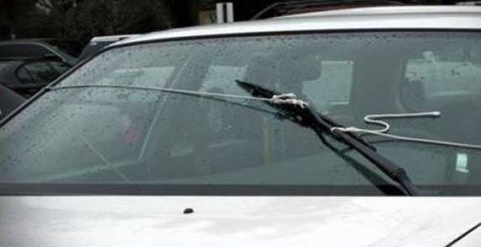
Let’s do this right and avoid anything like this …

Slide 18





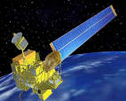
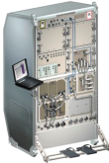
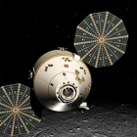
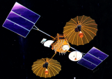



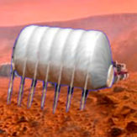

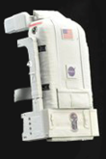







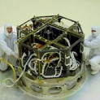











We’re done!
Many thanks to ESA for meeting hosting during the CCSDS Spring 2014 meetings!
Systems Engineering
Security
Space Assigned Numbers Auth.
Delta-DOR
Time Correlation & Synchronization
MISSION CONTROL
CENTER
End Users
Applications/Archives
MISSION CONTROL
CENTER
End Users
Spacecraft Onboard
Interface Services
Space Link
Services
Cross Support
Services
Space Internetworking
Services
Mission Ops &
Info Mgt Services
Onboard Wireless WG
Application Supt Services (incl. Plug-n-Play)
RF & Modulation
Coding & Sync.
Multi/Hyper Data Comp.
Space Link Protocols
Next Generation Uplink
Space Data Link Security
Planetary Comm
Optical Coding and Mod
CS Service Management
CS Transfer Services
Cross Supt Service Arch.
Asynchronous Messaging
IP-over-CCSDS Links
Motion Imagery & Apps
Delay Tolerant Networking
Voice
CFDP over Encapsulation
Data Archive Ingestion
Navigation
Spacecraft Monitor & Control
Digital Repository Audit/Certification
Telerobotics

Slide 19
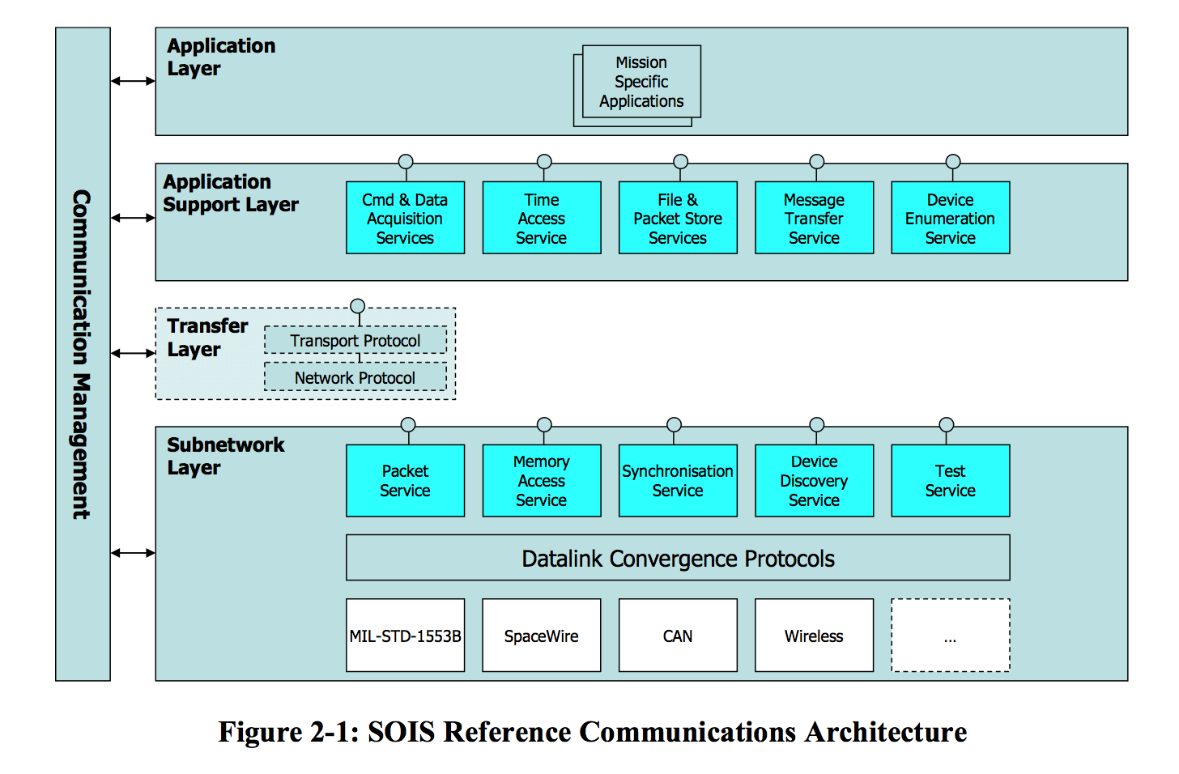
SOIS Reference Architecture, CCSDS 850.0-G-2
SPACECRAFT ONBOARD INTERFACE SERVICES

Slide 20
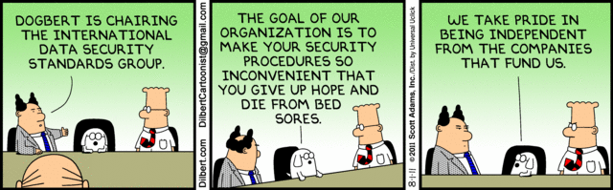
  Systems Engineering Area Report
  We’re from the CCSDS Security WG, we’re here to help …

Slide 21
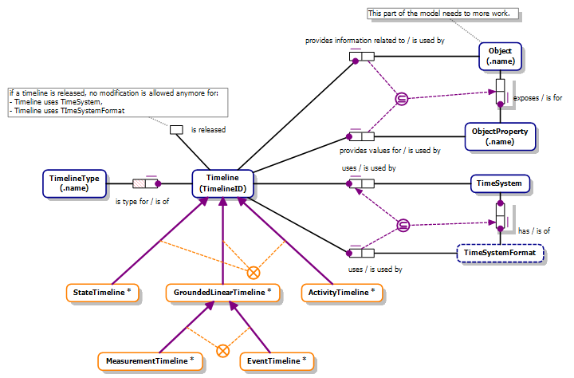
  Timeline Data Exchange – Concept Model
  Uses Fact Based Modeling (FBM) – S. Valera

Slide 22
CCSDS Ref Arch, Option 1
Use to make explicit the relationships of standards & groups
Six Technical Areas,
Twenty-Seven Teams
Systems Engineering
Working Group (producing standards)
Birds-Of-a-Feather stage (pre-approval)
Special Interest Group (integration forum)
Security standards
Delta-DOR standards
Timeline Data Exchange standard
XML Standards and Guidelines
System Architecture standards
SEA Standards
Contents
Relationships
MISSION CONTROL
CENTER
End Users
Applications/Archives
MISSION CONTROL
CENTER
End Users
Spacecraft Onboard
Interface Services
Space Link
Services
Cross Support
Services
Space Internetworking
Services
Mission Ops &
Info Mgt Services
Onboard Wireless WG
Application Supt Services (incl. Plug-n-Play)
RF & Modulation
Space Link Coding & Sync.
Multi/Hyper Data Compress.
Space Link Protocols
Next Generation Uplink
Space Data Link Security
Optical Coding and Mod
CS Service Management
CS Transfer Services
Cross Supt Service Arch.
Motion Imagery & Apps
Delay Tolerant Networking
Voice
CFDP over Encap
CFDP Revisions
Data Archive Ingestion
Navigation
Spacecraft Monitor & Control
Digital Repository Audit/Certification
Telerobotics
SOIS Standards
Contents
Relationships
SLS Standards
Contents
Relationships
CSS Standards
Contents
Relationships
SIS Standards
Contents
Relationships
SM&C Standards
Contents
Relationships

Slide 23
Examples of Glossary Issues
  service (RASDS, 311.0-M-1)
  A service is a provision of an interface of an object to support actions of another object.
  service user/provider (SLE Ref Model, 910.4-B-2)
  An entity that offers a service to another by means of one or more of its ports is called a service provider (provider). The other entity is called a service user (user). An entity may be a provider of some services and a user of others.
  service (SM&C MORM, 520.1-M-1)
  A set of capabilities that a component provides to another component via an interface. A Service is defined in terms of the set of operations that can be invoked and performed through the Service Interface. Service specifications define the capabilities, behaviour and external interfaces, but do not define the implementation.

Slide 24
Examples of Glossary Issues, contd
  action (RASDS 311.0-M-1)
  An action is something that happens within an object, either with or without participation of another object. An interaction is an action performed by an object with participation of another object or with its environment.
  action (SM&C 520.0‑G‑3)
  An atomic (non-interruptible) control directive of mission operations (equivalent to a telecommand or ground-segment directive) that can be initiated by manual or automatic control sources, via the M&C service. An action may have arguments and its evolving status can be observed. An action can typically apply pre- and post-execution checks.

Slide 25
Ontology Observations
Existing CCSDS definitions tend to make somewhat casual use of terms like “component”, “entity”, “interface”, “port”, “code”, “software”.
Definitions have evolved over the years even within domains.
Terms defined in different specs often are, when analyzed, specializations of other terms or are terms that relate to different viewpoints.
Relationships among definitions are almost always “casual” and not explicit, i.e. “A hardware component may contain other components. The contained components may be hardware or software.”
We do not have a tradition or guidance to define consistent sets of terms across all sets of documents.
An ontology would render all of these in a formal way.

Slide 26
  Systems Engineering Area Report: Cross Area Meetings
Security WG
  SDLS (joint activity with SecWG and SLS team) working very well
  Network layer security (coordinated activity with SecWG and SIS team) also progressing nicely
D-DOR WG
  Major success with commercial product based on D-DOR validated and used in production
  Discussion of new signal structures for higher resolution progressing well
  Coordination with SM WG& RFC planned for future D-DOR services
XML
  XML SIG poorly attended, but even more WG now working on, or developing XML schema
  Agree to produce RFC & policy then close
SAWG, Reference Architecture, and Ontologies
  “CCSDS Reference Architecture” continues to be a CMC hot button, current SCCS-ADD covers SLS, SIS & SEA, must be worked for MOIMS & SOIS.
  RASDS should be updated to support CSS & MOIMS services and offer guidelines for use of SysML/UML, also offers SC13 / SC14 coordination
  Glossary terms not aligned across WGs. Ontologies (defined meanings of terms and relationships) will help sort this out, but this needs integrated cross WG effort, this can focus it, ECSS & SC14 interest here as well. Coordinate with SOIS ontology as well, pilot core & domain extension model.
  XML schema have been isolated in WG domains, but interfaces have appeared, eg Nav and SM, SOIS and SM&C, SM and D-DOR. Adoption of common terminology, structure and semantics, along with validation tools, will help resolve CCSDS wide problems.
Notes:
26

