Slide 1
Systems Engineering Area (SEA)
Area Report
Spring 2024 Meetings
Peter Shames (Area Director)
Hiroshi Takeuchi (Deputy Area Director)
May 2024 – CESG Meeting
Notes:
1
1
1

Slide 2
Systems Engineering Area Executive Summary
Security Working Group:
Achievements
Symmetric Key Management MB at Secretariat. On-going work on Key Management GB, DTN/BPSec, and Intergov Cloud Certificate Authority (IGCA). Progress on new work items for Secure SW Engineering and new Space ATT&CK framework.
Problems / Issues: LNIS Security aspects discussed, are extremely weak
Systems Architecture Working Group:
Achievements
RASDS++ complete draft doc with integrated TC20/SC14 revisions was reviewed, some streamlining changes agreed.
SCCS-ARD revisions moving along, both ABA and SSI well in hand. Includes optical comm, USLP, SM, and many other new & revised documents. Creating new tabular summaries on a per node type basis.
Problems / Issues: We have a coherent group but very limited resources. NASA is the only agency supporting the SCCS-ARD Architecture work.
Delta-DOR Working Group:
Achievements
Making very good progress on document revisions, MB on Architecture, BB update, Operations MB update. New PN DOR tones being published by RFM WG. Considering changes for new Quasar flux database, fluxes for multiple baseline, and same beam interferometry.
Problems / Issues: Small, but effective, working group with all three agencies participating in this meeting.
Time Management WG:
Achievements
Working group has been making very good progress, with active participation from five agencies. Green Book is in publication process. Outline of single Time Management BB developed, possible second BB for networked time management.
Problems / Issues
The LunaNet LNIS spec is out ahead of this BB, it may not be ready in time to be effective.
SANA and SANA Steering Group (SSG):
Achievements
BETA ISO Terms website incorporating ISO TC20/SC14 terms is in use, working well. More new user interface and feature improvements, increase ease of use.
Problems / Issues
AOS SCIDs are now all used. No more S & X band identical SCIDs are available. Agency HOD must assign ARs to update their agency data in “Enterprise” registries. SM WG wants “qualified” Aperture aliases in Service Site and Aperture (SS&A) registry, needs AR support.
Notes:
JAXA is interested, resources being identified. Possible issues getting resources allocated / schedule.

Slide 3
SEA Area Report B. Meeting Demographics
Agency | 1.01 Sys Arch Working Group | 1.02 Security Working Group | 1.06 D-DOR Working Group | 1.07 Time Mgmt Working Group | 1.XX SANA Steering Group
CNES |  | 2 |  |  | 1
CNSA | 3
CSA |  | 1
DLR | 1 | 2 |  | 1
ESA |  | 8 | 1 | 2 | 2
JAXA |  | 3 | 1
NASA | 4 | 14 | 1 | 7 | 3
UKSA | 1 | 1
Other |  |  |  |  | (SANA) 3
Total | 9 | 27 | 3 | 10 | 10
Agency Diversity | 4 | 7 | 3 | 3 | 4
Update

Slide 4
SEA Security WG Executive Summary
Achievements for this meeting cycle:
Published: Symmetric Key Management MB; Glossary of Terms MB; Revised Cryptographic Algorithm GB.
In Secretariat processing: Secure Software Engineering for Space Missions GB; Bundle Protocol Security Protocol (BPSec) BB;
In Development: Revision of Cryptographic Algorithms BB for post-quantum, Revision of Security Architecture MB, Symmetric Key Management GB; MITRE ATT&CK Applied to Space MB; Secure Interconnection Guide MB
In AD review: Intergovernmental Cloud Certificate Authority (IGCA), Orange Book, proposes PKI for space systems managed by SANA, input to Agencies and IOAG Security WG; SDLS Extended Procedures – Concepts and Rationale GB;
Secure SW Engineering MB Document completed and submitted to Secretariat.
Trade study on Post Quantum Cryptography (PQC), evaluating application of asymmetric keys to SDLS.
Working Group Status:
Discussions of new IOAG Sec WG & relationship, discussion of Lunanet Interoperability Spec (LNIS) issues
Interactions with other WGs
Met with DTN WG: BPSec sent to Secretariat. New areas of work discussed (CCSDS security contexts, BPSec GB, network management (DTKA testing), DTN key management use cases and research)
Continuing discussions re secure interoperability framework for identity, access control, authentication, network management framework for Mars and Moon
Met with SDLS WG: completed SLDS Extended Procedures GB, to be sent to Secretariat
Met with SM&C WG: agreed that SM&C will adopt selected Sec WG recommendations
Discussed liaison with new IEEE P3349 Space System Cybersecurity Working Group. Request in process.
Problems and Issues:
Good participation from agencies continues
Notes:
JAXA is interested, resources being identified. Possible issues getting resources allocated / schedule.

Slide 5
Security WG Executive Summary
Goals for this meeting cycle: Review on-going documents in preparation, IGCA, new work items; continue work with DTN WG on security issues
Working Group Status:
Several docs completed and submitted to the Secretariat. Others in varying states of completion – see chart.
Problems and Issues:
Large number of people from many Agencies both in-person and via the virtual meeting. Yay!!!
Interaction with other WGs
SDLS, DTN, SM&C
Resolutions
Working group believes its time to include security sections in all CCSDS published books and not just standard documents.
Area and WG name | CCSDS Ref # | Document Title | Status / Comments | Start and / or Target Publication Date (dd/mm/year)
SEA SEC | 354.0 | CCSDS Symmetric Key Management Recommendations | Completed – Published December 2023 | Start date 12/06/2006 End date 01/12/2023
SEA SEC | 350.6 | Revise Key Management Green Book | Revise KM GB to reflect the KM work performed for the SDLS extended procedures BB – in development. | Start date 30/07/2019 End date 01/08/2024
SEA SEC | 357.1 | Intergovernmental Certificate Authority | Change from MB to OB. Continuing work. Resolution to move to Secretariat. | Start Date 09/02/2019 End date 06/06/2024
SEC + DTN | xxx.Y | Bundle Protocol Security Protocol (BPSec) | Completed - forwarded to Secretariat. | Start Date 30/06/2021 End date 01/06/2024
SEA SEC | xxx.Y | Secure Software Engineering for Space Missions | Completed – AD RIDs dispositioned -Forwarded to Secretariat | Start Date 30/06/2021 End date 1/06/2024
SEA+SDLS | 350.11 | SDLS Extended Procedures – Concepts and Rationale | Completed – final comments/RIDs dispositioned - will be forwarded to Secretariat | Start Date 30/07/2017 End date 9/06/2024
SEA SEC | 350.8 | Information Security Glossary of Terms | Competed – Published February 2024
SEA SEC |  | Secure Interconnection Guide | Draft Project – poll requested
SEA SEC | 352.0 | Cryptographic Algorithms | Draft Project – poll requested
SEA SEC | 351.0 | Security Architecture for Space Data Systems | Draft project – poll requested
Interaction with other WGs
SDLS, DTN, SM&C
Notes:
JAXA is interested, resources being identified. Possible issues getting resources allocated / schedule.

Slide 6
Security WG Additional Comments
InterGovernmental Cert Authority (IGCA): Book revised to Orange Book – background material normally found in a GB added to non-normative section to describe the system and how it will operate. Document will be forwarded to Secretariat. Need to resolve how to build a prototype system (e.g. SANA? NASA? ESA? Other?)
3GPP + WiFi Lunar Surface: Questions regarding how 3GPP (5G) or WiFi security will be used at lunar? CCSDS profile?
Key Management GB: in development – was to be completed by Daniel Fischer – needs to be discussed
Secure Software Engineering: Document completed, comments resolved, submitted to Secretariat.
Zero Trust for Space: Discussed NIST principals, how pillars could be applied to space, will continue to work. Poll requested to create project.
MITRE ATT&CK Applied to Space: Project approved. A white paper is being drafted to discuss the use of ATT&CK and SPARTA in the space environment. ATT&CK provides actual cyber attack information. SPARTA primarily provides threat intelligence and prediction information.
IEEE P3349 Space System Cybersecurity Working Group: discussed the IEEE P3349 plans and will continue to monitor as the group develops its plans. P3349 – ‘secure-by-design’ goals. AD is proposing a formal liaison relationship.
Secure Interconnection Guide MB: discussions regarding the evolution of the existing GB to a MB. Original GB based on NIST SP 800-47. New version 800-47v2 published. Changes to incorporate the use of NIST RMF. WG consensus to remain ‘neutral’ on certification and accreditation and risk management processes a la v1 of the NIST document. Use other RMF-like examples such as ISO 31000, ISO 270005.
AI Security: early stages of examination of the security implications of the use of AI in space environments.
SDLS: Post-Quantum + SDLS Asymmetric Key Management: ESA research into post quantum safe algorithms and how they could be applied to developing asymmetric key management for SDLS. Full discussion on Triple KEM algorithms. Paper on Triple KEM research released by TU/e. Completed Extended Procedures GB and book will be sent to Secretariat. Discussed additional material for revised Algorithms BB. New project to adapt SDLS Extended Procedures to handle constellations.
ECSS Security Standard: Presentation on the first ECSS Security Standard (Security in Space System Lifecycles). First in a series of security standards and handbooks.
DTN Joint Meeting: Bob Durst not in attendance, but good discussions regarding security – ESA/ESOC DTN Testbed (key management research study, interoperability testing, BPSec security policies). Discussed use cases (first discussed in Fall 2003), DTN to be included in revised Security Architecture document.
SM&C Joint Meeting: Marcus Wallum will be the liaison between SecWG and SM&C WG. MO security is vague (access control, authentication) and needs a GB/MB to discuss how to implement and use the security concepts. Material will be extracted from existing Security documents for the new SM&C GB. SM&C will capture the material and then it will be decided where it should be used – e.g., non-normative BB section, MAL GB
Notes:
JAXA is interested, resources being identified. Possible issues getting resources allocated / schedule.

Slide 7
Security WG Additional Comments
IOAG Security WG – little progress
The IOAG has created a Security WG to provide security sections for LNIS and both IOAG Lunar and Mars Comm Architecture documents.
Daniel Fischer and TBD (Peter Shames - retiring) have been appointed as co-chairs.
A draft set of Terms of Reference (ToR) has been created, but not yet approved. Push to include space internetworking, but also traditional ABA space link configurations.
Presented to the InterOperability Plenary (IOP) in June & approved
Mandatory Security Section
The Security Working Group believes the time has come to have security sections in *all* CCSDS color books and not just standards. Request CESG/CMC discussion to approve this change.
The impact would be adding a short security considerations section to all Green Books, Blue and Magenta already include this requirement.
CESG has asked that Sec WG provide some examples of what a Security section in different GB types might look like
Notes:
JAXA is interested, resources being identified. Possible issues getting resources allocated / schedule.

Slide 8
SEA Systems Architecture Working Group
Executive Summary
Achievements for this meeting cycle:
Work on RASDS++ revisions, including SC14 extensions, is progressing very well, reviewed complete Word doc draft.
Work on SCCS-ARD revisions is progressing well, reviewed ABA and SSI revisions, new tabular presentation in work.
Continued holding 2 sets of on-going monthly meetings and special topic discussions as needed
Working Group Status:
RASDS++ updates now include new Physical, Operational, and Service viewpoints, and extensions to Enterprise Viewpoint, for CCSDS and SC14, updated presentation guidance and object ontology for the viewpoint specifications in each section.
Joint CCSDS & TC20/SC14 approach working well, includes new/expanded viewpoints, contents, and presentation styles, agreed on a more streamlined document structure and improved handling of formal references & MBSE representations.
SCCS-ARD updates include recent standards, such as USLP, optical, DTN, Service Management, and CSTS services, and also clarify and streamline relationships among viewpoints.
The work to study & document SCCS-ARD sections that cover SSI security topics continues to inform DTN security
Confirmed that SCCS-ARD covers all of the topics needed for LNIS, except specific PNT elements that CCSDS does not yet address
Interaction with other WGs
Met with Sec WG on IOAG Sec WG and LNIS analysis, reviewed entire LNIS V5 spec
Joint meetings with ISO TC20/SC14 members related to RASDS++
Cross Area coordination discussions on ABA sections and SSI sections continue.
Problems and Issues:
Resources for RASDS continue to be constrained, but new support from UKSA & CNSA is appreciated.
Working two large documents in parallel is challenging, but we are making good progress.
The SCCS-ARD update will contain as complete an architecture as is practical, based on current published and in work materials. We require support from all SLS, SIS, CSS, and SEA WGs to identify [Future], [Prospective], and [Not to be standardized] documents for inclusion. CESG agrees to review current draft by end of January 2024.
The size of the document remains a concern, and we are still working on a “slimming diet”
Notes:
JAXA is interested, resources being identified. Possible issues getting resources allocated / schedule.

Slide 9
SEA Systems Architecture Working Group
Executive Summary
Resolutions agreed upon this meeting
Resolution 1: Expect to re-confirm the Reference Architecture for Space Information Management
Further Resolutions anticipated in the next 6 months:
Request to review the Reference Architecture for Space Data Systems (RASDS++)
Planning (only approved Projects):
Area and WG name | CCSDS Ref Nr | Document Title | Status / Comments | Start and / or Target Publication Date (dd/mm/year)
SEA SA | CCSDS 313.0-M | Reference Architecture for Space Data Systems (RASDS++) | Document content revisions reviewed Addition of new viewpoints adopted Revisions to document structure agreed | Start Date 11/09/2020 End Date 30/03/2024
SEA SA | CCSDS 901.1-M | Space Communication Cross Support – Architecture Requirements Document (SCCS-ARD) | Document updates & revisions discussed New / revised materials reviewed Expect final draft by Apr 2024 | Start Date 11/09/2020 End Date 31/07/2024
SEA SA | CCSDS 901.0-G | Space Communication Cross Support – Architecture Description Document (SCCS-ADD) | To be initiated once MB is completed | Start Date TBD End Date TBD
SEA SA | CCSDS 312.0-G | Reference Architecture for Space Information Management (RASIM) | Proposing simple reconfirmation after DAI WG concurrence | Start Date 20/10/2022 End Date 31/12/2023
Notes:
JAXA is interested, resources being identified. Possible issues getting resources allocated / schedule.

Slide 10
Delta-DOR Executive Summary (I)
Achievements for this meeting cycle:
Delta-DOR MB Ops: Discussion within WG continues
Discussion about update of DDOR GB
Cross support activities reviewed, plan for future effort on this
Exchange of quasar flux information (passes by the various Agencies) continues
Technical discussions (e.g. Solar plasma effects on data quality)
PN DOR tests are complete, forwarded to RFM
Main issues:
RFM will publish new PN DOR tones when they assemble the next tranche of updates to their 401 document

Slide 11
Delta-DOR Executive Summary (II)
Working Group Status:
Status: active
Three Projects in progress (2 MB, 1 BB) + 2 YBs (PNDOR)
Interaction with other WGs
No joint activity with RF&Mod, to continue at next meetings
No joint activity with CSSM, to continue at next meetings
No joint activity with NAV, is expected to continue at next meeting

Slide 12
Delta-DOR Executive Summary (III)
Planning (only approved projects):
Yellow Books:

Slide 13
Time Management Working Group Executive Summary
Achievements
Progress on the new Blue Book project ‘’Time Transfer, Clock Correlation, and Clock Synchronization Protocols’’.
All Final Action Items implemented for the Green Book and re-submitted.
Completed Pink Sheets revision for the Time Code Formats Blue Book and reached consensus with AD comments.
Completed the review of the LunaNet Interoperability Specification Document (LNIS) v5 and identified some RIDs and areas of potential overlap with the project Blue Book ‘’Time Transfer, Clock Correlation, and Clock Synchronization Protocols’’.
Interaction with other WGs
Nothing to report.
Working Group Status Good progress
The WG has met approximately once a month via telecon since the last Face-to-Face Spring meeting.
A new Chair is officially appointed. A deputy chair position is open.
New member from JAXA joined the WG.

Slide 14
Time Management Working Group - Executive Summary
Resolutions agreed upon this meeting
Provision of a consolidated Time Management WG feedback to the LunaNet Interoperability Specification Document (LNIS) v5.
Further Resolutions anticipated in the next 6 months
New Blue Book project ‘’Time Distribution in Space Networks’’.
In Progress:
Area and WG name | CCSDS Ref # | Document Title | Status / Comments | Start and / or Target Publication Date (dd/mm/year)
SEA Time | TBD | Time Management | All resulting comments have been resolved and the final revised version ready to be out for AD. | Start date 10/06/2019 End date 30/11/2023
SEA Time | 301.0-B-4 | Time Code Formats | Periodic review is complete. Pink sheets are ready for agency review. | Publication: 30/11/2023
SEA Time | TBD | Time Transfer, Clock Correlation, and Clock Synchronization Protocols | Including non-normative section about Time distribution in a space network. | Start date 11/10/2023 End date 15/12/2024

Slide 15
SEA SANA Steering Group Executive Summary
Achievements for this meeting cycle:
SANA Operator / COFOMO Corporation running smoothly, Improvements to user interfaces continue
SANA Operations systems are now fully virtualized in the cloud, new parallel Beta registries being created as needed
Review SANA Operations report, 233 new Q-SCIDs, 92 new spacecraft, 68 SCIDs returned
Some special requests asking for a specific pair of SCIDs (S & X), which requires custom queries in the address space
SS&A registry interface has been updated, interface now accommodates multiple inputs
ISO SC14 BETA TERMS registry in evaluation, ISO Term set updated. SC14 is very happy with product, asked for minor additions.
Working Group Status:
QSCID registries working well. Agencies are still wrestling with multiple spacecraft Identifiers.
SM WG requested changes to SS&A registry, must have operational access for Service Management queries, especially to apertures and aliases (new SSO integration may fix much of this)
Interaction with other WGs
Interactions with CSS SM WG (FRM), Nav registries, and Agency Representatives for SS&A
Problems and Issues:
The Service Site and Aperture (SSA) registry will still only to be open to those with CCSDS login, but new Single Sign-on (SSO) integration with CWE may eliminate issue.
Not all fields in SANA (SS&A) registry are well specified. CSS SM WG has asked for a consistent approach for “abbreviations” and “aliases” for apertures and spacecraft. May be of the form: “ESA::EXMO;DSN::TGO”
We need a special “SANA working meeting” to deal with remaining SS&A issues: access control, agency updates, decimal degrees (dd.nnn) or degrees, minutes, seconds (dd mm ss.ss).
Consider whether we need to clearly state that the SANA is being used operationally and seek an SLA that reflects this
Notes:
JAXA is interested, resources being identified. Possible issues getting resources allocated / schedule.

Slide 16
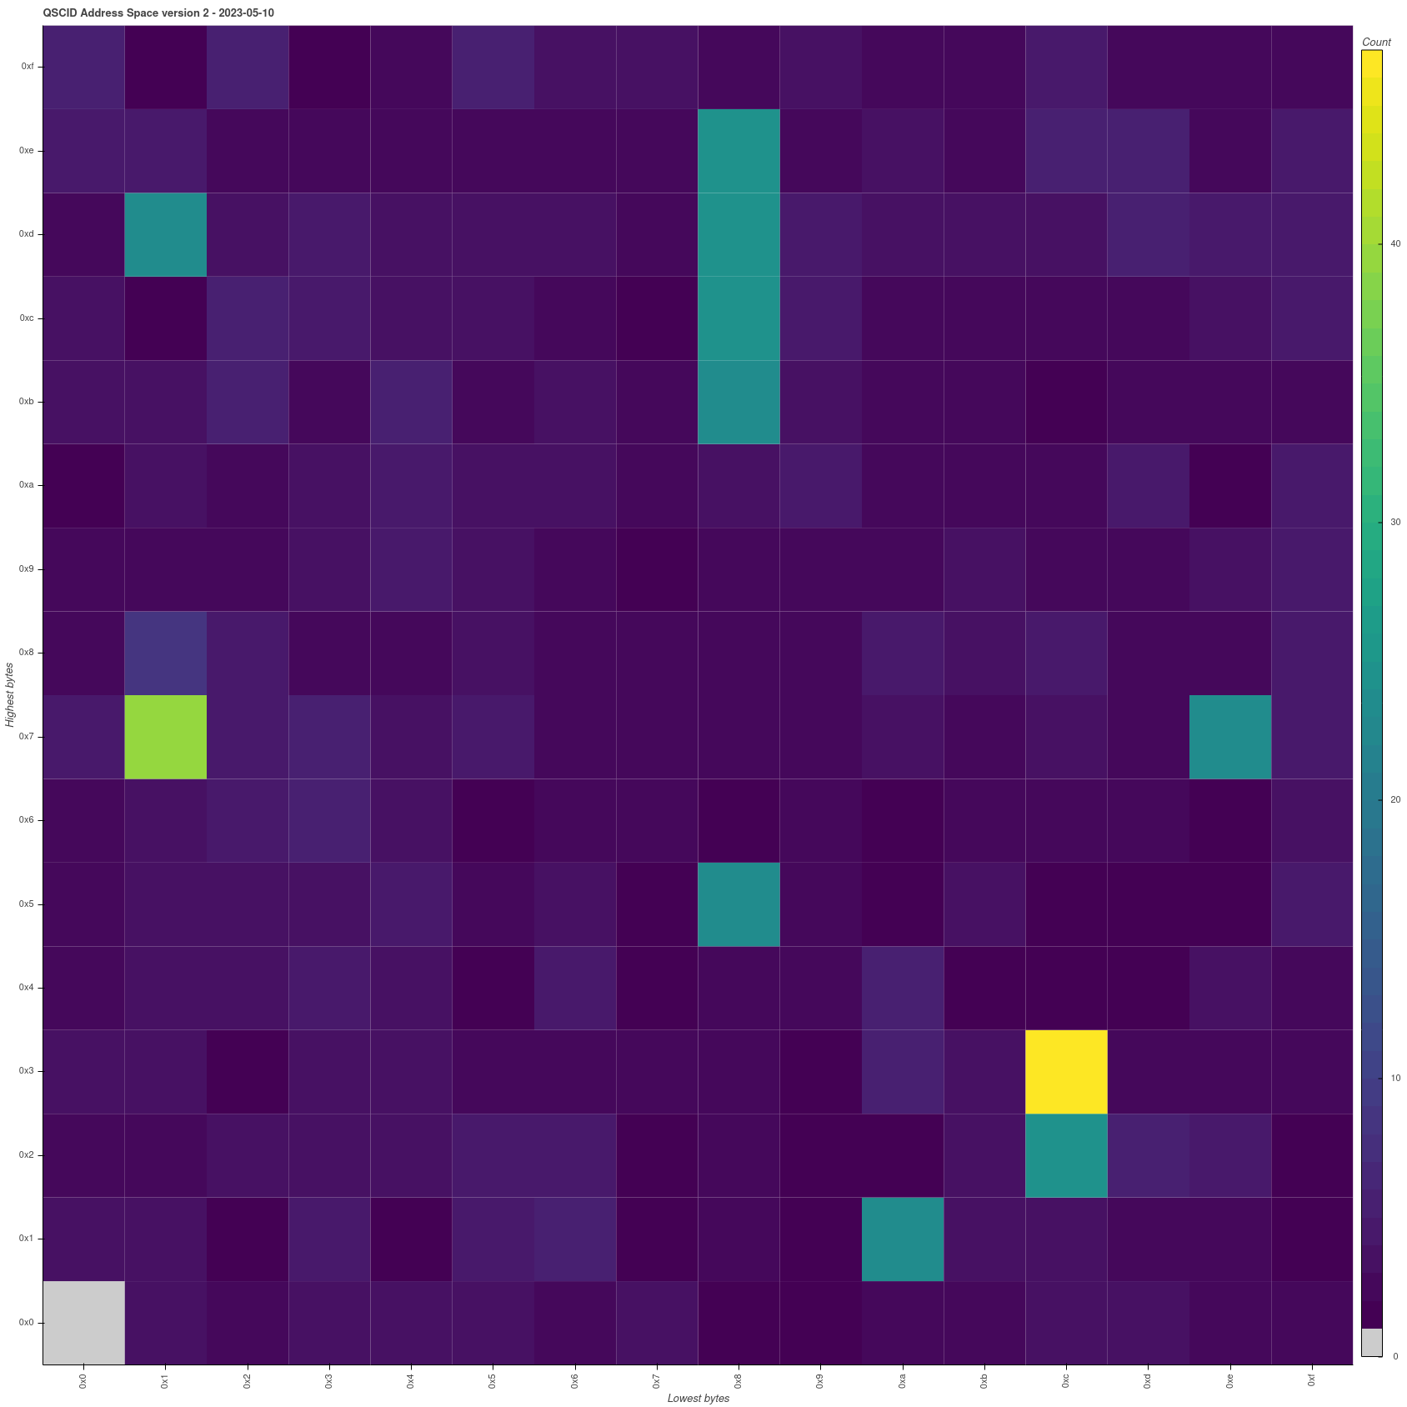
SpacecraftID Assignments Allocated QSCID Version 2 (AOS)
QSCID allocated on all frequencies and links
QSCID allocated on all frequencies, one link (fwd/ret)
QSCID unallocated
Other shades of blue represent a certain number of allocated QSCIDs, typically:
spacecraft for which we have many frequencies or both forward and return links
overlapped QSCIDs

Slide 17
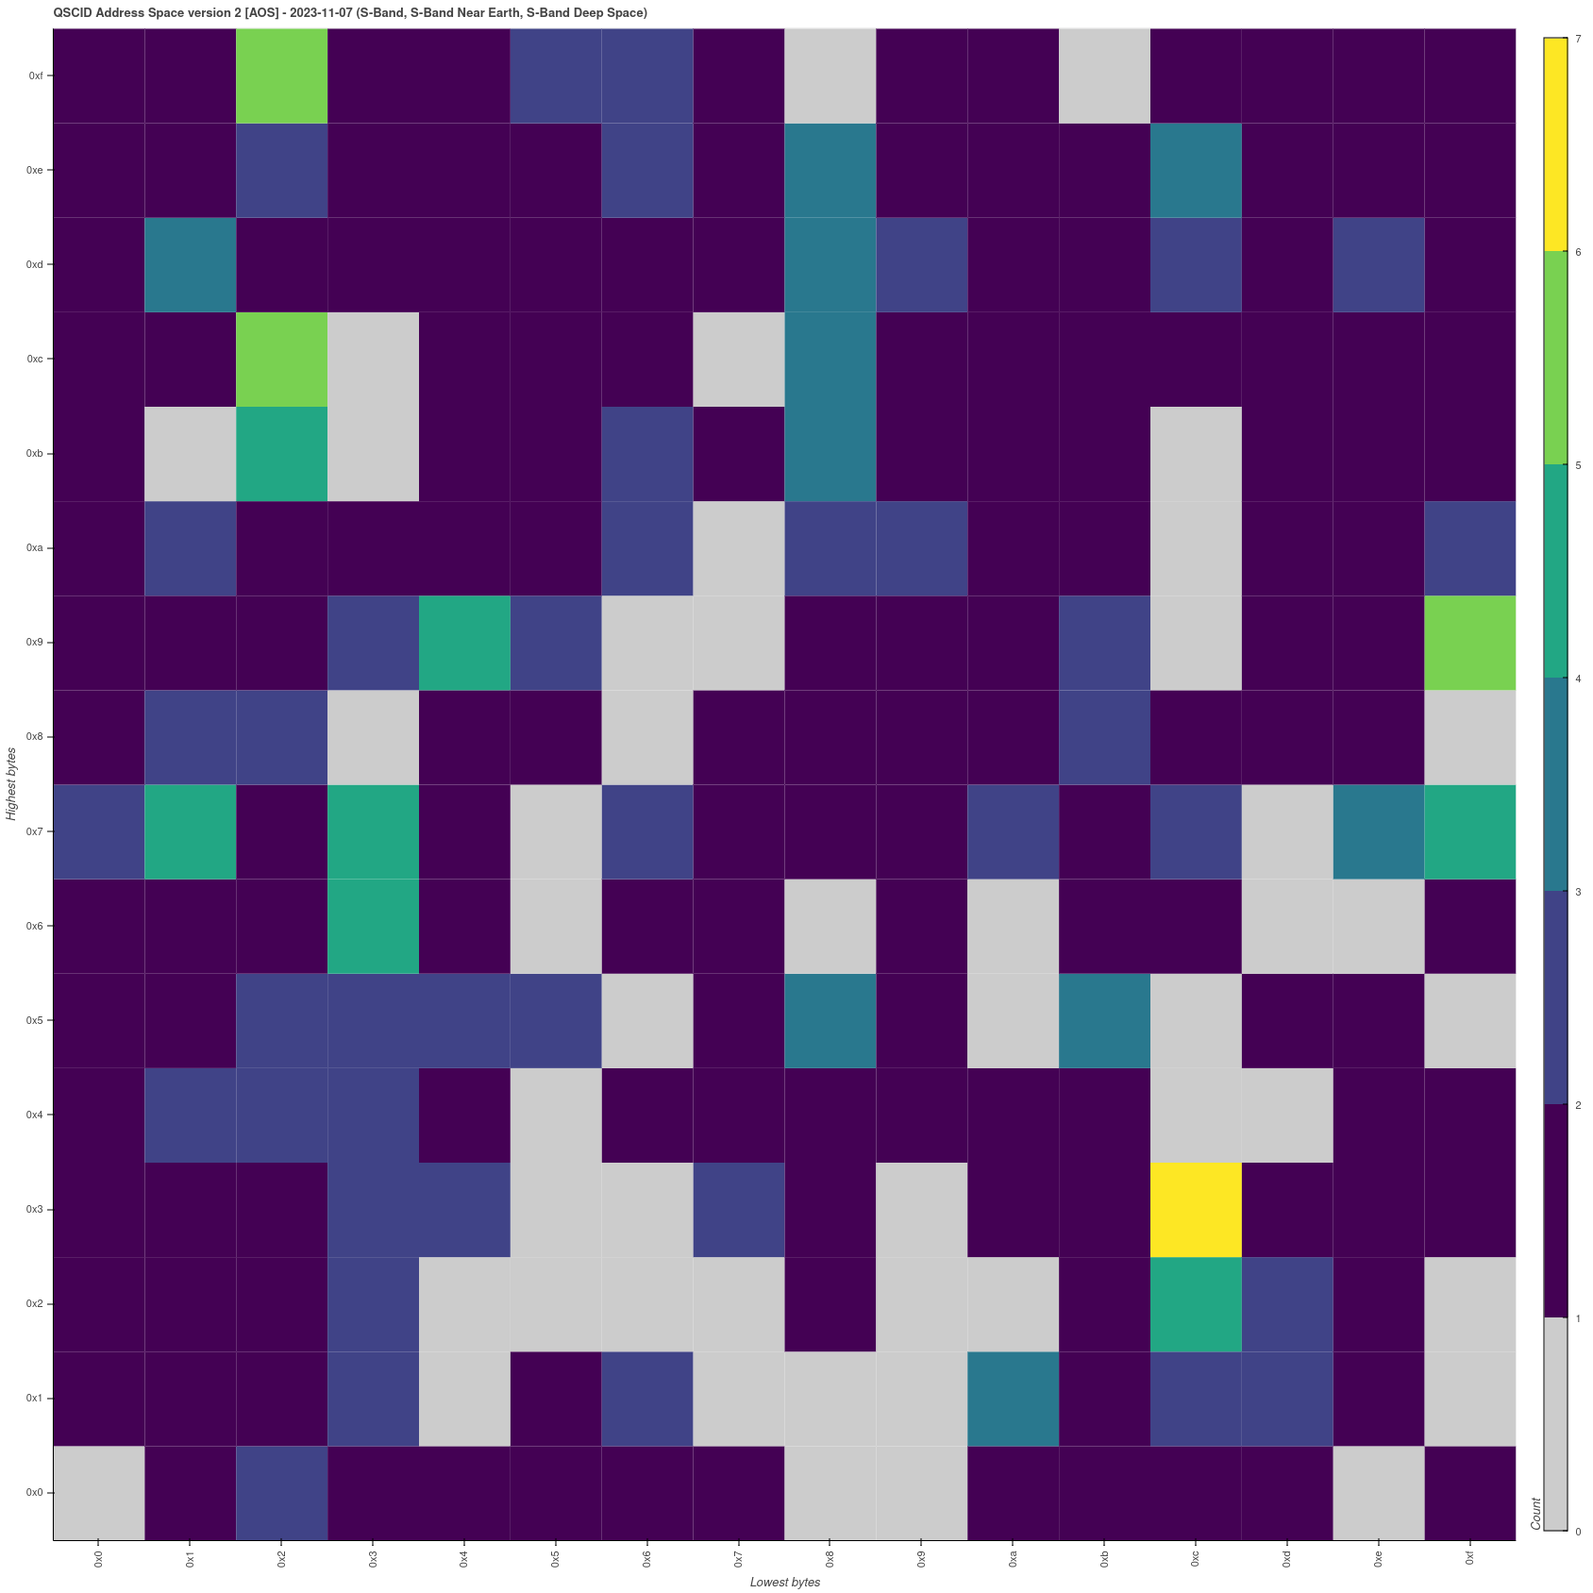
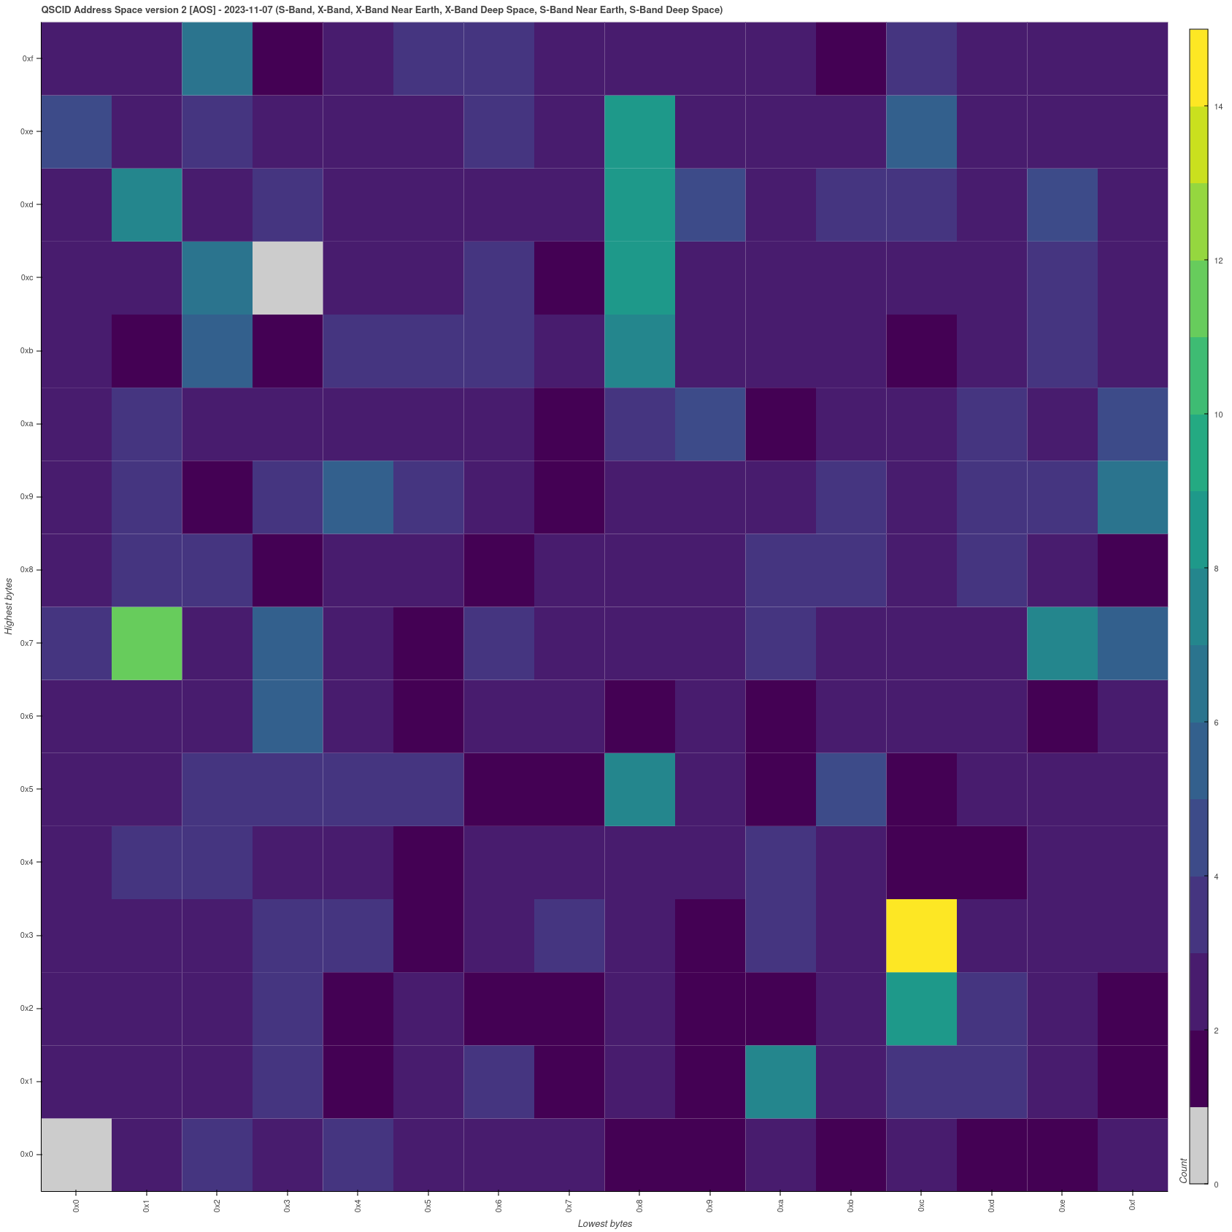
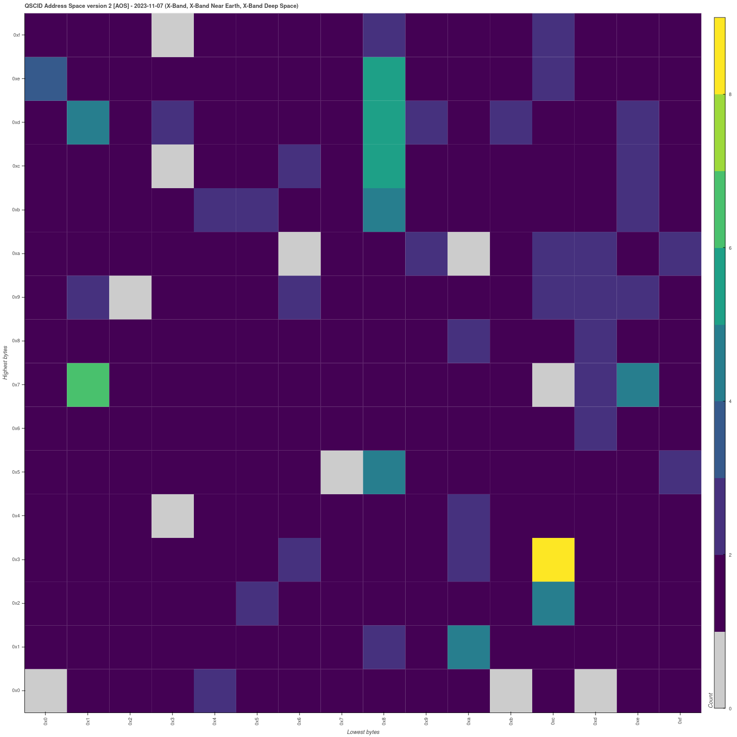
Spacecraftid Assignments
QSCID Version 2 S and X bands depletion – Nov 23
S-Band
S and X Bands
X-Band

Slide 18
SANA Registry Release Features
1 major Release
Favorite registries
UI improvements (registries list, SS&A editing)
NAV WG new registries, updated registries and new features
Misc fixes
2 minor Releases
Fixes
SCIDs allocation interface and algorithm improvements
Performances improvements

Slide 19
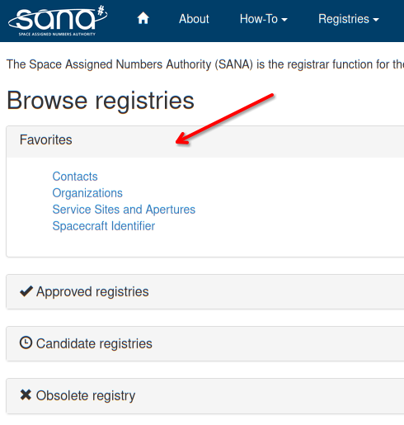
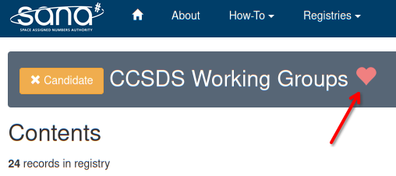
Favorite registries

Slide 20
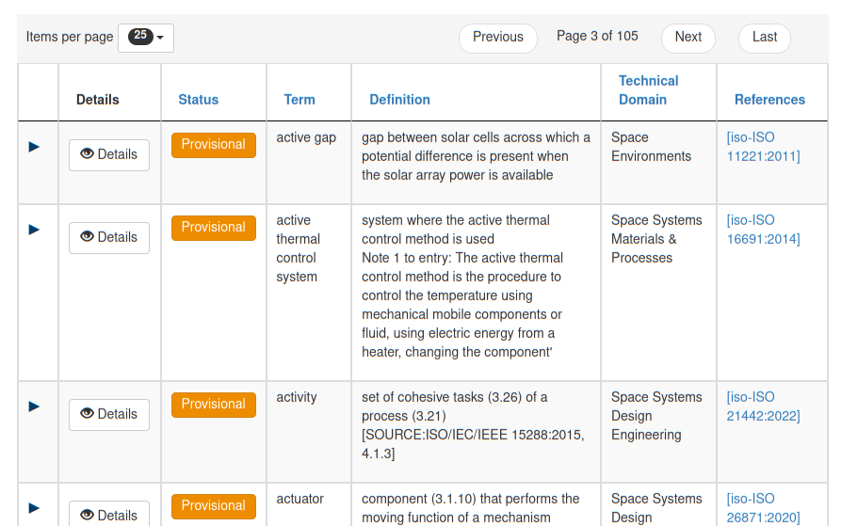
ISO Terms Work in Progress
https://iso-terms.sanaregistry.org/r/terms/​
Populated with ISO data
Fix after synchronization with production base code
ISO technical domains have been updated

Slide 21
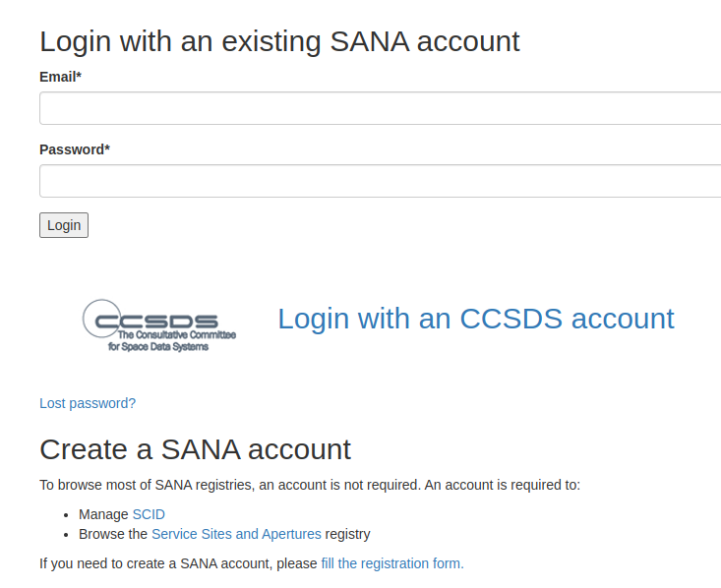
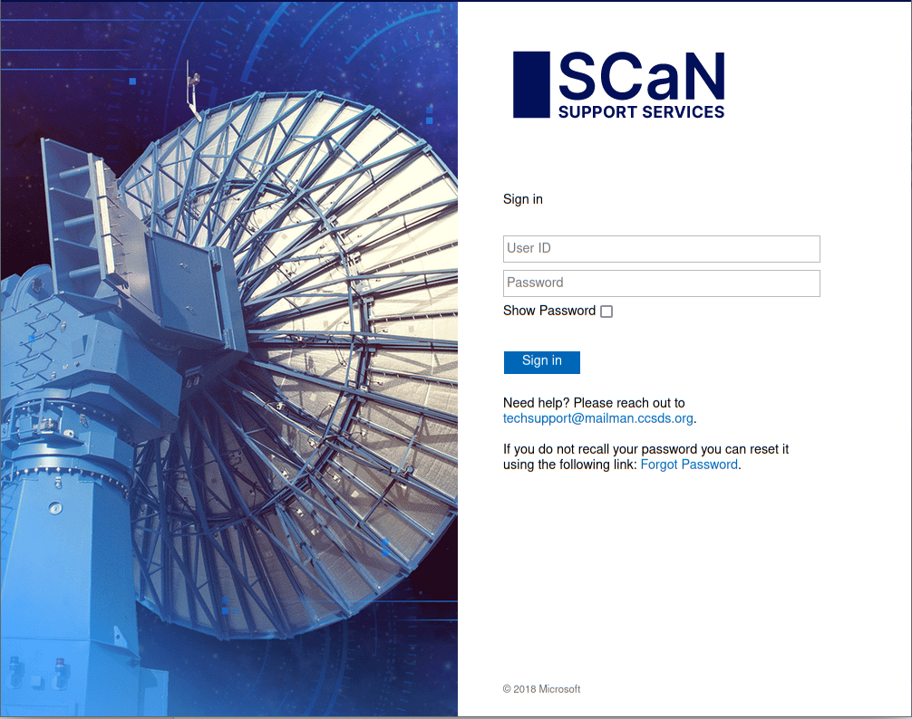
Single Sign-on (SSO) Work in Progress
Unify CWE and SANA accounts
Less confusion
Access permission for SS&A granted when SSO is used (need programmatic access for SM WG)
You can still have a SANA account without CWE account
Notes:
Defined the basic workflow of the SSO, needs to test with the CCSDS infrastrucure next and test the rest API with SSO.

Slide 22
SANA Upcoming Work
Item​ | Status​
Possible moon wifi/lte spacecraft ID registry​ | Waiting for specifications from SOIS​
ISO SC14 Terms updates and release​ | Discussed in this meeting
DTN (CBHE) node numbers​ registry | Ongoing discussion​
Assist CCSDS working groups to create/modify/enhance registries​ | Some requests on specific environments (beta, nav, iso-terms)
File versioning/history​ | Current state is fine
Registry with link to huge videos | MIA WG, no update so far
BPv7 draft Red Book registries needed | Chair retired, new DTN chair to take the lead
New registry with json schemas | Meeting with DAI WG, waiting for their data

Slide 23
Systems Engineering Area Issues for CESG / CMC
Issue 1:
There are no unallocated Version 2 (AOS) Q-SCIDs, and now none available in both S-Band and X-Band. Agencies must start to shift to USLP.
Issue 2:
Must have Area support (SLS, SIS, CSS) to review and complete SCCS-ARD and to review interoperable SSI architecture (Stage 1, 2a, 2b, 3) deployment descriptions
Issue 3:
The SANA Service Site & Aperture (SS&A) registry authorization framework is implemented. We need the CMC assigned Agency Representatives (AR) to update Agency asset information: add SMWG & D-DOR aliases, and update “agency specific” cross-support aliases as needed
Issue 4:
Work with the D-DOR WG, SM WG, and Nav WG, at a minimum, develop an agreed approach for consistent SS&A Registry “abbreviations” (Service Sites, apertures, S/C). Recommend use of unique “last part” of ISO OIDs or “Alias”.
Issue 5:
CCSDS still has several different, potentially overlapping, standards relating to system management and configuration: CSS SM Functional Resource Model (FRM), SOIS Electronic Data Sheets (EDS), SIS DTN Asynchronous Management Model (AMM) and protocol, and the MOIMS MO framework.
An integrated set of views is needed and some simplification / integration seems to be in order.
Appreciation:
The Systems Engineering Area (SEA) wishes to thank ESA / ESOC for doing a great job of hosting the working meetings.
Notes:
JAXA is interested, resources being identified. Possible issues getting resources allocated / schedule.

Slide 24
BACKUP

Slide 25
SCCS-ARD Significant Issue DTN Secure Interoperability
Problem Statement: The existing DTN standards (BPv7, BPSec) include the means to do routing & apply security to bundles, but the management & protocol infrastructure to support this are not defined.
Consequence: Any missions or projects wishing to use these standards must develop their own management structures for Node IDs, Endpoint IDs/names, Identities, Keys & Key Management, Routing & updates, and network management in general.
Within a single mission (or controlled project) this appears viable, and BPSec provides the means to authenticate and secure bundles (given some private key management).
In the context of multi mission, multi-agency, interoperability that quickly becomes very complex and the “DTN Suite” must be augmented with the new management protocols, services, policies, and governance.
We need to provide clear guidance to our DTN user community about what they need to do now and what will be possible in the future.

Slide 26
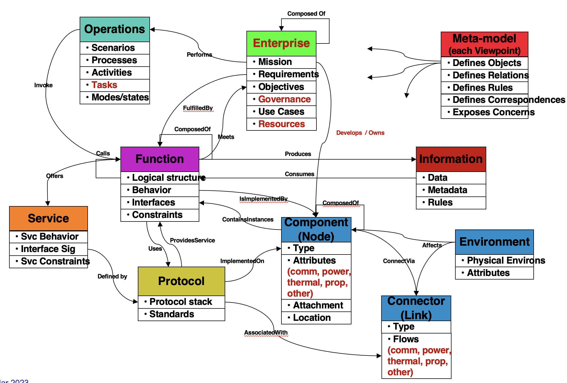
UAF is focused on the “What”
RASDS++ is focused on the “How”

Slide 27
SAWG RASDS++ Architecture Methodology Plan
Have created PPT-style revisions to the extended Reference Architecture for Space Data Systems (RASDS++) document
Agreed on CCSDS and SC14 extensions to existing framework with new and updated viewpoints, aligned with newest ISO 42010
Added new Operational Viewpoint (processes & procedures, activities), created new Physical Viewpoint (physical aspect of Nodes and related Connections) treat existing Connectivity Viewpoint (physical nodes & communications links) as sub-view, added new Services Viewpoint and expanded the Enterprise Viewpoint to better cover requirements and the Systems Engineering “V” (ISO 15288)
Working jointly with TC20/SC14 to ensure these new viewpoints work for their concerns as well. Reviewed their draft SC14 ADD companion document that uses the new framework.
Collaborated with SC14 (and ISO) on glossary & terminology, Beta registry with CCSDS terms (and tech domains) is available and an ISO subset is being integrated.
Evaluated RASDS++ against Unified Architecture Framework (UAF). UAF is designed for acquisition of Enterprise Architecture elements. RASDS++ is designed for description of technical systems architectures.

Slide 28
Reminder: RESOLUTIONS
Resolution: The SecWG will be actively engaged in the review of all Red Books:
Levels of involvement range from cursory examination of the Red Books under development, to active involvement in the development of the books.
Response: AD will provide docs to the WG for review in parallel with AD review
Resolution: All CCSDS document editors will reach out, early in the development of the book to the SecWG to reduce downstream security issues.
Response: AD will provide “pointers” to WGs for SecWG
Resolution: Security shall be addressed in all new project initiations. All new projects should consider the extent to which security is relevant. Considerations will be documented in the project initiation request.
Response: AD forwards new projects definitions to SecWG to analyze security implications & to work with the initiating WG.

Slide 29
Terminology, Ontology, Reference Architecture Definitions
Terminology: a set of terms and their descriptions, most often rendered in some “narrative” form.
From Wikipedia: “a general word for the group of specialized words or meanings relating to a particular field”.
Ontology: a formalized naming and definition of terms, categories, properties, and their relationship to other terms.
From Wikipedia: “a representation, formal naming and definition of the categories, properties and relations between the concepts, data and entities that substantiate one, many or all domains of discourse”.
Reference Architecture: a formalized definition of viewpoints, views, the objects they describe, and their relationships suitable for use in creating and describing specific systems architectures.
From Wikipedia: “A software reference architecture is a software architecture where the structures and respective elements and relations provide templates for concrete architectures in a particular domain or in a family of software systems. “ “System” can, obviously, be substituted for “software”.
The “elements and relations” required for a reference architecture are best formalized in an ontology, but a set (or sets) of terminology may have to suffice.

Slide 30
Cross-agency IGCA Considerations
Motivation
Multi-agency collaborations and joint exploration are important future activities for space agencies
Space missions require process to establish connections between agencies, people, and specified end-points.
The Inter-Governmental Certificate Authority (IGCA) can streamline the coordination, connection, and validation processes between the space agencies
Cooperation in space exploration would benefit from some sort of trusted Identity & Credentials Management system
Use Cases
Trust objectives:
Each agency validates its own users and sessions / service accounts
Agency-issued certificate authenticates within each agency
Each agency does not have to issue credentials to other agencies’ users
CA signing chain validates users / sessions to other agencies
Real-time operations use cases
Telemetry, command, & file data
Navigation messages
Ground station data distribution (e.g. SLE)
Cross-agency CA trust infrastructure can facilitate offline use cases which have also been problematic in the past
Encrypted emails
Protocols, agreements, etc.

Slide 31
DRAFT - Granular authentication and access control for Actors, Assets, and Dataflows
Provide Agreed policies
Policies
MarsNet Trust
Framework
Operations
Carried out by …
Authenticate Identity
Provide Identity Certificate
ICAM
ICGA
Actor
(Person, System)
PDP/PEP
Carry out one or more …
Authorize access to
Activities
(Uplink, Downlink, Data Access)
Uses one or more …
Asset
(Spacecraft, Network, Storage)
Control access & flows
IAM
Set of Tasks
Exchange data using
DTN/BPSec
Monitor
Dataflow

Slide 32
CCSDS Implementation - IGCA
IGCA Draft WP
June 2022

Slide 33
Other Related Activities
ISO TC20/SC14 requested shared use of the SANA on-line terminology set and already plans to use RASDS and CCSDS terms where applicable
This is to be a joint / collaborative effort with them
SC14 also has an information management and control issue, similar to what the CMC has identified
Handled in the context of the formal liaison relationship between CCSDS and SC14
The ISO Secretariat raised some potential road-blocks re use of “ISO terms” in a non-ISO context, but this has been resolved
Joint meeting with SANA has led to a plan to prototype the extended registry as a Beta
ECSS / ES is also moving toward a data repository for their requirements
ECSS data repository provides a representation of the current library of documents
Repository provides for presentation in a number of forms, i.e. output to Word, database, other tools
There has been no progress on ECCS collaboration

Slide 34
Harmonizing the Terminology is a lot of work, right?
Yes, it will be much work.
But help is available - - the Ukrainian delegation to TC20/SC14 has “an exquisite capability to identify/flag duplicative/contradictory terms and definitions across all ISO standards”.
Used to some extend in SC14 to harmonize terms, but much work to be done.
Reference: ISO/TC 20 N3925: “ISO TC 20 report to ISO/TC 37 “Language and Terminology”, September 2020.
Proposal to adjust CCSDS Terminology registry attributes
Add references for ISO TC20/SC14 standards as well as CCSDS
Associate a “Domain” with each set of standards (CCSDS Area or ISO “WG”)
Allow each Domain to identify its “Preferred” definitions
WG may adopt these preferred terms, or not, when they revise their documents

Slide 35
Delta-DOR Architecture New features
New Ka Band Quasar catalog
Revisions to RDF Data Exchange format
New PN DOR Signal formats
Revisions to D-DOR Arch & Ops documents

Slide 36
SANA Authorization framework
Policies
SSG: any member of SSG can edit a registry with policy "SSG". e.g.
Roles registries
Agency Representative: any AR can edit records linked or owned by its organization in registries with policy "CCSDS Agency Representative". e.g.
SCID Assignor: SCID and spacecraft registries
Asset Assignor: Service site and apertures
Area or WG: Any area director or working group chair can edit a registry with policy "CCSDS Area or Working Group" and authority containing its own area or working group as specified in Area and Working Group registries
Area and Working Group registries:
https://sanaregistry.org/r/areas/
https://sanaregistry.org/r/wg/
Logged users can edit their own contact information
Some data can only be edited by administrators (e.g. user roles, SCID value, SCID owner, ...)
“Pen” indicates editable field

