Slide 1
Systems Engineering Area (SEA)
Area Report
Fall 2021 Meetings
Peter Shames (Area Director)
Hiroshi Takeuchi (Deputy Area Director)
November 2021 – CESG Meeting
Notes:
1
1
1

Slide 2
  Systems Engineering Area Executive Summary
Security Working Group:
  Achievements
    Crypto Algorithm and Threats GB sent to Secretariat. On-going work on Key Management, DTN/BPSec progressing very well. Recent work items for Intergov Cloud Certificate Authority, and Secure SW Engineering off to a great start.
    Problems / Issues: Role of security architecture in multi-mission space deployments. Staffing back to normal levels, no major issues.
Systems Architecture Working Group:
  Achievements
    RASDS & integrated TC20/SC14 revisions making very good progress, solid plan to improve presentation of concepts and include ontology views and an MBSE/SysML Annex.
    SCCS-ARD revisions moving very well, revised flow from service to protocol viewpoint, including optical comm, USLP, SM, and many other new & revised documents.
  Problems / Issues: We have a coherent group but very limited resources, and are losing a key contributor. We need stronger support from other agencies than NASA to complete this CCSDS-wide Architecture work in a timely way.
Delta-DOR Working Group:
  Achievements
    Making very good progress on document revisions, MB on Architecture, BB update, Operations MB update. New PN DOR tones are being included in RFM update. Test results with new NASA and ESA open loop receivers progressing well. Planning for new Quasar flux database and same beam interferometry.
  Problems / Issues: Small, but effective, working group with all three agencies participating in this meeting.
Time Management WG:
  Achievements
    Working group has been making good progress, with active participation from five agencies. Green Book writing assignments are mostly being met; agency approaches are documented.
  Problems / Issues
    The time synchronization section is still weak, otherwise adequate resources seem to be provided.
SANA and SANA Steering Group (SSG) – reported separately:
  Achievements
    Programmatic API and web pages to access new Authorization framework allowing multiple roles and multiple agencies per Contact has been implemented and is in Production. Documentation is being produced. Many other improvements have been made.
  Problems / Issues
    Agency HOD must assign ARs to update their agency data in “Enterprise” registries. SS&A registry access is open for updates to apertures. Connection between CCSDS website and SANA is not yet optimized for performance.
Notes:
JAXA is interested, resources being identified. Possible issues getting resources allocated / schedule.

Slide 3
SE Area Report
B. Meeting Demographics (estimates)
Agency | 1.01 - SEA - Systems Architecture Working Group | 1.02 - SEA - Security Working Group | 1.06 – SEA – D-DOR Working Group | 1.07 Time Management Working Group | 1.XX - SEA - SANA Steering Group
CNES |  | 1
CNSA | 1 |  |  | 1
CSA |  | 1
DLR |  | 2 |  | 1
ESA |  | 7 | 2 | 2 | 2
JAXA |  | 1 |  | 1
NASA | 3 | 13 | 2 | 7 | 3
ROSCOSMOS |  |  |  | 1
UKSA |  | 1
Other (South Korea) |  |  |  |  | SANA 3
Total | 4 | 26 | 4 | 13 | 8
Meeting Duration | 3x3 hrs | 4x3.0 hrs | 2.0 hrs | 1x3.0 hrs | 1x3 hrs
Agency Diversity | 2 | 7 | 2 | 6 | 3

Slide 4
  SEA Security WG Executive Summary
Achievements for this meeting cycle:
  On-going work on Symmetric Key Management & KM GB (Sect queue), DTN/BPSec (IETF review) progressing very well.
  Good progress on Intergovernmental Cloud Certificate Authority (IGCA) gaining interest
  Crypto Algorithm and Threats GB revisions sent to Secretariat.
  Sec WG to review 1st draft of IETF BPSec RFC in CCSDS Red Book format.
  New Secure SW engineering MB has started, draft White Book being reviewed.
Working Group Status:
  No new publications, but KM MB and Threat GB in CTE queue for pre-publication processing
Interactions with other WGs
  DTN on-going work on Bundle Security, shifting to DTN BPv7 and BPSec (DTN will draft, SecWG will review and finish).
  Initial discussion of need for secure identity, access control, authentication, network management interoperability framework for Mars and Lunar interoperability
  Met with SM&C WG during this session on security issues
Problems and Issues:
  Good participation continues, in spite of virtual format.
  Virtual meetings slowed forward motion, but still made substantial progress. Planning for continued monthly telecon sessions.
Notes:
JAXA is interested, resources being identified. Possible issues getting resources allocated / schedule.

Slide 5
  Security WG Executive Summary
Goals for this meeting cycle: Review on-going documents in preparation and new work items
Working Group Status:
  Docs in varying state of completion – see chart.
Problems and Issues:
  Good things: Large number of people from many Agencies connected to the virtual meeting
Planning:
Interaction with other WGs
  DTN, SM&C
Resolutions
  [Resolution 1 Resolution to submit revised Algorithms GB for editing and polling.
  [Resolution 2] Resolution to ask the SEA AD to poll the CMC/CESG regarding Agency’s thoughts on IGCA
Area and WG name | CCSDS Ref # | Document Title | Status / Comments | Start and / or Target Publication Date (dd/mm/year)
SEA SEC | 354.0 | CCSDS Symmetric Key Management Recommendations | Completed and forwarded to Secretariat – resolution received and document is in editor queue. | Start date 12/06/2006 End date 11/10/2021
SEA SEC | 350.6 | Revise Key Management Green Book | Revise KM GB to reflect the KM work performed for the SDLS extended procedures BB – in progress. | Start date 30/07/2019 End date 01/10/2021
SEA SEC | 350.1 | Revise Threat Green Book | Completed and forwarded to Secretariat – resolution received and document is in editor queue | Start Date 02/09/2019 End date 31/03/2021
SEA SEC | 350.9 | Revise Algorithm Green Book | Final review completed, document will be forwarded to the Secretariat | Start date 20/09/2019 End date 07/03/2022
SEA SEC | 357.1 | Intergovernmental Certificate Authority | Continuing work. | Start Date 09/02/2019 End date 06/06/2022
SEC + DTN | xxx.Y | Bundle Protocol Security Protocol (BPSec) | 1st draft completed by DTN WG to be reviewed by SecWG | Start Date 30/06/2021 End date 01/06/2023
Notes:
JAXA is interested, resources being identified. Possible issues getting resources allocated / schedule.

Slide 6
Security WG Additional Comments
Intergovernmental Cloud Cert Authority: Continued discussion regarding hierarchy and inclusion into IATF Framework. If we build it, will they come?
Crypto Algorithm GB revisions: Final review completed. Document will be sent to Secretariat.
Threat GB revision: Resolution sent to Secretariat – document now in editor’s queue.
Key Management GB: in progress
Key Management MB: Resolution sent to Secretariat – document now in editor’s queue.
SDLS: Extended Procedures GB action items reviewed, protocol pink sheets RID disposition.
DTN: DTN-WG provided 1st draft of IETF BPSec RFC in CCSDS Red Book format to be reviewed.
Secure Software Engineering: Approved project. Bailey presented updates to his white book presented.
SM&C: Joint meeting to discuss security issues with MO services.
Notes:
JAXA is interested, resources being identified. Possible issues getting resources allocated / schedule.

Slide 7
Cross-agency IGCA Considerations
Motivation
  Multi-agency collaborations and joint exploration are important future activities for space agencies
  Space missions require process to establish connections between agencies, people, and specified end-points.
  The Inter-Governmental Certificate Authority (IGCA) can streamline the coordination, connection, and validation processes between the space agencies
  Cooperation in space exploration would benefit from some sort of trusted Identity & Credentials Management system
Use Cases
  Trust objectives:
    Each agency validates its own users and sessions / service accounts
      Agency-issued certificate authenticates within each agency
    Each agency does not have to issue credentials to other agencies’ users
      CA signing chain validates users / sessions to other agencies
  Real-time operations use cases
    Telemetry, command, & file data
    Navigation messages
    Ground station data distribution (e.g. SLE)
  Cross-agency CA trust infrastructure can facilitate offline use cases which have also been problematic in the past
    Encrypted emails
    Protocols, agreements, etc.

Slide 8
DRAFT - Granular authentication and access control for Actors, Assets, and Dataflows
Provide Agreed policies
Policies
MarsNet Trust
Framework
Operations
Carried out by …
Authenticate Identity
Provide Identity Certificate
ICAM
ICGA
Actor
(Person, System)
PDP/PEP
Carry out one or more …
Authorize access to
Activities
(Uplink, Downlink, Data Access)
Uses one or more …
Asset
(Spacecraft, Network, Storage)
Control access & flows
IAM
Set of Tasks
Exchange data using
DTN/BPSec
Monitor
Dataflow

Slide 9
  SEA Systems Architecture Working Group
  Executive Summary
Achievements for this meeting cycle:
  Work on RASDS++ and SCCS-ARD revisions is progressing very well.
  Been holding on-going monthly meetings and special topic discussions as needed
Working Group Status:
  Refining RASDS++ updates, to include new Physical, Operational, and Service viewpoints, and extensions to Enterprise Viewpoint, for CCSDS and SC14, updating some drawing representations based on SCCS and ASL results, and expanding the annex on MBSE representation styles and ontology representations of the viewpoint specifications.
  Agreement on joint CCSDS & TC20/SC14 approach, including new/expanded viewpoints, contents, and shared Glossary approach.
  Refining SCCS-ARD updates, primarily to include newly defined standards, such as USLP, optical, DTN, Service Management, and CSTS services, but also to clarify and streamline relationships among viewpoints.
Interaction with other WGs
  Joint meetings with ISO TC20/SC14 members related to RASDS++ and SANA Terminology updates
  A separate cross Area coordination meeting on ABA sections is planned for the week after these meetings.
  SEA needs to reconfirm the Reference Architecture for Space Information Management, as requested by DAI WG; still to be considered as new work item.
Problems and Issues:
  Resources are constrained (as always), and virtual meetings have had an impact as well, but excellent progress was made.
  Attempted to schedule our three meetings within the weeks of other WGs, was generally effective, but many other WG also shifted their schedules. This is a general challenge for cross WG meetings.
  The SCCS-ARD update will contain as complete an architecture as is practical, based on current published and in work materials. We still request input from all SLS, SIS, CSS, and SEA WGs to identify [Future], [Prospective], and [Not to be standardized] documents for inclusion.
Notes:
JAXA is interested, resources being identified. Possible issues getting resources allocated / schedule.

Slide 10
  SEA Systems Architecture Working Group
  Executive Summary
Resolutions agreed upon this meeting
  Resolution 1: No new resolutions
Further Resolutions anticipated in the next 6 months:
  Request to re-confirm the Reference Architecture for Space Information Management
Planning (only approved Projects):
Area and WG name | CCSDS Ref Nr | Document Title | Status / Comments | Start and / or Target Publication Date (dd/mm/year)
SEA SA | CCSDS 313.0-M | Reference Architecture for Space Data Systems (RASDS) | Document content revisions discussed Addition of new viewpoints agreed Working plan agreed | Start Date 11/09/2020 End Date 31/08/2022
SEA SA | CCSDS 901.1-M | Space Communication Cross Support – Architecture Requirements Document (SCCS-ARD) | Document updates & revisions discussed New / revised materials agreed Working plan agreed | Start Date 11/09/2020 End Date 31/08/2022
SEA SA | CCSDS 901.0-G | Space Communication Cross Support – Architecture Description Document (SCCS-ADD) | To be initiated once MB is completed | Start Date TBD End Date TBD
Notes:
JAXA is interested, resources being identified. Possible issues getting resources allocated / schedule.

Slide 11
SAWG Reference Architecture Plan
Formulating PPT-style revisions to the extended Reference Architecture for Space Data Systems (RASDS++) document
  Agreed on extensions to existing framework with new and updated viewpoints, aligned with newest ISO 42010
  Adding new Operational Viewpoint (processes & procedures, activities), extending existing Connectivity Viewpoint (physical nodes & links) to create new Physical Viewpoint (physical aspect of Nodes and related Connections), adding new Services Viewpoint and expanding the Enterprise Viewpoint to better cover requirements and the Systems Engineering “V” (ISO 15288)
  Working jointly with TC20/SC14 to ensure these new viewpoints work for their concerns as well
  Collaborating with SC14 (and ISO) on glossary & terminology (no progress this session)
The Space Communication Cross Support Architecture (SCCS) documents are now being updated in SEA
  These are already use the RASDS architecture methodology and framework
  One of the key contributors, John Pietras, is retiring at end of year. We need a replacement to carry forward his tasks ... Seeking support from other agencies for this key task
  Ensuring adequate coverage of the broad subject matter requires a level of active engagement with the three other Areas that are covered by this document: SLS, SIS, SLP
  Focus so far has been on traditional, ABA, configurations, SSI to follow next
  Holding a coordination review with the other Areas and WG next week (23 Nov 21)

Slide 12
Revised RASDS++ (DRAFT)
Top Level Object Ontology
Operations
Composed Of
Scenarios
Meta-model
(each Viewpoint)
Processes
Performs
Organization
Procedures
Defines Objects
Invoke
Activities
Mission
Defines Relations
Modes/states
Requirements
Defines Rules
FulfilledBy
Objectives
Defines Correspondences
Goals
Exposes Concerns
ComposedOf
Fulfills
Use Cases
Develops/ Owns/
Operates
Calls
Function
Produces
Information
Offers
Logical structure
Consumes
Data
Behavior
IsAllocatedTo
Metadata
Interfaces
ComposedOf
Rules
Service
Constraints
ContainsInstances
Component
Svc Behavior
ProvidesService
Environment
Interface Sig
Uses
Type
Affects
Svc Constraints
ImplementedOn
Attributes
(comm, power,
thermal, prop)
ConnectVia
Physical Environs
Defined by
Communication
Attributes
Protocol stack
Attachment
Connector
Standards
Location
AssociatedWith
Type
Attributes
(comm, power,
thermal, prop)

Slide 13
RASDS Concept Model
… and Proposed TC20/SC14 extensions
Services Viewpoint
Tabular views of functions, operations, and related standards
Support system Design & Construction - realization
Correspondence to Protocol stacks and interface binding signature
RASDS++ as Architectural Framework *
Functional allocation and distribution of functions and trade-offs (correspondence)
Engineering Viewpoint
System Design & Construction - realization
Functional allocation
Distribution of functions and trade-offs
Development
Validation & verification & engineering processes
Enterprise Viewpoint (15288)
Organizations
People
Use Case
Contracts Agreements (CONFERS)
Glossary
Connectivity / Deployment Viewpoint
Connectivity
Components & connectors
RF & optical
Physics of Motion
End to End Views
External Forces
Performance
Functional Viewpoint
Functional Structure - abstract
Functional Behavior & abstract interfaces
End to End View
Cross Support Services
Information Viewpoint
Information & information management
Data structures, syntax & semantics
Attributes & constraints (ASN, FRM, EDS)
Protocol Viewpoint
Protocols & comm standards
End to end Information Transfer Mechanisms
Cross Support Services
Service interface bindings
State & Sequence charts ?
Just use 15288 or agency specs
Mission Assurance Viewpoint ??
Enterprise Risks
Cost
Validation & verification
Safety
Reliability & quality
Augment to Capture:
Capabilities
Mission Design & Drivers (OV-1?)
Requirements
Phases
Physical Viewpoint -Structures:
Power
Mass
Thermal
Orbit
Propulsion
Operational Viewpoint
Processes
Procedures
Activities, tasks, actions
Scenarios, Events
Modes & states
New Viewpoint
Modified Viewpoint
Just use 15288 or agency specs
De-selected Viewpoint
* Reference Architecture for Space Data Systems (RASDS)
** Reference Model Open Distributed Processing (RMODP, ISO 10746 spec)
Notes:
13

Slide 14
Meta-models: relationships between UML, ISO 42010, RASDS meta-models, and user models
conformsTo
RASDS meta-model defines specific Viewpoints, Objects, and Representations
conformsTo
RASDS conformant Architecture Description adopts specific Views & Model attributes, users may extend
representedBy
Users adopt / adapt RASDS to describe their specific systems architecture
Copyright 1998-2016 by Rich Hilliard :: http://www.iso-architecture.org/42010
Reference: Jean Bezivin, “On the unification power of models”, 2005

Slide 15
CCSDS SAWG - SCCS-ARD/ADD update project
In process SCCS-ARD/ADD specifics
  Update SCCS-ARD & ADD
    Update existing viewpoints and requirements for current (and planned [Future] standards
    Incorporate new work
    Update security view sections, as needed
    Substantially update contents of different viewpoints to eliminate overlaps and improve flow, moving all protocol stack details to tables in Sec 6, major clarifications to doc structure
  Update viewpoints with new/modified standards
    SLS (USLP, coding, modulation, other changes to SPP)
    SIS (DTN, routing, management, security, [Future] CFDP)
    CSS (new CSTS services & SM replacement for old 910.11-B spec)
    SEA (security, key management & D-DOR, SANA & RMP)
  Incorporate new / missing work items
    Optical comm
    Audio and video for human exploration
    RFID
    Time management [largely Future]
Aside from the above, no other major changes to structure, contents, nor presentation are planned, except with adjustments to align with new RASDS representations for services, function interfaces, and information models

Slide 16
SEA Delta-DOR Executive Summary
Achievements for this meeting cycle:
  Update of recommendation 2.5.7B has been agreed with RFM WG, as well as approach for NASA and ESA YBs
  Delta-DOR RDEF BB: Discussion continues within WG
  Delta-DOR MB Ops: Discussion continues within WG
  Delta-DOR MB Architecture: Sent to AD following completion of internal WG review
  Cross support activities reviewed
  Quasar flux calculations discussed and clarified
  C. Volk nominated for deputy chair role
Main issues:
  Alignment between DDOR books (RDEF BB and MB Ops) and SANA registries: Use of common nomenclature and addition of new fields (e.g. acceptable Spacecraft and Aperture abbreviations, new DDOR baselines).
  Evaluations of current HW implementations (as required for YBs) and recommendation 2.5.7B (DOR tone frequency in Ka-Band, roll-off factor of Square Root Raised Cosine filter). Ka DOR tone frequency is challenging for a digital implementation.

Slide 17
Delta-DOR Executive Summary [II]
Working Group Status:
  Status: active
  Three Projects in progress (2 MB, 1 BB) + 2 YBs (PNDOR)
Interaction with other WGs
  Joint activity with RF&Mod to continue at next meetings
  Joint activity with CSSM to continue at next meetings
  Joint activity with NAV is expected at next meeting

Slide 18
Delta-DOR Executive Summary [III]
Planning (only approved projects):
Yellow Books:

Slide 19
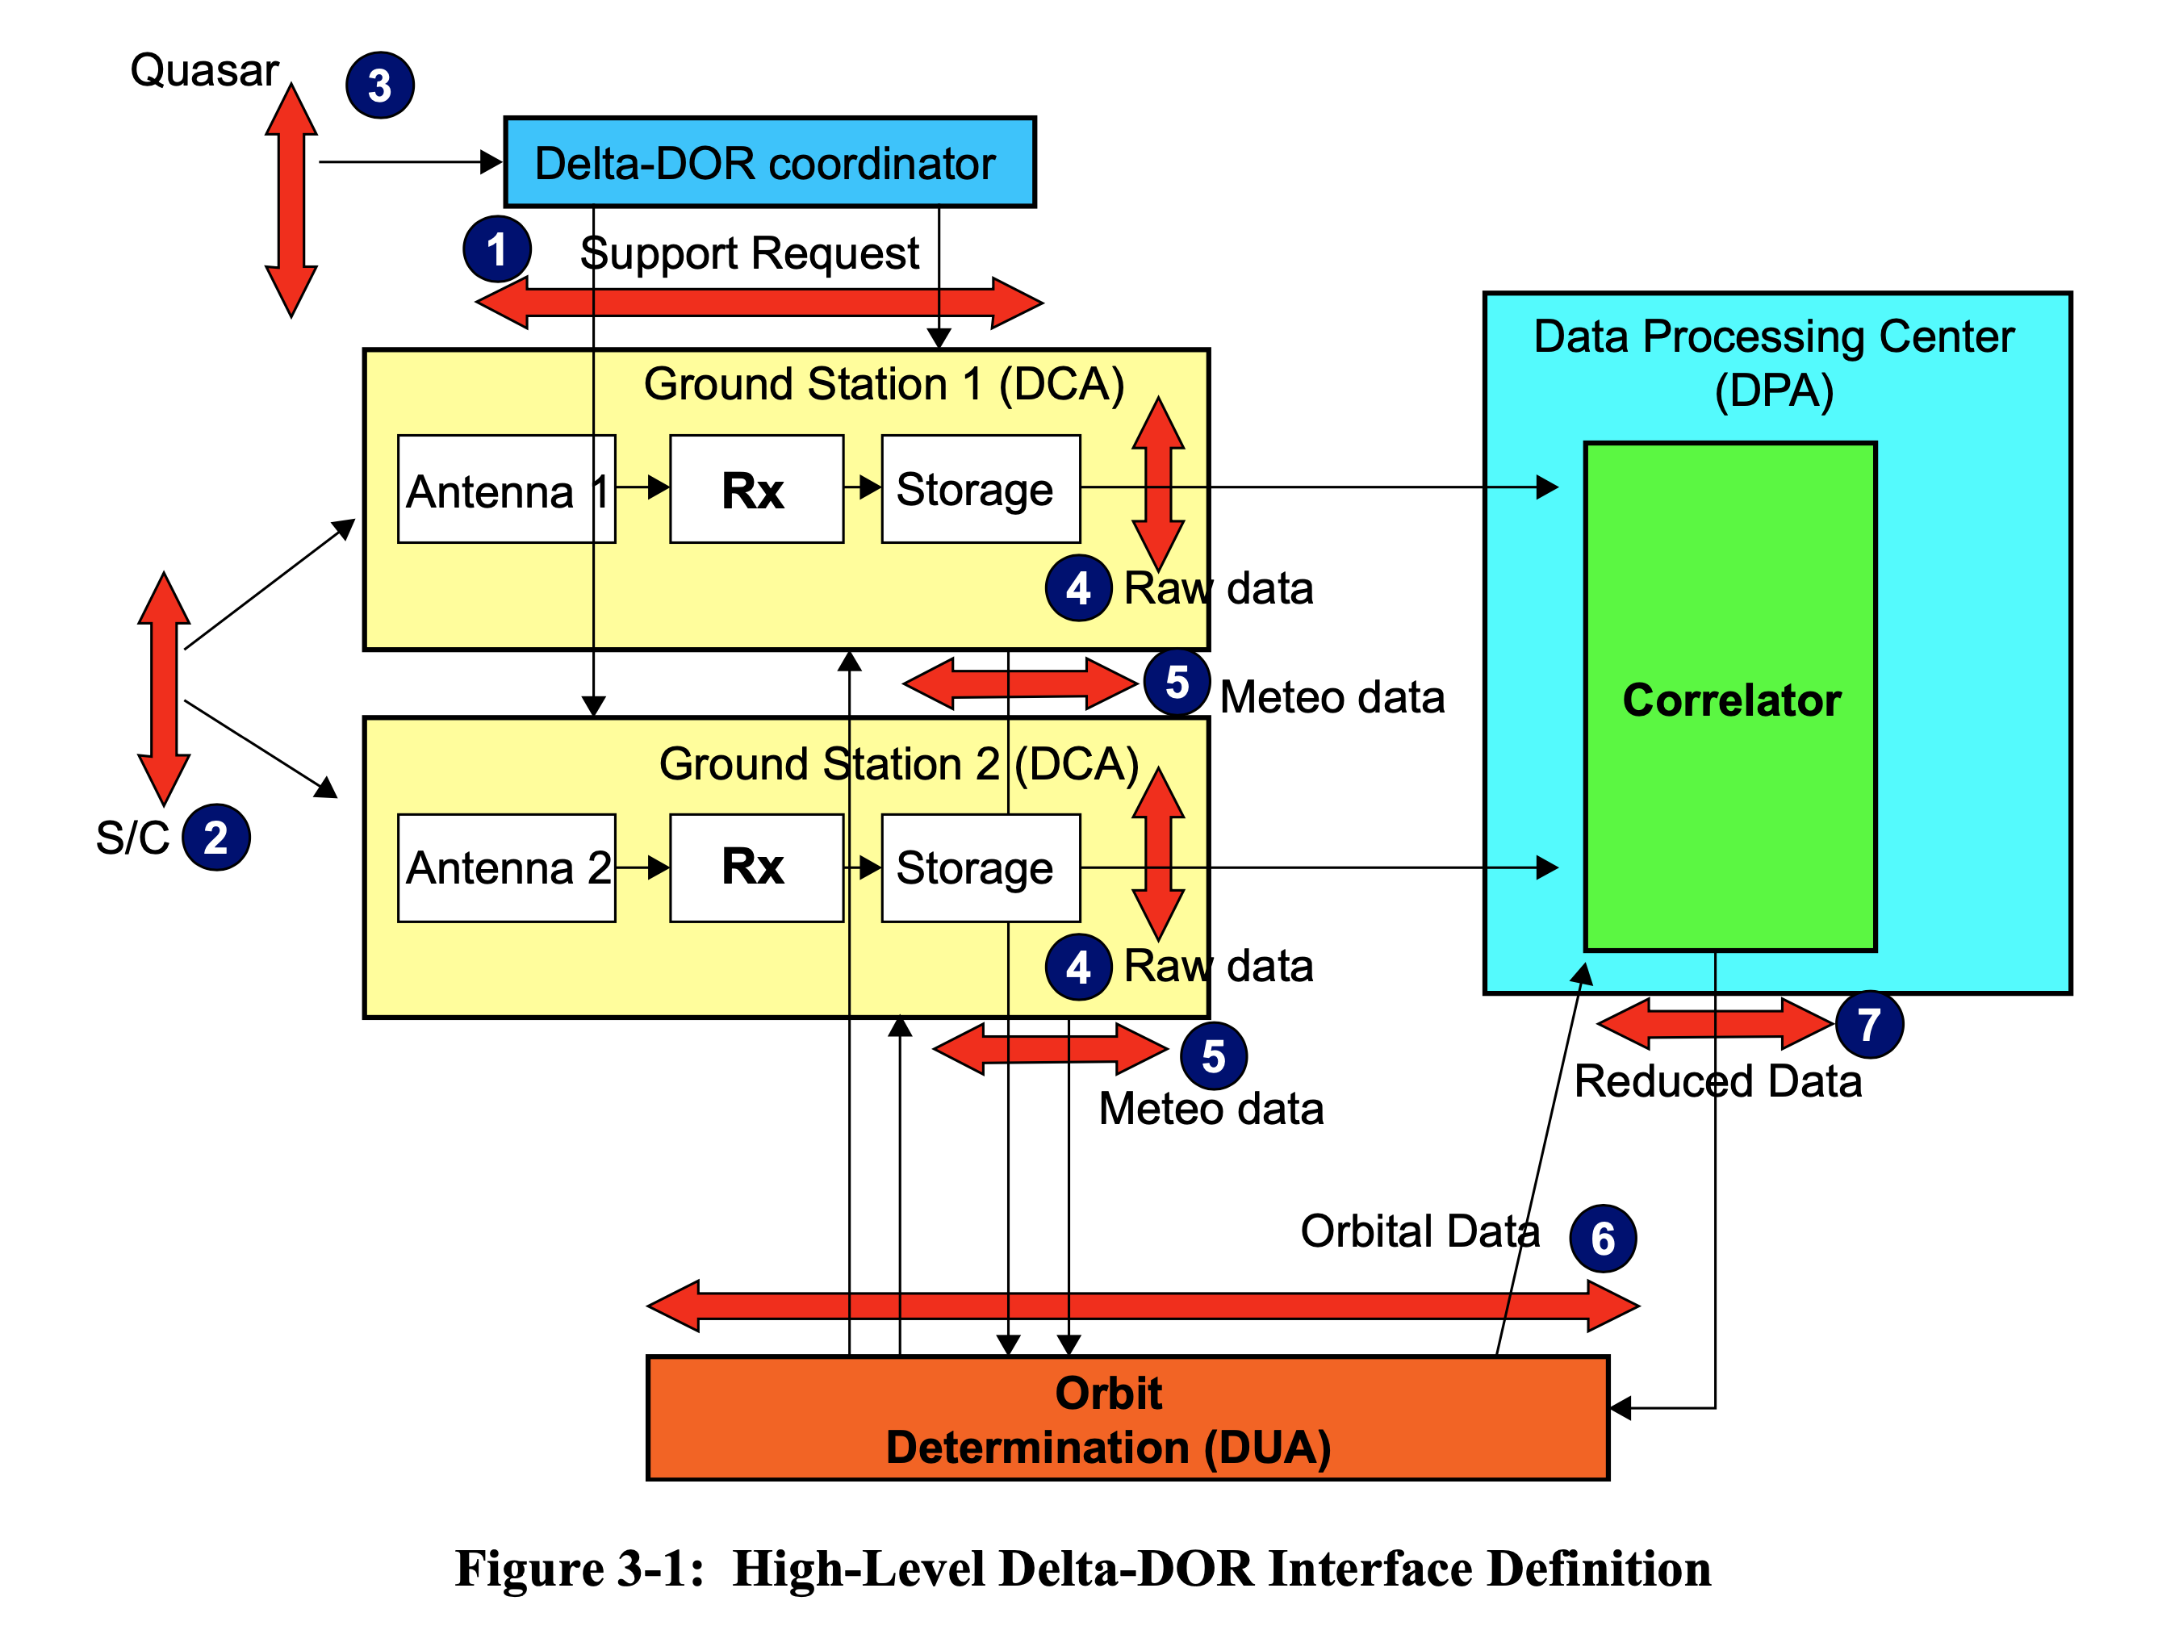
Delta-DOR Architecture
New features
New Ka Band Quasar catalog
Revisions to RDF Data Exchange format
New PN DOR Signal formats
Revisions to D-DOR Arch & Ops documents

Slide 20
  Time Management WG Executive Summary
Goals for this meeting cycle: The primary goal of the meeting was to substantially complete a first draft of the Green Book, finalizing the mission survey data and initial edits to the Green Book.
Working Group Status:
  The Time Management Working Group met on 2021-10-27 and 2021-11-01, 7 – 9 am PDT.
  The Green Book draft is nearly complete, but 6 open action items open issues remain, a few of which require significant work.
  The mission survey results were poorly captured in the tables presented at the meeting. This means that significant additional effort will be needed before these tables can be considered complete.
  WG aims to complete this by the end of the calendar year, but this may spill over.
Problems and Issues:
  NA
Planning:
Interaction with other WGs:
  RFM, SLP
Resolutions: none
Area and WG name | CCSDS Ref # | Document Title | Status / Comments | Start and / or Target Publication Date (dd/mm/year)
SEA Time | TBD | Time Management | NASA, ESA, DLR, ROSCOSMOS provided inputs for the Geen Book, detailing their agency methods for time management. | Start date 10/06/2019 End date 12/31/2021
SEA Time | TBD | Time Management Protocols | This project will be requested once a full Green Book draft is complete. | TBD
SEA Time | TBD | Recommended Practices for Time Management | This project will be requested once a full Green Book draft is complete. | TBD

Slide 21
Time Management WG Additional Comments
Day 1 activities, 2021-10-27:
  Review of draft Green Book action items
    Agencies have released mission survey data
    Section 7.1 on science activities has been completed
    Complete mission survey tables have been incorporated into draft
    Acronyms list has been completed
  Mission survey tables were presented. They had numerous conceptual and technical problems.
Day 2 activities, 2021-11-01:
  A presentation on quantum clock synchronization was made by James Troupe of Xairos Systems
  Updated mission survey tables were discussed.
  Section 6 on clock synchronization was discussed and the Working Group agreed to rewrite it.
A Working Group meeting is planned for early December.
Notes:
JAXA is interested, resources being identified. Possible issues getting resources allocated / schedule.

Slide 22
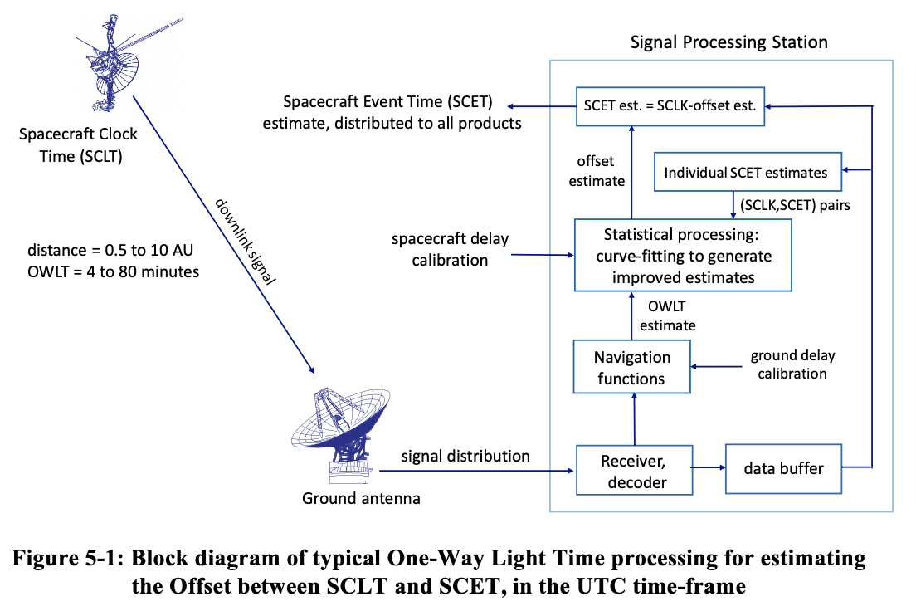
Time Management Green Book
Figure 5-1 Time Correlation
Time Management Stds
Time Transfer
Time Correlation
Time synchronization

Slide 23
  SEA SANA Steering Group Executive Summary
Achievements for this meeting cycle:
  SANA Operator is now part of COFOMO corporation, no issues were seen during transition
  SANA Operations systems are now fully virtualized, no access or performance issues are expected in the future
  Review SANA Operations report, authorization framework implementation status
  Programmatic Registry API with authenticated access control developed and being documented
  New standards projects that will have an effect on the SANA were discussed (FRM, Glossary, operational use)
Working Group Status:
  New QSCID registries are in use, some agencies are still reporting anxiety about dual (multiple) SCID allocations and possibility of assigning more than one SCID per spacecraft. Some implementations are adopting assigned OID as global spacecraft Identifier.
  Many new features have been deployed: added SCID V4 (USLP) Q-SCID, updates to FR registry, improved caching, math rendering, SCID management interface, account request interface
Interaction with other WGs
  Interactions with CSS SM WG (FRM), Nav registries, and agency specific schemas
  New Authorization framework improves access,
Problems and Issues:
  The Service Site and Aperture (SSA) registry is still only to be open to those with CCSDS login, and SANA now has list of users with CWE credentials (see above). The SANA has developed a new authorization structure to allow secure, remote access, update interfaces for AR’s to take responsibility for their own Agency’s data. Agency HoDs have been asked to assign these ARs.
  “Abbreviations” in SANA registries (SS&A) are sometimes missing, sometimes longer than the name. There is no consistent approach. D-DOR (and other) WG would like for there to be 4-character abbreviations. There need to be some consistent rules.
  Disconnects and performance issues in SANA to CCSDS website integration. This is in discussion between the two groups.
Notes:
JAXA is interested, resources being identified. Possible issues getting resources allocated / schedule.

Slide 24
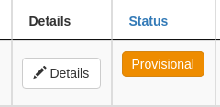
SANA Authorization framework
Policies
  SSG: any member of SSG can edit a registry with policy "SSG". e.g.
    Roles registries
  Agency Representative: any AR can edit records linked or owned by its organization in registries with policy "CCSDS Agency Representative". e.g.
    SCID Assignor: SCID and spacecraft registries
    Asset Assignor: Service site and apertures
  Area or WG: Any area director or working group chair can edit a registry with policy "CCSDS Area or Working Group" and authority containing its own area or working group as specified in Area and Working Group registries
Area and Working Group registries:
  https://sanaregistry.org/r/areas/
  https://sanaregistry.org/r/wg/
Logged users can edit their own contact information
Some data can only be edited by administrators (e.g. user roles, SCID value, SCID owner, ...)
“Pen” indicates editable field

Slide 25
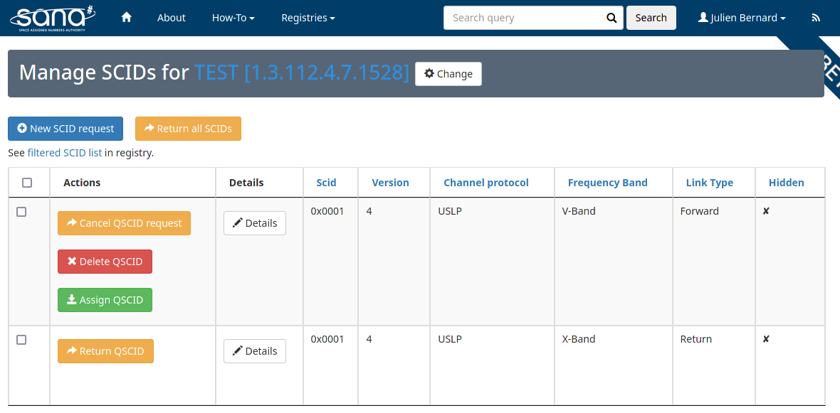
SCID management interface
New, access for both admin and ARs
AR can discard requests and return SCIDs

Slide 26
SANA Upcoming Work
Assist CCSDS working groups to create/modify/enhance registries
User documentation on authorization framework and authenticated API
Update SSA registry with mainly ESA comments
XML schema versioning
Fix SCIDs/Spacecraft registries data
Implementing updated SANA Yellow Books
Possible Lunar wifi/lte spacecraft ID registry (new Q-SCID, non-CCSDS ID use)
ISO/CCSDS Terms registries (still awaiting specific guidance)

Slide 27
  Systems Engineering Area Issues for CESG / CMC
Issue 1:
  There are no unallocated Version 2 (AOS) Q-SCIDs, and only a very few available in S-Band and X-Band. Agencies must start to shift to USLP.
Issue 2:
  Now that the new SANA authorization framework is implemented we need the CMC assigned ARs to update Agency asset information in at least the SS&A registry.
Issue 3:
  CCSDS must quickly develop a more complete security architecture (identity, access control, authentication, secure network management) for multi-mission / agency “interoperable network” deployments.
Issue 4:
  Request that the D-DOR WG, SM WG, and Nav WG, at a minimum, develop an agreed approach for consistent SS&A Registry abbreviations (Service Sites, apertures, S/C).
Appreciation:
  The Systems Engineering Area (SEA) wishes to thank Covid-19 (again) for helping us to learn how to effectively use virtual meetings
Notes:
JAXA is interested, resources being identified. Possible issues getting resources allocated / schedule.

Slide 28
BACKUP

Slide 29
Reminder: RESOLUTIONS
Resolution: The SecWG will be actively engaged in the review of all Red Books:
  Levels of involvement range from cursory examination of the Red Books under development, to active involvement in the development of the books.
    Response: AD will provide docs to the WG for review in parallel with AD review
Resolution: All CCSDS document editors will reach out, early in the development of the book to the SecWG to reduce downstream security issues.
    Response: AD will provide “pointers” to WGs for SecWG
Resolution: Security shall be addressed in all new project initiations. All new projects should consider the extent to which security is relevant. Considerations will be documented in the project initiation request.
    Response: AD forwards new projects definitions to SecWG to analyze security implications & to work with the initiating WG.

Slide 30
Terminology, Ontology, Reference Architecture
Definitions
Terminology: a set of terms and their descriptions, most often rendered in some “narrative” form.
  From Wikipedia: “a general word for the group of specialized words or meanings relating to a particular field”.
Ontology: a formalized naming and definition of terms, categories, properties, and their relationship to other terms.
  From Wikipedia: “a representation, formal naming and definition of the categories, properties and relations between the concepts, data and entities that substantiate one, many or all domains of discourse”.
Reference Architecture: a formalized definition of viewpoints, views, the objects they describe, and their relationships suitable for use in creating and describing specific systems architectures.
  From Wikipedia: “A software reference architecture is a software architecture where the structures and respective elements and relations provide templates for concrete architectures in a particular domain or in a family of software systems. “ “System” can, obviously, be substituted for “software”.
The “elements and relations” required for a reference architecture are best formalized in an ontology, but a set (or sets) of terminology may have to suffice.

Slide 31
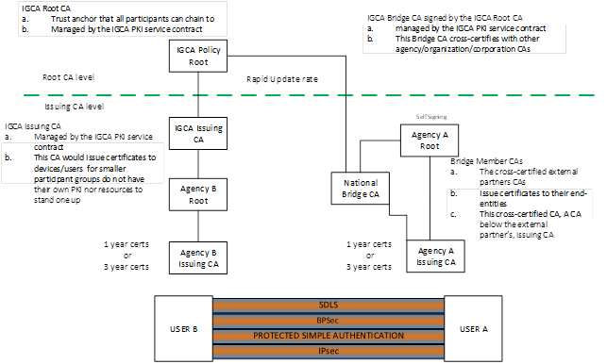
CCSDS Implementation - IGCA

Slide 32
Other Related Activities
ISO TC20/SC14 requested shared use of the SANA on-line terminology set and already plans to use RASDS and CCSDS terms where applicable
  This is to be a joint / collaborative effort with them
  SC14 also has an information management and control issue, similar to what the CMC has identified
  Handled in the context of the formal liaison relationship between CCSDS and SC14
  The ISO Secretariat raised some potential road-blocks re use of “ISO terms” in a non-ISO context, but this has been resolved
  Joint meeting with SANA has led to a plan to prototype the extended registry as a Beta
ECSS / ES is also moving toward a data repository for their requirements
  ECSS data repository provides a representation of the current library of documents
  Repository provides for presentation in a number of forms, i.e. output to Word, database, other tools
  There has been no progress on ECCS collaboration

Slide 33
Harmonizing the Terminology is a lot of work, right?
Yes, it will be much work.
But help is available - - the Ukrainian delegation to TC20/SC14 has “an exquisite capability to identify/flag duplicative/contradictory terms and definitions across all ISO standards”.
  Used to some extend in SC14 to harmonize terms, but much work to be done.
  Reference: ISO/TC 20 N3925: “ISO TC 20 report to ISO/TC 37 “Language and Terminology”, September 2020.
Proposal to adjust CCSDS Terminology registry attributes
  Add references for ISO TC20/SC14 standards as well as CCSDS
  Associate a “Domain” with each set of standards (CCSDS Area or ISO “WG”)
  Allow each Domain to identify its “Preferred” definitions
  WG may adopt these preferred terms, or not, when they revise their documents

