Slide 1
CESG Fall 2014:
items brought to attention
of the CMC

Slide 2
LACK OF RESOURCES IN THE SHORT TERM
CESG needs to solve urgently the challenges of the present
CESG proposes to place an action upon the CMC to deploy necessary resources during 2015 -2016
CCSDS Ref Architecture 1.5 FTEs
CCSDS Ontology 2+ FTEs
RASDS 5 year review 1-2 FTEs
MOIMS SM&C Zero MQ binding: 1 Prototype missing 6 mm
MOIMS DAI WG – NASA resources ??
CCS CSTS MD:Prototype User Role (NASA resources ? 1-2 mm) IOAG Dec 15
CSS CSTS TD: Prototypes Provider and User Role Total 6 mm IOAG Dec 20
CSS SM Planning Data: Prototype 1 and 2 : Total 6 mm
CSS Generic File Transfer: Prototype 1 and 2: Total 4 mm IOAG Dec15
Trajectory Prediction Data Format: Proto 1 and 2 Total 2 mm
Service Request / Package Data Formats: Proto 2 Total 6 mm
Service Agreement / Config Profile Data Formats Total 24 mm
SIS Bundle Sec / CGR / NW management: Extra 6 mm IOAG End 17/18/19
SOIS EDS GB / BB
SOIS Subnet WG Books 5 year review ca. 2 FTEs

Slide 3
Project Schedule
Many CWE Projects have a very optimistic schedule
Lessons learned indicates that the average elapsed time to produce a BB is between 3 to 4 years
It is suggested to adapt the Project schedule to these lessons learned

Slide 4
CESG FUTURE COMPOSITION
CESG composition is changing
Outstanding MOIMS AD replacement
SEA DAD to be replaced in 2015
SOIS AD to be replaced in 2015
Some DADs not participating regularly in CESG meetings

Slide 5
Procedures & Organization YB
CESG has discussed an outstanding issue on the last approved Proc & Org YB on consensus
A new YB update has been approved by CESG during its meeting on 17th Nov. 2014
Actual text changes were only done to these sections:
2.3.1.1: brief explicit statement about CMC use of consensus, refers to 5.1.2
2.3.2.2.b: some text CESG procedures removed and put into Sec 5.1.2
2.3.3.2: brief explicit statement about consensus added to WG procedures, refers to 5.1.2
5.1.2: text from CESG moved here. Reference to Annex G added.
5.3.1: changes to voting text to reflect that CMC & CESG both vote
5.3.5.4.4.1: agreed changes to voting / disapproval text
Annex G: new annex with description of consensus process and flow chart (2 page version)
TG will deliver the new YB version for CMC endorsement

Slide 6
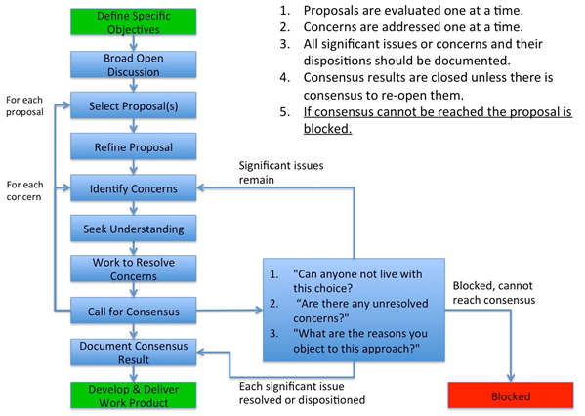
Procedures & Organization YB

Slide 7
Proposed change to CCSDS A20.0-Y-4, CCSDS Publications Manual (Yellow Book, Issue 4, April 2014)

Slide 8
Proposed change to CCSDS A20.0-Y-4, CCSDS Publications Manual (Yellow Book, Issue 4, April 2014) continued

Slide 9
CESG Area / WG Overlaps
Agreement to Resolve Cross Support and MOIMS MO Services Overlap
CCSDS shall maintain a single reference architecture and lexicon
Cross Support Transfer Services (CSTS) Framework and Cross Support Service Management (CSSM) shall be used for interfaces between the mission control systems and the ground network/stations, including for ground station planning and scheduling.
MOIMS Mission Operations Framework and Services shall be used for interfaces between the mission control systems and all other mission operations ground assets (except ground stations) and for E2E space-ground MO services via encapsulation/SLE tunneling, including mission planning and scheduling.
The CESG shall enforce a clear apportionment of tasks to WGs consistent with the above frameworks. Deviations are possible, but they need to be justified and approved by CESG

Slide 10
CESG Area / WG Overlaps
Remaining overlaps will be discussed in the next CESG webex meetings (Feb 2015)
Spread-sheet will be re-issued prior to Spring 2015 and presented during the CMC meeting (May 2015)

Slide 11
CESG Other Issues
SLS RFM + C&S WGs not meeting in Caltech
Either Pasadena (not JPL ?) Or CNES
It is strongly recommended to have the mtg in Pasadena even nominating a temporary Chair. If it is imperative to have the mtg in May, JPL has an action to find a place. It is up the WG to fix location / time.
SLS Optical WG BB way forward
One solution or not: Action on WG to reach a consensed solution
PLACOM GB
CESG consider that, if it is confirmed that only Agency works on this book, technical quality cannot be guaranteed. CMC to advise
Expert Group
Need of Expert Group in Areas
Formalise ?
Proc & Org update ?
CESG to discuss in next webex planned for Feb 2015
Poor Agency participation in some books review, e.g.
CSS CSTS FW
CSS CSTS MD
Please improve the situation by actively participating in the CSS CSA Architecture Requirements Document (901x1r1)

