Slide 1
CCSDS Spring 2017 Working Group San Antonio, TX
Michael Epperly
Southwest Research Institute
mepperly@swri.org
(210) 522-3477

Slide 2
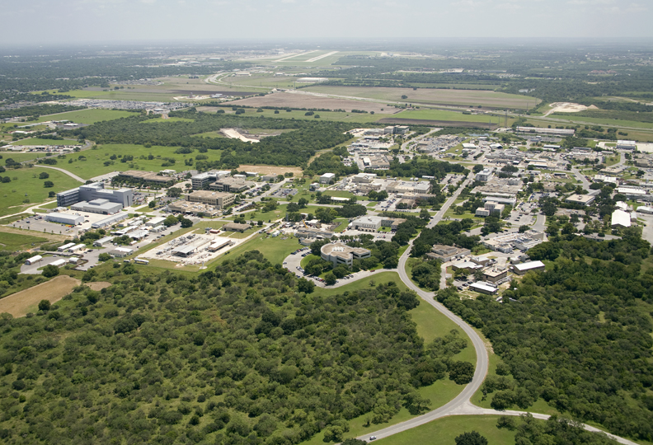
Southwest Research Institute

Slide 3
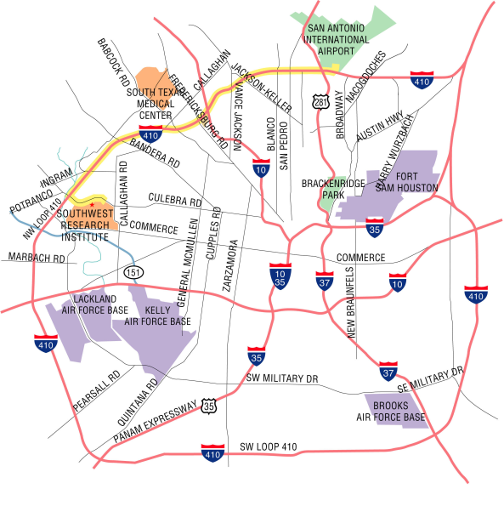
SwRI

Slide 4
Fall 2013 Meeting
Last meeting at SwRI was Fall of 2013
Coordinated with Nick Tongson for Room and Schedule
Reserved up to 22 rooms for week (5 days)
Used 15 for 4 days and CESG met on Friday
Rooms are scattered across campus – all within walking distance of each other and cafeteria
SwRI provided beverages and snacks at 5 different locations for breaks

Slide 5
Fall 2013
Room | Mon AM 28 Oct | Mon PM 28 Oct | Tue AM 29 Oct | Tue PM 29 Oct | Wed AM 30 Oct | Wed PM 30 Oct | Thu AM 31 Oct | Thu PM 31 Oct | Break Area | Fri All Day 1 Nov
Bldg 263 Main (40-97) | CCSDS Plenary + MOIMS Plenary (0945-1030) + SM&C | SM&C | SM&C | SM&C | SM&C | SM&C | SM&C | SM&C + MOIMS Plenary | 263
Bldg 263-CR 1 (12) |  | Cross Support Architecture | Cross Support Architecture | Cross Support Architecture |  |  |  | SIS Plenary | 263
Bldg 263-2A (12) | Service Management | Service Management | Service Management | Service Management | Service Management | Service Management | Service Management | Service Management | 263
Bldg 263-2B (15) | CSS Plenary + Cross Support Transfer Services | Cross Support Transfer Services | Cross Support Transfer Services | Cross Support Transfer Services | Cross Support Transfer Services | Cross Support Transfer Services | Cross Support Transfer Services | Cross Support Transfer Services + CSS Plenary | 263
Bldg 178-CR 1 (20) | Optical Com | Optical Com | Optical Com | Optical Com | SDLS | SDLS | SDLS |  | 263
Bldg 178-CR 2 (17) | Navigation | Navigation | Navigation | Navigation | Navigation | Navigation | Navigation | Navigation | 263
Cafeteria-CR 1 (20) |  |  | D-DOR | D-DOR | D-DOR | D-DOR | D-DOR | SEA Plenary | Cafeteria
Cafeteria-CR 2 (20) |  |  | MIA | Voice | MIA | Voice | Voice | Boot Camp | Cafeteria
Cafeteria-CR 3 (35) |  |  | DTN | DTN | DTN | DTN Interops Test | XML SIG |  | Cafeteria | CESG Executive
Bldg 189-VTC 1 (20) | Application Support Services | Application Support Services | Application Support Services | Application Support Services | Application Support Services | Application Support Services | Application Support Services | Application Support Services | 189
Bldg 189-VTC 2 (20) | D-DOR + SEA Plenary | D-DOR | Space Link Protocols | Space Link Protocols | Space Link Code/Sync | Space Link Code/Sync |  |  | 189
Bldg 160-Auditorium (40) |  |  | Security | Security |  | PlaCom | RFM+C&S+ SLP+NGU+OCM | SLS Plenary | 189
Bldg 168-CR 1 (16) |  | Boot Camp | MHDC | MHDC | MHDC | MHDC |  |  | 263
Library-Reading Room (20) |  | Security |  | CSS BoF (Generic File Transfer) | Timeline Data X | Timeline Data X | Timeline Data X | Timeline Data X | 256
Bldg 238-CR 1 (20) Div 14 |  | CFDP Refresh BoF | RF Modulation | RF Modulation | RF Modulation |  | TeleRobotics | TeleRobotics | 263
Bldg 256-CR 1A (16) | Wireless | Wireless | Wireless | Wireless | Wireless | Wireless | Wireless | Wireless | 256
Room Assignments for the CESG Meetings at SwRI, San Antonio, Texas (28-31 October 2013)

Slide 6
Spring 2017
SwRI is proud to host the Spring 2017 Working Group and CESG in San Antonio
Possible dates: Any week between 6-March and 26-May
Fiesta is 20-Apr to 30-Apr
Recommend: 1-May to 5-May with CESG on 8-May
5 day meeting reduces number of conference rooms required daily
San Antonio can get pretty hot by the end of May
Same Rules as last time
Foreign nationals must have special badge
Visitors on campus after 6:30am and off by 6:30pm
SwRI will provide refreshments and snacks each day
Plenty of coffee

Slide 7
Open Dates
 | Sun | Mon | Tue | Wed | Thu | Fri | Sat
MARCH |  |  |  | 1 | 2 | 3 | 4
 | 5 | 6 | 7 | 8 | 9 | 10 | 11
 | 12 | 13 | 14 | 15 | 16 | 17 | 18
 | 19 | 20 | 21 | 22 | 23 | 24 | 25
 | 26 | 27 | 28 | 29 | 30 | 31 | 1
APRIL | 2 | 3 | 4 | 5 | 6 | 7 | 8
 | 9 | 10 | 11 | 12 | 13 | 14 | 15
 | 16 | 17 | 18 | 19 | 20 | 21 | 22
 | 23 | 24 | 25 | 26 | 27 | 28 | 29
MAY | 30 | 1 | 2 | 3 | 4 | 5 | 6
 | 7 | 8 | 9 | 10 | 11 | 12 | 13
 | 14 | 15 | 16 | 17 | 18 | 19 | 20
 | 21 | 22 | 23 | 24 | 25 | 26 | 27
 | 28 | 29 | 30 | 31
FIESTA
FIESTA
Recommended
Avg High:85
Avg Low: 65

Slide 8
San Antonio Temperatures
32
29
27
24
21
18
16
13
10
7
Comfort Range

Slide 9
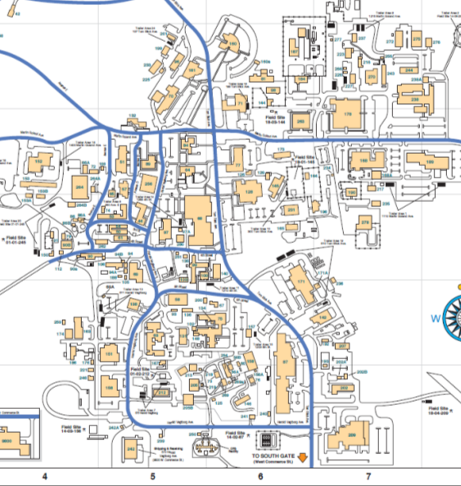
Locations
*
*
Cafeteria
*
*
*
*
Opening Remarks
& Plenary
*
*
*
*
Available but did not use in 2013

Slide 10
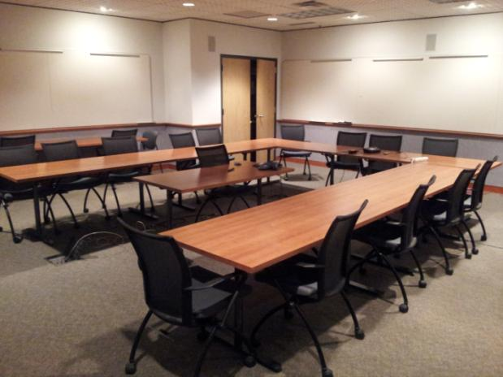
Bldg 178 – CR1
Size | 30 x 26
Screen and Projector | Yes
Telephone | Yes
Table Seats | 20
Additional Seats | 10

Slide 11
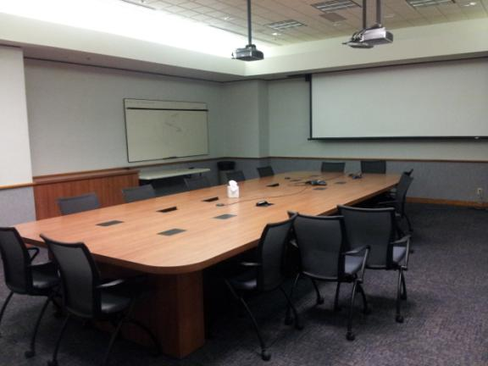
Bldg 178 – CR2
Size | 30 x 26
Screen and Projector | Yes
Telephone | Yes
Table Seats | 17
Additional Seats | 10

Slide 12
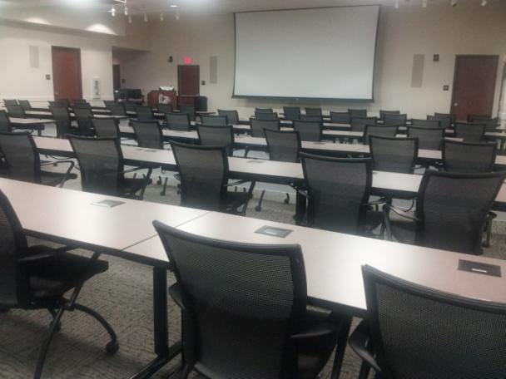
Bldg 263 - Main
Size | 30 x 26
Screen and Projector | Yes
Telephone | Yes
Table Seats | 40 – 97
Additional Seats | 30

Slide 13
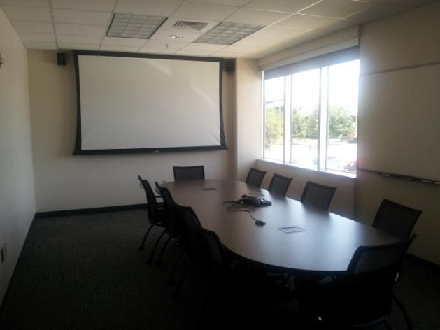
Bldg 263 – CR1
Size | 24 x 12
Screen and Projector | Yes
Telephone | Yes
Table Seats | 12
Additional Seats | 10

Slide 14
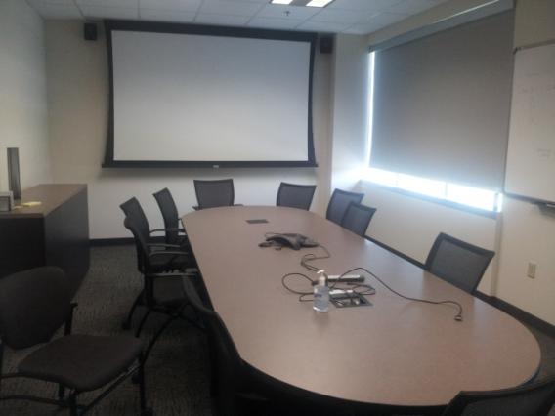
Bldg 263 – 2A
Size | 24 x 12
Screen and Projector | Yes
Telephone | Yes
Table Seats | 12
Additional Seats | 10

Slide 15
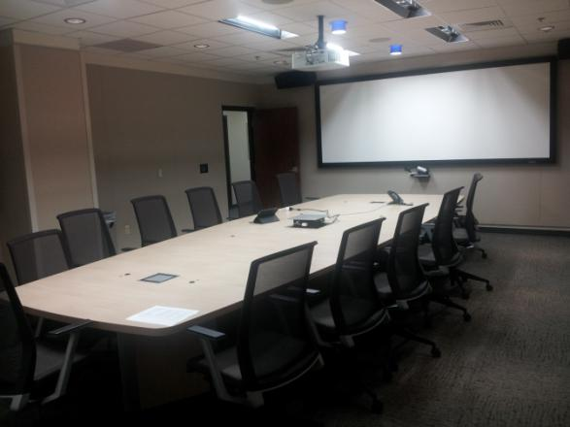
Bldg 263 – 2B
Size | 30 x 20
Screen and Projector | Yes
Telephone | Yes
Table Seats | 15
Additional Seats | 10

Slide 16
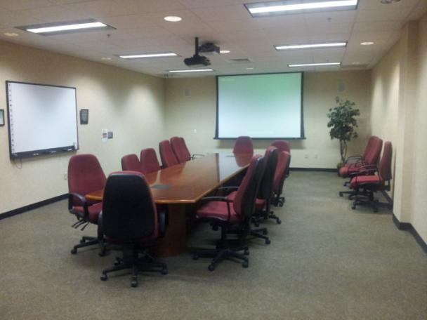
Bldg 168 – CR1
Size | 30 x 20
Screen and Projector | Yes
Telephone | Yes
Table Seats | 16
Additional Seats | 10

Slide 17
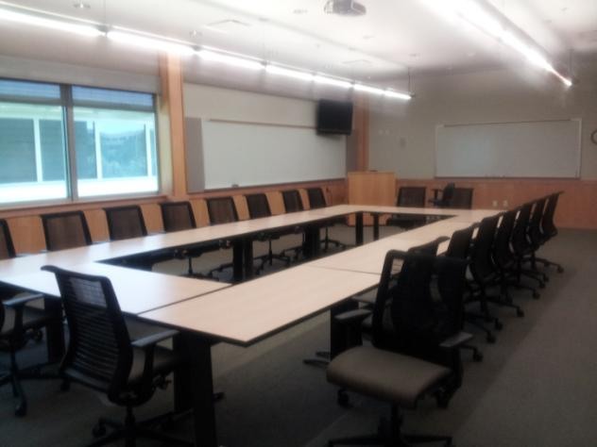
Bldg 238 – CR1
Size | 36 x 20
Screen and Projector | Yes
Telephone | Yes
Table Seats | 20
Additional Seats | 10

Slide 18
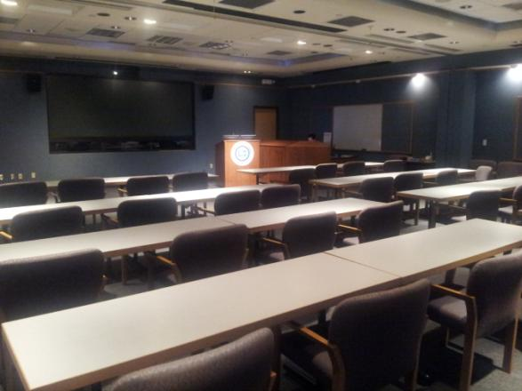
Bldg 189 - VTC
Size | 45 x 45
Screen and Projector | Yes
Telephone | Yes
Table Seats | 40
Additional Seats | 30

Slide 19
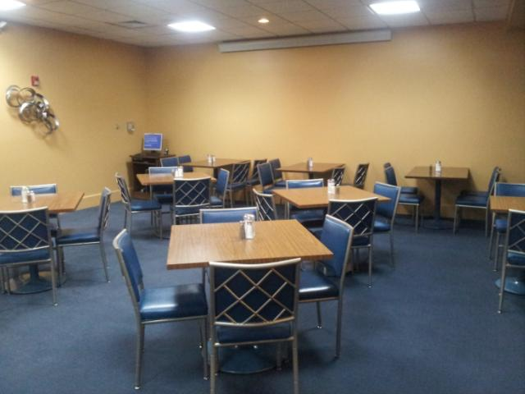
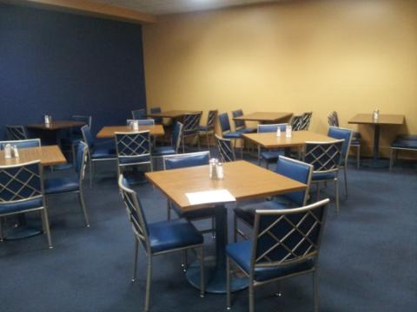
Cafeteria – CR1
Size | 24 x 24
Screen and Projector | Yes
Telephone | Yes
Table Seats | 20
Additional Seats | 10
Notes | CR1 and CR2 can be combined

Slide 20
Cafeteria – CR2
Size | 24 x 24
Screen and Projector | Yes
Telephone | Yes
Table Seats | 20
Additional Seats | 10
Notes | CR1 and CR2 can be combined

Slide 21
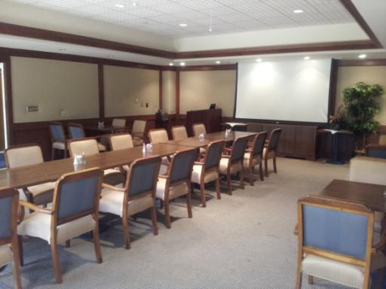
Cafeteria – CR3
Size | 36 x 24
Screen and Projector | Yes
Telephone | Yes
Table Seats | 35
Additional Seats

Slide 22
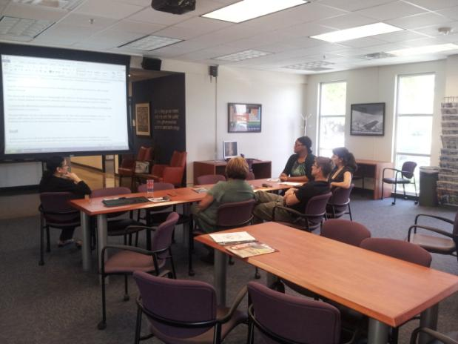
Library – Reading Room
Size | 30 x 30
Screen and Projector | Yes
Telephone | Yes
Table Seats | 20
Additional Seats | 10
Notes | Open area in library

Slide 23
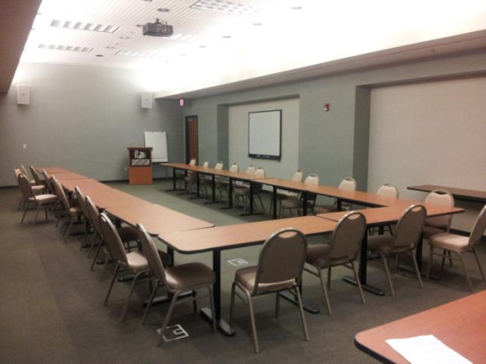
Bldg 209 – CR103
Size | 55 x 20
Screen and Projector | Yes
Telephone | Yes
Table Seats | 28
Additional Seats | 10
Notes | Not available 10/31

Slide 24
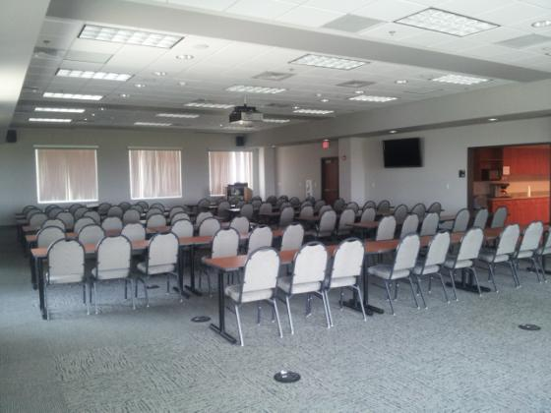
Bldg 209 – CR313
Size | 75 x 45
Screen and Projector | Yes
Telephone | Yes
Seats | 160 - 290
Notes | Best location for Plenaries

Slide 25
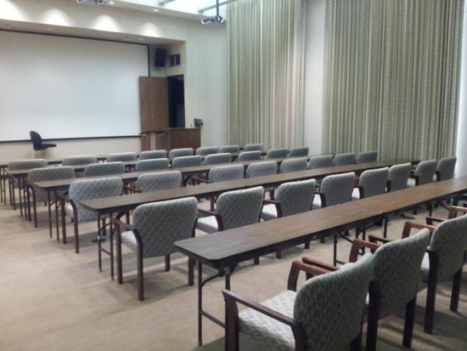
Bldg 160 – Auditorium
Size | 45 x 30
Screen and Projector | Yes
Telephone | Yes
Table Seats | 40
Notes | Can be configured as a “U” or Classroom

Slide 26
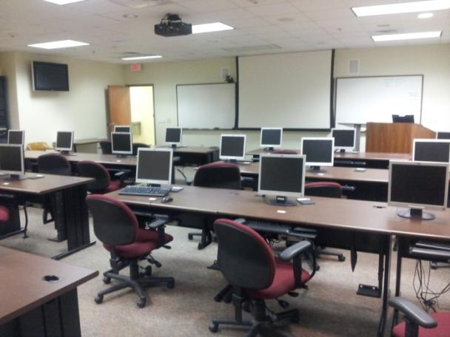
Bldg 256 – Training Room
Size | 36 x 36
Screen and Projector | Yes
Telephone | Yes
Table Seats | 22
Notes | Tables cannot be moved

Slide 27
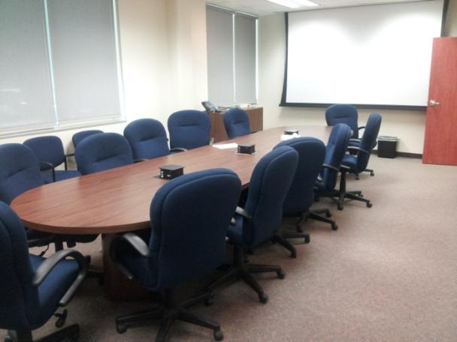
Bldg 256 – CR1A
Size | 30 x 20
Screen and Projector | Yes
Telephone | Yes
Table Seats | 16
Additional Seats | 10

Slide 28
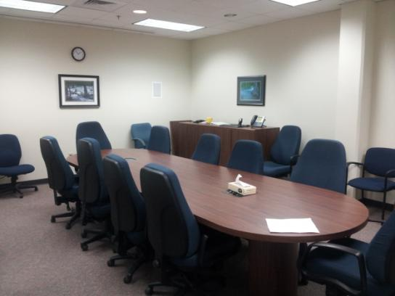
Bldg 256 – CR2A
Size | 24 x 20
Screen and Projector | Yes
Telephone | Yes
Table Seats | 16
Additional Seats | 10

