Slide 1
SM&C WG Report to MOIMS
Fall Technical Meetings 2022
M. Sarkarati
Scott Reeves
Notes:
1
1
1

Slide 2
SM&C WG Executive Summary
Achievements for this meeting cycle:
SM&C WG met five days in hybrid mode with f2f and remote session. The effectiveness of having f2f meetings has significantly improved both in terms of time and quality.
Key members could unfortunately not attend in person due to COVID and administrative issues. Big thank to the discipline and support via the remote participation.
WG would like to express its appreciation on excellent hosting and high quality of the facilities.
For future hybrid meetings, a web cam would improve the interactiveness.
Meeting held with SEA AD and other CESG members. All conditions raised as part of the CESG review on the MAL Book CCSDS 521.0-B-3 have been met and agreed to start the Agency Review. Question of the color of the MAL book resolved. MAL Book and other SM&C BB remain Blue. It was agreed to add a Adaptation Chapter.
M&C revised Book with MO 2.0 updates presented by CNES and reviewed by the WG. Approach to speeding up the finalization of the book agreed.
The new MDPDS concept validated against typical use cases for cross-agency interoperability. The information model and outline of the service capabilities reviewed and agreed.
Packet Service Concept revisited and work resumed.
In response to CESG Action for facilitating infusion of MO standards in missions, the WG drafted a respective profile for concrete G2G deployment scenarios
Focus until Spring 2023 meeting will be as planned on
Finalise Reference Model MB
Update the HTTP/XML binding Book
Have M&C BB ready for submission to Agency Review (including the Packet Distribution Service)
Have the MDPDS ready for agency review
Working Group Status:
”High Momentum”: Very active and participating (impressed by remote participants) . All WG members were focused on reaching pragmatic and consensus agreements
3 CNES, 1 DLR, 5 ESA, 3 NASA
Interaction with other WGs
Joint Meeting. With DAI. Very useful. Agreed to support DAI in outlining a DAI generic data transfer service.
SM&C WG members supported the MP&S WG
Problems and Issues:
Very long. time from the point the book is released from the WG to AD for starting the Agency Review until its publication. (e.g. from 20 May, five months for CESG poll of MAL BB to start the AR )
With the satisfactory resolution of starting the AR of the MAL book, proposed to have as far as possible parallel AR of SM&C and MP&S books
In line with the CESG discussion to foster MO infusion in the missions, the WG would welcome active promotion of our standards by NASA collogues in large inter-agency collaborative missions (e.g. Artemis). Similarly we would welcome feedback on needs of the corresponding missions towards our standards
The SM&C WG considers essential to meet 5 days during Spring Meetings 2023.

Slide 3
SM&C WG Executive Summary
Resolutions agreed upon this meeting:
Request to silverise CCSDS 523.2-M-1 Mission Operations Message Abstraction Layer--C++ API
Request to silverise CCSDS 523.1-M-1 Mission Operations Message Abstraction Layer--JAVA API
Further Resolutions anticipated in the next 6 months:
Request the AD to publish the CCSDS 521.0-B-3 Mission Operations - Message Abstraction Layer (MAL) - B-3 after the Agency Review
Request new project for the revision of CCSDS 522.1-B-1 Mission Operations Monitor & Control Services M(&C)
Request new project for the revision of CCSDS 524.3-B-1 Mission Operations--Message Abstraction Layer Binding to HTTP Transport and XML Encoding
Planning (only approved Projects):
Area and WG name | CCSDS Ref Nr | Document Title | Status / Comments | Start and / or Target Publication Date
MOIMS SM&C | 520.0-G-4 | Mission Operations Services Concept (Issue 4) | Waiting MO 2.0 updates. Parked for now, as it is not the highest priority. | Start date 12Jan2016 End date 30Jun2024
MOIMS SM&C | 520.1-M-2 | Mission Operations Reference Model | Updated version with changes agreed with SEC WG and SEA AD will be available in March 2023 | Start date 19Oct2018 End date 01DEC2023
MOIMS SM&C | 521.0-B-3 | Mission Operations - Message Abstraction Layer (MAL) - B-3 | Passed CESG Review, starting the Agency Review. Prototyping approach being discussed. | Start date 2021 End date 1DEC2023
MOIMS SM&C | 524.2-B-2 | Mission Operations - Message Abstraction Layer Binding to TCP/IP Transport and Split Binary Encoding– 2 | Draft /on hold- priority given to HTTP/XML Binding in line with proposed G2G profile for MO infusion | Start date 2021 End date 1DEC2024
MOIMS SM&C | 522.2-B-1 | Mission Operations - Mission Data Product Distribution Services | Work resumed, Book shall be ready for AR by Spring meetings 2023 | Start date 2015 End date 30June2024
MOIMS SM&C | Xxx-x-B1 | Mission Operations File Management Services | On Hold/ Priority given to MDPDS | Suspended for now. Not high priority.

Slide 4
MO 2.0 Implementation Roadmap
MO Framework:
(1) MAL BB: Sent to AR (ESA Editor, ESA/CNES prototype)
Reference Model MB with MO 2.0 and security related updates to go to AR in Spring 2023
MO Green Book: Not priority and parked.
COM BB: Silverise, once MO 2.0 set of consistent standards are published
Language Bindings:
Silverise all books (C++ and JAVA), once MO 2.0 set of consistent standards are published
Transport Bindings:
update in the following order:
(3) HTTP/XML (ESA editorship, JPL-ESA prototype tbc)
TCP/IP and Split Binary Encoding (DLR editorship, prototype TBD)
Space Packet and Binary Encoding (TBD)
ZMTP (TBD)
Application Layer Services:
(2) Mission Data Product Distribution Service: Work in parallel to M&C. Send to AR in Spring 2023 (ESA Editor, ESA/JPL prototype TBC)
(2) M&C BB: Send to AR in Spring 2023 (CNES Editor, ESA-CNES prototype)
Common Services BB – on hold – To be tackled later

Slide 5
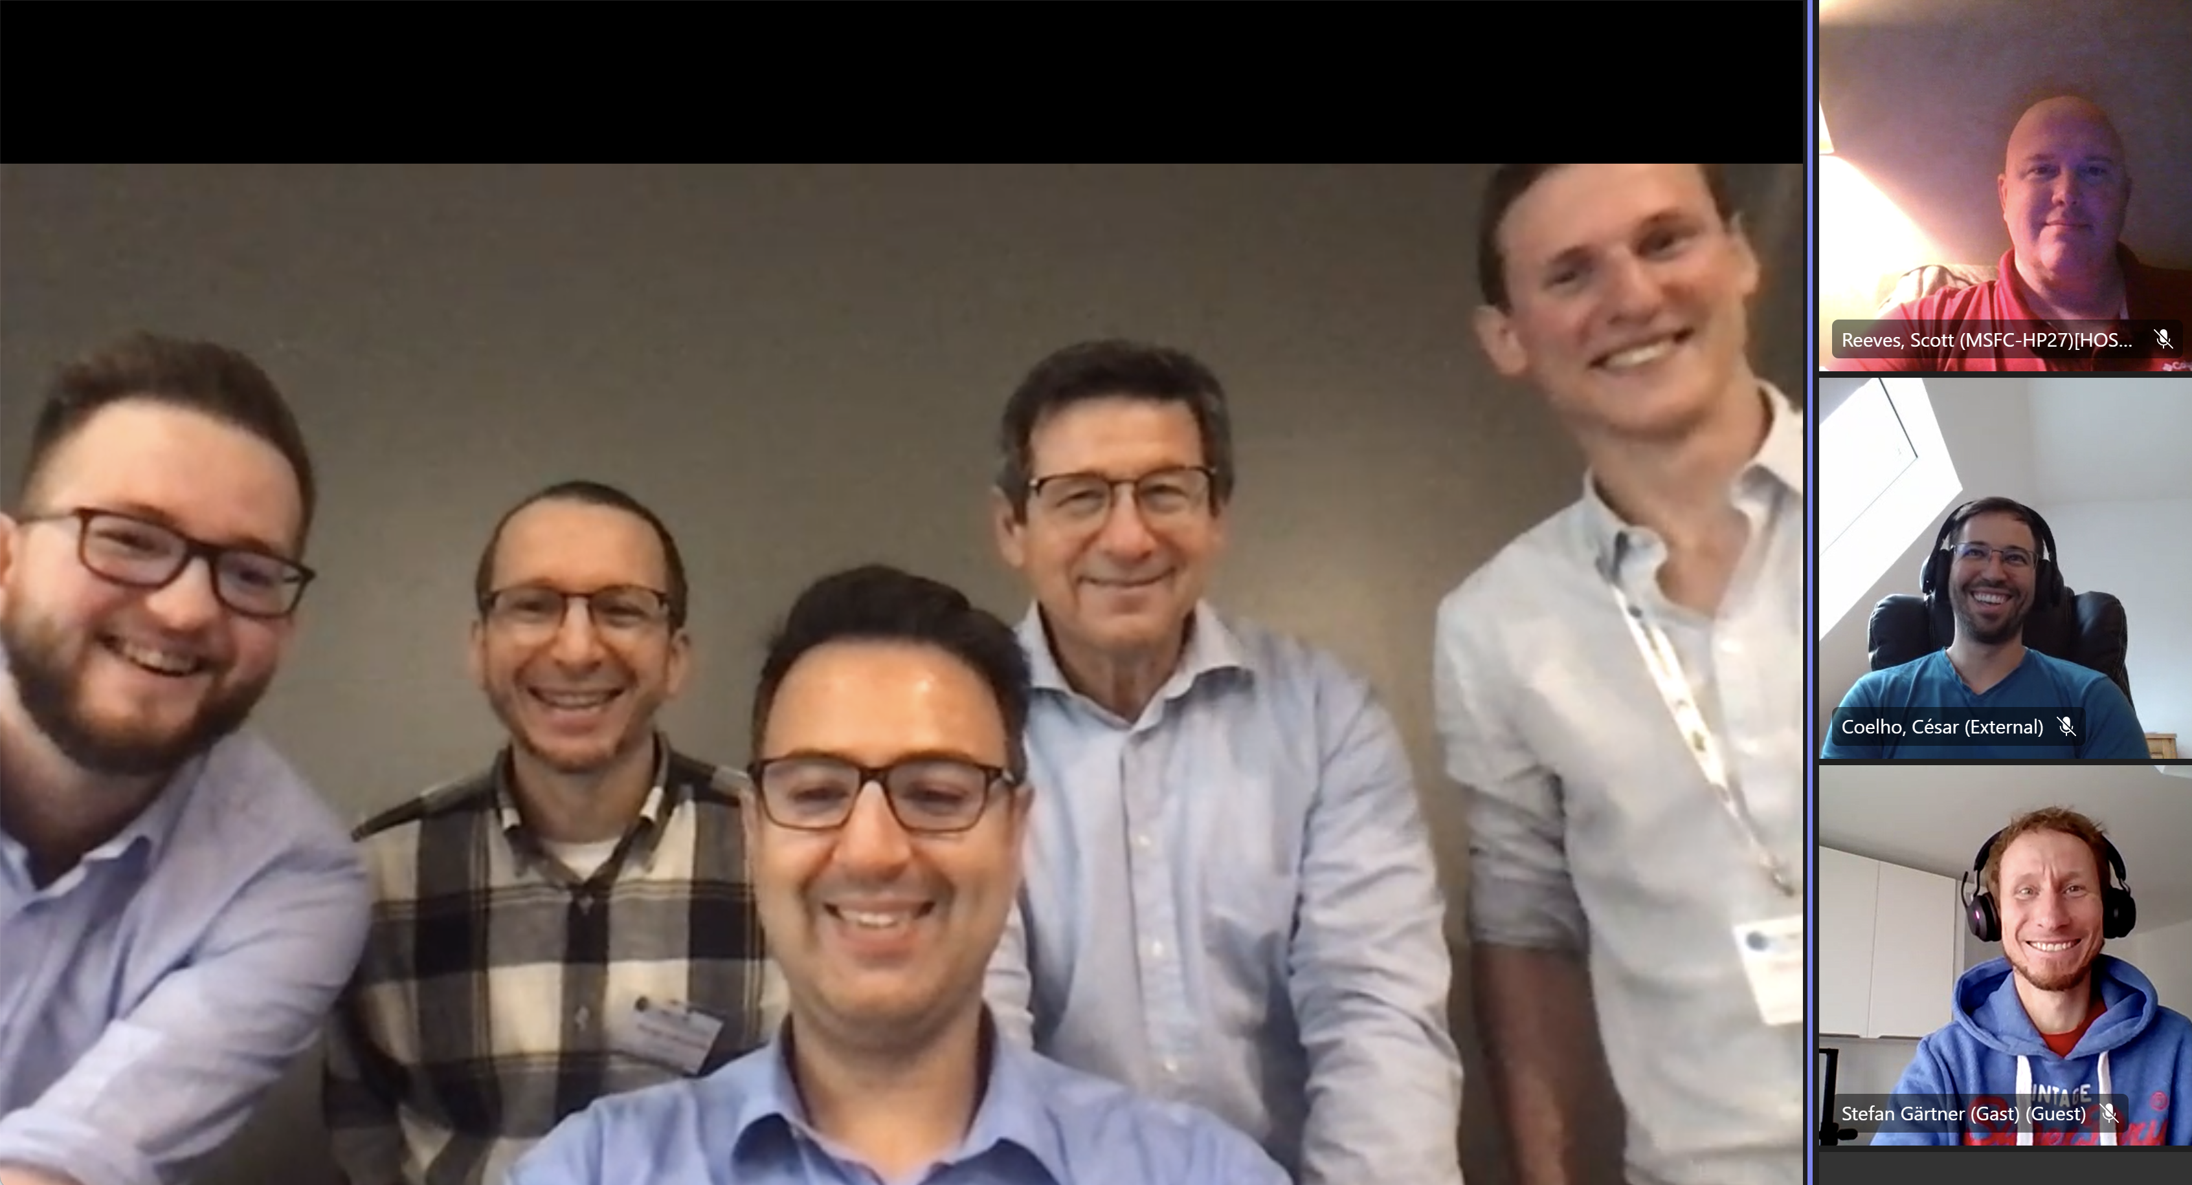
Virtually United ☺

