Slide 1
SM&C WG Report to MOIMS
Virtual Spring Technical Meetings 2022
M. Sarkarati
Scott Reeves
Notes:
1
1
1

Slide 2
SM&C WG Executive Summary
Achievements for this meeting cycle:
5 Technical sessions dedicated to technical discussions on MO 2.0 and MDPDS and Packet Service
MAL BB WG review concluded and sent to AD with request to start the Agency Review
The concept of MDPDS revisited. Agreed to re-validate the concept against typical use cases for cross-agency interoperability. Each Agency will come back with typical use cases.
Packet Service Concept revisited and work resumed. Agreed to produce a high-level presentation of the scope of the service to discuss with IOAG and CSS WG before going any further.
MAL BB project approval resumed (after SW Bug in CWE). Hopefully we can recover to avoid delays for AR of the BB.
Focus until Fall meeting will be as planned on
TCP/IP and Binary Encoding binding
M&C BB
MDPDS and Packet Service (as the WG expect these two services to boost the adoption of the MO standards)
Working Group Status:
”High Momentum”: Very active and participating . All WG members were focused on reaching pragmatic and consensus agreements
3 CNES, 1 DLR, 7(+1) ESA, 4 NASA
Interaction with other WGs
No Joint Meeting. MAL BB sent to DAI for raising awareness.
MP&S WG members attended on session dedicated to MAL update discussions
Problems and Issues:
The WG acknowledges that for completing the updates, required on all existing books to have a consistent set of standards as MO 2.0 requires significant effort and with the current pace may take many years.
Virtual Setup (Teams) although worked fine, the time is by far too short as compared to 5 full day sessions and by no means a long-term solution/replacement for physical collocation meetings
The SM&C WG considers essential to meet 5 days during Fall Meetings 2022, in case it takes place f2f. Please book the room!

Slide 3
SM&C WG Executive Summary
Resolutions agreed upon this meeting:
Request the AD to send Mission Operations - Message Abstraction Layer (MAL) - B-3 to to Agency Review
Request to silverise CCSDS 523.2-M-1 Mission Operations Message Abstraction Layer--C++ API
Request to silverise CCSDS 523.1-M-1 Mission Operations Message Abstraction Layer--JAVA API
Further Resolutions anticipated in the next 6 months:
Request new project for the revision of CCSDS 522.0-B-1 Mission Operations Monitor & Control Services M(&C)
Request new project for the revision of CCSDS 524.2-B-1 Mission Operations--Message Abstraction Layer Binding to TCP/IP Transport and Split Binary Encoding
Planning (only approved Projects):
Area and WG name | CCSDS Ref Nr | Document Title | Status / Comments | Start and / or Target Publication Date
MOIMS SM&C | 520.0 | Mission Operations Services Concept (Issue 4) | Mostly completed, waiting MO 2.0 updates. Parked for now, as it is not the highest priority. | Start date 12Jan2016 End date 30Jun2024
MOIMS SM&C | 520.1 | Mission Operations Reference Model | Updated version with changes agreed with SEC WG and SEA AD will be available in Oct 2022 | Start date 19Oct2018 End date 01DEC2022
MOIMS SM&C | CCSDS 521.0-B-3 | Mission Operations - Message Abstraction Layer (MAL) - B-3 | Draft / Sent to AD for starting the Agency Review | Start 2021 / Mid 2023
MOIMS SM&C | CCSDS 524.2-B-2 | Mission Operations - Message Abstraction Layer Binding to TCP/IP Transport and Split Binary Encoding– 2 | Draft / Work paused | Start 2021 / End 2023
MOIMS SM&C | CCSDS 522.2 | Mission Operations - Mission Data Product Distribution Services | Work resumed, starting at review of the service concept. | Start 2015/ End 2023
MOIMS SM&C |  | Mission Operations File Management Services | Suspended for now | Suspended for now. Not high priority.

Slide 4
MO 2.0 Changes Implementation Roadmap
MAL BB: Sent to AD requeting to start AR. Prototyping ESA/CNES to start in 2022.
COM BB shall be silverised. COM Object aspects are integrated in the MAL book. Archive Service to be dropped, Activity Tracking to be taken into account with the Action Service, Event Service goes to MAL book (Document best practices and as clear as possible guitdeline for when to use the Event service as oposed to using service specific pub-sub operation). Concepts of the COM will be taken into account and reflected in the Green Book alined with the new concepts of MO 2.0.
Language Binding MBs to be silverized.
Transport/encoding BBs: Will be updated as next. TCP/IP and Binary Encoding BB is the first one to work on. DLR will do the editorship and JPL-ESA will do the prototyping.
Reference Model MB with security related updates will be ready Oct 2022
MO Green Book: Not priority and parked.
M&C BB: Next WG Priority. Splinter WG started. Expected to publish Q1 2024
Common Services BB – Shalll be tackled after M&C book

Slide 5
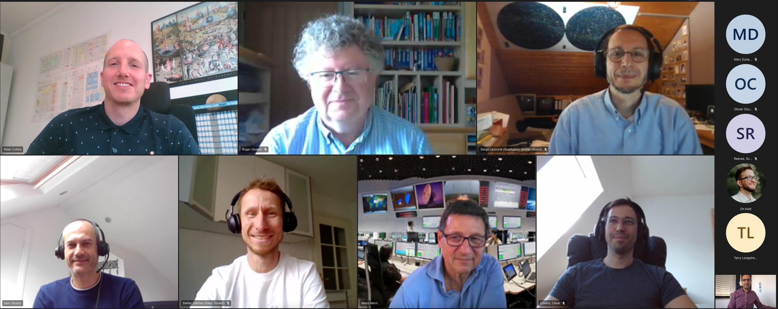
Virtually United at Corona Times ☺

