Slide 1
COM 5 year review
Day 2

Slide 2
Overview
Agree the scope
Define the issues to be addressed
Define the approach
Specify guidelines
Work out the roadmap
Other Considerations

Slide 3
Scope
Primary Focus on Interagency interoperability (per IOAG MOSSG Catalog #3)
Focus on edge-to-edge
Does not preclude intraoperability as long as it does not force architecture/design
Goal is reduction in complexity of service model
Avoid internal system architecture and design
Re-use current service functionality where possible
Must consider:
Ground to Ground
Ground to Space
Space to Space

Slide 4
Proposed Issues
Complexity of COM service model
its more an architecture/implementation
No native support for versioning of service objects
Text identifiers over numeric identifiers on ground
Proposal for making this context specific
Appropriateness of COM Archive service

Slide 5
Approach
Apply the work we have done for 15+ years!
We do not need to change the service concepts
Only how they are presented and to what level
Procedure
List and agree the issues we want to address
Clear and specific issues to be considered
Produce a new roadmap
Include due dates and Agency commitments
Name a technical lead(s)
Working telecons once per month
Can we start any sub-teams now?
What do we do with current books and those in progress?

Slide 6
Guidelines
We should agree to Guidelines for service definitions
For example:
Do not expose internal IDs across external interfaces
Do not store your config info on some one else’s system
Simplify simplify simplify

Slide 7
Other considerations
Backward compatibility
Work towards retaining some level of backwards compatibility
Do not ignore all that some agencies already have invested
Document message formats as well as service specifications
Should work with or without the MAL as a layer
Reinforce that MAL is a set of requirements not an implementation
Consider assumption that XTCE is available
Should do a trade off between available resources and proposed issues

Slide 8
Backups

Slide 9
1a) No native support for versioning
NOTE: This is NOT the COM archive service
Services such as Parameter etc define their service object model to support object versioning
This is when the specification supports the persistence of all changes to objects
Issue:
There is no built-in support for this feature in the COM service model
Each service is required to “build” the feature itself
It makes each service far more complex than expected

Slide 10
2a) Service object identification
Currently each service COM Object “instance” is uniquely identified by:
Its domain (String)
Its Object Type (Long – Composed of 4 numbers)
Its object instance id (Long)
For example, a value update for a parameter holding the temperature of a payload would be:
Domain: int.esa.lpf.platform.temps.obc
Object Type
Area: 4
Service: 2
Type: 3
Instance Id: 746545432

Slide 11
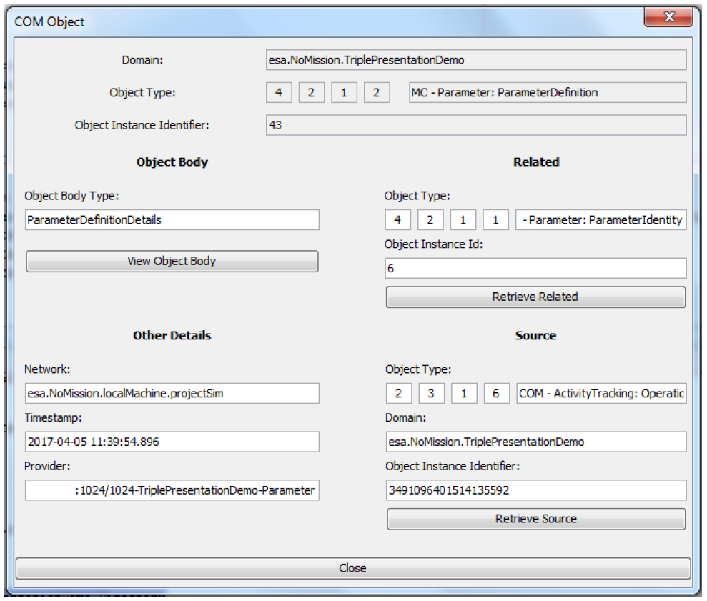
2a) Service object identification - Instance

Slide 12
2a) Service object identification issue
For most ground to ground cases the use of strings is preferable
Onboard and on the space link the use of numbers is very important
At the moment there is a mix of both strings and numbers
The use of numbers for object identifiers means for most ground to ground situations there needs to be a “query” pattern
The assumption is for space/ground interactions this is a fixed scenario
No lookup is expected here

Slide 13
2b) Service model complexity
In part this is caused by issue 1a)
The very prescriptive nature of the COM model forces design/implementation
Whilst it claims to be optional in parts you are still forced to implement much more than expected
COM archive access for example for definition lookups
It should focus on edge to edge interoperability
However, due to the heavyweight model it actually forces its architecture into implementations

Slide 14
2c) Usefulness of COM Archive
The COM archive is used in two ways:
For archiving historic values for later data exploitation
As a version control system for recording changes to definitions
Two opposing views on its usefulness:
One view is the COM Archive is useful
Operationally in use by:
OPS-SAT (on ground and space)
It is currently in use in many prototypes:
In the MPDS Prototype
In METERON
Implemented successfully with EUD4MO
The opposing view is it is a hindrance
For historic values (e.g. parameter values over time):
Archive retrieval usually results in more complex queries than COM can support
A system will always use an actual archive/database
It is the only way to get the performance required
For version control (e.g. parameter definitions):
You should use a proper version control system
COM archive is not that, it is a simple CRUD database
Therefore, use of archive and archiving in general must be implementation specific

