Slide 1

Spring 2023 CCSDS Technical and CESG Meetings

Slide 2
Time (UTC) | Duration | Topic | Presenter
14:00 | 10 minutes | Welcome – NASA Marshall Space Flight Center | Ivica (Vinny) Ristovski Mason Hall
14:10 | 10 minutes | Introduction | Klaus-Juergen Schulz – CESG Chair
14:20 | 10 minutes | Role of the CESG | Peter Shames – SEA Area Director
14:25 | 10 minutes | MOIMS Workplan | Daniel Fischer – MOIMS Area Director
14:30 | 10 minutes | SIS Workplan | Rodney Grubbs – SIS Deputy Area Director
14:35 | 10 minutes | SLS Workplan | Ignacio Aguilar – SLS Area Director
14:40 | 10 minutes | SOIS Workplan | Jonathan Wilmot – SOIS Area Director
14:45 | 10 minutes | CSS Workplan | Holger Dreihahn– CSS Deputy Area Director
14:50 | 10 minutes | SEA Workplan | Peter Shames – SEA Area Director
14:55 |  | Additional Topics
15:00 |  | Adjournment | Klaus-Juergen Schulz – CESG Chair

Slide 3






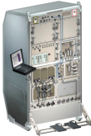
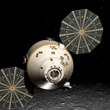
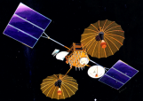



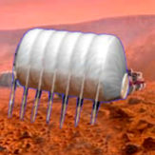

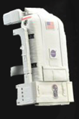






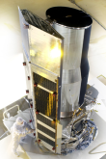
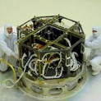



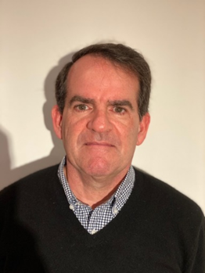






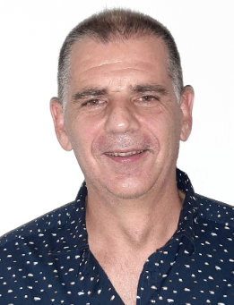
Members of the CESG
CESG Chairs
CESG Chair K.-J. Schulz
Deputy Timothy Pham
SE Area Director Peter Shames
Deputy Hiroshi Takeuchi
MOIMS Area Director Daniel Fisher
Deputy Marc Duhaze
CSS Area Director Erik Barkley
Deputy Holger Dreihahn
SLS Area Director Ignacio Aguilar Sanchez
Deputy Gilles Moury
SIS Area Director Tomaso de Cola
Deputy Rodney Grubbs
SOIS Area Director Jonathan Wilmot
Deputy Xiongwen He
6 Areas
23 WGs
Systems Engineering
Security
Delta-DOR
System Architecture
MISSION CONTROL
CENTER
End Users
Applications/Archives
MISSION CONTROL
CENTER
End Users
Spacecraft Onboard
Interface Services
Space Link
Services
Cross Support
Services
Space Internetworking
Services
Mission Ops &
Info Mgt Services
Onboard Wireless WG
Application Supt Services
Subnetwork Services
RF & Modulation
Coding & Sync.
Multi/Hyper Data Comp.
Space Link Protocols
Space Data Link Security
Optical Communications
CS Service Management
CS Transfer Services
Motion Imagery & Apps
Delay Tolerant Networking
Voice
CFDP Revisions
Data Archive Ingestion
Navigation
Spacecraft Monitor & Control
Telerobotics
Planning & Scheduling
Notes:
Need to update graphic based on new appointments/retirements.

Slide 4
CCSDS Publications since CMC Mtg Fall 2022
Blue Books – Recommended Standards
CCSDS 124.0-B-1, Robust Compression of Fixed-Length Housekeeping Data (Blue Book, Issue 1, February 2023)
CCSDS 922.2-B-2, Cross Support Transfer Service—Tracking Data Service (Blue Book, Issue 2, February 2023)
CCSDS 131.2-B-2, Flexible Advanced Coding and Modulation Scheme for High Rate Telemetry Applications (Blue Book, Issue 2, February 2023)
CCSDS 505.0-B-3, XML Specification for Navigation Data Messages (Blue Book, Issue 3, May 2023)
CCSDS 502.0-B-3, Orbit Data Messages (Blue Book, Issue 3, April 2023)
Magenta Books – Recommended Practices
-
Orange Books
CCSDS 141.10-O-1 Optical High Data Rate (HDR) Communication-1550 NM, June 2022
Green Books – Informational Reports
-CCSDS 920.0-G-1, Cross Support Transfer Service Specification Framework Concept (Green Book, Issue 1, May 2023)
CCSDS 130.0-G-4, Overview of Space Communications Protocols (Green Book, Issue 4, April 2023)
CCSDS 130.3-G-1, Space Packet Protocols (Green Book, Issue 1, April 2023)
CCSDS 500.2-G-3, Navigation Data Messages Overview (Green Book, Issue 3, March 2023)
CCSDS 120.2-G-2, Lossless Multispectral and Hyperspectral Image Compression (Green Book, Issue 2, December 2022)
Yellow Books
-
Notes:
Updated – AM – 5/7/23

Slide 5
CMC Poll Statistics since CMC Mtg Fall 2022
Authorisation to publish
No open polls
Agency Reviews
CCSDS 521.0-P-2.1, Mission Operations Message Abstraction Layer (Pink Book, Issue 2.1, February 2023)
CCSDS 734.2-P-1.1, CCSDS Bundle Protocol Specification (Pink Book, Issue 1.1, April 2023)
CCSDS 350.8-P-2.1, Information Security Glossary of Terms (Pink Sheets, Issue 2.1, February 2023)
CCSDS 131.0-P-4.1, TM Synchronization and Channel Coding (Pink Sheets, Issue 4.1, February 2023)
CCSDS 912.1-P-4.1, Space Link Extension—Forward CLTU Service Specification (Pink Book, Issue 4.1, November 2022)
CCSDS 911.1-P-4.1, Space Link Extension—Return All Frames Service Specification (Pink Book, Issue 4.1, November 2022)
CCSDS 911.2-P-3.1, Space Link Extension—Return Channel Frames Service Specification (Pink Book, Issue 3.1, November 2022)
CCSDS 911.5-P-3.1, Space Link Extension—Return Operational Control Fields Service Specification (Pink Book, Issue 3.1, November 2022)
CCSDS 505.0-P-2.1, XML Specification for Navigation Data Messages (Pink Book, Issue 2.1, November 2022)
CCSDS 876.1-R-3, Spacecraft Onboard Interface Services—Specification for Dictionary of Terms for Electronic Data Sheets (Red Book, Issue 3, December 2022)
Notes:
Updated – AM – 5/7/23

Slide 6
CMC Poll Statistics since CMC Mtg Fall 2022
Approval of new Projects
New Projects of the SLS Area
Optical Communication Working Group Project – Orange Book
New Projects of the MOIMS Area
Data Archive Interoperability Working Group – Blue Book
Data Archive Interoperability Working Group – Green Book
Navigation Working Group – Blue Book
New Projects of the SIS Area
Delay Tolerant Networking Working Group – Orange Book
Motion Imagery and Applications Working Group – Green Book
Motion Imagery and Applications Working Group – Green Book
CFDP Revisions Working Group – Blue Book
CFDP Revisions Working Group – Magenta Book
Notes:
Amber asking Brian

Slide 7
CMC Poll Statistics since CMC Mtg Fall 2022
New Appointments
New MOIMS Area Director: Daniel Fischer
New SIS DTN Working Group Chair: Robert Durst
New SIS CFDP Working Group Chair: Felix Flentge

Slide 8
CESG Topics since Fall 2022
1. IOAG-CCSDS Product Agreement (ICPA)
IOAG Service Catalog #1 and #2 updates proposed, ICPA update pending
2. Lunar Inter-Satellite Network (ISN)
Proposal for potential Magenta Book still under discussion
SOIS Electronic Data Sheets
SOIS Wireless: Tail circuits with WiFi and 3GPP
3. Joint IOAG-CCSDS Security Working Group
Leads: Daniel Fischer, Peter Shames
Under creation, Terms of Reference to be written
4. Space Communications Cross Support – Architecture Requirements Document (SCCS-ARD)
Involvement of SLS, SIS, CSS

Slide 9
CCSDS Resources

Slide 10
Area Directors / Area Directors Overview

Slide 11
WG Chair / Deputy Chair Overview

Slide 12

CCSDS Plenary
Role of the CESG
Peter Shames, SEA AD
NASA, Huntsville, AL, USA
May 2023

Slide 13
Agenda
An intro to CESG and AD guidelines and norms
Extracted from “the Bible”, Organization and Processes for the Consultative Committee for Space Data Systems. Yellow Book. Issue 4, Jan 2016.
  Text in this font, in blue, is quoted from that document
Just what role is the CESG intended to play?
  Explore expectations on CESG, ADs, and their WGs
Current definitions of guidelines, principles, and responsibilities
Consensus Process
Architectural Principles

Slide 14
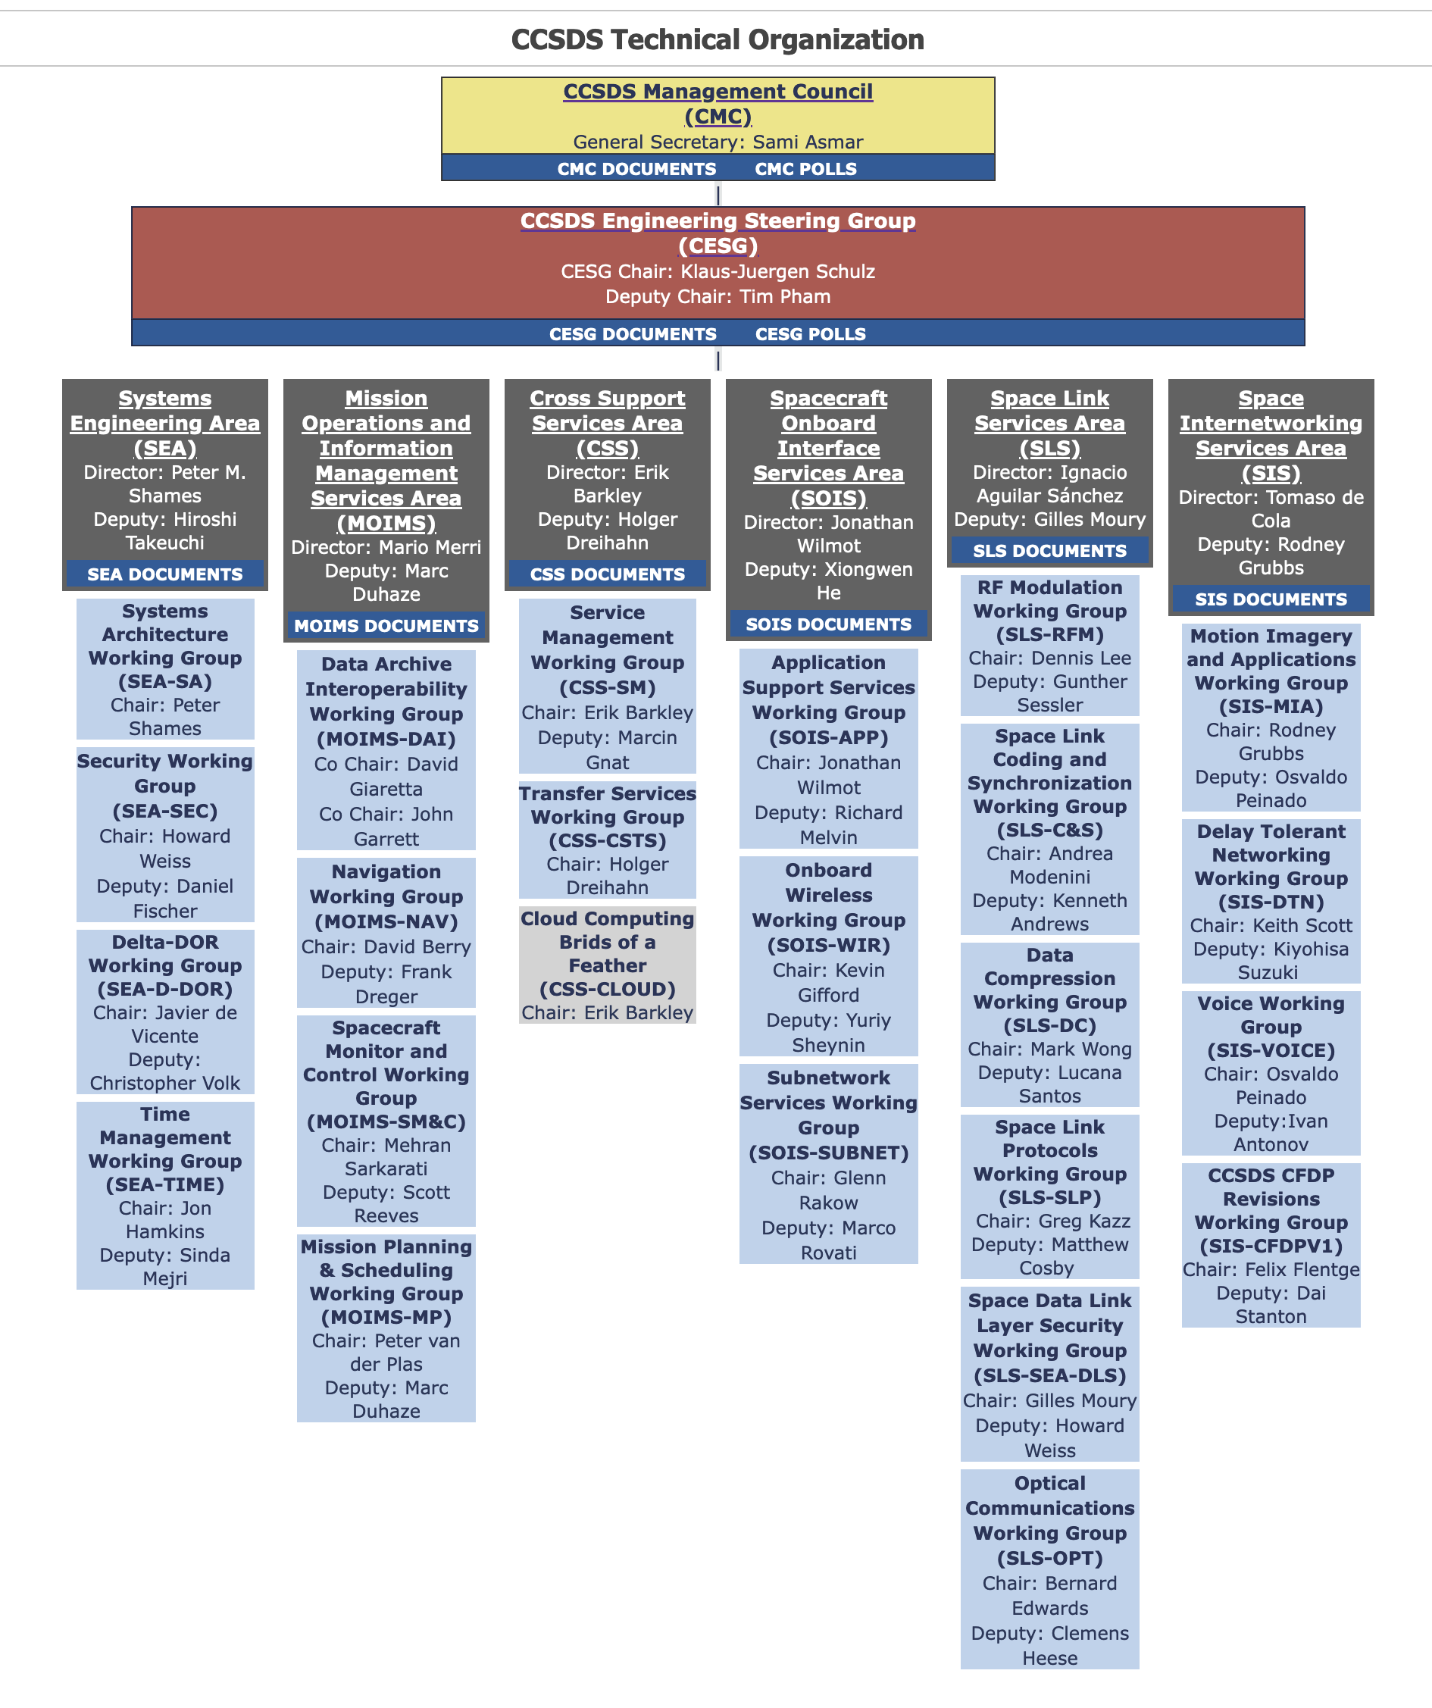
CCSDS Org Chart
(top down view)
CMC / Agency Approvals
CESG Technical Approvals
AD Approvals
Working Groups
Agency “Desirements”

Slide 15
CCSDS Organizational Responsibilities
Top Down
CMC
  Represent Member Agencies, approve observer agencies and associates from their countries
  Provide CCSDS resources
  Final approval to publish for most CCSDS documents
CESG
  Senior technical architecture body across all CCSDS standards
  Ensure consistency, integrity, functionality, and alignment of all CCSDS standards
  Responsible for coordination across all Areas
Area Directors
  Senior technical leader for a related body of work
  Ensure consistency, integrity, functionality and alignment of all standards in their Area
  Responsible for coordination across all WGs in their Area
CMC Agency Approvals
CESG Cross-Area Technical Approvals
Area & WG Approvals

Slide 16
CESG Responsibilities (1 of 2)
The CESG is specifically responsible for the following:
a) maintaining and upholding the overall technical quality and consistency of the evolving set of CCSDS Recommended Standards and Practices;
b) providing the CCSDS-wide forum where the work programs of the Areas may be coordinated and synchronized in the context of an overall architecture for space- mission cross support and the needs of individual customers;
c) reviewing the proposed composition and program of work of all new WGs in each Area to ensure that they are technically consistent, contribute to a cohesive set of CCSDS architectural concepts, properly respect the need for smooth evolution of the large installed base of CCSDS-compatible systems, and are not otherwise disruptive to the needs of customers;
d) making recommendations to the CMC concerning which new WGs should be approved;
e) ensuring that the resource requirements of all WGs are addressed, identified, and approved by the CMC prior to initiating new work;
f) hearing appeals from any BOF whose proposal to form a WG was rejected by an AD;
g) deciding and recommending to the CMC the appropriate “track” assignment for a particular work item, and monitoring the work item’s progression through various stages of maturity;

Slide 17
CESG Responsibilities (2 of 2)
h) reviewing requests from ADs to advance specifications in their Areas along the various document tracks, and making consensus recommendations to the CMC when it feels that documents and related materials are ready for publication as CCSDS products, in their various interim and final stages of maturity;
i) periodically reviewing the technical work of each Area to ensure that it is progressing toward common goals, that the process of consensus is being observed and that the needs of CCSDS stakeholders (2.2) are being satisfied in a timely manner (the ADs shall be responsible for reporting on all work items within their Area);
j) identifying “red flag” items where technical work in a proposed CCSDS document is not of the required quality or nature, where technical work is not progressing satisfactorily, where resources are inadequate, or where significant issues exist, and raising these to the attention of the CMC for corrective action;
k) maintaining records of the status of all CCSDS work items, including completed WG deliverables that have been deployed into operational use;
l) making recommendations to the CMC concerning when to reconvene a WG to refresh a standard that has been finalized and deployed into operational use;
m) making recommendations to the CMC concerning when to retire a standard based on its obsolescence;
n) approving WG Chairs and Deputy Chairs;
NOTE – BOF and SIG chairs are not subject to CESG approval.
o) monitoring the need for and triggering periodic maintenance of published CCSDS documents.

Slide 18
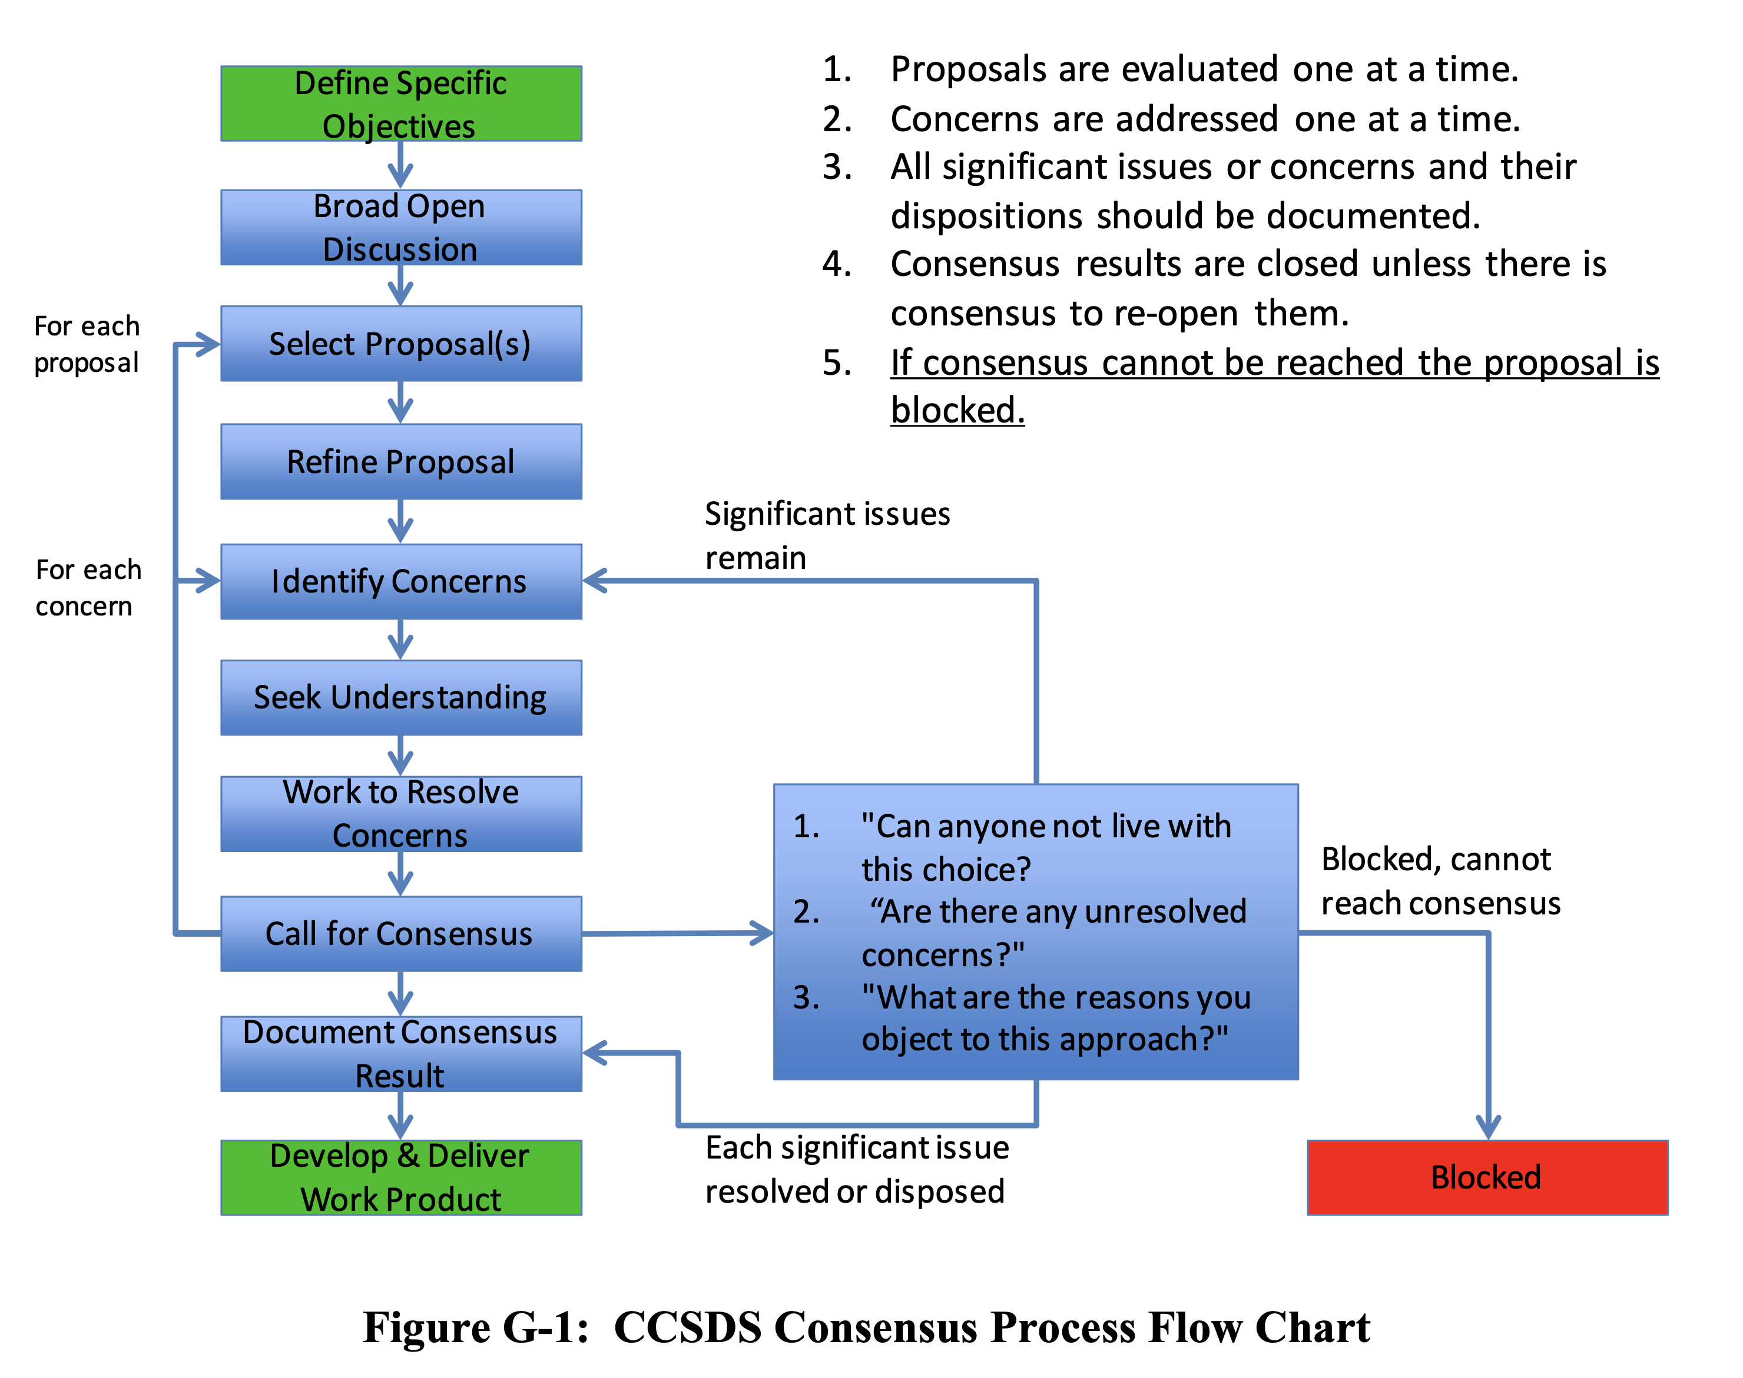
Consensus Process
(Annex G)
The entire CCSDS technical organization is run by a process of consensus, and it is the CESG that decides if the standardization process has come up with a result that reflects a real consensus. Consensus does not necessarily mean that unanimous agreement has been reached, but that the result incorporates the best set of compromises that all parties can agree to. The principle of consensus applies to the decisions made at the CMC, CESG, and WG levels.
Coming to consensus is a matter of understanding, considering, eliminating disagreements, and arriving at the best set of compromises. Consensus is achieved when all significant issues are addressed, but not necessarily accommodated.

Slide 19
Architectural Principles
(Annex A)
CESG Chair Responsibility, Sec 2.3.4.3.2
d) ensuring that all CCSDS work follows the agreed set of architectural principles and is properly synchronized with the smooth evolution of the large installed base of CCSDS-compatible mission support infrastructure;
A2 DEVELOP LEADING STANDARDS
  Statement: Develop Leading Standards to Meet Aggregate Future Multi-Mission Requirements
A3 PROVIDE CROSS SUPPORT
  Statement: Provide Cross Support Capabilities Among Different Organizations
A4 MINIMIZE DISRUPTIONS
  Statement: Minimize Disruptions to Existing Standards and Installed Systems
A5 ADOPT, ADAPT, DEVELOP
  Statement: Adopt, Adapt, Develop (i.e., only develop new standards when necessary)
A6 USE FREELY AVAILABLE TECHNOLOGY
  Statement: Define Standards Using Unpatented or Royalty Free, Internationally Available, Free Technology Independent of Specific Agency or Vendor
A7 ADOPT NATURAL, MODULAR BOUNDARIES
  Statement: Define Interfaces at Natural Boundaries, Adopt Modularity and Loose Coupling, Reduce Integration Complexity
A8 INTEROPERABILITY IS ESSENTIAL
  Statement: Interoperability is Essential and Must Be Demonstrated, Use Testing for Early Standards Validation and Defect Elimination
A9 SEEK SCALABILITY AND EXTENSIBILITY
  Statement: Seek Scalability and Extensibility Across Different Deployments (single mission / interdependent missions, near Earth / in Situ, Deep Space, low cost / flagship, robotic / manned)
A10 STRIVE FOR SIMPLICITY AND CLARITY
  Statement: Strive for Simplicity and Clarity in Design and Documentation
A11 USE COMMON VOCABULARY AND DEFINITIONS
  Statement: Develop and Utilize Common Vocabulary and Data Definitions

Slide 20
References
Organization and Processes for the Consultative Committee for Space Data Systems. CCSDS A02.1-Y-4, Yellow Book. Issue 4, Corrigendum 2. Jan 2016.
CCSDS Publications Manual. CCSDS A20.0-Y-4, Yellow Book. Issue 4, Corrigendum 1. Feb 2015.
CCSDS Implementation Conformance Statements, CCSDS A20.1-Y-1, Yellow Book, Issue 1, April 2014.
Space Assigned Numbers Authority (SANA)—Role, Responsibilities, Policies, and Procedures, CCSDS 313.0-Y-3, Issue 3, Oct 2020.
CCSDS Registry Management Policy, CCSDS 313.1-Y-2, Issue 2, Oct 2020.
Procedures for SANA Registry Specification, CCSDS 313.2-Y-2, Issue 2, Oct 2020.

Slide 21
Mission Operations and Information Management Services Area (MOIMS)
CCSDS Plenary
Daniel Fischer (ESA), Marc Duhaze (CNES)
8 May 2023

Slide 22
CCSDS/MOIMS Document Status (Nov22-Apr23)-1
Data Archive Interoperability WG (DAI)
  MB: 650.0 Open Archival Information System (OAIS): 5y revision Completed AR. CCSDS/ISO issue resolved
  MB: 652.0 Audit and Certification of Trustworthy Digital Repositories: 5y revision Completed AR. CCSDS/ISO issue resolved
  MB: 653.0 Information Preparation to Enable Long Term Use (IPELTU) Completed AR. CCSDS/ISO issue resolved
  MB: 652.1 Requirements for Bodies Providing Audit and Certification of
  Trustworthy Digital Repository: 5y revision disposing CCSDS RIDs
  MB: 671.0 Open Archive Information Systems Interoperability
  Framework (OAIS-IF) Architecture Description On-going
Navigation WG (NAV)
  GB: 500.2 Navigation Data Messages Overview: 5y revision (v3) Publication complete
  BB: 502.0 Orbit Data Message (ODM - NASA, ESA): 5y revision Prototyping complete, Approval to publish
  BB: 503.0 Tracking Data Message (TDM - NASA, ESA): 5y revision Continued discussion of Pink Book draft
  BB: 504.0 Attitude Data Message (ADM - CNES, ESA): 5y revision Review testing status, prepare for publication
  BB: 505.0 Navigation Data Message XML Specs (NDM - no prototype): 5y revision Approval to publish (v4)
  BB: 507.0 Navigation Events Message (NEM – CNES, ESA) Preparation for testing
  BB: 508.0 Conjunction Data Message (CDM): 5y revision internal review, preparation of testing and AR
  BB: 509.0 Pointing Request Message (PRM) New corrigendum in work
  Meeting with SANA team to discuss current developments and upcoming registry changes

Slide 23
CCSDS/MOIMS Document Status (Nov22-Apr23)-2
Spacecraft Monitor & Control WG (SM&C)
  BB: 521.0 Mission Operations - Message Abstraction Layer (MAL) (ESA, CNES) Agency review ongoing
  GB: 520.0 MO Services Concept (ESA): 5y revision On hold waiting for MAL
  MB: 520.1 Mission Operations Reference Model (DLR): 5y revision On hold waiting for MAL
  BB: 522.2 Mission Product Data Distribution Services (ESA, CNES) On hold waiting for MAL
  BB: 522.x File Management Services (ESA, ?) On hold waiting for MAL
Mission Planning & Scheduling WG (MP&S)
  BB: 529.1 Mission Planning and Scheduling (ESA, DLR) Draft ready for AR, prototyping ongoing

Slide 24
SIS Area Spring 2023 Status + Meeting Objectives (1/2)
Voice WG
  Dormant, not meeting
CFDP Revision WG
  CFDP 727.0-B-5 Pink Sheets Minor updates and clarification based on mission feedback; making more features optional for easy implementation („Basic CFDP“)
  CFDP Green Books (TBC) Review and extension on the basis of the collected experience in missions implementations
  CCSDS 722.1-M-1 (CFDP over Encap) Extension to include CFDP over BP, LTP,
  UDP, and TCP
MIA WG
  766.3-B-1 (RTP over DTN) Finalisation of the book to address CESG review comments and revise yellow book accordingly
  706.1-G-2 (Motion Imagery and Applications) 5-Years Review
  Video Quality Assessment for Space Applications
  (new Green Book) Definition of ToC, content, and chapter responsible
Notes:
24

Slide 25
SIS Area Spring 2023 Status + Meeting Objectives (2/2)
DTN WG
  LTPv2 (Blue Book) Discuss and review current proposal
  BPsec (Blue Book) Joint SEA/SEC-SIS/DTN meeting towards new agency review
  BPsec (Green Book) Update on the basis of the spec evolution
  DTN Network Management (Blue and Green Books) Discussion and consolidation of the content
  Compressed Bundle Status Reporting (Orange book) Definition of ToC and overall content
  SSI-DTN Joint SIS-DTN/SEA-SA meeting
  Additional items for discussion towards new DTN extensions:
  Upcoming Agency DTN Missions: Overview, Rqts, Key Dates
  Multi-Destination DTN Support
Notes:
25

Slide 26

SLS Meeting Objectives: 1/2
RF & Modulation WG (D. Lee & G. Sessler)
  415.0-B 2 GHz CDMA Links for Data Relay Satellites
    Non-regenerative PN ranging and Lunar Relay with CDMA Achieve consensus on updates
    401.1-B RF & Modulation:
  Filtering for SP-L/PM Achieve consensus on updates
  MFSK for Low-Rate Communications Discussion, achieve consensus for new project
  413.1-G Simultaneous GMSK and PN Ranging
  GMSK Carrier Tracking with High Doppler Updates Achieve consensus on updates
  211.1-B Proximity-1 Physical Layer:
  Physical Layer Updates for Lunar S-band Proximity-1 Discussion (Joint RFM/SLP/C&S Meeting)
Space Link Code/Sync WG (A. Modenini & K. Andrews)
  Slicing
  New Blue Book on slicing Introduction
  131.0-B update Introduction
  131.0-P-4.1
  PN 17 Randomizer Agency Review – RID disposition
  Joint topics
  VCM analysis (C&S, RFM) Discussion
  Proximity-1 (SLP, C&S, RFM) Discussion
Space Link Protocols WG (G. Kazz & M. Cosby)
  211.0-B Proximity-1 SDLP
    Directive set for Lunar operations and beyond
    Directive set change Discussion, achieve consensus on updates
  Proposed Orange Book
    Proximity Link Default Session Access Control Parameters for the Mars and Lunar Enterprises Introduction of a proposed new project
  732.1-B
    VCP and VCA services, with more than 1 USLP frame per CLTU and other updates Achieve consensus on updates
  5-year Due Diligence
    Agency Review on SLP WG docs Status check
  Joint topics
    Proximity-1 (SLP, C&S, RFM) Discussion

Slide 27
SLS Meeting Objectives: 2/2
Space Data Link Security (SDLS) WG (G. Moury & H. Weiss)
  350.5-G-2 SDLS Core Protocol
    SEA AD comments Finalization of the document
  PQC Asymmetric Key Exchange and Authentication Protocol Presentation
  Revised text for SDLS-COP-1 ordering in TC and USLP pink sheets Review
  350.11-G SDLS Extended Procedures
    Contributions + AI SDLS 1022/05 Review
Data Compression (DC) WG (M. Wong & L. Santos)
  124.0-G Robust Compression of Fixed-length Housekeeping Data Review
  123.0-B2 Low-Complexity Lossless and Near-Lossless Multispectral and
  Hyperspectral Image Compression Review
  125.0- B Raw SAR Compression Review
Optical Communications WG (B. Edwards & C. Heese)
  O3K Prototypes and Yellow Books
    Physical Layer Discussion
    Coding and Sync Layer Discussion
  O3K/HPE
    Uplink data rate for ranging Discussion
  HPE Draft Green Book Review, achieve consensus on updates
  Joint topic (OPT, SLP, C&S)
    VLF/GFP/Slicing Discussion
  Agency Presentations on Topics of Interest
    DLR IKN (3 topics) and NICT (1 topic) Discussion
  Coherent Blue Book
    White Paper Review
    Proposals from ESA, CNES and JAXA Review

Slide 28
SOIS Area Spring 2023 Status + Meeting Objectives (1/2)
Application Support WG
  Disposition of open items on Git repository https://github.com/rkrosley/ccsds.sois/issues?q=is%3Aopen+is%3Aissue
    Discuss feedback from Artemis systems engineering
  Update and finalize SEDS test plan (Funding from ESA released for interoperability tests)
  Discussion of SEDS container magenta book
    Create book outline and with key section details
  Discuss Mission use cases and tooling for SEDS and container definitions
  Document FRM/SOIS relationship on definition of functional interfaces
  Support meetings with SEA, DTN, and present DTN use case at High Performance Spaceflight Computing (HPSC) workshop (virtual JSC)
  Update SOIS project schedules in CWE based on resource availability
    Work with Secretariat to resolve editor document queue issues
    Create project for SEDS container magenta book (funding already in place with mission projects support)
  Joint meeting with Subnet WG
Subnet WG
  Discussion of Subnet 5-year review updates
  SOIS Sub-network Synchronization Service 5 Year Book Review
    Discussion on integration of other standards (like Precision Time Protocol (PTP))
  SOIS Sub-network Device Discovery Service 5 Year Book Review
    Updates to SOIS device discovery/enumeration with focus on use cases for crewed systems (in orbit and surface)
  Achieve WG consensus on updates
Notes:
28

Slide 29
SOIS Area Fall 2023 Status + Meeting Objectives (2/2)
Wireless WG
  Meeting Virtually
  Scope updates for version 4 of the Wireless Network Communications Overview for Space Mission Operations Green Book
  Discuss potential updates related to 3GPP 5G for the Spacecraft Onboard Interface Services-High Data Rate Wireless Proximity Network Communications Blue Book
  Discuss testbed buildout strategies for the NASA 3GPP Testbed at JSC
Notes:
29

Slide 30
CSS Area Spring 2023 Status + Meeting Objectives (1/2)
Cross Support Transfer Services WG
  Monitored Data Service (B-2) B-2 published
  Tracking Data Service (B-2) B-2 published
  All SLE Books Agency Review completed, AD review initiated
  Functional Resource Model (MB) Agency Review completed, poll requested
  Functional Resource Model (SANA+) Review Tier 2 resource definitions
  Service Control – SC-CSTS Second White Book under WG review
  CSTS Concept Book CMC polling to authorize publication
  Cross Support Reference Model Re-submitted to AD review prior to going out for polling for agency review
Cross Support Service Management WG
  Service Management Concept (GB) Survey for refresh
  Common Data Entities (MB-2) Updated from agency reviews; ready for publication
  Service Management Utilization Request
  Format (BB) Updated from agency reviews; ready for publication
  Service Package Data Format (BB) Updated from agency reviews; ready for publication
  SMURF/SPDF Prototype Review prototype progress, discuss
  Configuration Profile, Service Agreement (BB) Review draft material developed and
  auto schema (from FRM) generation progress;
  discuss service agreement content; project initiation discussion
  Event Sequence (BB) Review draft material developed
  Management Service Review draft book outline; discuss, develop
Notes:
30

Slide 31
CSS Area Fall 2022 Status + Meeting Objectives (2/2)
Cross Computing BOF
  Encoding approach Verify
  Local agency approaches re cloud computing Review, discuss
  WG composition, books to produce Discuss, confirm
  Concept paper Review, finalize
  Announcement of Opportunity Review, finalize
CSS (Area Level)
  CSTS & CSSM Discuss, coordinate: re
  FRM classification metadata
  Use of GitHub
  Developer’s forum discussion
Notes:
31

Slide 32
Systems Engineering Area (SEA)
Area Report to Plenary
Spring 2023 Meetings
Peter Shames (Area Director)
Hiroshi Takeuchi (Deputy Area Director)
May 2023 – CCSDS Opening Plenary
Notes:
32
32
32

Slide 33
  Systems Engineering Area Executive Summary
Security Working Group:
  Planned work:
    Symmetric Key Management MB ready for Secretariat. On-going work on Key Management GB, DTN/BPSec, and Intergov Cloud Certificate Authority (IGCA). Recent work items for Secure SW Engineering and new Space ATT&CK framework.
  Problems / Issues: Design of security and management architecture for DTN multi-mission space deployments needs attention for SSI Stage 2.
Systems Architecture Working Group:
  Planned work:
    RASDS++ with integrated TC20/SC14 revisions making very good progress, all concepts clarified and ontology views for each viewpoint are included. An MBSE/SysML Annex is planned.
    SCCS-ARD revisions moving very well, both ABA and SSI now quite complete. Revised flow from service to protocol viewpoint, including optical comm, USLP, SM, and many other new & revised documents.
  Problems / Issues: We have a coherent group but very limited resources. NASA is the only agency supporting this CCSDS-wide Architecture work.
Delta-DOR Working Group:
  Planned work:
    Making very good progress on document revisions, MB on Architecture, BB update, Operations MB update. New PN DOR tones agreed with RFM WG, JPL prototype presented at Fall 2022, ESA prototype to be presented Spring 2023. Planning for new Quasar flux database and same beam interferometry.
  Problems / Issues: Small, but effective, working group with all three agencies participating in this meeting.
Notes:
JAXA is interested, resources being identified. Possible issues getting resources allocated / schedule.

Slide 34
  Systems Engineering Area Executive Summary
Time Management WG:
  Planned work:
    Working group has been making good progress, with active participation from five agencies. Green Book draft is complete and undergoing final review by WG members. Plan formulated for a single new Time Management Blue Book.
  Problems / Issues
    The LunaNet and other IOAG network requirements are way ahead of this work, it may not be ready in time to be effective.
SANA and SANA Steering Group (SSG):
  Planned work:
    BETA website incorporating ISO TC20/SC14 terms is prototyped, needs SC14 review and updates. New process improvements increase ease of adaptation. Many other improvements have been made.
  Problems / Issues
    Agency Head’s of Delegation must assign an Agency Representative (AR) to update their data in the “Enterprise” registries. Service Site and Aperture (SS&A) registry access supports updates to apertures by ARs.
Notes:
JAXA is interested, resources being identified. Possible issues getting resources allocated / schedule.

Slide 35

CCSDS 2023 Fall Meeting
The Fall 2023 meeting will be hosted by the European Space Agency in The Hague, Netherlands.
  Technical Meetings will occur 06-10 November 2023
  CESG will occur 13-14 November 2023
  CMC meetings will occur 15-16 2023
Venue for the meeting is Marriott The Hague hotel, the same location as the Fall 2017 meetings:
  https://www.thehaguemarriott.nl/
  A special room rate is available to CCSDS attendees Please be aware that a different cancellation policy applies for the reduced rate (cancellation has to be made 1 week in advance).

