Slide 1
CCSDS 502.0-B-2 (ISO 26900: Orbit Data Messages
Dan Oltrogge
17 Oct 2022

Slide 2
CCSDS Orbit Data Message
Current (published) version is from 2011.
The NAV WG has completed development of CCSDS 502.0-B-2 draft revision
Completed agency review ~March 2022
Very few comments received during agency review; these have been dispositioned
Now are in testing phase for message

Slide 3
ISO 26900 Status
ISO 26900 is a “co-published” standard developed within CCSDS Navigation WG
ODM draft shared with SC14 during last five years for their awareness and comment.
The process, from the SC14 Secretariat:
CCSDS Secretariat asked for permission to share near-final version with SC14 to begin its review at DIS.
ISO/CS will require formal DIS circulation so all SC14 experts can review the draft.
In terms of publishing at the same time, it has rarely happened even between CCSDS and SC13 because of the different processes. The best-case scenario is that the ISO version was published 2-3 months behind the CCSDS version. I don’t believe there is an SC13 version of ISO 26900 (at least none when it was originally published in 2012) so the only versions are the CCSDS Blue Book (502.0-B-2) and the ISO version processed in SC14 instead of SC13.
Procedurally, CCSDS (Yellow Book A02.1-Y-4) only turns over the official file to ISO when it is published in CCSDS. Ideally, any CCSDS document that goes to ISO processing (whether in SC13 or SC14) at the DIS stage should be received by ISO after the CCSDS agency review(s) and is ready to be voted on for approval for publication (it is now considered to be a mature draft). This is to allow the least amount of time between the CCSDS and ISO publication.

Slide 4
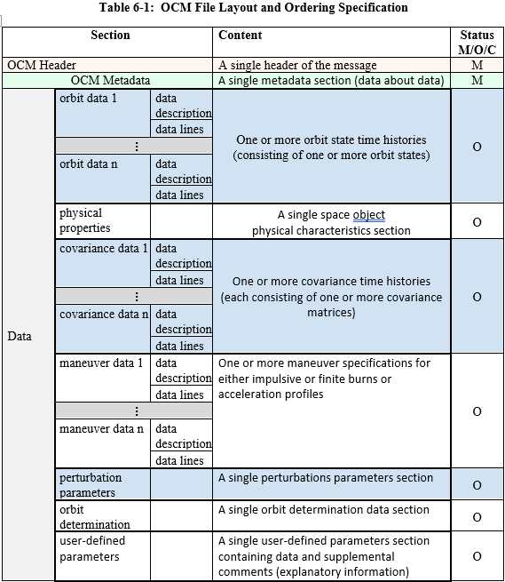
Structure of Orbit Comprehensive Message

Slide 5
Elements of OCM Test Plan
Intro
Test description
Expected results
Findings
Variant of Test Case #1
For this test, NASA/GSFC will send an OPM to NASA/JPL. In general this must be a syntactically valid OPM. The only special requirement on this OPM is that it contain some number of User Defined Parameters. NOTE: In general the use of User Defined Parameters must be agreed in advance between the exchange partners because they may require custom programming.
Expected Results
It is anticipated that the consumer’s prototype will not crash when encountering the User Defined Parameters. For this test, that is all that is necessary, given that in general User Defined Parameters must be agreed in advance by exchange partners and may require special programming. Assuming that these criteria are met, the test will be considered successful. In the event of discrepancies, troubleshooting will be conducted by the participants in the test.

Slide 6
Proposed test plan elements
Propose 10 tests (x 2 = 20, for KVN and XML), as follows:
① Rudimentary test, Orbit Data (only)
② Physical characteristics (only)
③ Covariance (only)
④ Maneuvers (only)
⑤ Perturbations (only)
⑥ Orbit determination (only)
⑦ User Parameters (only)
⑧ Full message, ALL elements
⑨ Orbit/Covar/DV ingest, SANA registry
⑩ Maneuver/deployment scenario
Legend:
BLUE: Round-trip consistency test
GREEN: SANA normative content incorporation, astrodynamics processing
Physical Characteristics
Orbit Determination
User Param
COMSPOC
Orbit Data
Covariance
Maneuvers
Perturbations
①⑧⑨⑩ ②⑧⑩ ③⑧⑨⑩ ④⑧⑨⑩ ⑤⑧⑨⑩ ⑥⑧ ⑦⑧
Physical Characteristics
Orbit Determination
User Param
Orbit Data
Covariance
Maneuvers
Perturbations
OREKIT
①⑧⑨⑩ ②⑧⑩ ③⑧⑨⑩ ④⑧⑨⑩ ⑤⑧⑨⑩ ⑥⑧ ⑦⑧

Slide 7
All ten test cases now run in COMSPOC prototype OCM tool

Slide 8
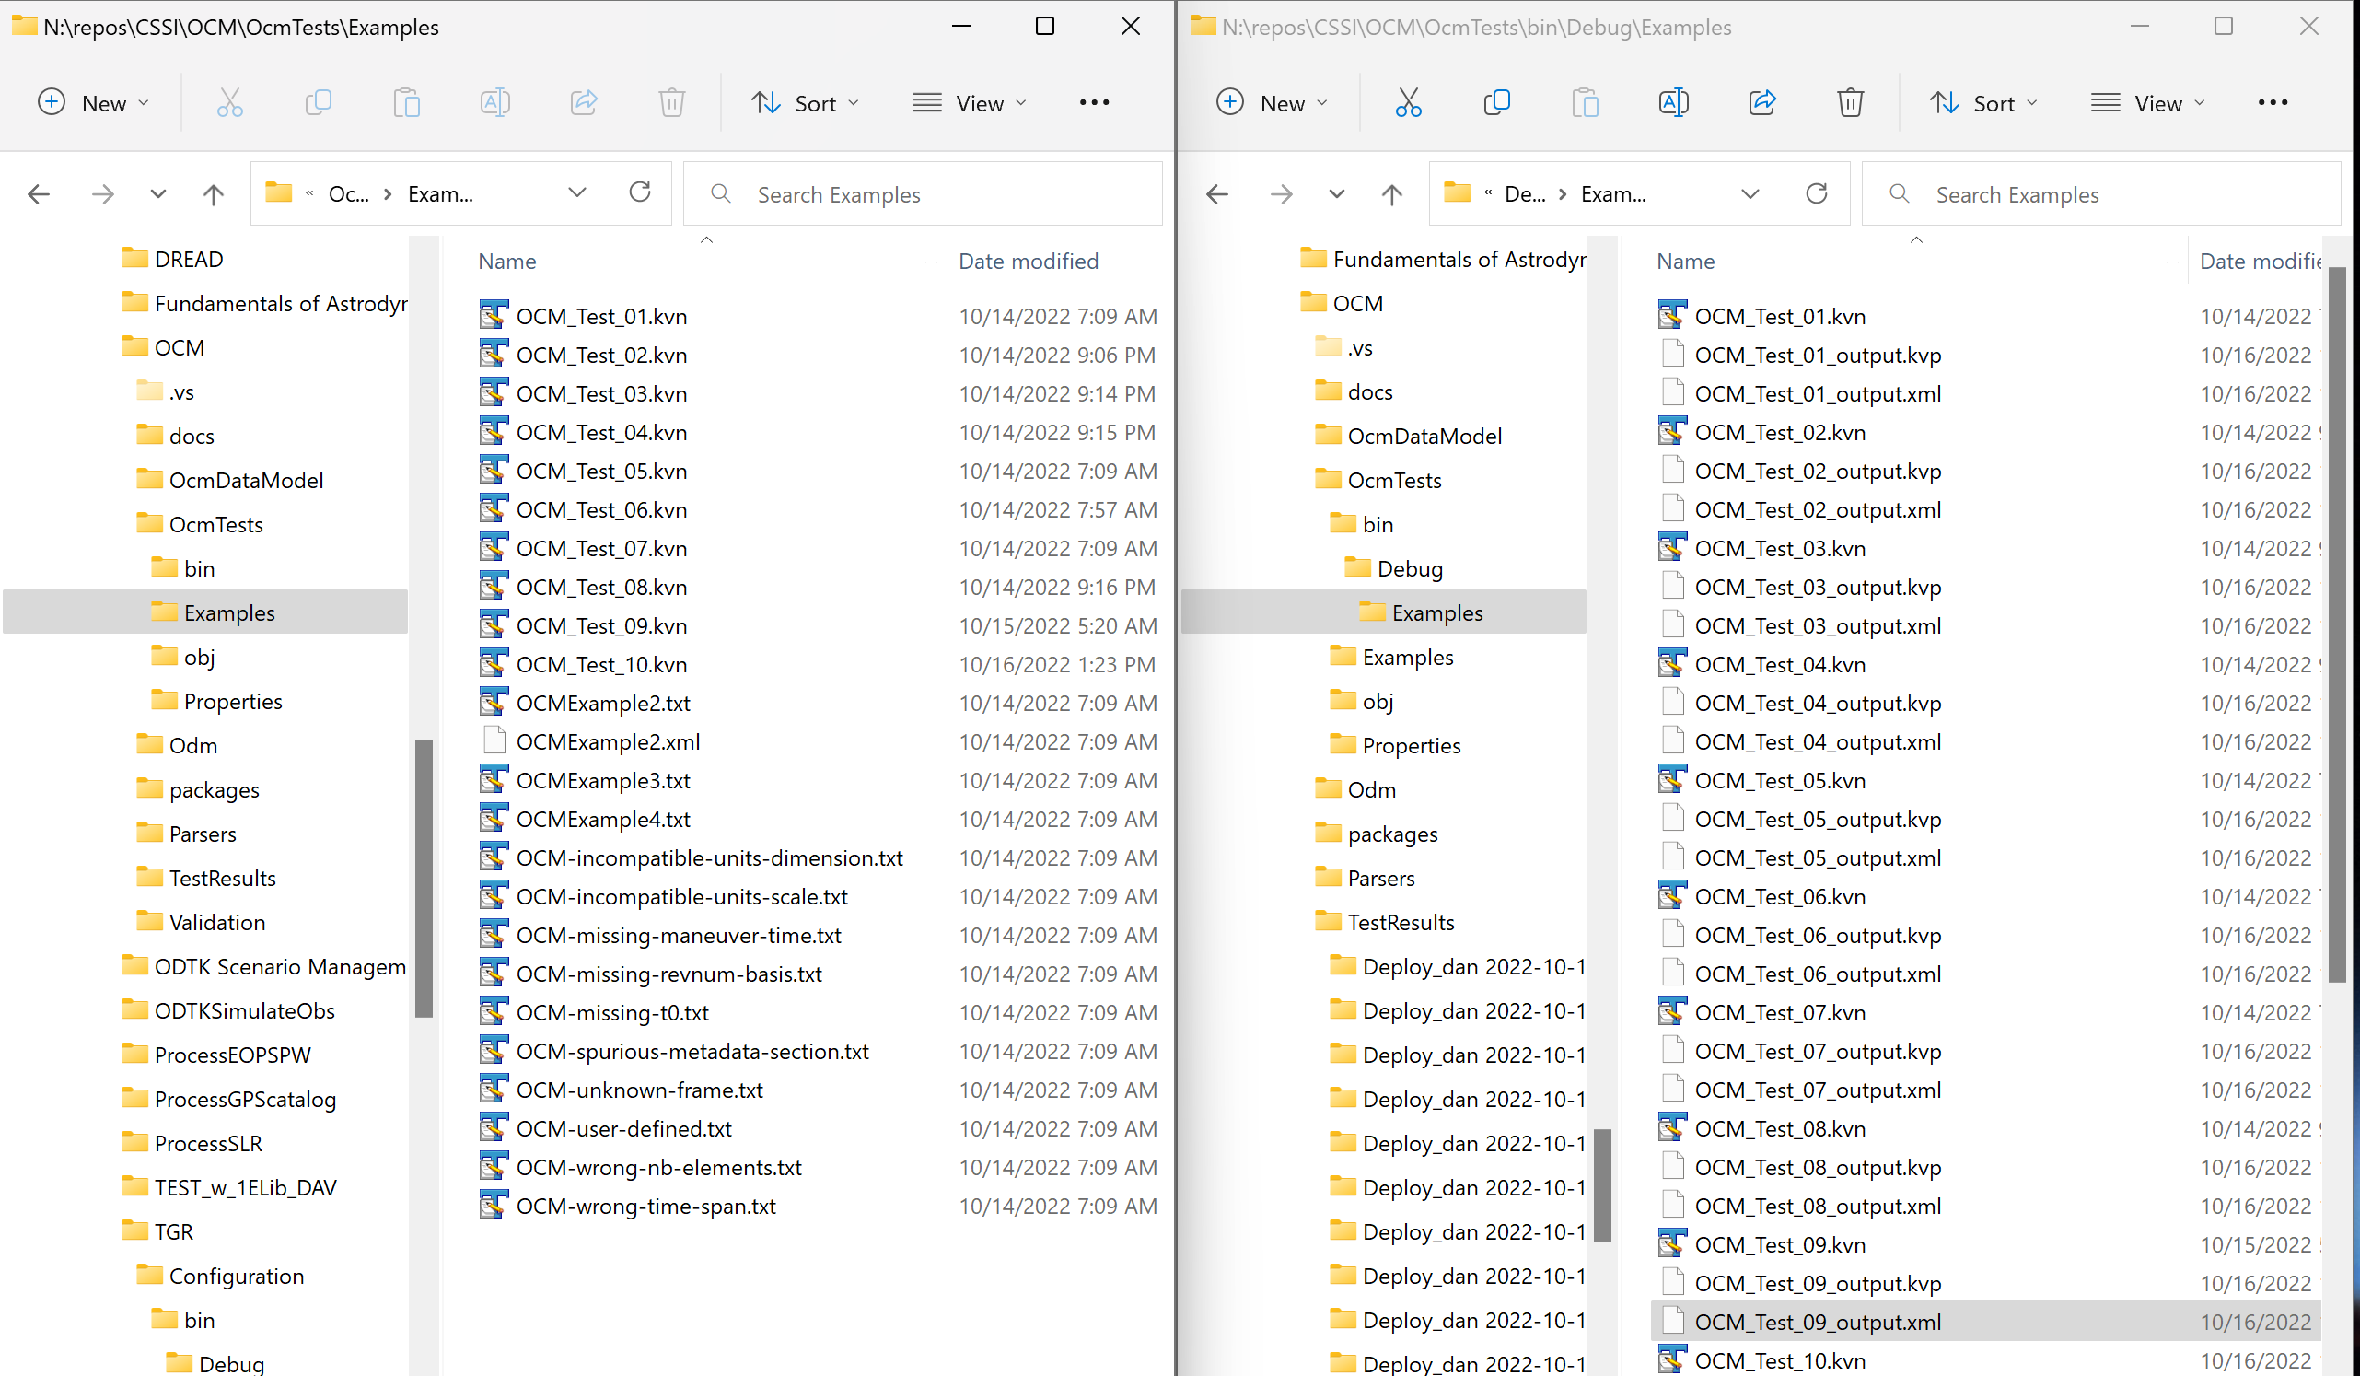
COMSPOC unit tests make round trip…
Ingest KVN, output both XML and KVN

Slide 9
COMSPOC string-based prototype now complete

Slide 10
Keywords with default values

