Slide 1

Spring 2021 Virtual CCSDS Technical and CESG Meetings

Slide 2
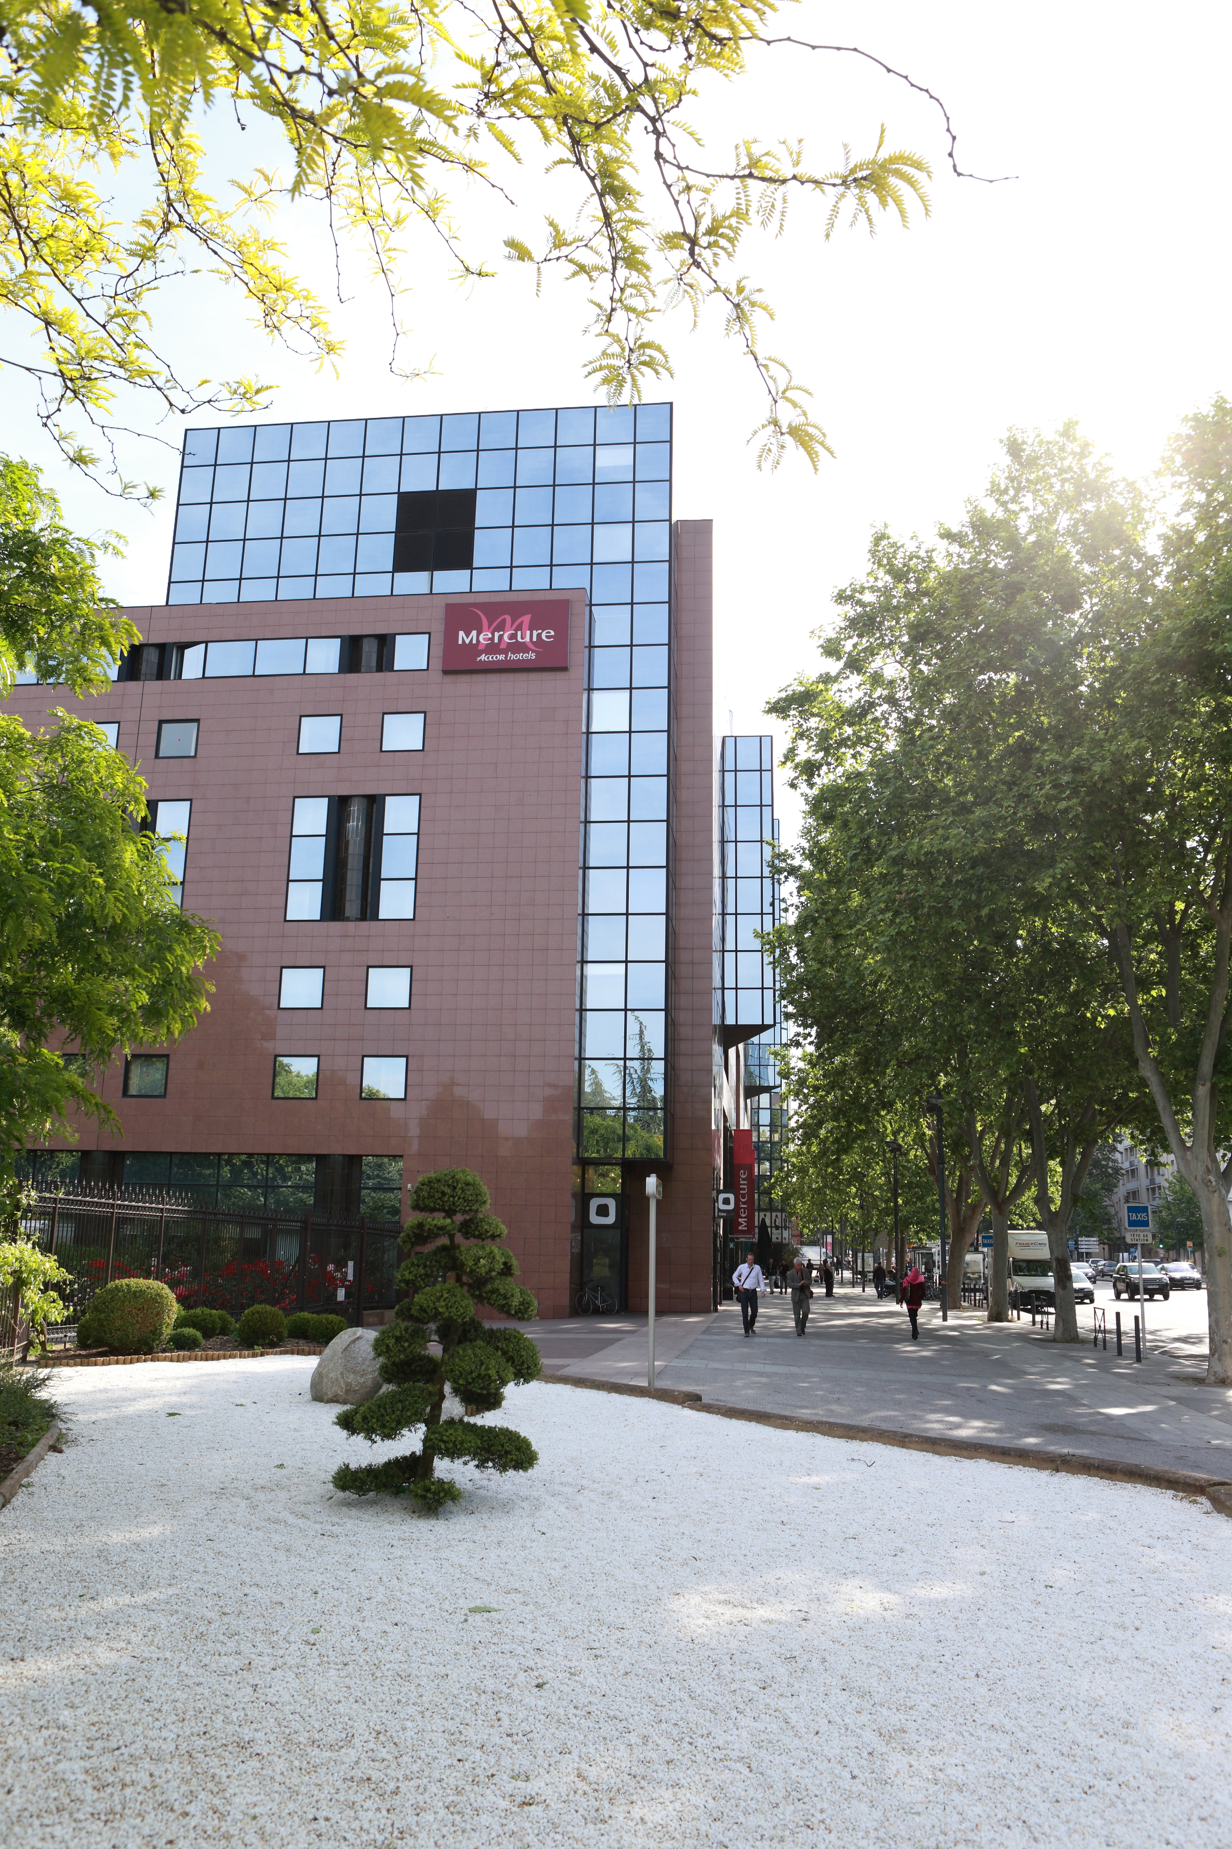
Upcoming Meetings – Fall 2021
Toulouse, France
Hosted by CNES at the
Mercure Hotel
  (with additional meeting rooms at the nearby Novotel)
CCSDS Technical Meetings: 18 to 22 October 2021
CESG: 25 October 2021
CESG+CMC and CMC/ISO meetings: 26 to 28 October 2021
Registration will be required on the CCSDS web site. Participant badges will be available on site.
WiFi is available in the hotel including meeting rooms.
Coffee Breaks will be served in several areas between meeting rooms.
Lunches will be served at the Mercure hotel: free of charge for registered participants with coupons distributed on registration day.
Cocktail Receptions will be offered by CNES during both weeks: free of charge for registered participants with coupons distributed on registration day.

Slide 3
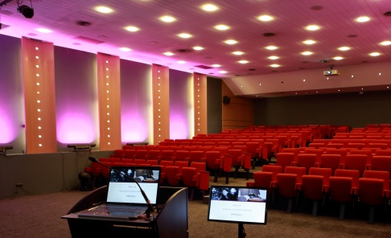
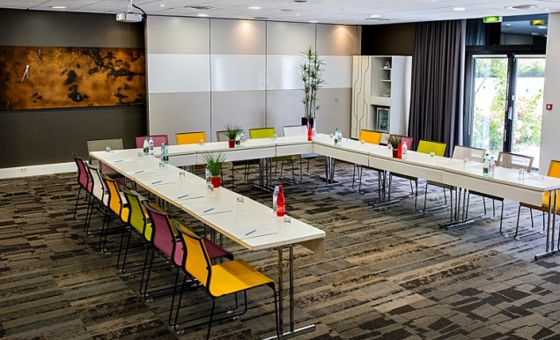

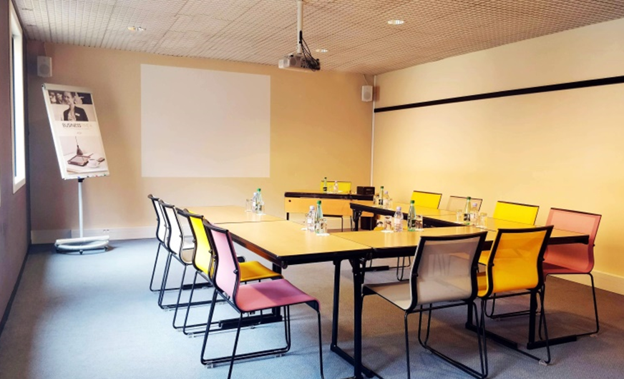
Upcoming Meetings – Fall 2021

Slide 4
Upcoming Meetings – Fall 2021
Hôtel Mercure Toulouse Centre Compans
4 Stars Hôtel - 8 Espl. Compans Caffarelli, 31000 Toulouse
Novotel Toulouse Centre Compans Caffarelli
4 Stars Hôtel - 5 place Alfonse Jourdain, 31000 Toulouse
Room rates (2020):
Week days 110 € including breakfast
Friday ~ Sunday 90 € including breakfast
Public parking 13 € / day.

Slide 5
Future Meetings
Date | WG/CMC | Host | Location | Date | Comments
Fall 2021 | WG/CESG | CNES | Toulouse, France | 18-25 October 2021
 | CMC/SC13 | CNES | Toulouse, France | 26-28 October 2021
Spring 2022 | WG/CESG | NASA | Huntsville, Alabama, USA | 9-26 May 2022
 | CMC/SC13 | JAXA | Tokyo, Japan | TBD Date
Fall 2022 | WG/CESG | ESA | TBD, hosted by ESTEC | TBD Date
 | CMC/SC13 | ESA | TBD | TBD Date
Spring 2023 | WG/CESG | NASA | USA | TBD Date
 | CMC/SC13 | INPE | Sao Jose dos Campos, Brazil | TBD Date
Fall 2023 | WG/CESG | UKSA | USA | TBD Date
 | CMC/SC13 | UKSA | TBD | TBD Date
Spring 2024 | WG/CESG | NASA | TBD | TBD Date
 | CMC/SC13 | ROSCOSMOS | TBD | TBD Date
Fall 2024 | WG/CESG | ESA | TBD | TBD Date
 | CMC/SC13 | ESA | TBD | TBD Date
5-Day
5-Day

Slide 6
CCSDS Overview
Active Publications
Currently Active
Publications: 176
Normative (Blue & Magenta): 113
Informative (Green): 63
Downloadable for free from www.ccsds.org
All major pubs since 1982: ~392
(Some were historical mission needs
or superseded technologies)

Slide 7





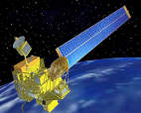
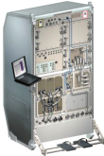
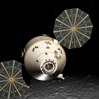
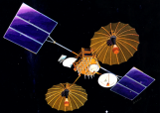



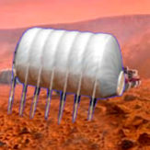

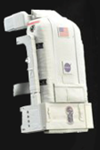






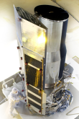
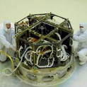












Members of the CESG
CESG Chairs
CESG Chair K.-J. Schulz
Deputy Wallace Tai / Nom.
SE Area Director Peter Shames
Deputy Hiroshi Takeuchi
MOIMS Area Director Mario Merri
Deputy Marc Duhaze
CSS Area Director Erik Barkley
Deputy Colin Haddow
SLS Area Director G-P Calzolari / Nom.
Deputy Gilles Moury
SIS Area Director Scott Burleigh / Nom.
Deputy Tomaso de Cola
SOIS Area Director J. Wilmot
Deputy X. He
6 Areas
23 WGs
Systems Engineering
Security
Delta-DOR
System Architecture
MISSION CONTROL
CENTER
End Users
Applications/Archives
MISSION CONTROL
CENTER
End Users
Spacecraft Onboard
Interface Services
Space Link
Services
Cross Support
Services
Space Internetworking
Services
Mission Ops &
Info Mgt Services
Onboard Wireless WG
Application Supt Services
Subnetwork Services
RF & Modulation
Coding & Sync.
Multi/Hyper Data Comp.
Space Link Protocols
Space Data Link Security
Optical Communications
CS Service Management
CS Transfer Services
Motion Imagery & Apps
Delay Tolerant Networking
Voice
CFDP Revisions
Data Archive Ingestion
Navigation
Spacecraft Monitor & Control
Telerobotics
Planning & Scheduling

Slide 8
CCSDS Publications since CMC Mtg Fall 2020
Blue Books – Recommended Standards
CCSDS 766.1-B-3, Digital Motion Imagery (Blue Book, Issue 3)
CCSDS 922.3-B-1, Cross Support Transfer Service—Forward Frame Service (Blue Book, Issue 1)
CCSDS 123.0-B-2 Cor. 3, Technical Corrigendum 3 to CCSDS 123.0-B-2, Issued February 2019
CCSDS 401.0-B-31, Radio Frequency and Modulation Systems—Part 1: Earth Stations and Spacecraft (Blue Book, Issue 31)
CCSDS 431.1-B-1, Variable Coded Modulation Protocol (Blue Book, Issue 1)
CCSDS 921.1-B-2, Cross Support Transfer Service—Specification Framework (Blue Book, Issue 2)
Magenta Books – Recommended Practices
CCSDS 902.12-M-1, Cross Support Service Management—Common Data Entities (Magenta Book, Issue 1)
CCSDS 902.13-M-1, Abstract Event Definition (Magenta Book, Issue 1)
Orange Books
None
Green Books – Informational Reports
CCSDS 660.0-G-2, XML Telemetric and Command Exchange (XTCE) (Green Book, Issue 2)

Slide 9
CMC Poll Statistics since CMC Mtg Fall 2020
Agency Review (split by B,M,G)
CCSDS 131.3-P-1.1, CCSDS Space Link Protocols over ETSI DVB-S2 Standard (Pink Sheets, Issue 1.1)
CCSDS 132.0-P-2.1, TM Space Data Link Protocol (Pink Sheets, Issue 2.1)
CCSDS 232.0-P-3.1, TC Space Data Link Protocol (Pink Sheets, Issue 3.1)
CCSDS 732.0-P-3.1, AOS Space Data Link Protocol (Proposed Pink Sheets, Issue 3.1)
CCSDS 732.1-P-1.1, Unified Space Data Link Protocol (Pink Sheets, Issue 1.1)
CCSDS 883.0-R-1, Spacecraft Onboard Interface Services—High Data Rate Wireless Proximity Network Communications (Red Book, Issue 1)
CCSDS 401.0-P-31.1, Radio Frequency and Modulation Systems—Part 1: Earth Stations and Spacecraft (Red/Pink Sheets, Issue 31.1)

Slide 10
CMC Poll Statistics since CMC Mtg Fall 2020
Approval of new Projects (1)
New Projects of the SEA Area
Reference Architecture for Space Data Systems (RASDS), revision 2 - Magenta Book
Space Communication Cross Support Architecture Requirements Document, version 2 - Magenta Book
New Projects of the CSS Area
SPACE LINK EXTENSION - Space Link Extension - Forward Space Packet Service Specification Issue 4 - Blue Book
SPACE LINK EXTENSION— FORWARD CLTU SERVICE SPECIFICATION Issue 5 - Blue Book
SPACE LINK EXTENSION—RETURN ALL FRAMES SERVICE SPECIFICATION Issue 5 - Blue Book
SPACE LINK EXTENSION—RETURN CHANNEL FRAMES SERVICE SPECIFICATION Issue 4 - Blue Book
SPACE LINK EXTENSION—RETURN OPERATIONAL CONTROL FIELDS SERVICE SPECIFICATION Issue 4 - Blue Book

Slide 11
CMC Poll Statistics since CMC Mtg Fall 2020
Approval of new Projects (2)
New Projects of the SLS Area
TC Space Data Link protocol, Issue 4 - Blue Book
Unified Space Data Link Protocol Blue Book Issue 2 - Blue Book
USLP Green Book Version 2 - Green Book
Image Data Compression - Issue 3 - Green Book
Other
SEA Charter Modification
New Appointments
Appointment of New Chair for the Coding and Synchronization Working Group (SLS-C&S): Andrea Modenini (ESA)
Approval a new Deputy WG Chair for SLS-OPT Working Group: Clemens Heese (ESA)
Approval a new WG Chair & Deputy WG Chair for the Spacecraft Monitor & Control Working Group: WG Chair: Mehran Sarakati, Deputy WG Chair: Scott Reeves (NASA)
Approval of a new WG Chair for DELTA-DIFFERENTIAL ONE WAY RANGING (DELTA-DOR): Javier de Vicente (ESA)

Slide 12
CCSDS Resources

Slide 13
Area Directors / Area Directors Overview

Slide 14
WG Chair / Deputy Chair Overview

Slide 15
Working Group Agendas and Additional Resources
All information about the CCSDS Spring 2021 Meetings can be found on the CCSDS Public Website page: https://public.ccsds.org/meetings/2021Spring/default.aspx
Individual Working Group Agendas may be found on the CCSDS Public Website at: https://public.ccsds.org/meetings/2021Spring/2021SpringAgendas.aspx
To find contact information for each Area Director and Working Group Chair and request a meeting invitation visit the CWE at: https://cwe.ccsds.org/default.aspx.
If you have any questions about the meetings or require any other assistance, please let us know at secretariat@mailman.ccsds.org.

Slide 16
Acknowledgements
The Secretariat wishes to thank CNES for providing the information on the location of the Fall 2021 CCSDS Meetings.

