Slide 1

Fall 2020 Virtual CCSDS Technical and CESG Meetings

Slide 2

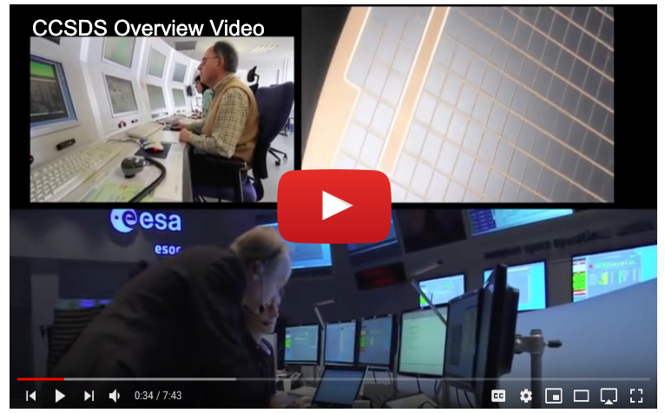
New CCSDS Public Website
With the deployment of the newly redesigned CCSDS public website now complete, the Secretariat would love to hear from you. Let us know what you think of the website by completing a brief survey. Or contact us directly at secretariat@mailman.ccsds.org.
Since the website was announced, CCSDS Tech Support has completed a number of improvements suggested by community members like you. If there any improvements you would like to suggest, please include them in your survey response or send them to us in an email.

Slide 3

Upcoming Meetings – Spring 2021
The Spring 2021 Technical and CESG Meetings will be hosted by NASA Marshall Space Flight Center in Huntsville, AL.
Dates: 10-14 May 2021
The CESG will meet 17 May 2021
The venue for the meeting is
The Westin Hotel at Bridge Street Town Center
Bridge Street Town Center offers multiple options for dining and shopping and is central to the Huntsville area.
The CCSDS Management Council (CMC) will continue to asses the impacts of COVID-19 and will make a final decision about holding the Spring 2021 meetings in-person at a later date.

Slide 4

Upcoming Meetings – Spring 2021
Huntsville is a city centrally located in the northernmost part of the U.S. state of Alabama.
It is home to NASA’s Marshall Space Flight Center.
  10 Best Places for STEM work
  Home to Boeing, Lockheed, US Army, L3, and Hudson Alpha BioTech
Bordered by the Smokey Mountains to the east and the Tennessee River on the south.
Lots to see and do.
  Art Museums
  Entertainment Districts
  Outdoor Spaces/Recreation
Videos about Huntsville:
  Huntsville - We've Got Space
  This is Huntsville

Slide 5
Future Meetings
Date | WG/CMC | Host | Location | Date | Comments
Spring 2021 | WG/CESG | NASA | Huntsville, AL, USA | 10-17 May 2021
 | CMC/SC13 | JAXA | Tokyo, Japan | TBD Date
Fall 2021 | WG/CESG | CNES | Toulouse, France | TBD Date
 | CMC/SC13 | CNES | Tokyo, Japan | TBD Date
Spring 2022 | WG/CESG | NASA | USA | TBD Date
 | CMC/SC13 | INPE | Brazil | TBD Date
Fall 2022 | WG/CESG | ESA | TBD, hosted by ESTEC | TBD Date
 | CMC/SC13 | ESA | TBD | TBD Date
Spring 2023 | WG/CESG | NASA | USA | TBD Date
 | CMC/SC13 | ROSCOSMOS | TBD | TBD Date
Fall 2023 | WG/CESG | UKSA | USA | TBD Date
 | CMC/SC13 | UKSA | TBD | TBD Date
Spring 2024 | WG/CESG | NASA | TBD | TBD Date
 | CMC/SC13 | CNSA | TBD | TBD Date
5-Day
5-Day

Slide 6
CCSDS Overview
Active Publications
Currently Active Publications: 170 Normative (Blue & Magenta): 108
Informative (Green): 67
Downloadable for free from www.ccsds.org
All major pubs since 1982: ~386
(Some were historical mission needs
or superseded technologies)
Hundreds of space missions have adopted and used various CCSDS standards

Slide 7





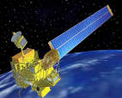
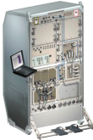

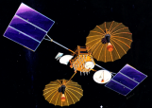



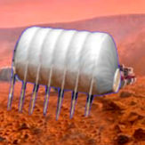

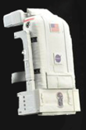



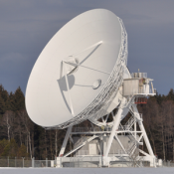


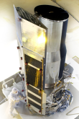
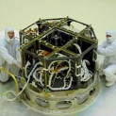












Members of the CESG
CESG Chairs
CESG Chair M. di Giulio
Deputy Wallace Tai
SE Area Director Peter Shames
Deputy Hiroshi Takeuchi
MOIMS Area Director Mario Merri
Deputy Brigitte Behal
CSS Area Director Erik Barkley
Deputy Colin Haddow
SLS Area Director G-P Calzolari
Deputy Gilles Moury
SIS Area Director Scott Burleigh
Deputy Tomaso de Cola
SOIS Area Director J. Wilmot
Deputy X. He
6 Areas
23 WGs
Systems Engineering
Security
Delta-DOR
System Architecture
MISSION CONTROL
CENTER
End Users
Applications/Archives
MISSION CONTROL
CENTER
End Users
Spacecraft Onboard
Interface Services
Space Link
Services
Cross Support
Services
Space Internetworking
Services
Mission Ops &
Info Mgt Services
Onboard Wireless WG
Application Supt Services
Subnetwork Services
RF & Modulation
Coding & Sync.
Multi/Hyper Data Comp.
Space Link Protocols
Space Data Link Security
Optical Communications
CS Service Management
CS Transfer Services
Motion Imagery & Apps
Delay Tolerant Networking
Voice
CFDP Revisions
Data Archive Ingestion
Navigation
Spacecraft Monitor & Control
Telerobotics
Planning & Scheduling

Slide 8
CCSDS Publications since CMC Mtg Spring 2020
Blue Books – Recommended Standards
CCSDS 133.0-B-2, Space Packet Protocol (Blue Book, Issue 2)
CCSDS 503.0-B-2, Tracking Data Message (Blue Book, Issue 2)
CCSDS 211.0-B-6, Proximity-1 Space Link Protocol—Data Link Layer (Blue Book, Issue 6)
CCSDS 727.0-B-5, CCSDS File Delivery Protocol (CFDP) (Blue Book, Issue 5)
CCSDS 141.0-P-1.1, Optical Communications Physical Layer (Pink Sheets, Issue 1.1)
CCSDS 123.0-B-2 Cor. 2, Technical Corrigendum 1 to CCSDS 123.0-B-2
CCSDS 121.0-B-3, Lossless Data Compression (Blue Book, Issue 3)
Magenta Books – Recommended Practices
CCSDS 921.2-M-1 Cor. 1, Technical Corrigendum 1 to CCSDS 921.2-M-1, Issued March 2019
Orange Books
CCSDS 551.1-O-2, Correlated Data Generation (Orange Book, Issue 2)
Green Books – Informational Reports
CCSDS 700.1-G-1, Overview of the Unified Space Data Link Protocol (Green Book, Issue 1)
CCSDS 130.1-G-3, TM Synchronization and Channel Coding—Summary of Concept and Rationale (Green Book, Issue 3)

Slide 9
CMC Poll Statistics since CMC Mtg Spring 2020
Agency Review
Blue Books – Recommended Standards
CCSDS 141.0-P-1.1, Optical Communications Physical Layer (Pink Sheets, Issue 1.1)
CCSDS 766.1-P-2.1, Digital Motion Imagery (Pink Book, Issue 2.1)
CCSDS 401.0-RP-30.1, Radio Frequency and Modulation Systems—Part 1: Earth Stations and Spacecraft (Red/Pink Sheets, Issue 30.1)
CCSDS 141.1-R-1, Atmospheric Characterization and Forecasting for Optical Link Operations (Red Book, Issue 1)
Approval of new Projects
New Projects of the SLS Area
Space Data Link Security Protocol, Issue 2 - Blue Book
AOS Space Data Link Protocol, Issue 4 - Blue Book
TM Space Data Link Protocol, Issue 3 - Blue Book
Other
Charter Modification for the Multispectral Hyperspectral Data Compression (SLS-MHDC) Working Group
CESG Escalation to CMC about Unresolved CESG Poll
Approval of new CCSDS Liasion Wi-Fi Alliance

Slide 10
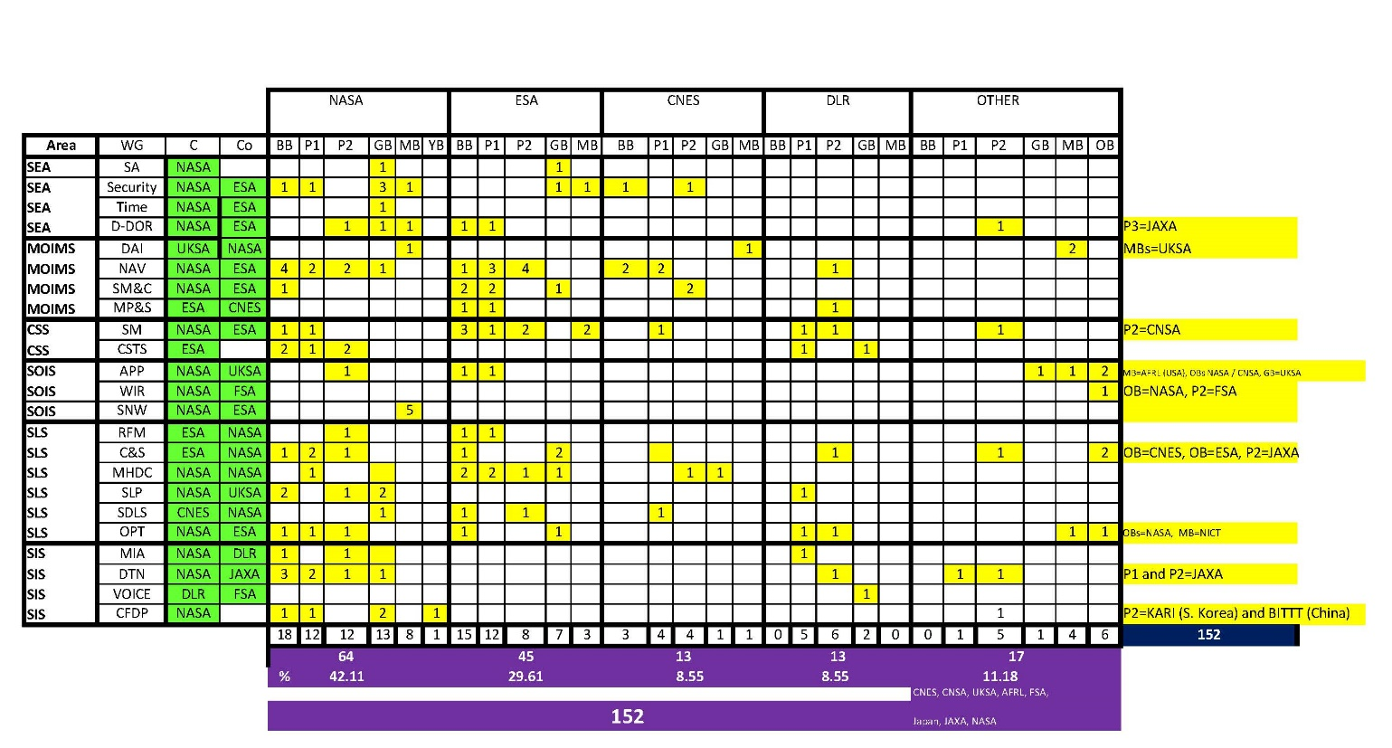
CCSDS Resources

Slide 11
WG Chair / Deputy Chair Overview

Slide 12
Working Group Agendas and Additional Resources
All information about the CCSDS Fall 2020 Meeting can be found on the CCSDS Public Website page: https://public.ccsds.org/meetings/2020Fall/default.aspx.
Individual Working Group Agendas may be found on the CCSDS Public Website at: https://public.ccsds.org/meetings/2020Fall/2020FallAgendas.aspx.
To find contact information for each Area Director and Working Group Chair and request a meeting invitation visit the CWE at: https://cwe.ccsds.org/default.aspx.
If you have any questions about the meetings or require any other assistance, please let us know at secretariat@mailman.ccsds.org.

