Slide 1
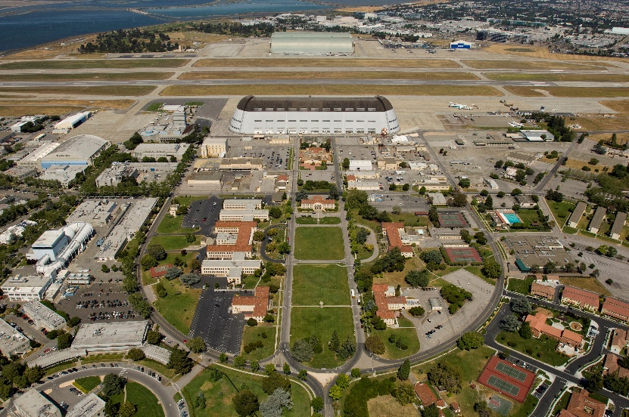

>195 Participants
CNES 13 CNSA 5
CSA 2 DLR 21
ESA 37 JAXA 12
ROSCOSMOS 5 NASA 93
UKSA 5 South Korea 4
CCSDS Opening Plenary |  | 6th May 2019 Mountain View, California, United States
08:45 | Opening remarks and welcome | Stephen Townes, CCSDS General Secretary and Margherita di Giulio, CESG Chair
8:50 | CCSDS meeting overview: Administrative, Boot Camp, Meetings | Michael Blackwood, CCSDS Secretariat
8:55 | NASA Human Exploration and Cislunar Science Initiatives | Phil Liebrecht, Assistant Deputy Associate Administrator for NASA Space Communications and Navigation
9:10 | CESG Open Issues & More | Margherita di Giulio, CESG Chair
9:15 | Systems Engineering Area objectives | Peter Shames, SEA Area Director
9:20 | Mission Ops and Information Mgt Services Area objectives | Mario Merri, MOIMS Area Director
9:25 | Cross Support Services Area objectives | Erik Barkley, CSS Area Director
9:30 | Spacecraft Onboard Interface Services Area objectives | Jonathan Wilmot, SOIS Area Director
9:35 | Space Link Services Area objectives | Gian-Paolo Calzolari, SLS Area Director
9:40 | Space Internet Services Area objectives | Scott Burleigh, SIS Area Director
09:45 | Closing remarks; Adjourn

Slide 2
Administrative Overview
Registration will be set up near a central location in Building 152 and will also double as the Secretariat area through the rest of the week.
Recommended meeting and break schedules are as follows:
    Start time 08:45
    Coffee break 10:30-10:45
    Lunch Break 12:30-13:30
    Coffee Break 15:30-15:45
    End time 17:30
Not all rooms have equipment for teleconferencing. The Secretariat staff has Bluetooth speakers available should they be required.
Please let the Secretariat staff know as soon as possible if you will not be using your meeting room at your scheduled time.
Wi-Fi access: Each attendee has a unique username and password. Please see the Secretariat to collect your guest account credentials. Please use the “nasa-guest” network.
A covered outdoor patio next to Building 152 is available for lunch or breaks.

Slide 3
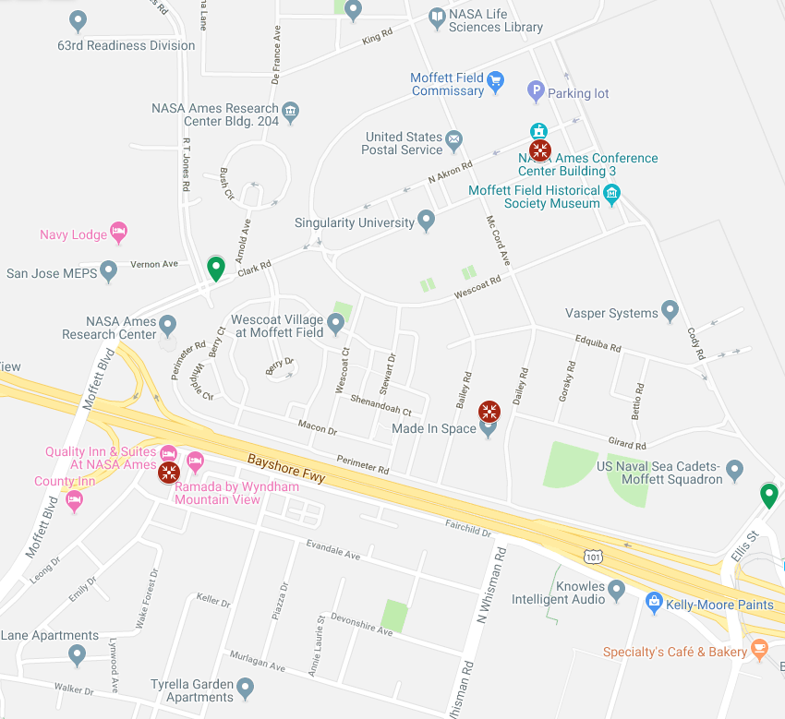
Meeting Locations
Building 152 – Main Building
  200 Bailey Rd
  Mountain View, CA 94043
Building 3 – Additional Meetings
  500 Severyns Av
  Moffett Field, CA 94035
Quality Inn – Mission Planning and Scheduling Working Group
  5 Fairchild Dr
  Mountain View, CA 94043
Main Gate
Building 3
South Gate
Building 152
Quality Inn
500 meters

Slide 4
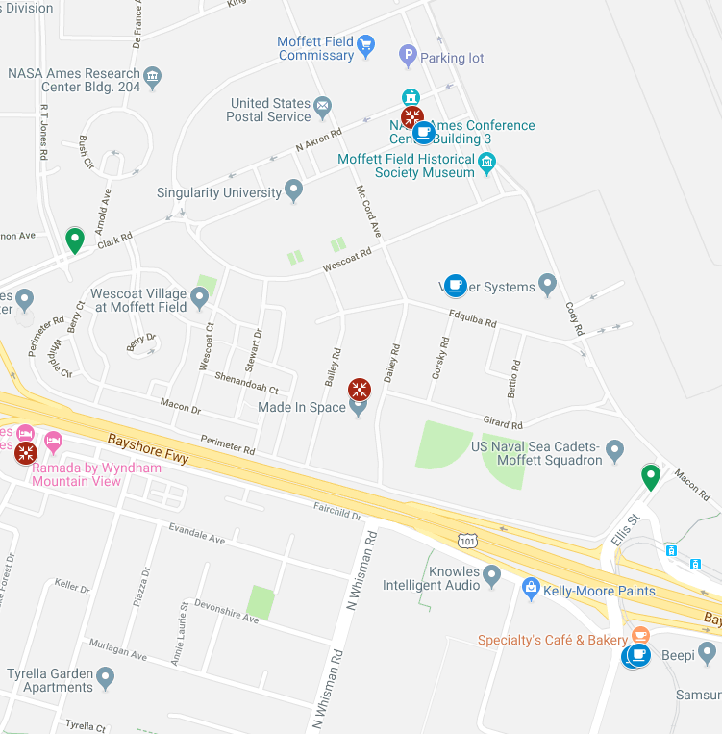
COFFEE
Inside the NASA Research Park
Space Bar
S Akron Rd
Mountain View, CA 94043
Moon Mart
596 Edquiba Rd
Mountain View, CA 94043
Outside the South Gate
Specialty's Cafe & Bakery
&
Peet's Coffee & Tea
645 Ellis St
Mountain View, CA 94043
B 3
Main Gate
B 152
South Gate
500 meters

Slide 5
Future Meetings
Date | WG/CMC | Host | Location | Date | Comments
Spring 2019 | WG/CESG | NASA | Mountain View, CA, USA | 06-10 May 2019
 | CMC/SC13 | CSA | Montreal, Canada | 11-13 June 2019
Fall 2019 | WG/CESG | ESA | Darmstadt, Germany | 21-25 October 2019
 | CMC/SC13 | ESA | Darmstadt, Germany | 28-30 October 2019
Spring 2020 | WG/CESG | NASA | Huntsville, AL, USA | TBD Date
 | CMC/SC13 | JAXA | Tokyo, Japan | TBD Date
Fall 2020 | WG/CESG | CNES | France | TBD Date
 | CMC/SC13 | CNES | France | TBD Date
Spring 2021 | WG/CESG | NASA | USA | TBD Date
 | CMC/SC13 | INPE | Brazil | TBD Date
Fall 2021 | WG/CESG | ESA | TBD | TBD Date
 | CMC/SC13 | ESA | TBD | TBD Date
Spring 2022 | WG/CESG | NASA | USA | TBD Date
 | CMC/SC13 | ROSCOSMOS | TBD | TBD Date
4-Day
4-Day

Slide 6

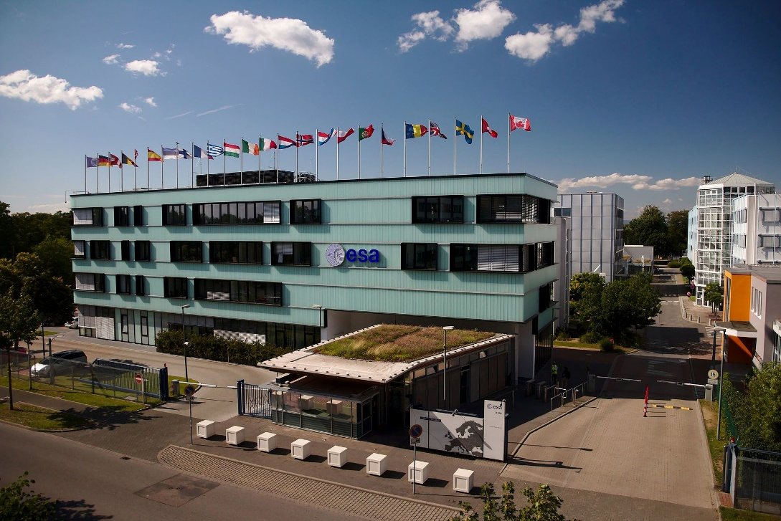
Upcoming meetings – Fall 2019
Hosted by ESA
  Date: 21st Oct – 30th Oct 2019
  Location: Darmstadt, Conference Centre + ESA/ESOC

Slide 7
Upcoming meetings – Fall 2019
Technical Meeting will last 4 days (21st Oct - 24th Oct 2019)
Contract with Darmstadtium Conference Centre has been signed
  Large plenary meeting room booked for 21st morning
  12 rooms for technical meetings, internet, projectors, coffee breaks
  Non-host budgeted lunch, arranged with the Darmstadtium at ~10€
Extra meetings rooms (if needed) will be available at ESOC
CESG meeting will be held at ESOC on Friday 25th Oct 2019
CMC meetings (+ ISO SC13) will be held at ESOC from 28th Oct until 30th Oct
2 meeting rooms booked at ESOC from 25th - 30th Oct
CMC host dinner (tbc) will be held on Monday 28th Oct

Slide 8



CCSDS Technical Editors:
“Boot Camp”
Tom Gannett - CCSDS Chief Technical Editor
Peter Shames – CCSDS SEA Area Director
The purpose of the technical editor “boot camp” is to improve overall quality and enable faster processing of documents submitted to the Secretariat by familiarizing working group technical editors with CCSDS requirements for technical content, publication style and procedures for document submission.
IT IS MANDATORY THAT ANY PERSON ASSIGNED TO BE THE EDITOR OF A CCSDS DOCUMENT ATTEND A BOOT CAMP.
This week, Boot Camp is scheduled for:
Session
Room
Thursday, 08:45- 12:30
Building 152 Room 108

Slide 9
CCSDS Overview
Active Publications
Currently Active Publications: 160 Normative (Blue & Magenta): 99
Informative (Green): 61
Downloadable for free from www.ccsds.org
All major pubs since 1982: ~375
(Some were historical mission needs
or superseded technologies)
Hundreds of space missions have adopted and used various CCSDS standards

Slide 10





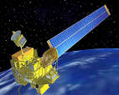
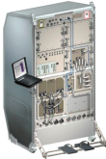
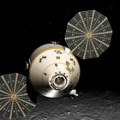
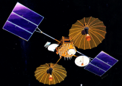


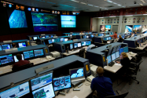
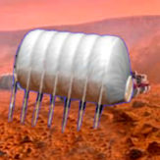

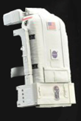






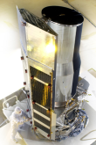
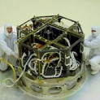












Members of the CESG
CESG Chairs
6 Areas
23 WGs
Systems Engineering
Chair M. di Giulio
Deputy Wallace Tai
SE Area Peter Shames
Deputy Hiroshi Takeuchi
MOIMS Mario Merri
Deputy Brigitte Behal
CSS Area Erik Barkley
Deputy Colin Haddow
SLS Area G-P Calzolari
Deputy Gilles Moury
SIS Area Scott Burleigh
Deputy Tomaso de Cola
SOIS Area J. Wilmot
Deputy X. He
Security
Delta-DOR
System Architecture
MISSION CONTROL
CENTER
End Users
Applications/Archives
MISSION CONTROL
CENTER
End Users
Spacecraft Onboard
Interface Services
Space Link
Services
Cross Support
Services
Space Internetworking
Services
Mission Ops &
Info Mgt Services
Onboard Wireless WG
Application Supt Services
Subnetwork Services
RF & Modulation
Coding & Sync.
Multi/Hyper Data Comp.
Space Link Protocols
Space Data Link Security
Optical Communications
CS Service Management
CS Transfer Services
Motion Imagery & Apps
Delay Tolerant Networking
Voice
CFDP Revisions
Data Archive Ingestion
Navigation
Spacecraft Monitor & Control
Telerobotics
Planning & Scheduling

Slide 11
CMC/CESG Poll Statistics since Fall Meeting 2019
CMC closed Polls
• Publication
  CCSDS 350.7-G-2, Security Guide for Mission Planners
  CCSDS 876.0-B-1, Spacecraft On-board Interface Services—XML Specification for Electronic Data Sheets
  CCSDS 130.11-G-1, SCCC—Summary of Definition and Performance
  CCSDS 232.1-B-2 Cor. 1, Technical Corrigendum 1 to CCSDS 232.1-B-2 (COP-1)
  CCSDS 350.4-G-2, CCSDS Guide for Secure System Interconnection
CCSDS 120.3-G-1, Spectral Pre-Processing Transform for Multispectral & Hyperspectral Image Compression
CCSDS 921.2-M-1, Guidelines for the Specification of Cross Support Transfer Services
CCSDS 401.0-B-29, Radio Frequency and Modulation Systems—Part 1: Earth Stations and Spacecraft
CCSDS 350.0-G-3, The Application of Security to CCSDS Protocols (Green Book, Issue 3)
CCSDS 123.0-B-2, Low-Complexity Lossless and Near-Lossless Multispectral and Hyperspectral Image Compression (Blue Book, Issue 2)
CCSDS 141.11-O-1, Optical High Data Rate (HDR) Communication—1064 NM (Orange Book, Issue 1)
CCSDS 523.2-M-1, Mission Operations Message Abstraction Layer—C++ API (Magenta Book, Issue 1)
CCSDS 706.2-G-2, Voice Communications (Green Book, Issue 2)
CCSDS 732.1-B-1, Unified Space Data Link Protocol (Blue Book, Issue 1)
• Agency Review
CCSDS 211.2-P-2.1, Proximity-1 Space Link Protocol—Coding and Synchronization Sublayer (Pink Sheets, Issue 2.1)
CCSDS 851.0-P-1.1, Spacecraft On-board Interface Services—Subnetwork Packet Service (Pink Book, Issue 1.1)
CCSDS 921.1-P-1.1, Cross Support Transfer Service—Specification Framework (Pink Book, Issue 1.1)
CCSDS 431.1-R-1, Variable Coded Modulation Protocol (Red Book, Issue 1)
CCSDS 922.3-R-1, Cross Support Transfer Service—Forward Frame Service (Red Book, Issue 1)
CCSDS 522.2-R-1, Mission Operations—Mission Data Product Distribution Services (Red Book, Issue 1)

Slide 12
CESG / CMC Poll Statistics since Fall Meeting 2019 (cont.)
Approval of new Projects
New CSS CSTS Project
CSTS Specification Framework - Update
3 New projects in MOIMS SM&C
  XML Telemetric and Command Exchange (XTCE) Informational Report
  XML Telemetric and Command Exchange (XTCE) Element Description
  MO Reference Model 5yr update
2 New projects in MOIMS NAV
Tracking Data Message Version 3
Conjunction Data Message 5 Year Review Revision
3 New projects in SLS SLP
SLS Glossary of Terms
Encapsulation Service - Issue 3
Proximity-1 Space Link Protocol - Data Link Layer (Issue6)
- 1 New project in SLS C&S
CCSDS Experimental Specification (Orange Book) “SCCC Extension”
Reconfirmation
None already approved via Poll, but several Recommendations have been earmarked for reconfirmation (notably from MOIMS/DAI WG).
CESG-only Polls
Appointment of Deputy Chair of the Mission Planning and Scheduling WG

Slide 13
RESOURCES

Slide 14
WG Chair / Deputy Chair Overview

Slide 15
CESG Topics for discussion
CESG Meeting on 10th May
TIME Services BOF - Definition of WG Charter - Status
AOS Uplink: status of Action on C&S WG about paper on coding and modulation options. Progress from the Berlin Meeting
CCSDS 870.10-Y-1, MO Services and SOIS Electronic Data Sheets – Boundaries of Services and Interfaces
Documents with due date for R/U/S
RID template - update
CTE Document Queue

Slide 16
CCSDS/IOAG
ICPA has been updated w.r.t IOAG’s SC#1 and SC#2
All projects ICPA have been linked to the relevant (existing or draft) projects
IOAG Priority has been assigned, as per Infusion Table, CCSDS Comments have been entered
Following services have no related CCSDS Draft Project and/or assignment to WG
    CORS- Off-line Radio Metric Service
    DDORS - CSTS D-DOR Service
    Forward CFDP File Service
    Forward Packet File Service
    Return CFDP File Service
    Return Packet File Service
    Time Synchronization Services (Clock Correlation Procedures, Time Synchronisation , Time Transfer)-- > TIME Services “BOF” established, WG Charter in preparation

Slide 17
SEA Meeting Objectives: 1/1
Security WG
  Network Layer Security Adaptation Profile (BB) Joint with SIS, published 2018
  Link Layer Security update (BB) Joint with SLS, SDLS & SLP updates published
  Link Layer Security update (GB) Joint with SLS, SDLS & SLP, published 2018
  Key Management (GB, MB) MB draft in work, application being worked in SDLS
  Application Credentials Developing white book
  Glossary, Interconnect, Mission Planning Green Books, 5-year updates approved, Glossary submitted as MB
  RF Layer transport New discussion topic, digitized RF delivery
  Standard security section Mandatory
Delta-DOR WG
  Overview document (GB) GB, planning v2 revision
  Delta-DOR implementation architecture (MB) BB published, revision in work, higher precision, work with RF&M
  Quasar catalog Update Procedure (MB) Published 2018 including SANA X-band Catalog, Ka-band in work now
  Delta-DOR Ranging Operations (MB) Published 2018
System Architecture (SAWG)
  CCSDS Application & Support Architecture GB Analyze & describe MOIMS & SOIS application architectures
  RASDS MB Updates Reconfirmed, updates in discussion, TC20 / SC 14 resolution in review
  CCSDS Ontology Glossary issues noted, TC20/SC14 discussions re coordination
  SCID Procedures update MB Published, Corrigendum in process, Frequency bins, Q-SCID, implemented in SANA procedures
SANA Steering Group (SSG)
  SANA Steering Group (SSG) Active, meeting this week
  CCSDS Registry Re-Engineering SANA Registries have been re-engineered, see RMP, CMC concur
Time Exchange / Sync Standards BoF Charter approval delayed, needs discussion with SLS
  Initial exploration of topics

Slide 18
MOIMS Meeting Objectives 1/2
Data Archive Ingestion WG (DAI)
  MB: Information Preparation to Enable Long Term Use (IPELTU) On-going
  MB: Open Archival Information System (OAIS) : 5y revision External review on-going
  MB: Audit and Certification of Trustworthy Digital Repository: 5y revision External review on-going
  MB: Digital Archive Architecture Design Document On-going
Navigation WG (NAV)
  GB: Navigation Data - Definitions and Conventions Ready for publ. by spring mtg
  GB: Navigation Data Messages Overview Ready for publ. by spring mtg
  BB: Orbit Data Message (ODM - NASA, ESA): 5y revision On-going
  BB: Tracking Data Message (TDM - NASA, ESA): 5y revision Prototype on-going
  BB: Attitude Data Message (ADM - CNES, ESA): 5y revision On-going
  BB: Navigation Data Message XML Specs (NDM - no prototype): 5y revision On-going
  BB: Conjunction Data Message (CDM): 5y revision Initial revisions started
  BB: Re-entry Data Message (RDM - ESA, DLR) Prototype done. Ready for publ.
  BB: Navigation Events Message (NEM – CNES, ESA) Initial work started
Notes:
500.0 Navigation Data - Definitions and Conventions Green Book: Version 4 updates are in progress, and nearing completion. The 3.6 update should be distributed this week. We plan to request the CESG/CMC "approval to publish" polls around the time of the Spring Meetings or shortly thereafter.
500.2 Navigation Data Messages Overview - Green Book: Version 2 updates are in progress, and nearing completion. A third draft of the document was distributed in early January; a few editorial revisions have been suggested from the review. Progress is very good overall. Again, we plan to request the CESG/CMC Polls and publication around the time of the Spring Meetings or possibly before.
502.0 Orbit Data Message (ODM): The latest draft (P2.38) was distributed late November and is still under internal review (target for completion at end of April 2019). Updates to CCSDS Normative Annexes SANA Registries continue. The ODM will be one of the first to take advantage of this new feature; applicable annexes have been removed from the draft of P2.38. We hope to have a P2.39 initial update around the time of the Spring Meetings.
503.0 Tracking Data Message (TDM): Unfortunately very little progress has been made recently.
504.0 Attitude Data Messages (ADM): Version 2 updates are in progress. A version P1.8 update of the ADM including the new Attitude Comprehensive Message (ACM) material (analogous to the ODM's Orbit Comprehensive Message (OCM)) will be produced about 2 weeks prior to the Spring Meetings.
505.0 Navigation Data Messages XML Specification (NDM/XML): There has not been much progress since last report, given the priority on other documents.
508.0 Conjunction Data Message (CDM): Preliminary discussions among the co-editors of the document have commenced.
508.1 Re-Entry Data Message (RDM): Prototype testing by ESA and DLR has been completed, and a test report produced. A final, detailed proofreading of the Red Book 1.4 will commence, with a Red Book 1.5 expected to be ready for "approval to publish" CESG/CMC polls as an output of the Spring Meetings. Excellent progress is being made.
509.0 Pointing Request Message (PRM): Recently published, no new work necessary.
50x.0 Navigation Events Message (NEM): Distribution of the first NEM White Book should be occur around the beginning of the Spring Meetings.

Slide 19
MOIMS Meeting Objectives 2/2
Spacecraft Monitor & Control WG (SM&C)
  GB: MO Services Concept: 5y revision New draft received
  GB: XTCE Informational Report: 5y revision New project initiated
  GB: XTCE Element Description: 5y revision New project initiated
  BB: Common Services (ESA, CNES) AR RIDs under implem.+ prototype
  BB: Mission Product Data Distribution Services (ESA, CNES) AR RIDs are being processed
  BB: ZeroMQ Transport Binding (CNES, ESA) Submitted for publication
  BB: File Management Services (ESA, ?) New project agreed
  MB: C++ MAL API (NASA) Published!
  MB: Mission Operations Reference Model (DLR): 5y revision Draft update received
  BB: XML Telemetric & Command Exchange (XTCE) (NASA, no prototype assumed) Awaiting AD Y/N voting resolution
Mission Planning & Scheduling WG (MP&S)
  Marc Duhaze (CNES) is the new deputy chair
  WG forced AGAIN to meet in isolation from the rest of CCSDS
  BB: Mission Planning and Scheduling (ESA, DLR) Progressing nominally
Telerobotics WG (TEL)
  Will not meet, WG in dormant status
  BB: Telerobotic Standard On hold. Demoted to draft

Slide 20
CSS Meeting Objectives
Cross Support Transfer Services WG
  Tracking Data Service (BB) Close out Prototype Interactions; set publication schedule
  Concept (GB) Close out AD review comments; submit for publication
  Guidelines (MB) Dispose of RIDs from agency reviews
  Forward Frame Dispose of RIDs from agency reviews
  Functional Resource Model Review updates; consider SANA updates
  Service Control BB project initiation discussion
Cross Support Service Management WG
  Planning Information Format (BB) Review, set schedule for Red-1 Agency Review
  Terrestrial Generic File Transfer (BB) Review, set schedule for Red-1 Agency Review
  Service Management Utilization Request Format (BB) Review, set schedule for Red-1 Agency Review
  Service Package (BB) Review preliminary draft; plan forward
CSS (Area Level)
  CSTS & CSSM Discuss, coordinate (event sequence, SC-CSTS, Functional Resource Model)
Notes:
20

Slide 21
SOIS Area Meeting Objectives 1/2
SOIS-APP WG and SOIS-SUBNET WG joint meetings
  Review updates to Specification for Dictionary of Terms for EDS (876.1) and prepare book for release
  Review and complete final edits to EDS & DoT overview green book
    Discuss use cases and development tool flows
  Review and discuss 5 year updates to Subnetwork service books
  Mission infusion updates for SEDS and tooling. cFS, CAST, ESA
  Create example SEDS and DOT terms for command and telemetry of existing standard interfaces. (Not APIs) Potential standards include: ECSSS-E-70-41C PUS service interfaces (limited set of common), CFDP, DTN BP, AMS, Unified Space Data Link Protocol
    Promotes adoption and infusion
    Discuss method to publish (SANA?)
  Lunar Orbital Platform-Gateway (LOP-G) use cases
    Discuss SOIS File store, discovery, and packet store service books, include Subnetwork interfaces with focus on EDS definition
  Discuss current prototyping activities (ESA & NASA)
  Liaison with other CCSDS and external groups, MOIMS, DTN, CFDP, SEA, Time BoF to align concepts
Notes:
21
21

Slide 22
SOIS Area Meeting Objectives 2/2
SOIS-WIR WG
  High Data-rate External Wireless Network Communications Orange Book
    Goal is to provide standard recommendation to support wireless voice/video/data in LOP-G proximity network
      IEEE 802.11 / Wi-Fi and 3GPP LTE/4g/5g
    Will draw heavily from LTE experience in public safety wireless networks
    Joint SCAN/Advanced Exploration Systems (AES)-funded testbed at University of Colorado Boulder being stood up to support validation testing
    Inputs provided to International Deep Space Interoperability Standards / International Communication System Interoperability Standards (ICSIS)
    Finalizing initial draft of OB currently
      includes technology recommendations and informative discussion of
      interoperability test cases with detailed configuration data to follow
    Target OB completion by Fall 2020 face-to-face meeting
      currently NASA-only official participation
      soliciting partner agency for book development and interoperability testing
      OB being written in BB style
        Along with turnkey testing capability, will enable rapid pivot to BB (normative) / GB (informative) should a second test partner be identified
Notes:
22
22

Slide 23
SLS Meeting Objectives: 1/2
RF & Modulation WG
  401.0-B RF & Modulation:
    MSPA implementation via multicarrier transmission Finalization of draft new rec’s
    or flexible transponder turn-around ratios
    Station frequency stability Finalization of updated recommendation
    22/26 GHz turn-around ratios Finalization of draft new recommendation
    Telemetry ranging Prototypes yellow book approval
    Wide-band DDOR In-depth discussion of draft updated recommendation (with SEA-DDOR)
  VCM, High Data Rate randomizers: Discussion (with C&S)
  211.1-B, 414.0-G and 414.1-B: Proximity-1 and Pseudo-Noise (PN) Ranging Books reconfirmation review
  ACHIEVEMENTS: 401.0-B-29 “Radio Frequency and Modulation Systems--Part 1” Blue Book: Published;
Space Link Code/Sync WG
  VCM Blue Book 431.1-B (new colour) Discuss RIDs from Agency review (with RFM)
  Proximity-1 C&S Sublayer 211.2-B Discuss RIDs from Agency review (with SLP)
  AOS Uplink with TM Codes Pending NASA reply to former action items
  TC Coding Green Book 230.1-G Discussion on updates
  DVB-S2X & SCCC-X Orange Books Discussion on updates (with RFM)
  ACHIEVEMENTS: 130.11-G “TM Channel Coding for SCCC” Green Book: Published;
Space Link Protocols WG
  SPP Revision 133.0-B Finalize DRAFT Pink Sheets towards starting Agency Review
  Check needs for a SPP GB (CCSDS 130.3-G)
  Encapsulation Service Revision 133.1-B Finalize DRAFT Pink Sheets towards starting Agency Review
  Proximity-1 SDL Protocol 211.0-B Start updates due to USLP impact
  SLS Glossary Magenta Book Start Project Discussion for general SLS Glossary of Terms
  USLP Green Book CCSDS 700.1-G Finalize USLP Green book
  Overview of Space Comm. Protocols 130.0-G Review proposed revisions to OSCP Green Book
  ACHIEVEMENTS: 732.0-B-1 Unified Space Data Link Protocol Blue Book: Published; Technical Corrigendum 1 to CCSDS 232.1-B-2 COP-1: Published;

Slide 24
SLS Meeting Objectives: 2/2
Space Data Link Security (SDLS) WG
  Extended Protocol Blue Book 355.1 Finalize document & interoperability testing report to publish
  Extended Protocol Green Book 350.11 Review contributions and produce second draft
Multispectral & Hyperspectral Data Compression (MHDC) WG
  CCSDS-124.0-B Compression of “housekeeping-like” telemetry data Review White Book
  CCSDS-121.0-B “Lossless Data Compression” Determine suitable revisions to resolve ambiguities
  ➔ Corrigendum
  CCSDS-120.0-G “Lossless Data Compression” Review proposed revisions for Green Book update
  CCSDS-120.2-G: Update to cover additional features added in 123.0-B Review new contributions, identify sections needing more revision & writers
  ACHIEVEMENTS: 123.0-B-2 “Lossless & Near-Lossless Multispectral & Hyperspectral Image Compression” Blue Book: Published; 120.3-G-1 “Spectral Pre-Processing Transform for Multispectral & Hyperspectral Image Compression” Green Book (supporting CCSDS 122.1-B-1): Published;
Optical Communications WG
  Optical Communications “Physical Layer” and “Coding & Synchronization” Blue Books.
    Deep Space Scenario: High Photon Efficiency (HPE) Scenario Resolution to publish Physical and Coding Layer BBs.
    Near Earth Scenario for Low Complexity (O3K) Systems: Review the draft section(s) for Optical On/Off Keying (O3K) Physical Layer
    Target to reach consensus on Physical Layer.
    Start discussion about options for O3K Coding & Synchronisation Layer
  Discuss latest draft Atmospheric Characterization for Optical Link Operations (future Magenta) book
  Review latest version of Optical High Data Rate (HDR) Communication 1550 nm (NASA/CNES/JAXA/NICT) Orange Book
  Technical discussion on possible ways of adding ranging to the High Photon Efficiency scenario
  ACHIEVEMENTS: 141.11-O-1 Optical High Data Rate (HDR) Communication 1064 nm (ESA/DLR) Orange Book: Published;

Slide 25
SIS Meeting Objectives (1 of 2)
Motion Imagery and Applications WG
  Monday PM (15), Tuesday AM (15), Tuesday PM (14)
    Review RTP White Book Draft 2
    Review Yellow Book (Test Plan for prototyping)
    Update RTP schedule
    Gateway overview & follow-on discussion
    Plan future work
CFDP Revisions WG
  Thursday AM (14)
  Discuss results of interoperability testing
  Discuss CRC32 issues
  As appropriate, discuss resolution to publish Blue Book
Notes:
25
25

Slide 26
SIS Meeting Objectives (2 of 2)
Delay Tolerant Networking WG
  Wednesday AM (14)
    Schedule-Aware Bundle Routing: status
    Bundle Security for CCSDS: plan to completion
    Network Management Protocol and Green Book
      Review current draft
      Review resource requirements / commitments
    Review NASA PACE mission questions
  Wednesday PM (15)
    Bundle Security Protocol
      Book editor?
      Resources
  Thursday PM (11)
    KARI testing, KPLO status
    NASA mission status
    ESA work on DTN implementations
Notes:
26
26

