Slide 1
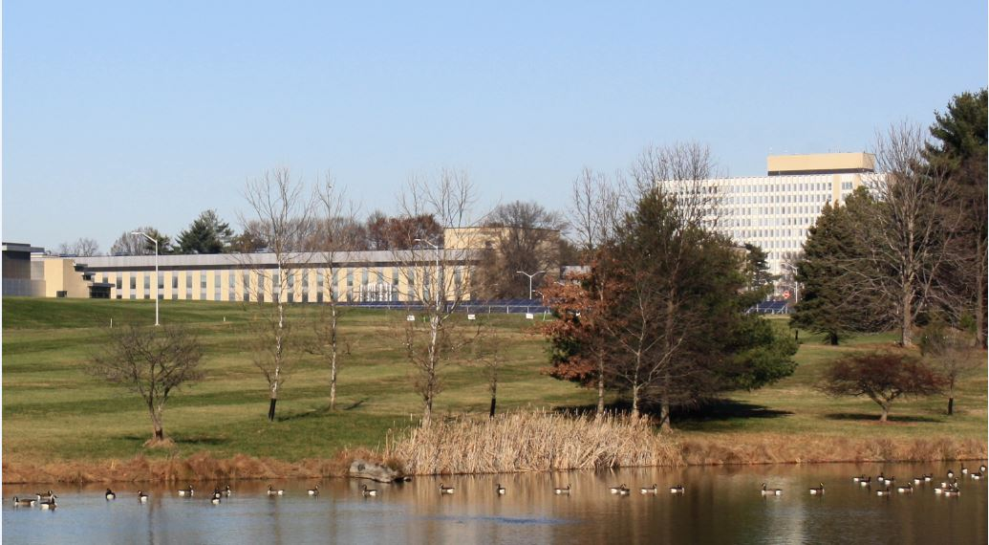
> 185 participants
CNES 13 CNSA 11
DLR 17 ESA 30
FSA 5 JAXA 7
NASA 92 UKSA 8
South Korea 3
CCSDS Opening Plenary |  | 9th April 2018 NIST-Gaithersburg
08:30 | NIST – Welcome | Dr. Kent Rochford, Associate Director for Laboratory Programs, NIST
08:50 | Space Communications and Navigation – The Future | Philip Liebrecht, Deputy Program Manager, NASA SCaN
09:10 | DTN for Manned and Robotic Missions and Digital Preservation | Vinton Cerf, Chief Internet Evangelist for Google
09:30 | CESG Opening remarks | M. Di Giulio, CESG Chair
09:37 | CCSDS meeting overview: Administrative, Boot Camp, Meetings | David Ross, NASA HQ
09:44 | CESG Open Issues & More | M. Di Giulio, CESG Chair
09:51 | Systems Engineering Area objectives | Peter Shames, SEA Area Director
09:58 | Mission Ops and Information Mgt Services Area objectives | Mario Merri, MOIMS Area Director
10:05 | Cross Support Services Area objectives | E. Barkley, CSS Area Director
10:12 | Space Link Services Area objectives | Gian-Paolo Calzolari, SLS Area Director
10:19 | Space Internet Services Area objectives | S. Burleigh, SIS Area Director
10:26 | Spacecraft Onboard Interface Services Area objectives | J. Wilmot, SOIS Area Director
10:33 | Closing remarks; Adjourn

Slide 2
Administrative Overview
Registration will be set up near a central location and will also double as the Secretariat area through the rest of the week.
Recommended meeting and break schedules are as follows:
Start time 08:45
Coffee break 10:30-10:45
Lunch Break 12:30-13:30
Coffee Break 15:30-15:45
End time 17:30
Lunch will be on your own from 12:30-13:30. Lunch will be available in the NIST Cafeteria. The cafeteria, located in the Administration Building (Bldg. 101) is open for Breakfast from 07:30 to 10:00 and for lunch from 11:00 to 15:00
Please let the Secretariat staff know as soon as possible if you will not be using your meeting room at your scheduled time.
WiFi access:
SSID: NIST-Guest Password: N/A – complete access and use policy agreement
Notes:
2

Slide 3
Administrative Overview - Meetings
Date | WG/CMC | Host | Location | Date | Comments
Spring 2018 | WG/CESG | NASA | Gaithersburg, MD, USA | 09-13 April 2018
 | CMC/SC13 | CNSA | Beijing, China | 14-17 May 2018
Fall 2018 | WG/CESG | DLR | Berlin, Germany | 15-19 October 2018
 | CMC/SC13 | DLR | Berlin, Germany | 22-24 October 2018
Spring 2019 | WG/CESG | NASA | USA | TBD Date
 | CMC/SC13 | CSA | Montreal, Canada | 11-13 June 2019
Fall 2019 | WG/CESG | ESA | ESA – ESOC | 21-25 October 2019
 | CMC/SC13 | ESA | ESA – ESOC | 28-30 October 2019
Spring 2020 | WG/CESG | NASA | USA | TBD Date
 | CMC/SC13 | JAXA | JAXA | TBD Date
Fall 2020 | WG/CESG | CNES | FRANCE | TBD Date
 | CMC/SC13 | CNES | FRANCE | TBD Date
Spring 2021 | WG/CESG | NASA | USA | TBD Date
 | CMC/SC13 | INPE | BRAZIL | TBD Date
5-Day
5-Day
Notes:
3

Slide 4
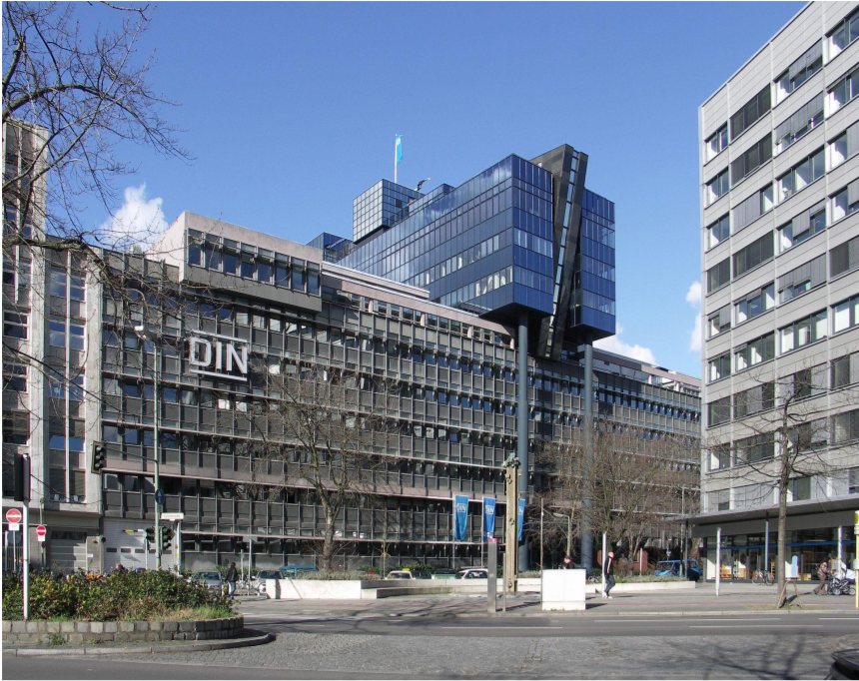
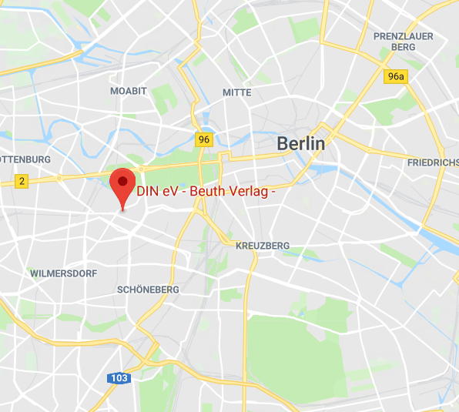
Fall 2018 CCSDS Technical Meetings
15 – 19 October, 2018
DIN Deutsches Institut für Normung e.V. Burggrafenstraße 6 10787 Berlin Germany
Berlin, Germany
Nearest underground station (U-Bahn) is Bahnhof Wittenbergplatz
Very nice facilities
All meeting rooms are located on the ground floor and can be accessed from both sides of the building
Plenary session will be on the 9th floor
Additional information will be posted to the public CCSDS website soon, and can be found on the web at:
https://www.din.de/

Slide 5
CCSDS Technical Editors:
“Boot Camp”
Tom Gannett - CCSDS Chief Technical Editor
Peter Shames – CCSDS SEA Area Director
The purpose of the technical editor “boot camp” is to improve overall quality and enable faster processing of documents submitted to the Secretariat by familiarizing working group technical editors with CCSDS requirements for technical content, publication style and procedures for document submission.
IT IS MANDATORY THAT ANY PERSON ASSIGNED TO BE THE EDITOR OF A CCSDS DOCUMENT ATTEND A BOOT CAMP.
This week, Boot Camp is scheduled for:
Session
Room
Friday, 08:45- 12:30
Dining Room A

Slide 6
CCSDS Overview
Active Publications
Currently Active Publications: 150 Normative (Blue & Magenta): 92
Informative (Green): 58
Downloadable for free from www.ccsds.org
All major pubs since 1982: ~366
(Some were historical mission needs
or superseded technology)
Revised by linking to SANA
1,094 space missions have adopted and used various CCSDS standards

Slide 7
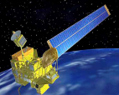
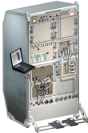
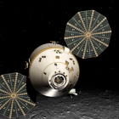
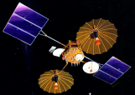
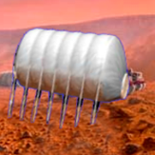
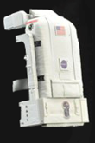
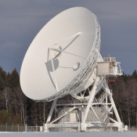
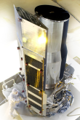
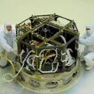
Members of the CESG
CESG Chairs
6 Areas
23 WGs
Chair M. di Giulio
Deputy Wallace Tai
SE Area Peter Shames
Deputy Hiroshi Takeuchi
MOIMS Mario Merri
Deputy Brigitte Behal
CSS Area Erik Barkley
Deputy Colin Haddow
SLS Area G-P Calzolari
Deputy Gilles Moury
SIS Area Scott Burleigh
Deputy Tomaso de Cola
SOIS Area J. Wilmot
Deputy X. He
Systems Engineering
Security
Delta-DOR
System Architecture
MISSION CONTROL
CENTER
End Users
Applications/Archives
MISSION CONTROL
CENTER
End Users
Spacecraft Onboard
Interface Services
Space Link
Services
Cross Support
Services
Space Internetworking
Services
Mission Ops &
Info Mgt Services
Onboard Wireless WG
Application Supt Services
Subnetwork Services
RF & Modulation
Coding & Sync.
Multi/Hyper Data Comp.
Space Link Protocols
Space Data Link Security
Optical Communications
CS Service Management
CS Transfer Services
Motion Imagery & Apps
Delay Tolerant Networking
Voice
CFDP Revisions
Data Archive Ingestion
Navigation
Spacecraft Monitor & Control
Telerobotics
Planning & Scheduling

Slide 8
CESG / CMC Poll Statistics since Nov 2017
CMC Polls
• Publication
CCSDS 401.0-B-28, Radio Frequency and Modulation Systems—Part 1: Earth Stations and Spacecraft (Blue Book, Issue 28)
CCSDS 506.3-M-1, Delta-DOR Quasar Catalog Update Procedure (Magenta Book, Issue 1)
CCSDS 506.0-M-2, Delta-Differential One Way Ranging (Delta-DOR) Operations (Magenta Book, Issue 2)
CCSDS 509.0-B-1, Pointing Request Message (Blue Book, Issue 1)
CCSDS 413.0-G-3, Bandwidth-Efficient Modulations: Summary of Definition, Implementation, and Performance (Green Book, Issue 3)
• Reconfirmation
• Historical Status
CCSDS 740.0-G-1, Mars Mission Protocol Profiles—Purpose and Rationale (Green Book, Issue 1, July 2008)
CCSDS 131.4-M-1, TM Channel Coding Profiles (Magenta Book, Issue 1, July 2011)
• Agency Review
- CCSDS 141.0-R-1 Optical Communications Physical Layer (Red Book, Issue 1)
CCSDS 522.0-R-1 Mission Operations—Common Services (Red Book, Issue 1)
CCSDS 524.4-R-1 Mission Operations--Message Abstraction Layer Binding to ZMTP Transport
CCSDS 921.2-R-1 Guidelines for the Specification of Cross Support Transfer Services
CCSDS 734.5-R-1 CCSDS Streamlined Bundle Security Protocol Specification

Slide 9
CESG / CMC Poll Statistics since Nov 2017 (cont.)
• Approval of Charters
- Space Link Protocols Working Group Charter Changes (SLS-SLP)
RF and Modulation (RFM) Working Group Charter Changes (SLS-RFM)
• Appointment of new Ads / DADs/ Liaison
Appointment of new Deputy Area Director of CSS (C.Haddow, ESA)
Appointment of new CCSDS Liaison for IOAG (J.Afarin, NASA)
Support for the candidacy of Mrs. Yuxia Zhou for ISO/TC 20/SC 13 Chairperson
Approval of new Projects
New Delay Tolerant Networking Working Group Projects (SIS Area)
- CCSDS Bundle Protocol Network Management - Green Book
- CCSDS Bundle Protocol Network Management - Blue Book
New Cross Support Service Management Working Group Project (CSS Area)
Service Package Data Formats - Blue Book
2 New Multispectral and Hyperspectral Data Compression Working Group Projects (SLS Area)
Robust Compression of Fixed-Length Housekeeping Data - Blue Book
Low-Complexity Lossless & Near-Lossless Multispectral & Hyperspectral Image Compression Issue 2 – Green Book
2 New Space Link Protocols Working Group Projects (SLS Area)
Space Packet Protocol, Issue 2 - Blue Book
Overview of Space Communications Protocols, Issue 4 - Green Book
1 New Cod & Synch WG Working Group Project (SLS Area)
CCSDS Space Link Protocols over ETSI DVB-S2X standard” CCSDS Experimental Specification
New Security Working Group Projects (SEA Area)
Information Security Glossary of Terms Revision - Green Book
Security Guide for Mission Planners GB Revision - Green Book
New Cross Support Transfer Services WG Project (CSS Area)
Forward Frame CSTS - Blue Book

Slide 10
CESG / CMC Poll Statistics since Nov 2017 (cont.)
Demoted Projects
Navigation Hardware Message approved Project Demote to Draft Project
Adaptive Code and Modulation (ACM) Systems for CCSDS - Project has been cancelled.
CESG Polls, not through CMC Poll yet
Publication
CCSDS 647.4-O-1, Data Entity Dictionary Specification Language (DEDSL)—XML/XSD Syntax (Orange Book, Issue 1) (with conditions)
CCSDS 730.2-G-1, Requirements for Streaming Services over Bundle Protocol (Green Book, Issue 1) (with conditions)
Historical Status
Other
Approval of SC14 and SC13/CCSDS Information Exchange for Reference Architecture Extensions (CMC Poll concluded with conditions)

Slide 11
CESG Status
Project resources in CWE Framework
86 Approved Projects - CWE is up-to-date, all approved projects are in
13 projects in SEA
22 projects in MOIMS
8 projects in CSS
11 projects in SOIS
21 projects in SLS
11 projects in SIS
CESG main topics addressed since November 2017
SOIS / SIS Strategic Plan Update (CMC Actions)
Change of CCSDS liaison to IOAG
CWE RID tool in Excel format (prototype)
CESG topics organizational aspects of S18 meeting
DDOR WG does not meet
SIS-Video WG will meet in Huston in 4 weeks
SIS-Voice WG does not meet
P&S (MOIMS) will meet outside NIST

Slide 12
CESG Status

Slide 13
CESG - OTHER ISSUES
Document Status – Issues with Docs with Date due To be discussed at S18 Meeting
WG | Document | Due Date for action (Reconfirm, Update, Silverise) | AD Recommendation | Resources WM
SEA SEC | 350.6-G-1 Space Missions Key Management Concept | Nov-16 | TDB | 3
SEA SEC | 312.0-G-1 Reference Architecture for Space Information Management | Mar-18 | Uddate / Reconfirm ? | 3
MOIMS SMC | 521.0-B-2 Mission Operations Message Abstraction Layer | Mar-18 | Update / Reconfirm ? | 6
MOIMS SMC | 520.1-M-1 Mission Operations Reference Model | Jul-15 | Update | 1
MOIMS SMC | 523.1-M-1 Mission Operations Message Abstraction Later - JAVA API | Apr-18 | Update / Reconfirm ? | 1
MOIMS SMC | 660.0-G-1 XML Telemetric and Commad Exchange (XTCE) | Jul-11 | Update / Reconfirm ? | 1
MOIMS SMC | 660.1-G-1 XML Telemetric and Command Exchange (XTCE) - Element Description | May-17 | Update / Reconfrm ? | 1
CSS CSTS | 912.11-O-1 Space Link Extension— Enhanced Forward CLTU Service Specification | Jul-17 | Update | 3
CSS SM | 910.4-B-2 Cross Support Reference Model—Part 1: Space Link Extension Services Action | Oct-10 | Update | 3
CSS CSTS | 910.0-G-2 Space Link Extension Services—Executive Summary. | Mar-11 | Update | 3
SOIS WIR | 881.0-M-1 Spacecraft Onboard Interface Services - RFID Based iIventory Management Systems | May-17 | TBD | 3
SLS MHDC | 120.0-G-3 Lossless Data Compression | Apr-18 | Updat / Reconfirm ? | 1
SLS C&S | 131.2-B-1 Flexible Advanced Coding and Modulation Scheme for High Rate TM Applications | Mar-17 | ESA to propose a way to update in S18 | 6
SLS C&S | 130.1-G-2 TM Synchronization and Channel Coding - Summary of Concept and Rationale | Nov-17 | Update / Reconfirm ? | 1
SLS RFM | 415.0-G-1 Data Transmission and PN ranging for 2 GHz CDMA link via Data Relay satellite | Apr-18 | Update / Reconfirm ? | 1
SIS DTN | 734.0-G-1 Rationale, Scenarios, and Requirements for DTN in Space | Aug-15 | Update | 1.5
SIS DTN | 735.1-B-1 Asynchronous Message Service | Sep-14 | Update | 6
SIS DTN | 735.0-G-1 Asynchronous Message Service | Dec-17 | Update / Reconfirm ? | 1
 |  |  | Total | 45.5

Slide 14
RESOURCES
 |  |  |  | NASA |  |  |  |  |  | ESA |  |  |  |  | CNES |  |  |  |  | DLR |  |  |  |  |  | OTHER |  |  |  |  | Missing Resources
Area | WG | C | Co | BB | P1 | P2 | GB | MB | YB | BB | P1 | P2 | GB | MB | BB | P1 | P2 | GB | MB | BB | P1 | P2 | GB | MB | BB | P1 | P2 | GB | MB | OB | P2
SEA | SA | NASA |  |  |  |  |  | 1 |  |  |  |  | 1
SEA | Security | NASA | ESA | 2 | 2 | 1 | 4 |  |  |  |  |  | 1 | 1 |  |  | 1
SEA | D-DOR | ESA |  |  |  | 1 | 1 | 1 |  | 1 | 1
MOIMS | DAI | UKSA | NASA |  |  |  |  | 1 |  |  |  |  |  |  |  |  |  |  | 1 |  |  |  |  |  |  |  |  |  | 2 | 1 |  | OB= CNES, MB=UKSA
MOIMS | NAV | NASA | ESA | 3 |  | 2 | 2 |  |  | 1 | 3 | 2 |  |  | 2 | 2 |  |  |  |  |  | 1
MOIMS | SM&C | NASA | ESA | 1 |  | 1 |  | 1 |  | 3 | 3 | 1 | 1 |  | 1 | 1 | 2
MOIMS | TELROB
MOIMS | MP&S | ESA | NASA |  |  |  |  |  |  | 1 | 1 |  | 1 |  |  |  |  |  |  |  |  | 1
CSS | SM | NASA | ESA | 1 | 1 | 1 |  |  |  | 4 | 1 | 2 |  |  |  | 1 |  |  |  |  | 2 | 1 |  |  |  |  | 1 |  |  |  |  | P2=CNSA
CSS | CSTS | ESA |  | 2 | 1 | 2 |  |  |  |  |  |  |  | 1 |  |  |  |  |  |  | 1
SOIS | APP | NASA | UKSA |  |  | 1 |  |  |  | 1 | 1 |  |  |  |  |  |  |  |  |  |  |  |  |  |  |  |  | 1 | 1 | 2 |  | MB=AFRL (USA), OBs NASA / CNSA, GB=UKSA
SOIS | WIR | NASA | FSA |  | 1 |  |  |  |  |  |  |  |  |  |  |  |  |  |  |  |  |  |  |  |  |  | 1 |  |  | 1 |  | OB=NASA, P2=FSA
SOIS | SNW | NASA | ESA |  |  |  |  | 5
SLS | RFM | ESA | NASA |  |  | 1 |  |  |  | 1 | 1
SLS | C&S | ESA | NASA | 2 | 2 | 1 |  |  |  |  |  |  | 2 |  |  | 1 |  |  |  |  |  | 1 |  |  |  |  | 1 |  |  | 1 |  | OB=CNES, P2=JAXA
SLS | MHDC | NASA | NASA |  | 1 |  | 1 |  |  | 2 | 1 | 1 |  |  |  |  | 1 | 1
SLS | SLP | NASA | UKSA | 2 |  | 1 | 2 |  |  |  |  |  |  |  |  |  |  |  |  |  | 1
SLS | SDLS | CNES | NASA |  |  |  | 1 |  |  | 1 |  | 1 | 1 |  |  | 1
SLS | OPT | NASA | ESA | 1 | 1 | 1 |  |  |  | 1 |  |  | 1 |  |  |  |  |  |  |  | 1 | 1 |  |  |  |  |  |  | 1 | 2 |  | OBs=NASA, ESA, MB=NICT
SIS | MIA | NASA | DLR | 1 |  | 1 | 1 |  |  |  |  |  |  |  |  |  |  |  |  |  | 1
SIS | DTN | NASA | JAXA | 3 | 2 | 1 | 1 |  |  |  |  |  |  |  |  |  |  |  |  |  |  | 1 |  |  |  | 1 | 1 |  |  |  |  | P1 and P2=JAXA
SIS | VOICE | DLR | FSA |  |  |  |  |  |  |  |  |  |  |  |  |  |  |  |  |  |  |  | 1
SIS | CFDP | NASA |  | 1 | 1 |  | 2 |  | 1 |  |  | 1 |  |  |  |  |  |  |  |  |  |  |  |  |  |  |  |  |  |  |  | ESA P2 not granted
 |  |  |  | 19 | 12 | 15 | 15 | 9 | 1 | 16 | 12 | 8 | 8 | 2 | 3 | 6 | 4 | 1 | 1 | 0 | 6 | 6 | 1 | 0 | 0 | 1 | 4 | 1 | 4 | 7 | 0 | 162
 |  |  |  | 71 |  |  |  |  |  | 46 |  |  |  |  | 15 |  |  |  |  | 13 |  |  |  |  | 17
 |  |  |  | % |  | 43.83 |  |  |  |  |  | 28.40 |  |  |  |  | 9.26 |  |  |  |  | 8.02 |  |  |  |  | ####
 |  |  |  |  |  |  |  |  |  |  |  |  |  |  |  |  |  |  |  |  |  |  |  |  | CNES, CNSA, UKSA, AFRL, FSA,
 |  |  |  |  |  |  |  |  |  |  |  |  |  |  | 162 |  |  |  |  |  |  |  |  |  | Japan, JAXA |  | NASA

Slide 15
CESG WG Chair / Deputy Chair Overview
Area
WG
C
Co
WG Deputy Chair
SEA
SA
NASA
0
WG Chair
WG Deputy Chair
SEA
Security
NASA
ESA
NASA
14
6
FSA
SEA
D-DOR
0
ESA
4
6
JAXA
11%
MOIMS
DAI
UKSA
NASA
CNES
1
0
5%
MOIMS
NAV
NASA
ESA
DLR
1
1
UKSA
NASA
MOIMS
SM&C
NASA
ESA
UKSA
1
2
10%
32%
MOIMS
TELROB
0
0
JAXA
0
1
DLR
MOIMS
MP&S
ESA
NASA
FSA
0
2
5%
ESA
CNES
32%
CSS
SM
NASA
ESA
Total
21
18
5%
CSS
CSTS
ESA
SOIS
APP
NASA
UKSA
DLR
JAXA
SOIS
WIR
NASA
FSA
4%
0%
WG Chair
SOIS
SNW
NASA
ESA
UKSA
FSA
SLS
RFM
ESA
NASA
CNES
5%
0%
SLS
C&S
ESA
NASA
4%
SLS
MHDC
NASA
NASA
SLS
SLP
NASA
UKSA
SLS
SDLS
CNES
NASA
ESA
SLS
OPT
NASA
ESA
23%
SIS
MIA
NASA
DLR
NASA
SIS
DTN
NASA
JAXA
64%
SIS
VOICE
DLR
FSA
SIS
CFDP
NASA
0

Slide 16
Topics for CESG Meeting
CESG meeting on 16 April – Main topics
To be addressed with IOAG Liaison:
Status of ICPA. The IOAG updated the Service Catalogue #1 and Service Catalogue #2, and is supposed to check the status of ICPA. → is the ICPA up-to-date?
Service Catalogue #3 is in preparation→ implications on ICPA
SOIS / SIS Updated Strategic Plan
Reviews that closed long time ago
Books with outstanding Poll conditions
Agenda and presenters of CMC meeting in Beijing
The case of CFDP → missing prototyping resources
RID Template in Excel format- discuss comments and approach
CTE Document Queue
Documents with due date for R/U/S
Interface to subscribe to a mailing list
Some CWE improvements

Slide 17
New Work Item – STATUS
Area and WG name | CCSDS Ref Nr | Activity (RB, Pink, Draft. Update) | Document Title | Target Start / Publication Date | Resources Needed (total, Editor, Proto 1, Proto 2) |  |  |  | Comments Rationale What if not started?
SEA SEC | 350.6-G-1 | Update | Space Missions Key Management Concept (Nov 2011) | Start 20/06/2017 End 10/12/2018 | 2017 | 2 WMs for GB | No Prot 1 | No Prot 2 | Project not yet agreed. Revise GB to include new material.
 |  |  |  |  | 2018 | 2 WMs for GB
SEA SEC | 352.0-B-1 | Update | CCSDS Cryptographic Algorithms (Nov 2012) | Start TBD End TBD | 2017 | TBD | TBD | TBD | Project not yet agreed.
 |  |  |  |  | 2018 | TBD | TBD | TBD
 |  |  |  |  | 2019 | TBD | TBD | TBD
SIS-DTN | CCSDS 734.0-G-2 |  | Rationale, Scenarios, and Requirements for DTN in Space | 1/1/2018 -- 12/31/2018 | 2018 | 1.5 |  |  | Updates needed to track current CONOPS and CCSDS architecture. Resources: NASA
MOIMS SM&C | CCSDS 520.1-M-1 |  | MO Reference Model | 2017 | 0 | 0 | 0 | 0 | ESA.
MOIMS NAV | 500.2-G-1 |  | Navigation Data Message Overview | 2017 | 0 | 0 | 0 | 0 | NASA/JPL The document wlll not reflect new message types added, and message types subtracted from the work program
 |  |  |  | 2018 | 1 | 1 | 0 | 0
 |  |  |  | 2019 | 0 | 0 | 0 | 0

Slide 18
New Work Item – STATUS
Area and WG name | CCSDS Ref Nr | Activity (RB, Pink, Draft. Update) | Document Title | Target Start / Publication Date | Resources Needed (total, Editor, Proto 1, Proto 2) |  |  |  | Comments Rationale What if not started?
SLS C&S | TBD |  | AOS Uplink Profiles | January 2018 December 2018 | 2018 | NASA 6 WM | N/A | N/A | Definition of coding subset allowed for AOS Uplink Other Agencies as Monitors TBD as Magenta or Blue
SLS-SLP | 133.0-B |  | Space Packet Protocol (SPP) | Start : January 2018 Publication: May 2019 | 2018 | 0.5 M NASA | N/A | N/A | No Prototype required as only current concepts e.g., LDP are revised. Several monitoring Agencies expected.
 |  |  |  |  | 2019 | 0.2 WM NASA | N/A | N/A

Slide 19
SEA Meeting Objectives: 1/1
Security WG
Link Layer Security update (BB) Joint with SLS, SDLS & SLP updates published
Key Management (GB, MB) MB draft in work, application being worked in SDLS
Application Credentials Developing white book
Glossary, Interconnect, Mission Planning Green Books, 5-year updates
RF Layer transport New discussion topic, digitized RF delivery
Standard security section Mandatory
Delta-DOR WG (not meeting, WG Chair change)
Overview document (GB) GB, planning v2 revision
Delta-DOR implementation architecture (MB) BB, published Jun 2013
Quasar catalog Update Procedure (MB) Including SANA X-band Catalog, queued for publication
Delta-DOR Operations (MB) MB, produced v2 revision, queued for publication
System Architecture (SAWG)
CCSDS Application & Support Architecture GB Analyze & describe MOIMS & SOIS application architectures
RASDS MB Updates In discussion, TC20 / SC 14 resolution in review
CCSDS Ontology On hold for now
SCID Procedures update MB Published, Freq bins, Q-SCID
SANA Steering Group (SSG)
SANA Steering Group (SSG) Active, meeting this week
CCSDS Registry Re-Engineering SANA Registries have been re-engineered, see RMP
Time Exchange / Sync Standards BoF Delayed due to illness, discussion with SIS, SLS, & MOIMS
Initial exploration of topics

Slide 20
MOIMS Meeting Objectives 1/2
Data Archive Ingestion WG (DAI)
MB: Information Preparation to Enable Long Term Use (IPELTU) More work required
MB: Open Archival Information System (OAIS) : 5y revision External review on-going
MB: Audit and Certification of Trustworthy Digital Repository: 5y revision External review on-going
MB: Digital Archive Architecture Design Document Project approved, work start
OB: DEDSL XML CMC poll to publish soon
Navigation WG (NAV)
GB: Navigation Data Messages Overview Under CMC poll for new project
GB: Navigation Data - Definitions and Conventions CESG poll after Spring 18
BB: Pointing Request Message (PRM - ESA, NASA/CNES/JAXA/AGI) Published!
BB: Attitude Data Message (ADM - CNES, ESA): 5y revision Nearing readiness for AR
BB: Tracking Data Message (TDM - NASA, ESA): 5y revision Under CESG poll for AR
BB: Orbit Data Message (ODM - NASA, ESA): 5y revision On-going/Discussion
BB: Navigation Data Message XML Specs (NDM - no prototype): 5y revision Update not yet started
BB: Re-entry Data Message (RDM - ESA, DLR) Under CESG poll for AR
BB: Navigation Hardware Message (NHM - NASA) Demoted to draft project
BB: Navigation Events Message (NEM – CNES, ESA) Initial work started
Notes:
Pointing Requests Message (PRM): Published! The PRM will be removed from the next report.
Re-Entry Data Message (RDM): At the time of our telecon Wednesday, it was "same status as last month", i.e., waiting for the CESG Poll to commence Agency Review. I just checked before writing this report and see that the CESG Poll for the RDM Red Book Agency Review opened today, 30-Mar-2018, and ends 23-Apr-2018. Hooray!
Tracking Data Message (TDM): At the time of our telecon Wednesday, it was "same status as last month", i.e., waiting for the CESG Poll to commence Agency Review. I just checked before writing this report and see that the CESG Poll for the TDM Pink Book Agency Review opened today, 30-Mar-2018, and ends 23-Apr-2018. Hooray!
Orbit Data Message (ODM): No significant change in status since last month. The current draft is P2.37, distributed in mid-February; it is currently in internal review. This will be the version of the document we discuss at Gaithersburg.
Attitude Data Messages (ADM): Version 2 updates are in progress. No significant change in status since last month. The current draft is P1.6, distributed in January; it is currently in review. This will be the version of the document we discuss at Gaithersburg. We still need to incorporate the XML sections.
Navigation Data Messages XML Specification (NDM/XML): Start on this has been delayed. It was originally thought that this would appear after the ADM, ODM, and TDM had been revised. I had planned to put out an initial draft prior to the Spring Meetings, but now it will be after.
Navigation Events Message (NEM): A first White Book is anticipated following the Spring 2018 Meetings. We are still gearing up for this project and should make some good progress at the Spring Meetings.
Navigation Data—Definitions and Conventions Green Book: Version 4 updates are in progress. An updated draft (3.5) was distributed earlier this week. At this point we are hoping to request the CESG Poll and publication between the Spring 2018 Meetings and Fall Meetings. The Lead Editor (at Glenn Research Center) has lost funding for travel so will not be attending the Spring Meetings.
Navigation Data Messages Overview - Green Book: CMC Poll to approve this new project is currently in progress, closing 04-Apr-2018.
Conjunction Data Message: The 5 Year Review discussion is coming up at the Spring Meetings. At this point we are reasonably certain that "retire" is not an appropriate option; we will decide between "reconfirm" and "revise" at the Spring Meetings. A small set of corrigenda has been requested of the Secretariat in conjunction with migration of the "CDM Originator" registry information into the "Organizations" registry.

Slide 21
MOIMS Meeting Objectives 2/2
Spacecraft Monitor & Control WG (SM&C)
GB: MO Services Concept: 5y revision Discussion at spring 2018
BB: Common Services (ESA, CNES) AR closed on 12Feb18
BB: Mission Product Data Distribution Services (ESA, CNES) Solving CESG conditions for AR
BB: TCP/IP Transport Binding and Split Binary Encoding (ESA, CNES) Published!
BB: HTTP Transport Binding and XML Encoding (ESA, NASA/JPL) Awaiting polls for publication
BB: ZeroMQ Transport Binding (CNES, ESA) AR closed on 12Feb18
MB: C++ MAL API (NASA) Completed AR, RIDs disposed
MB: Mission Operations Reference Model (ESA ): 5y revision Approval of new project on-going
BB: XML Telemetric & Command Exchange (XTCE) (NASA, no prototype assumed) OMG approved v1.2 (Mar18)
Mission Planning & Scheduling WG (MP&S)
GB: Mission Planning and Scheduling Submitted for publication
BB: Mission Planning and Scheduling (ESA, DLR) Progressing nominally
Telerobotics WG (TEL)
Will not meet, WG in dormant status
BB: Telerobotic Standard On hold. Demoted to draft

Slide 22
CSS Meeting Objectives
Cross Support Transfer Services WG
Tracking Data Service (BB) Close out Prototype Interactions; set publication schedule
Concept (GBs) Finalize; set publication schedule
Guidelines (MB) Dispose of RID from Agency Review; set publication schedule
Forward Frame Advance recommendation; prototype plan
Functional Resource Model MB project initiation discussion
Service Control BB project initiation discussion
Cross Support Service Management WG
Schedule Publication Format (BB) In CESG/CMC Publication Polling
Planning Information Format (BB) Review, set schedule for Red-1 Agency Review
Terrestrial Generic File Transfer (BB) Review, set schedule for Red-1 Agency Review
Service Management Utilization Request Format (BB) Review, set schedule for Red-1 Agency Review
Service Package (BB) Review preliminary draft; plan forward
CSS (Area Level)
Service Control Architecture – CSTS & CSSM Discuss, coordinate (event sequence, SC-CSTS, Functional Resource Model)
MOIMS NAV/CSSM WGs Coordinate re abstract event definition, Navigation Events Message, Planning Information Format
SIS DTN/CSSM WGs Schedule Format, Planning Information Format and Network Management
Notes:
22

Slide 23
SLS Meeting Objectives: 1/2
RF & Modulation WG
401.0-B RF & Modulation:
Telemetry ranging Finalization of draft Recommendation
Flexible turn-around ratios, multi-carrier operations, and MSPA Finalization of draft Recommendations
Station frequency stability Recommendation update discussion
DDOR wide-band PN signal Recommendation Initial discussion with DDOR WG
BW-Efficient modulations for SRS Recommendation update discussion (HOMs addition)
VCM, SCCC, DVB-S2X, and High Data Rate randomizers Discussion (with C&S)
ACHIEVEMENTS: ; 401.0-B-28 Radio Frequency and Modulation Systems (updates to Turn-around ratios for EESS 7/8 GHz & Stations sweep specifications) . Issue 28. February 2018 Published; 413.0-G Bandwidth-Efficient Modulations: Summary of Definition, Implementation, and Performance” Issue 3 Published;
Space Link Code/Sync WG
Proximity-1 C&S Sublayer 211.2-B Start update for USLP adaptation
VCM Blue Book 431.1-B Check of the status (concept paper, simulations...) (with RFM)
SCCC Blue Book 131.2-B Propose extension as part of 5-year review (with RFM)
DVB-S2X Orange Book 131.6-O First draft to be presented to WG (with RFM)
SCCC Green Book 130.11-G Start WG review to finalize draft for publication (with RFM)
Space Link Protocols WG
USLP Final Updates to USLP Red book
Discuss progress on USLP Interoperability Testing (NASA and DLR)
Start work on updated Proximity-1 Coding Book (with C&S)
Review updated USLP Green Book
SDLP Books Discuss Corrigenda on TM, TC, AOS (Preparing for 5-year Review)
SPP Revision Discuss Revision Plan & identify areas to be modified

Slide 24
SLS Meeting Objectives: 2/2
Space Data Link Security (SDLS) WG
Extended Protocol Blue Book 355.1 Review of last modifications introduced in draft RED Book v1 Review final interoperability testing results
Extended Protocol Green Book 350.5 Review contributions
ACHIEVEMENTS: 350.5-G SDLS Core Protocol Green Book: (Waiting CESG Poll to be) Published; 355.1-R SDLS Extended Procedures: (Waiting CESG Poll to) start Agency review;
Multispectral & Hyperspectral Data Compression (MHDC) WG
CCSDS-123.0-B: Lossless/Near-Lossless Compression (Issue 2 Extension of CCSDS-123.0-B)
Review recent changes (Draft Pink Book queued to start Agency review)
Review cross-verification progress. Establish timeline to complete Yellow Book.
CCSDS-124.0-B: Compression of “housekeeping-like” telemetry data
Establish selection criteria & Review and assess test data
CCSDS-120.2-G: Update to issue 2 to cover additional features added in CCSDS-123.0-B-2
Establish topics to be updated / added, make writing assignments
CCSDS-120.3-G, “Spectral Pre-processing Transform for Multispectral & Hyperspectral Image Compression”
Resolve for publication (book supports recently released 122.1-B)
Optical Communications WG
Optical Communications “Physical Layer” and “Coding & Synchronization” Blue Books.
Deep Space Scenario: High Photon Efficiency (HPE) Scenario – Resolve Agency Reviews RIDs for Physical Layer book and finalize Draft Red Book for Coding Layer to submit for agency review.
Near Earth Scenario for Low Complexity (O3K) Systems: Work towards reaching a consensus on Optical On-off Keying (O3K) physical layer.
High Data Rate (HDR) Near Earth Scenario: Agree on resolution for publication of ESA/DLR Orange Book

Slide 25
SIS Meeting Objectives
CFDP Revisions WG
Monday AM (West Square)
Discuss, once again, a way forward for interoperability testing.
Delay Tolerant Networking WG
Thursday AM (Portrait)
WG Status: SBSP, SABR, network management
NASA AES DTN Project status
Antarctica Demonstration
Update on DTN Dev Kits
Schedule-Aware Bundle Routing (SABR): JAXA implementation status
IETF Bundle Specification status
Discussion of First Hop / Last Hop (Emergency or Legacy) communications
Thursday PM (Portrait)
Joint meeting with Cross-Support Services: SSF, PIF, MD-CSTS
Working session on Network Management
Update Space DTN Green Book
Friday PM (Portrait)
Update on DTN operations on the International Space Station
KARI DTN Testing update
JPL ION Configurator update
Notes:
25
25

Slide 26
SOIS Area Meeting Objectives 1/2
SOIS-APP WG and SOIS-SUBNET WG joint meeting
Review and prepare Electronic Data Sheet (EDS) blue book (876.0) for publication in FY18
CCSDS 876.0 included in draft International Deep Space Interoperability Standards document (March 2018)
Review interoperability test plan
Discuss current prototyping activities (ESA & NASA)
Review draft EDS & DoT overview green book
Discuss use cases and development tool flows
Discuss updated SOIS SUBNET Packet Service magenta book
Mission infusion updates for SEDS and tooling. cFS, CAST, ESA
Leveraging resources outside of CCSDS
Liaison with other CCSDS and external groups, MOIMS, DTN, CFDP, SEA XML SIG to align concepts
Discussion with SLS-SLP WG on Space Packet Protocol namespace extensions
Discuss resource availability and schedule for reminder of calendar 2018
Notes:
26
26

Slide 27
SOIS Area Meeting Objectives 2/2
SOIS-WIR WG
High Data-rate External Wireless Network Communications Orange Book
Goal is to provide standard recommendation to support wireless voice/video/data in habitat proximity network
Will draw heavily from LTE experience in public safety wireless networks
Joint SCAN/Advanced Exploration Systems (AES)-funded testbed at University of Colorado Boulder being stood up to support validation testing
Aiming to release first draft of OB in January 2019 in time to provide input to contract solicitation for Deep Space Gateway habitation module
Target OB completion by Fall 2020 face-to-face meeting
Strongly interested in participating with a partner agency for book development and interoperability testing
OB being written in BB style
Along with turnkey testing capability, will enable rapid pivot to BB should a second test partner be identified
Notes:
27
27

Slide 28
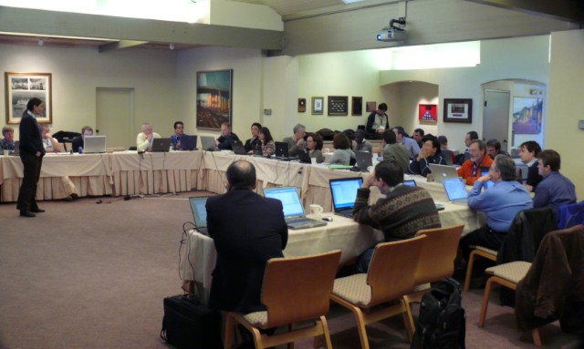
Have a great meeting week!
08:45
17:30
?

