Slide 1
Options to Achieve a Modular Navigation Comprehensive Message
12 April 2018

Slide 2
OPTIONS FOR ACHIEVING COMPOSITE MESSAGE GOAL | PROs | CONs | Project approval Likelihood (H, M, L) | Aggregate Prototyping effort (mo) | Date to Achieve Composite Msg Standard
1: Complete ODM v3 w OCM; Complete ADM v2 w ACM; Request New NDM-KVN v1 w/composite of OCM, ACM, and possibly other atomicized messages approximately 06/2020 | - Gets an OCM and ACM standard released “sooner” - No new project required now (no concept paper now) | - Would not take full advantage of synergies between messages - Risk not getting approval for new NDM-KVN Project | L+-M | +24 | 2023-2025
2: Complete ODM v3 w/o OCM; Complete ADM v2 w/o ACM; Now request New NDM-KVN v1 w composite of OCM, ACM, and possibly other atomicized messages | - Gets current ODM & ADM updates completed freeing resources for new effort. - Could result in OCM/ACM standard released sooner. | - Requires new concept paper / new project now - Risk not getting approval for new NDM-KVN Project - Attempts to add a new project to an already loaded plate. | L-M (seems lower than #1). | +12 | 2021-2022
3: Complete ODM v3 w/OCM & ACM well-integrated to create a Nav Comprehensive Message within the ODM v3; No ACM in ADM. Future development of NDM-KVN v1 w NCM + atomicized other messages | - No new concept paper/new project required now,, but is required later when additional atomicized content is added - Allows ADM to complete sooner - 6 DOF message realized - Could result in OCM/ACM standard released sooner. | - Adds complexity to ODM prototyping - Adds "non-orbit" material to ODM - Possibly more confusing to users of OCM | M | +12 | 2020-2021
4: Develop NDM XML w legacy structure of v2, new KVN of a ToBeDeveloped Nav Comprehensive Message and XML structure of composite NCM as v3, includes OCM/ACM/RDM/TDM/CDM. This concept yields ODM w/o OCM & ADM w/o ACM (similar to #2). | - Keeps legacy message integration as a full message structure (existing) - Add options for modular build up of messaging - No new concept paper/new project now - Could result in OCM/ACM standard released sooner. | - Adds KVN material to the XML document - Rescopes & retitles document - Creates an unnatural hybrid | L | +12 | 2021-2022

Slide 3
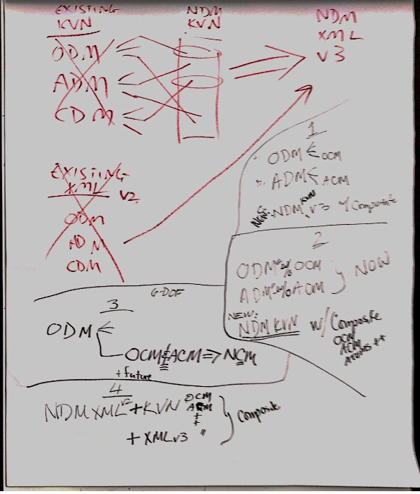
Reference diagram from 12 April 2018 Working Group discussion

