Slide 1
Simplifying MPS Expressions
Quinten Van Woerkom
ESA ESTEC
09/10/2024

Slide 2
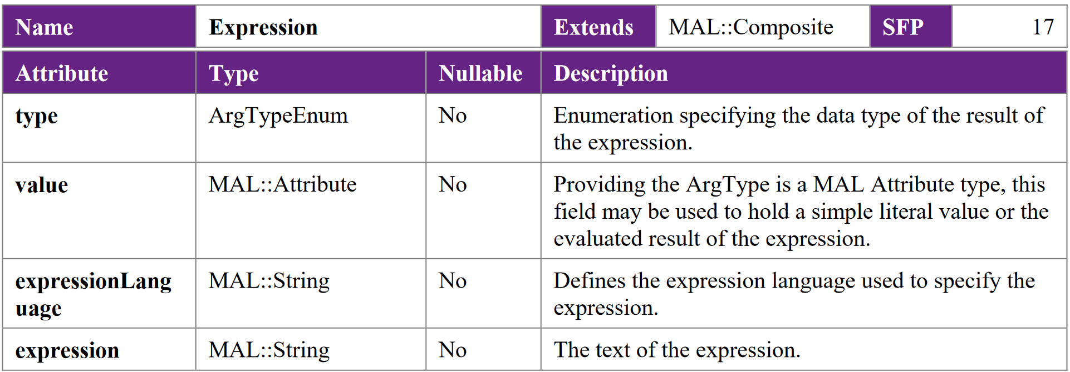
Status quo: Expression

Slide 3
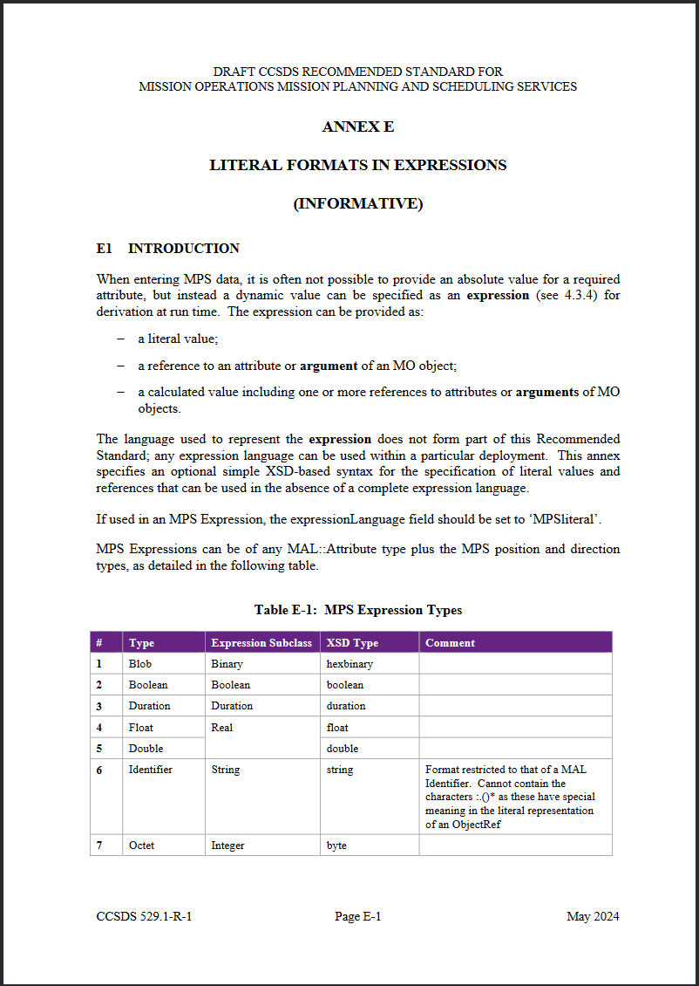
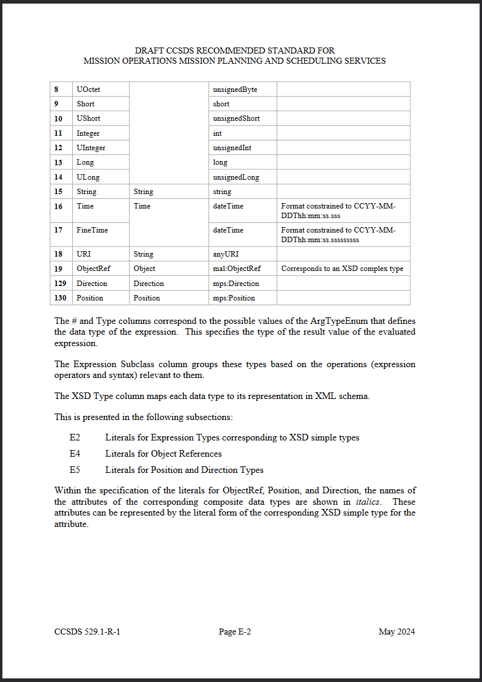
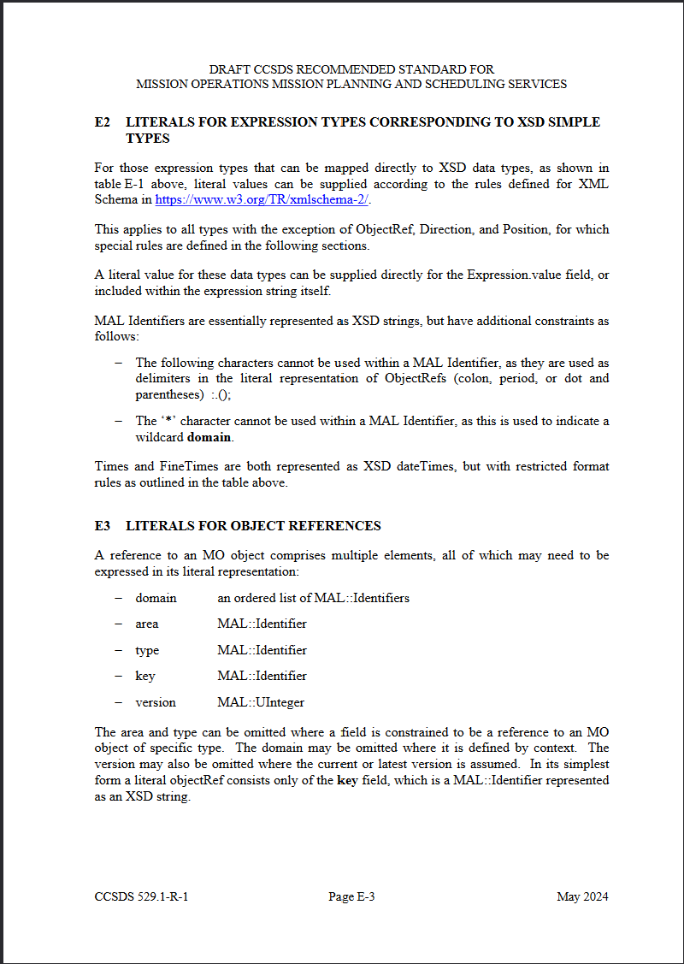
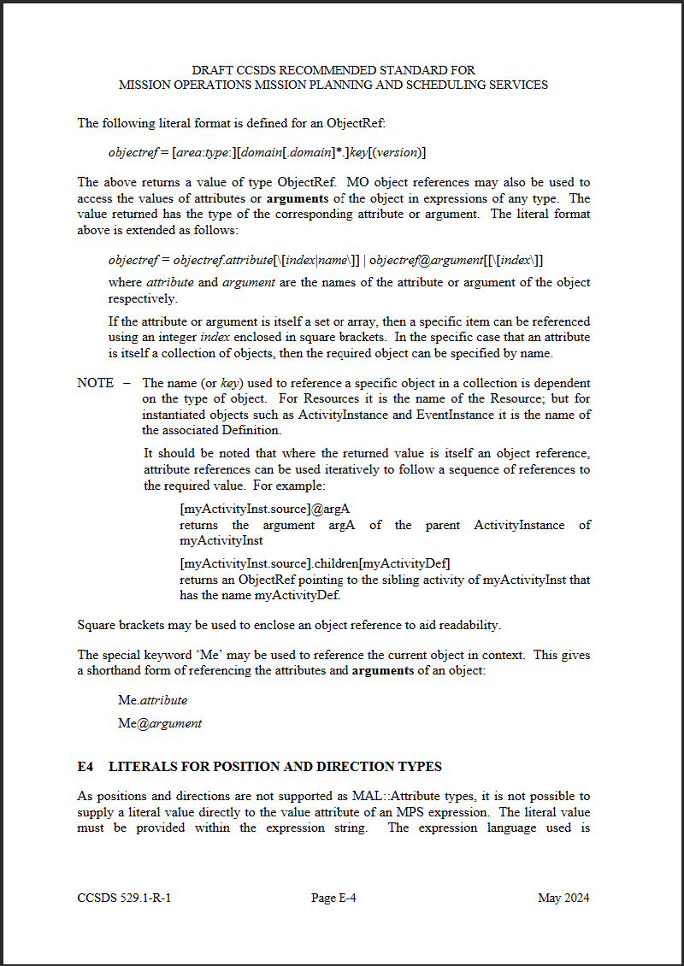
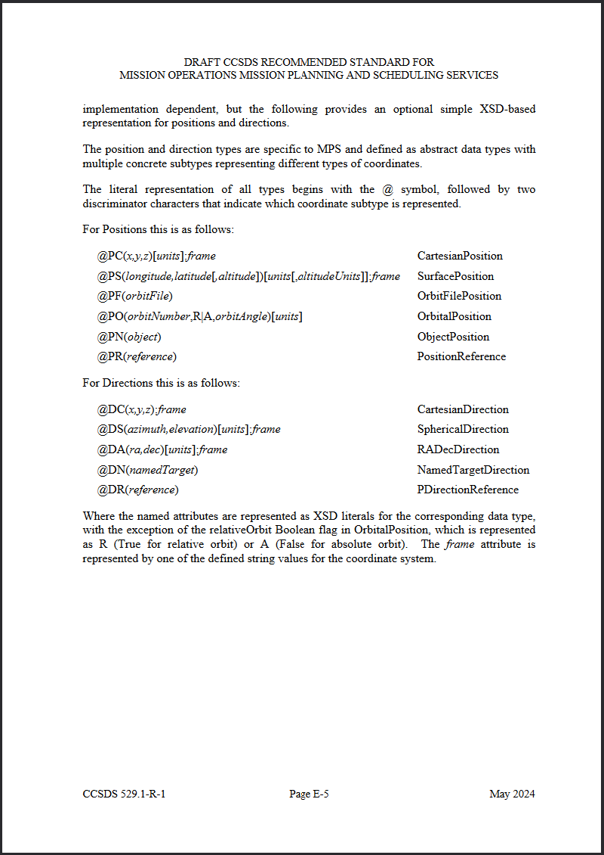
Status quo: expression literals

Slide 4
Resulting objects
Instantiating a literal Cartesian position.
Written in file formats XML syntax:
<expression>
<type>Position</type>
<value>@CP(0,0,0)[km]:ECI</value>
<expressionLanguage></expressionLanguage>
<expression></expression>
</expression>

Slide 5
Resulting objects
Instantiating a literal Cartesian position.
Written in file formats XML syntax:
<expression>
<type>Position</type> Hard-coded (non-extensible) type list
<value>@CP(0,0,0)[km]:ECI</value>
<expressionLanguage></expressionLanguage>
<expression></expression>
</expression>

Slide 6
Resulting objects
Instantiating a literal Cartesian position.
Written in file formats XML syntax:
<expression>
<type>Position</type>
<value>@CP(0,0,0)[km]:ECI</value> Opaque string literal DSL
<expressionLanguage></expressionLanguage>
<expression></expression>
</expression>

Slide 7
Resulting objects
Instantiating a literal Cartesian position.
Written in file formats XML syntax:
<expression>
<type>Position</type>
<value>@CP(0,0,0)[km]:ECI</value>
<expressionLanguage></expressionLanguage> Redundant fields
<expression></expression>
</expression>

Slide 8
Taking a step back
Necessary characteristics:
Encode literals of distinct types

Slide 9
Taking a step back
Necessary characteristics:
Encode literals of distinct types
Permit “external” expression languages

Slide 10
Taking a step back
Necessary characteristics:
Encode literals of distinct types
Permit “external” expression languages
Desired (but not presently achieved) characteristics
Arbitrarily extensible

Slide 11
Taking a step back
Necessary characteristics:
Encode literals of distinct types
Permit “external” expression languages
Desired (but not presently achieved) characteristics
Arbitrarily extensible
Stay within existing data type “language”

Slide 12
Taking a step back
Necessary characteristics:
Encode literals of distinct types
Permit “external” expression languages
Desired (but not presently achieved) characteristics
Arbitrarily extensible
Stay within existing data type “language”
We already have two types with similar needs: Constraint and Trigger

Slide 13
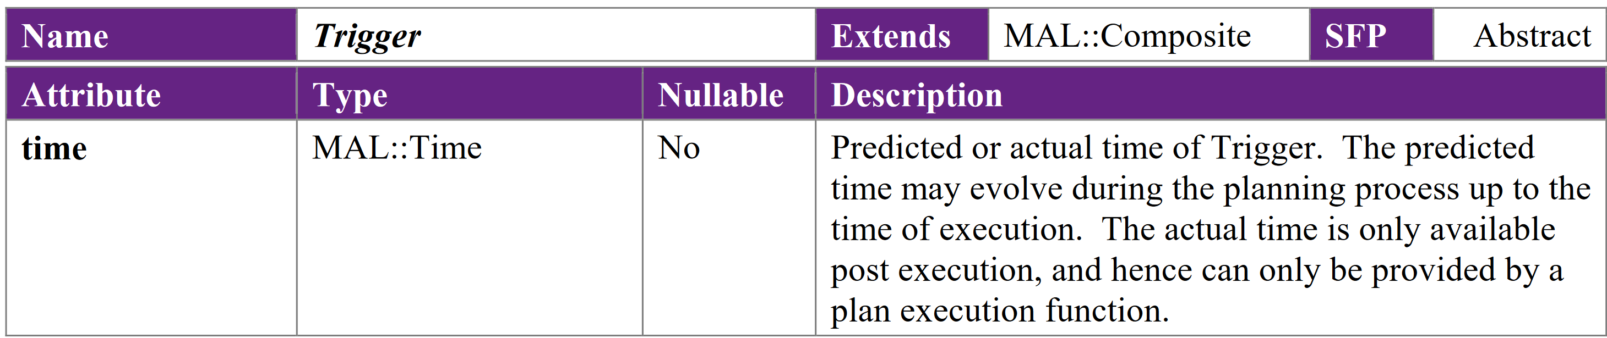
Design of Constraint/Trigger
Abstract base type:

Slide 14
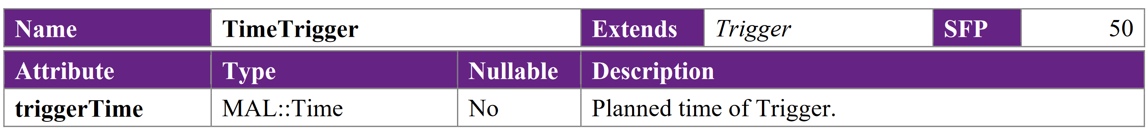
Design of Constraint/Trigger
Abstract base type:
With concrete subtypes:

Slide 15
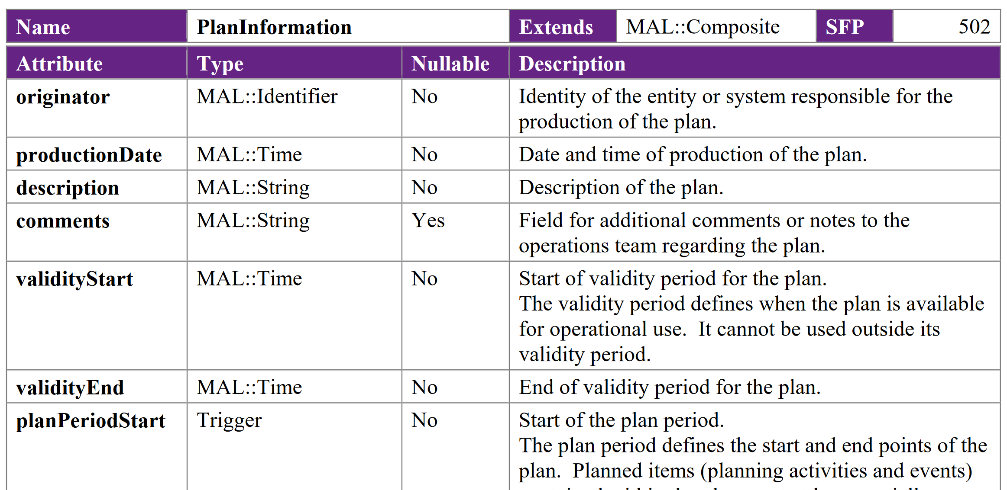
Design of Constraint/Trigger (cont.)
Usage:

Slide 16
Re-designing expressions
Redefine convention of Expression<Type> to be “MAL::Element that evaluates to given data type”.

Slide 17
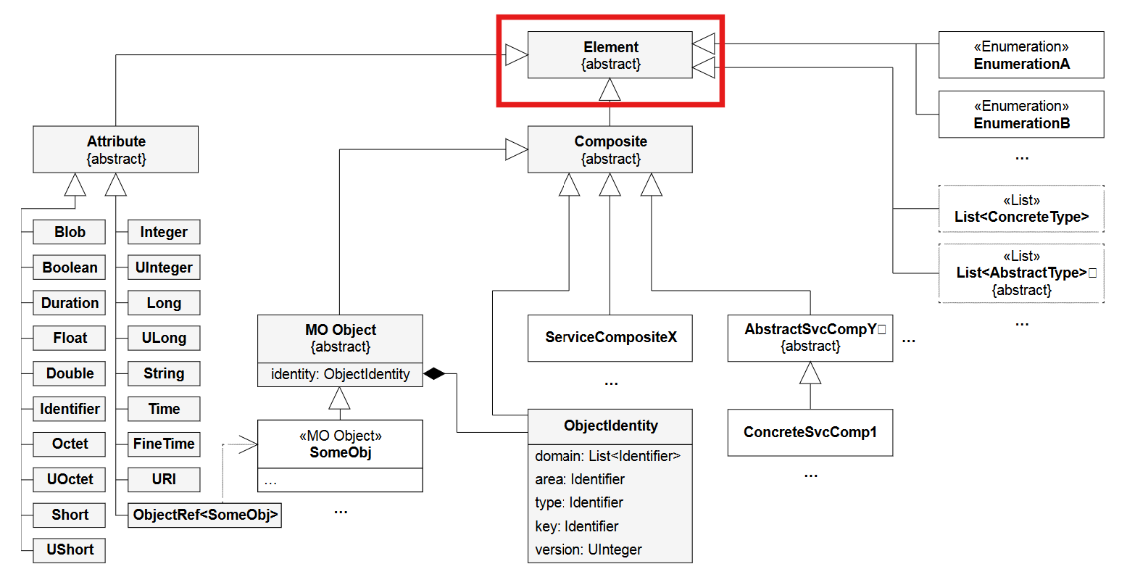
Re-designing expressions
Redefine convention of Expression<Type> to be “MAL::Element that evaluates to given data type”.
Abstract base type
MAL::Element

Slide 18
Re-designing expressions (cont.)
Concrete subtypes
Any existing type (out-of-band agreement needed for Expression<Type> convention)
  Replacing the existing “type” and “value” fields

Slide 19
Re-designing expressions (cont.)
Concrete subtypes
Any existing type (out-of-band agreement needed for Expression<Type> convention)
  Replacing the existing “type” and “value” fields
ExternalExpression to support external language expressions
  Replacing the existing “expressionLanguage” and “expression” fields

Slide 20
Resulting objects
Instantiating a literal Cartesian position.
Written in file formats XML syntax:
<expression>
<type>Position</type>
<value>@CP(0,0,0)[km]:ECI</value>
<expressionLanguage></expressionLanguage>
<expression></expression>
</expression>

Slide 21
Resulting objects
Instantiating a literal Cartesian position.
Written in file formats XML syntax:
<expression> <expression xsi:type=mps:CartesianPosition>
<type>Position</type> <x>0</x>
<value>@CP(0,0,0)[km]:ECI</value> <y>0</y>
<expressionLanguage></expressionLanguage> <z>0</z>
<expression></expression> <frame>ECI</frame>
</expression> <units>km</units>
</expression>
N.B.: this is identical to a “native” CartesianPosition!

Slide 22
Questions?

