Slide 1
MPS Issues for MO v2 (updated)
MO Objects and Object References, Polymorphism
Roger Thompson ESA

Slide 2
Background
MPS has relatively complex Information Model compared to MO M&C
MPS removed COM in anticipation of MO v2 which resulted in simplification of the Information Model
MPS still requires the concept of “MO” Objects – data items that may be contained or referenced in MPS service messages
MPS Objects do not fit with the COM concept of 2 fixed relationships Source and Related. They may have 0, 1 or more relationships to other objects that are specific to the object type.
The draft MPS Services standard makes assumptions on MO objects are how they are supported by new MAL Attribute types covering Identity and References
This includes identification of some standard MO Object patterns: MPS data items may require multiple MO Objects to represent them.
There are some additional aspects in the MAL that require resolution to support standards such as MPS

Slide 3
MPS Assumed Model for MO Objects
MO Objects have an identity that comprises 3 elements:
A scoping Domain
An immutable ID
Optionally a Version
New MAL Attribute Types are assumed to support this:
ObjectID (Domain and ID)
Version (Version)
ObjectRef (a reference to an Object that encompasses both of the above and supports arbitrary relationships between Objects)

Slide 4
Example MPS MO Objects
Activity Definition
Object ID and Version
No direct References/Relationships
Child Activities (specified as ActivityDetails) reference their Activity Definition
Activity Instance
ObjectID but not Version
Multiple References/Relationships as ObjectRefs
Definition – ref to Activity Definition
Source – ref to Parent Activity Instance, or for root Activity to Request Instance
Related Event – ref to Event Instance
Children – refs to child Activity Instances
References
References

Slide 5
MPS Issues with IDs and References
MPS Requires the ability to represent:
An Object with an Immutable ID and Versions
Object IDs scoped by Domain
Separate Definition and Instance Objects, the latter dynamically created; Instances usually do not, but may have Versions
References to Objects that include Domain, ID and optionally Version
Preferably allow references to a specific attribute (or argument) of an Object
Strong typing of Object References is recommended, but
MPS needs the ability to have ObjectRef attributes that can point to multiple concrete classes:
As a List or
As an Abstract super class
Or as a minimum, to have the option of an untyped reference
MPS has assumed 3 new MAL Attribute Types:
ObjectID (assumed to include Domain)
Version
ObjectRef (covers Domain, ID and optionally Version)

Slide 6
Conclusion: Object Identity
Clarify that MAL::Identifier that can be encoded as a mnemonic or a number
ObjectIdentity will be represented by a MAL Composite structure comprising 5 elements:
Domain (as an ordered List of MAL::Identifiers)
Area (as MAL::Identifier) note might have “Object Type as a composite containing Area/Type
Type (as MAL::Identifier)
Key (as new MAL::Identifier)
Version (MAL::UInteger)
The ObjectKey is unique within the scope of the Domain for a given Object Type.
If an object does not have versions, then it will simply have the value “1” (“0” reserved for wildcards)
Area and Type name and number is defined by Service
ObjectIdentity will also be considered a MAL::Attribute

Slide 7
Conclusion: Object References
Object References defined using the same structure as ObjectIdentity – this is used as the MAL::Attribute type MAL::ObjectIdentity
This means they can be used by MPS as a type for Arguments (and Resources) allowing Object References to be passed into Event and Activity Instances.
MPS Notes that if the set of MAL::Attributes can be extended with additional composite structures, this would allow native inclusion of Position and Direction types as Arguments.
MPS Notes that an explicit enum of available MAL::Attribute types is needed. Would make sense for this to be defined in MAL.

Slide 8
PUB-SUB Subscription Keys
Restricted to Four Keys of defined Type
MPS would ideally allow more than four subscription criteria, and of any type. For example:
Req_4.2.10.S.9 The monitorRequestStatus subscription shall be based on the provision of the following keys of the required RequestInstances in the Register message, all of which are nullable:
a) subDomain = domain of subscribed RequestInstances
b) entityKeys.firstSubKey = instanceID of subscribed RequestInstances
c) entityKeys.secondSubKey = definitionID of subscribed RequestInstances
d) entityKeys.thirdSubKey = userID of subscribed RequestInstances
e) entityKeys.fourth SubKey = userReference of subscribed RequestInstances
Note: this assumes the current MAL limit of four entity keys. It is hoped that in the future, the publish-subscribe pattern subscription will allow the specification of an arbitrary list of key field-value pairs. Should this be extended the following additional subscription keys should be supported:
f) status of subscribed RequestInstance
g) outputPlanRef of subscribed RequestInstance
MPS has identified subscription keys that are of the following types: ObjectID, Identifier, enum (Status), String (Tags and SubPlans). These need to be supported

Slide 9
Conclusion: PUB-SUB Subscription Keys
PUB-SUB Keys should allow reference to:
Domain, ID and Version
Object Type (may be inherent to the Service Operation)
An arbitrary list of MAL::Attributes, defined by Service, maintains backward compatibility with current approach as Key Fields correspond to MAL::Attributes
Propose to have an arbitrary list of Key Fields as Name-Value pairs. Standard filter names specified in MAL for:
Domain (should be able to wildcard any point in the tree)
Object Type (may be inherent to the Service Operation)
ID
Version (of the Object not the Service)
Filters Key Fields are defined by the Service, any number (not restricted to four), and of any MAL::Attribute type
Service also defines Key Field order, to enable encoding by index rather than name.

Slide 10
Polymorphism
In addition to the issue on MAL Attributes (Object References), MPS has other composite data types that are polymorphic in Information Model. To avoid complexity in representing these in MAL messages, the restriction on Polymorphism should be removed.
Conclusion:
Restriction on Polymorphic composite types to be removed
Does not require Abstract Types to have an SFP

Slide 11
MO Object Patterns
MPS has identified 3 Object Patterns that we believe will be common to many services:
MO Static Item: a data item that contains only static attributes defined in configuration data. There may be multiple Versions corresponding to changes in that configuration data, but there are no dynamic updates to attributes at run-time.
MPSSystemConfig
MO State: a data item which has both static and dynamic attributes, the static part typically being defined in configuration data. There may be multiple Versions corresponding to changes in that configuration, and there are dynamic updates to attributes at run-time (e.g. state or value), but there is only one copy or instance of the data item at run-time.
Planning Resource, Plan (or an M&C Parameter)
MO Instance: a data item which has both a static definition and multiple run-time invocations (copies or instances), each of which has both static and dynamic attributes. The definition may have multiple versions; and there are dynamic updates to the instances.
Planning Request, Planning Activity, Planning Event (or an M&C Action)

Slide 12
MO Object Patterns

Slide 13
MO Object Patterns: Elements
Each Service specialises the relevant elements of the pattern for a Data Item:
Definition: configuration data (static attributes) and optionally dynamic state/value. This is an MO Object, relevant for all patterns.
Instance: dynamic invocation (static and dynamic attributes). This is an MO Object, relevant only to Instance pattern.
Update: reporting of changes to dynamic attributes (state/value). This is not an MO Object, but a service data structure used in Request or Pub/Sub operation to report current state. Applies to State and Instance patterns.
Details: a data structure used to specify the information needed to create an Instance from a Definition, relevant only to Instance pattern. For example ActivityDetails may be included in an ActivityDefinition to specify child activities; or in a RequestInstance to request the inclusion of activities in a plan.

Slide 14
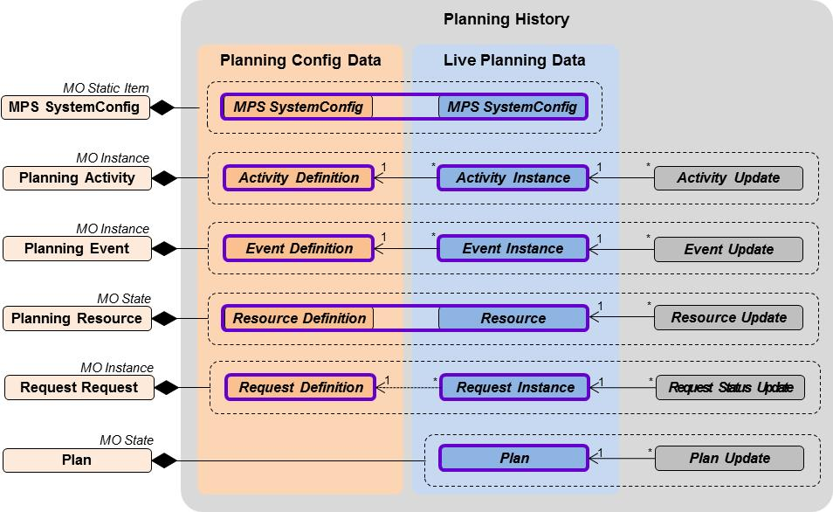
MPS MO Objects

Slide 15
Example MO State: Plan
1
0..*

Slide 16
Example MPS Service: Plan Distribution
Area Identifier | Service Identifier | Area Number | Service Number | Area Version
MPS | PlanDistribution | 42 | 2 | 1
Interaction Pattern | Operation Identifier | Operation Number | Capability Set
REQUEST | getPlanSummaries | 1 | 1
PROGRESS | getPlan | 2
REQUEST | getPlanStatus | 3
PUBSUB | monitorPlanStatus | 4 | 2
PUBSUB | monitorPlan | 5 | 3
PROGRESS | queryPlan | 6 | 4
REQUEST | getPartialPlan | 7 | 5
getPlan and monitorPlan return Plans
getPlanStatus and monitorPlanStatus return PlanUpdates
Operations of the Plan Information Management Service return Definitions for Planning Requests, Planning Activities, Planning Events and Planning Resources

Slide 17
Example MO Instance: Activity
1
0..*

