Slide 1
MP&S WG Report to MOIMS
Virtual Spring Technical Meetings 2020
M. Sarkarati
Marc Duhaze
Notes:
1
1
1

Slide 2
MP&S WG Executive Summary
Achievements for this meeting cycle:
Working managed to work at technical level despite virtual setup (despite a lot of limitations)
The Information model is now consolidated and fairly complete. This is a big achievement.
The WG recognizes the MP&S Information is complex. Initial discussions on possible simplifications took place. The WG believes substantial changes to the model would require significant time and effort. It was decided to leave the current model as is. The complexity could be better managed by dividing the model into a core and extension points (e.g. constraints) and by presentation techniques in the blue book. It was also agreed to now focus on service specs and review the model afterwards to see if further simplifications are possible.
Work on Services advanced
Working Group Status:
”High Momentum”: Very active and participating
1 CNES, 2 DLR, 8 ESA, 1 NASA, 1 EUMETSAT, 1 UKSA
prototyping of precursor services onboard OPSSAT at ESA side continues (not formal CCSDS prototype – Initial Results presented)
Interaction with other WGs
No joint meetings
Coordinated the schedule of MP&S and SM&C WG web-ex meetings. This allowed members of MP&S who are also member of SM&C WG to attend both
It was very good that System Architecture WG avoided overlapping meetings with MP&S WG (Roger is a key person in both WGs)
Problems and Issues:
Virtual Setup (web-ex) is by no means a long-term solution/replacement for physical collocation meetings
5 web-ex sessions of 2hours fragmented over two weeks → Reduced Efficiency
The MP&S WG considers essential to meet 5 days during Fall Meetings 2020, in case it takes place (COVID-19?) . Please book the room!
The discussions on going in the SM&C WG on review of MO Framework would have an considerable impact on MP&S Work. It is right now seen as an element of uncertainty. For the time being we ignore it!
Less progress on Services front. The focus so far has been too much on the data model --> Next Web-ex sessions will be focused on Services

Slide 3
MP&S WG Executive Summary
Resolutions agreed upon this meeting
None
Further Resolutions anticipated in the next 6 months:
None
Planning (only approved Projects):
Area and WG name | CCSDS Ref Nr | Document Title | Status / Comments | Start and / or Target Publication Date
MOIMS P&S | XXX | Mission Planning And Scheduling | OK. Work on BB specification is ongoing. | Start date 10/05/2017 End date 15/09/2021

Slide 4
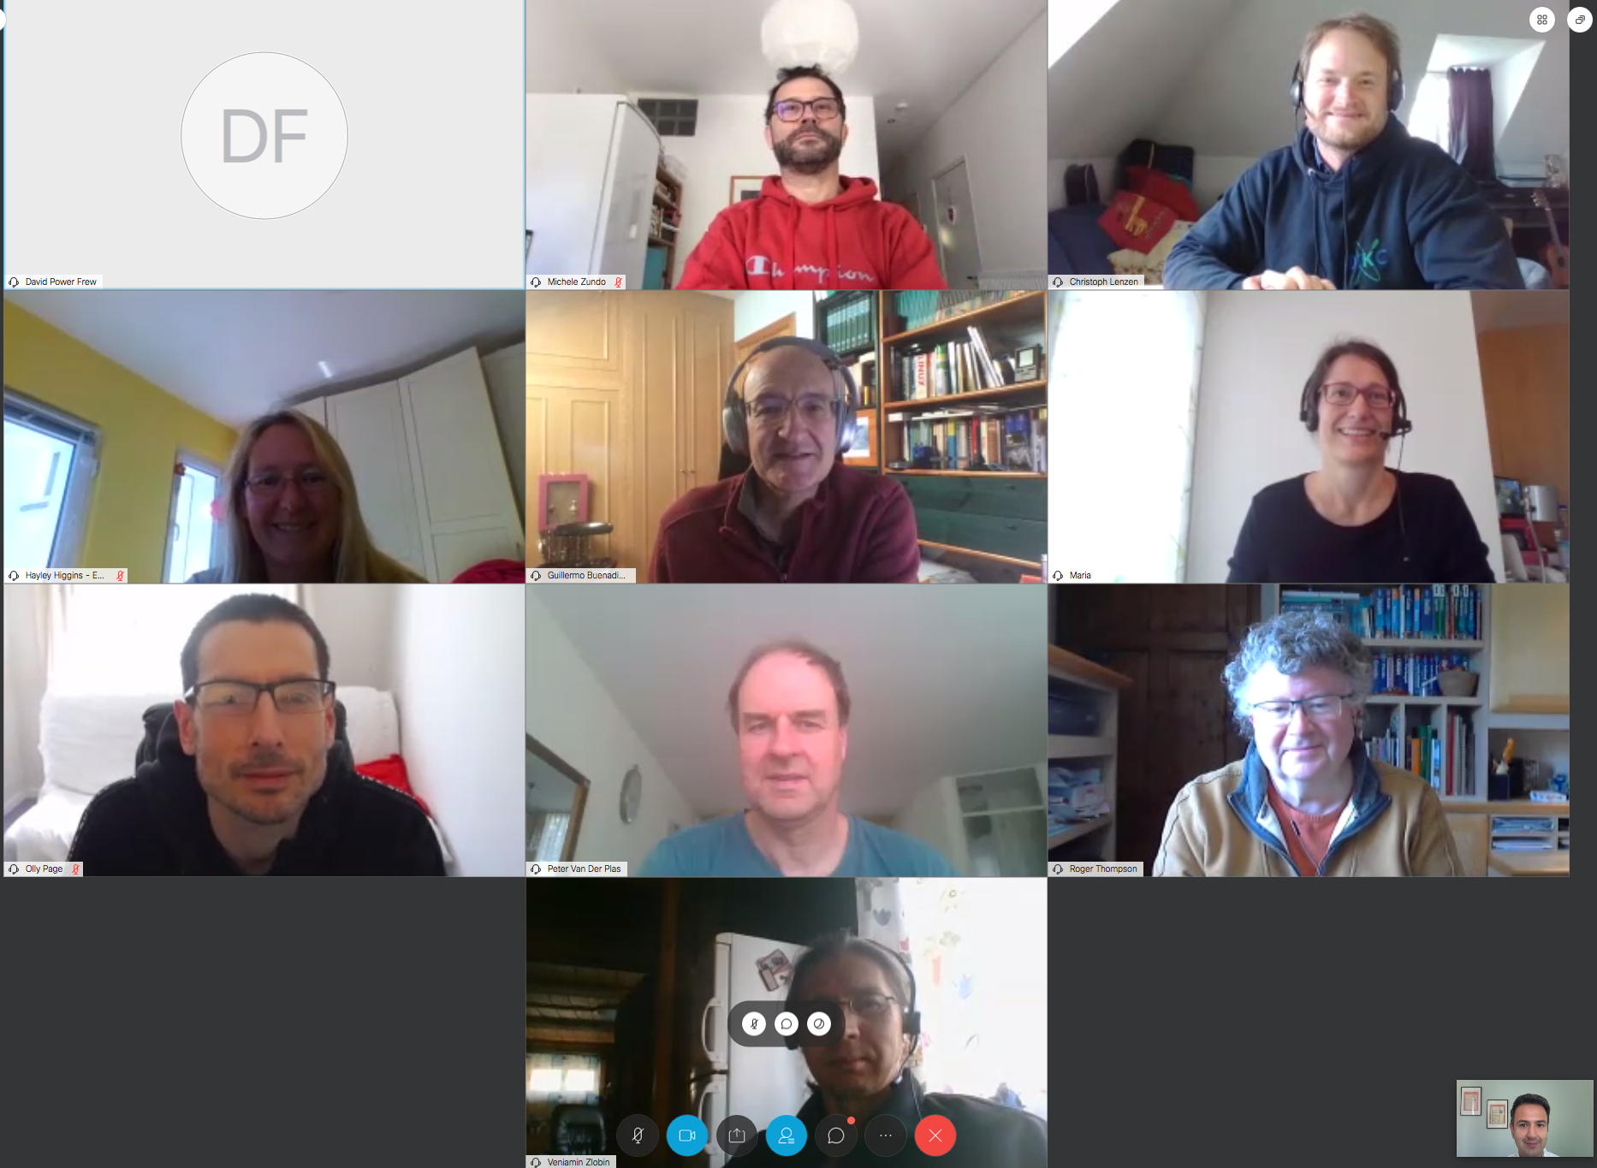
Virtually United at Corona Times ☺

