Slide 1
Development of New Standards for OAIS Interoperability SpaceOps 2023 March 6-10, Dubai UAE
Mike Kearney
KearneySolutions@gmail.com
Space Infrastructure Foundation
Also the CCSDS DAI WG
Also the Google Digital Vellum Project
Supporting Co-authors:
David Giaretta, PTAB Ltd.; DAI WG co-chair
John Garrett, Garrett Software; DAI WG co-chair
Steve Hughes, NASA JPL CalTech; DAI WG Architecture Document Book Editor

Slide 2
Intro to CCSDS and the DAI Working Group
Reasons for this presentation:
Introduce proposed new architecture for archive interoperability
Get feedback on our approach, invite participation
Elevate awareness of need for long-term digital preservation.
Background on CCSDS:
Consultative Committee for Space Data Systems
CCSDS is organized by space agencies, but inclusive of other (non-space) agencies, industry and academia
About 24 working groups, one of which is the DAI WG
Data Archive Interoperability Working Group
Focused on long-term Digital Preservation Archives
Developed the Open Archival Info System (OAIS) Reference Model
Published by both CCSDS and ISO, widely adopted for digital preservation

Slide 3
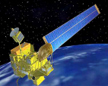
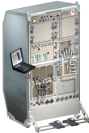
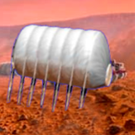
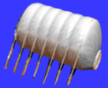
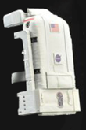
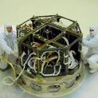
CCSDS Overview - End-to-End Architecture
Systems Engineering
Security
Delta-DOR
System Architecture
MISSION CONTROL
CENTER
End Users
Applications/Archives
MISSION CONTROL
CENTER
End Users
Spacecraft Onboard
Interface Services
Space Link
Services
Cross Support
Services
Space Internetworking
Services
Mission Ops &
Info Mgt Services
Onboard Wireless WG
Application Supt Services (incl. Plug-n-Play)
Subnetwork Services WG
RF & Modulation
Space Link Coding & Sync.
Multi/Hyper Data Compress.
Space Link Protocols
Space Data Link Security
Optical Coding and Mod
CS Service Management
CS Transfer Services
Motion Imagery & Apps
Delay Tolerant Networking
Voice
CFDP Revisions
Data Archive Interop.
Navigation
Spacecraft Monitor & Control
Telerobotics
Mission Planning & Scheduling
Notes:
The DAI WG works at the application layer of the CCSDS architecture, in MOIMS.
Encourage audience to consider lots of participation across the CCSDS areas.

Slide 4
New Direction for the DAI WG
Initially the DAI WG worked on processes for digital preservation.
That resulted in the OAIS Reference Model first published in 2002
Continued to optimize OAIS Processes in 5-year reviews.
OAIS-RM and associated process documents are now collectively referred to as the OAIS Process Framework (OAIS-PF)
Subsequently set up ISO certification process for trustworthy repositories
Result - OAIS practices are widely accepted and practiced among national archives and libraries around the world.
Now DAI is starting work on interoperability standards for archives
Google’s Vint Cerf approached us and advocated stronger focus on technical interoperability for preservation archives.
For both OAIS archives and “regular” archives (your current archives).
Called the OAIS Interoperability Framework (OAIS-IF).

Slide 5
The Digital Preservation Problem Statement for Space Missions
With a few exceptions, many missions lose access to their mission data after the mission terminates – funding stops – Software becomes obsolete
Legacy mission TLM is often valuable but inaccessible.
Lost mission and project lessons learned will handicap new programs.
Lessons learned (or not) examples:
Prior SpaceOps presentation examples: Apollo, ALSEP, NASA Galileo, IMAGE.
New Use Case: NASA Interstellar Probe mission may last 50+ years.
Software obsolescence seen as a global problem
Much of today’s data may be inaccessible in decades, or certainly in a century.
Google on “Digital Dark Age”
Massive data sets will be needed to train future AIs. Preservation→AI capability.
If program/project data is preserved, example query: “For all projects that use cost model X, what percentage of them came in at or under predicted costs?”
There is no better time to start to build this capability than right now.

Slide 6
OAIS-IF Development Plans and Constraints
OAIS-IF builds on OAIS standards (but should work fine with non-OAIS archives.)
OAIS-IF interfaces can work in parallel with existing archive interfaces.
OAIS-IF will be made up of a set of interfacing standards, not specifying the underlying functionality of the software, except as needed to enable the interface.
We expect to define protocols and Application Programming Interfaces (APIs) which can be used to create software adapters to enable interoperability.
We are developing OAIS-IF using UML models, which should be made available for archive developers building software to the standard.
CCSDS Requires two independently developed prototypes before a standard can be approved, and we hope that those will be available as references for archive developers, also.

Slide 7
Interoperability for OAIS-IF
There are many definitions of interoperability
For our purposes, we plan to provide archival interoperability for:
Users’ (Producers’ and Consumers’) access to archives
Archive-to-archive interoperability (assuming usage of the Users’ interfaces)
Producers
Consumers
Interfaces
Interfaces
Interfaces
Interfaces
Interfaces
Archive 1
Archive 2
Archive 3
Notes:
There are many definitions of interoperability which we won’t go into here. In our context, it means…
CLICK1 - Our goals of interoperability are to improve users’ access to archives. Users meaning Producers and Consumers.
CLICK2 - We also expect to provide archive-to-archive interoperability, and we believe this can be done simply with the same interfaces as producers and consumers. This should enable transfers between archives of preserved data and the supporting Representation Information.

Slide 8
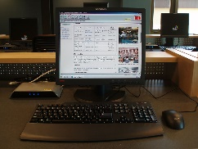
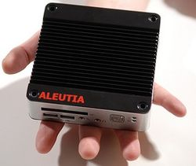
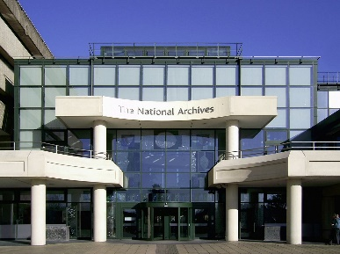
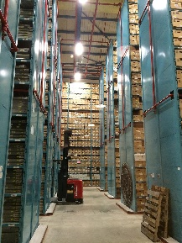
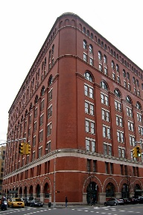
Current situation
Needs separate software for each type of data
Needs separate software for each type of data
Needs separate software for each type of data
Transferring whatever the archive
sends, usually simple files – relies
on client having appropriate s/w
Notes:
Consider the scenario where there are many different users, wanting to bring together information from many different sources (archives or other sources). Consider that these archives are widely different. Science, Web Archives, Engineering, Humanities, etc.
CLICK Client 1 talks to archive 1,2,3. (but requires circle, triangle and square SW)
CLICK Client 2 talks to archive 2,3,4. (similar)
CLICK Client 3 talks to archive 3,4,5. (similar)
BUT
CLICK each archive sends whatever it normally sends – often just files in the native format.
For any client to deal with all these interfaces, then different s/w needs to be installed and learned by all users

Slide 9
Our vision for OAIS-IF
User 1
s/w adapter
User 2
s/w adapter
User 3
s/w adapter
Transferring whatever the archive
sends, usually simple files – relies
on client having appropriate s/w
Transferring Information Packages in
a standard way allows development
of common adapters across nodes
Users always need some “adapters” in order to be able to use new SW without modifying their existing SW.
Archive 1
s/w adapter
Archive 2 s/w adapter
Archive 3
s/w adapter
Archive 4
s/w adapter
Archive 5
s/w adapter
Notes:
Our vision is that each client should need only one adapter at their location… and they should be able to talk to many archive adapters installed at the archives or sources.
And each adapter at the archives/sources should be able to talk to many users’ adapters.
What is exchanged is OAIS Information Objects – not only containing the object of preservation but also some representation information to interpret and validate the object data.
The key point is that instead of requiring the users to have lots of versions of archive software they only need the user adapters. And users have access to many more archives than they had before.
CLICK - Any solution that strives to avoid requiring expensive modifications to user or archive software will have to use some form of adapter-type software layers. We just specify interoperable adapters.

Slide 10
OAIS-IF Architecture Concept - Functions
User SW
Usual functions of existing user software – HMI display, search, etc.
(User = producer, consumer or other archives)
User Systems
Adapts user SW to generic adapter. May have some functions for specific users, driven by the user community.
OAIS-IF
User Specific Adapter
2
Handles info packages from archive in abstract fashion – Not sensitive to content of info packages. Meets the standardized interface to the Archive Generic Adapter.
OAIS-IF
Generic Adapter
1
Red waves are interfaces defined by OAIS-IF
Comm Infrastructure
Comm Infrastructure performs normal internet communications functions using TCP/IP protocols or other equivalent protocols.
Information Packages flow IAW the OAIS Information Model
1
Handles Info Packages from User in abstract fashion. Not sensitive to content of info packages. Meets the standardized interface to the User Generic Adapter.
OAIS-IF
Generic Adapter
2
Archive Systems
OAIS-IF
Archive Specific Adapter
Adapts the Archive legacy interface to the Archive Specific Adapter. May package or repackage Info Objects from the archive to deliver to users.
Archive SW
Usual functions of existing archive software – Database responses, retrieval of objects and RepInfo, etc.
Switchboard
Provides and registers info that describes how to talk to an archive.**
Registry
May provide to the User additional RepInfo that supplements the RepInfo from the archive.**
**Normally part of originating archive, but may be supplemental data in a remote archive.
Notes:
Now to describe the high-level functions of the components of the OAIS-IF Architecture
CLICK There is existing user s/w which does functions specific to the user’s discipline.
CLICK The User Specific Adapter adapts the User SW interface to the more abstract User Generic Adapter. It may be sensitive to information content that is unique to a user application or a user community (how to handle astronomy photos, for example). Probably aware of RepInfo structure/content.
CLICK The User Generic Adaptor simply handles the abstract transactions of information objects as they cross the communications interface.
CLICK Comm Infrastructure - The Information Objects cross the boundary from user to archive using common communications infrastructure.
CLICK The Archive Generic Adapter mirrors the functionality of the User Generic Adapter to deliver the information objects to the Archive Specific Adapter. Abstract transactions.
CLICK the Archive Specific Adapter adapts the Archive’s interface to the generic adapters. To a degree it understands the content of the information objects well enough to do common functions, such as repackaging the Archive’s response to the User’s Data Request.
CLICK The Archive SW is the existing (or legacy) software that hopefully will remain unchanged.
CLICK The Switchboard - There needs to be a resource that describes how to talk to any given archive. It may point to where adapters can be downloaded, for example. A switchboard may be may be within the archive, or in a remote archive, or simply an archive-like website run by a designated community.
CLICK The Registry - There may be a need to access additional RepInfo from outside of the originating archive. This Registry of supplemental RepInfo may be within the archive, or in a remote archive, or simply an archive-like registry run by a designated community. There may be negotiation to allow the user to request more RepInfo, or to have it transformed into an alternate format. This supports the cross-discipline capabilities we discussed earlier.
CLICK the Red Squiggly Lines are the interfaces that will be documented in normative CCSDS/ISO standards.
CLICK The interface between the two generic adapters is the same interface across the Comm Infrastructure.
The data flowing on these paths are Information Packages as defined by the OAIS Information Model.

Slide 11
OAIS-IF Architecture Concept – Resources
User SW
Existing USER software (User = producer, consumer or other archives)
User Systems
CCSDS will develop a prototype with limited capabilities. User s/w developers will have to write most of these. May be common for a user community.
OAIS-IF
User Specific Adapter
2
OAIS-IF
Generic Adapter
Prototype available from CCSDS can be used but people may want to write their own
1
Comm Infrastructure
1
OAIS-IF
Generic Adapter
Prototype available from CCSDS can be used but people may want to write their own
2
CCSDS hopes to provide a broadly usable implementation which archives would need to configure. Archives may need to produce their own s/w, but we believe that common versions should be sharable between many archive communities.
Archive Systems
OAIS-IF
Archive Specific Adapter
Archive SW
Existing ARCHIVE software
Switchboard
Developed by archives or perhaps a third party source in the designated community
Registry
Developed by archives or perhaps a third party source in the designated community
Notes:
Now to talk about resources for developing your own OAIS-IF implementation.
CLICK There is existing end-user software for Users and Archives. We hope that it doesn’t need modification.
CLICK User Specific Adapters – Because of the dependency on the legacy User SW, user developers will have to develop most of these, but we expect that they can be shared across discipline communities. (For example, a community like Web Archive users) CCSDS will develop a prototype which hopefully can be made open source and available for download.
CLICK We expect the Generic adapters (User and Archive side) to be common for many archives and communities. CCSDS plans to produce at least two prototypes of User Generic Adapters and Archive Generic Adapters. We hope to make them available to the community, again, open source so that user and archive developers can capitalize on them.
CLICK Archive Specific Adapter – Archives may need to produce their own software, but (again) we hope for a CCSDS prototype available as a starting point. And we expect that some communities of archives… those that use a certain commercial product, for example, can share what they developed, or buy commercial adapters. Best case is that they can use the CCSDS prototype and simply configure it, e.g. to fill in some tables.
Both Registry and Switchboard capabilities will most likely have to be developed by archives or a third party at the remote location. However, CCSDS will have some basic prototypes available. Many would consider these part of any archive’s job, but as I said our architecture accommodates remoteness. For adapters within these functions, they will probably use the same adapters as the archives that they supplement.

Slide 12
OAIS-IF Architecture Concept – Deployment options
Deployment Baseline Consolidated adapters Native Spec. Adapter Native Adapters
Options:
User SW
User SW
User SW
User SW
User Systems
OAIS-IF
User Specific Adapter
OAIS-IF
User Adapter
2
2
2
2
OAIS-IF
Generic Adapter
OAIS-IF
Generic Adapter
1
1
1
1
Communications Infrastructure (WAN, etc...)
1
1
1
1
OAIS-IF
Generic Adapter
OAIS-IF
Archive Adapter
OAIS-IF
Generic Adapter
Archive SW
Archive Systems
2
2
2
2
OAIS-IF
Archive Specific Adapter
Archive SW
Archive SW
Archive SW
Notes:
Now to discuss deployment options (in the MBE sense).
The first column is our baseline as we just described it.
The second column illustrates that some developers could combine their specific and generic adapters into one implementation. It looses some benefits of a layered architecture, but it will still be interoperable.
The third column illustrates that the specific adapter functions could be incorporated into the user software, and still retain interoperability.
The fourth column illustrates that BOTH adapters could be incorporated into the user or archive software and still retain interoperability.

Slide 13
DAI WG Document Tree
OAIS
Reference Model
OAIS RM constrains
all other OAIS docs
Legend:
Blue Book
Normative, SW implementable for interoperability
Magenta Book
Normative, but not SW implementable
IPELTU
Audit/Cert
PAIMAS
Green Book
Informative, not normative
Completed (or in systematic review)
In work
Future work
OAIS-PF
OAIS-IF
OAIS-IF Rationale, Scenarios and Requirements
OAIS-IF Architecture
Description Document (ADD)
OAIS-IF ADD constrains
all other OAIS-IF docs
PAIS/CAIS
OAIS-IF Switchboard
OAIS-IF Core Specifications
Generic Adapter Interfaces
OAIS-IF Specific Adapter Practices
OAIS-IF Registry
EAST
DEDSL
PVL
RepInfo I/F’s
XFDU
Representation Info Standards
Packaging
Standard
Notes:
Green dot = published, Orange = in work, red = future work.
The top half of the document tree is the OAIS-PF (already published). Bottom half is the OAIS-IF (this new work we’re describing).
Primarily working on the Green book, the ADD and the Core Specifications right now.
PAIS = Producer Archive Interface Standard (existing) and CAIS is a future Consumer equivalent.
(could use some help explaining PAIS compared to current OAIS-IF interface standards.)

Slide 14
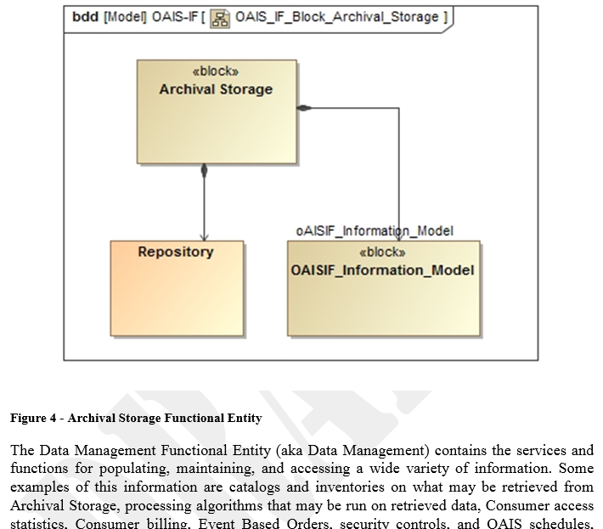
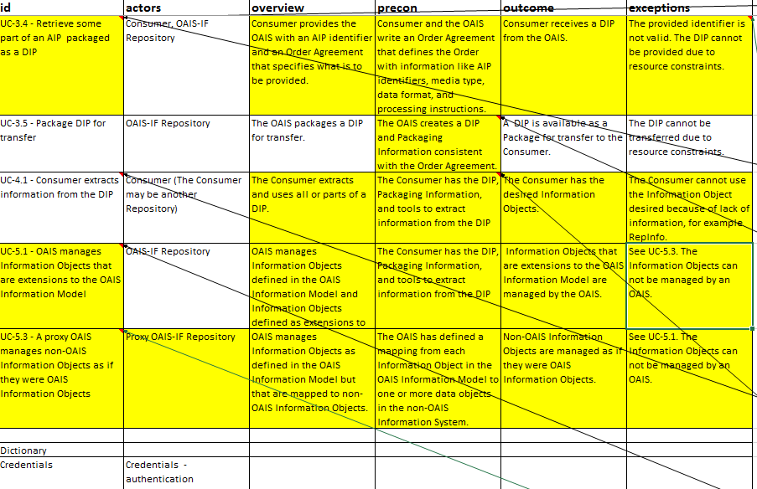
OAIS-IF Development Approach
Data Archive Architecture Description
UML Model
OAIS-RM
Info Model
& Processes
Data Archive
Architecture Description
Document
Use Cases
Notes:
We are developing our interface specs using UML models. We think we will be able to make the UML models available for developers, so those development organizations using MBE will benefit greatly in terms of rapid development of OAIS-IF systems.
Our inputs are the OAIS RM and Use Cases we have collected.
These feed into the UML model.
Much text for the ADD and Blue Book is directly generated by the UML model.

Slide 15
Key Conclusions
For all archive types, once we have broad availability of generic and specific adapters, we believe this will spawn greater access between disciplines for cross-discipline research.
For OAIS Archives, this of course requires Users and Archives to follow OAIS guidelines and store adequate Representation Information (metadata) to allow the interpretation of the preserved data object.
If *any* archive meets the interface specified by the generic adapter, they should realize the interoperability benefits of OAIS-IF.
The layered, modular architecture approach will enable rapid implementation by the space operations community.
By preserving engineering/design data as well as science data, missions will be better able to incorporate lessons learned and techniques from past missions.
Given appropriate access, this will also foster the “big data” capabilities for AI training with deeply historical data.

Slide 16
The DAI Working Group welcomes review and critique, and participation in the development of OAIS-IF from users or developers that can make substantive technical contributions.
Official contact info at:
https://cwe.ccsds.org/moims/default.aspx#_MOIMS-DAI
Questions, Comments?

Slide 17
Backup material

Slide 18
Example of OAIS functions
SIP
DIP
SIP = Submission Info Pkg
AIP
AIP = Archive Info Pkg
Consumer/Producer S/W
Archive S/W
DIP = Dissemination Info Pkg
User-defined Interface
User SW
OAIS-IF SW
Archive SW
OAIS-IF SW
Archive-defined Interface
User Specific
Adapter (USA)
OAIS Info Objects
Archive Specific Adapter (ASA)
2
(User*) Specific Adapter I/F
(Archive*) Specific Adapter I/F
2
Generic Adapter (GA)
Generic Adapter (GA)
Generic Adapter I/F
Archive Ingest
Generic Adapter I/F
1
Serialisation I/F (JSON, etc…)
Serialisation I/F (JSON, etc…)
User Access
1
Protocol I/F (HTTP/REST, etc…)
Protocol I/F (HTTP/REST, etc…)
Communications
Notes:
Now we’ll demonstrate some examples of OAIS functions with this architecture.
CLICK 1: A producer builds an SIP (Submission Info Pkg) to send data objects to the archive to be preserved.
CLICK 2: When the SIP is received by the archive, it is stored as an Archive Info Pkg
CLICK 3: When a user requests data from the archive, it is sent as a DIP (Dissemination Info Pkg).

Slide 19
DAI WG Standards and User/Archive Process Flow
Defines how to check that the information is being preserved
Guides the collection/creation of the metadata required for long term use and preservation
DATA PRODUCERS
AUDIT & CERTIFICATION
DATA CONSUMERS
IPELTU
Defines a process to transfer
Data /metadata to the archive
OAIS RM
Defines a process to transfer
Data /metadata from the archive
PAIMAS
CAIMAS
Defines how the information should be preserved
OAIS Process Framework (OAIS-PF)
OAIS Interoperability Framework (OAIS-IF)
DA-ADD
Data Archive Architecture Description Document
Describes Data Architecture;
how Software components
fit together
USER SPECIFIC ADAPTER
GENERIC ADAPTER
ARCHIVE GENERIC ADAPTER
GENERIC ADAPTER
USER SPECIFIC ADAPTER
PAIS
CAIS
EAST
DEDSL
DATA PRESERVERS (ARCHIVES)
XFDU
SPACE ARCHIVE SPECIFIC ADAPTER
SCIENCE ARCHIVE SPECIFIC ADAPTER
ENGINEERING ARCHIVE SPECIFIC ADAPTER
WEB ARCHIVE SPECIFIC ADAPTER
“OTHER” ARCHIVE SPECIFIC ADAPTER
These are examples of future Blue Books that might be required for specific adapters for each archive or type of archive.
PVL
RepInfo I/F’s
CCSDS/ISO Standard for Packaging
Legend:
CCSDS/ISO Standards for
Representation Information
Blue Book
Normative, SW implementable for interoperability
Magenta Book
Normative, but not SW implementable
Green Book
Informative, not normative
Completed (or in systematic review)
In work
Future work

Slide 20
Architecture Change Mapping from 2020 to 2021 versions
For audiences of prior OAIS-IF presentations
Architecture prior to 2020 Current Architecture Concept
Producer Archive
Application
Consumer Archive
Application
User SW
Red waves are interfaces defined by OAIS-IF
OAIS-IF
User Specific Adapter
User Systems
Producer Archive I/F
Consumer Archive I/F
OAIS-IF
User Generic Adapter
Archive Abstraction Layer
Same interface
Communications
Infrastructure
(WAN, etc...)
Science Data
Binding
Web/HTML Data
Binding
Engineering
Data
Binding
Enterprise Data
Binding
Web/HTML
Binding
Doc/PDF
Binding
OAIS RM Information Objects flow
OAIS-IF
Archive Generic Adapter
Science Data
Archive I/F
Science Data
Archive
Web
Archive I/F
Web
Archive
Engineering Data
Archive I/F
Engineering
Data Archive
Doc/PDF
Archive I/F
Doc/PDF
Archive I/F
OAIS-IF
Archive Specific Adapter
Archive Systems
Archive SW

Slide 21
Acronym list
Acronym | Description | Link (when available)
ADD | Architecture Description Document
AI | Artificial Intelligence
AIP | Archive Information Package
API | Application Programming Interface
ASA | Archive Specific Adapter
CAIMAS | Consumer Archive Interface Methodology Abstract Standard
CAIP | Consumer Archive Interface Protocol
CAIS | Consumer Archive Interface Specification
CCSDS | Consultative Committee for Space Data Systems | www.ccsds.org
DAI WG | Data Archive Interoperability Working Group | https://cwe.ccsds.org/moims/default.aspx#_MOIMS-DAI
DEDSL | Data Entity Dictionary Specification Language | CCSDS 647.1-B-1
DIP | Dissemination Information Package
EAST | Enhanced Data Subset (Data Description Language) | CCSDS 645.0-G-1
GA | Generic Adapter
HTML | HyperText Markup Language
I/F | Interface
IPELTU | Information Preservation to Enable Long Term Use
ISO | International Organization for Standardization | www.iso.org
JPL | Jet Propulsion Laboratory | www.jpl.nasa.gov
NASA | National Aeronautics and Space Administration | www.nasa.gov
OAIS | Open Archival Information System | https://public.ccsds.org/Pubs/650x0m2.pdf
OAIS-IF | OAIS Implementation Framework
OAIS-PF | OAIS Process Framework
OAIS-RM | OAIS Reference Model | CCSDS 650.0-M-2
PAIMAS | Producer Archive Interface Methodology Abstract Standard | CCSDS 651.0-M-1
PAIP | Producer Archive Interface Protocol
PAIS | Producer Archive Interface Specification | CCSDS 651.1-B-1
PDF | Portable Document Format
PVL | Parameter Value Language | CCSDS 641.0-B-2
SANA | (CCSDS) Space Assigned Numbers Authority | www.sanaregistry.org
SIP | Submission Information Package
SW | Software
UML | Unified Modeling Language | https://www.omg.org/spec/UML/About-UML/
USA | User Specific Adapter
WAN | Wide Area Network
XFDU | XML Formatted Data Unit | CCSDS 661.0-B-1

