Slide 1
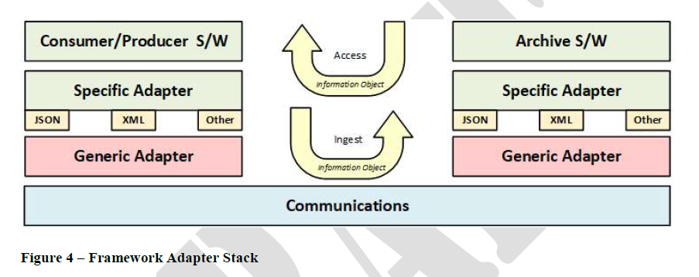

Slide 2
Archive S/W
User S/W
Specific Adapter
Specific Adapter
Generic Adapter
Generic Adapter
JSON
Serialisation i/f
JSON
Serialisation i/f
HTTP/REST
Protocol i/f
HTTP/REST
Protocol i/f
Communications

Slide 3
Minimum suggested changes
OAIS Info Objects
Consumer/Producer S/W
Archive S/W
User Specific Adapter
Archive Specific Adapter
Generic Adapter
Archive Ingest
Generic Adapter
JSON
Serialisation i/f
JSON
Serialisation i/f
HTTP/REST
Protocol i/f
User Access
HTTP/REST
Protocol i/f
Communications

Slide 4
Additional suggested changes
User Access flow
(HTTP example)
Data Flow is
OAIS Information Objects
Archive Ingest flow
(JSON example)
Consumer/Producer S/W
Archive S/W
Interface 3
User SW
OAIS-IF SW
Archive SW
OAIS-IF SW
Interface 3
User Specific Adapter
Archive Specific Adapter
Interface 2
Interface 2
Generic Adapter
Generic Adapter
*JSON
I/F
**HTTP/
REST I/F
**Serialization
I/F
**Protocol
I/F
*Default language binding
**Optional language bindings TBS
*JSON
I/F
**HTTP/
REST I/F
**Serialization
I/F
**Protocol
I/F
Interface 1
Interface 1
Communications

