Slide 1
Data Archive Interoperability
DAI WG Report to MOIMS
Virtual Meetings
Spring 2020 – Fall 2020
David Giaretta (WG Chair)
John Garrett (WG Deputy Chair)
Notes:
1
1
1

Slide 2
DAI WG Executive Summary
Achievements for this meeting cycle:
CCSDS 650.0 (ISO 14721) OAIS v3 Submitted for Agency and ISO reviews | Responded to Deputy Area Director Responded to comments from new ESA participants Responded to comments from Peter Shames (SEA + others)
CCSDS 652.0 (ISO 16363) Audit Metrics Submitted to AD 22 Oct 2020
IPELTU Submitted to AD 22 Oct 2020 | Expanded annexes, e.g. for Space Mission programs
CCSDS 652.1 (ISO 16919) Guidelines for Auditing Bodies Expect to submit to AD by December | Initiated new project and requested approval Collecting suggested changes
OAIS-IF Architecture Description document Document generation driven by detailed modelling – UML and Ontologies | Significant Modelling activity Significant clarification of approach Consideration of links to SM&C MAL
Certifications as Trustworthy Digital Repository based on our Standards | Government repositories Large scientific archives in progress

Slide 3
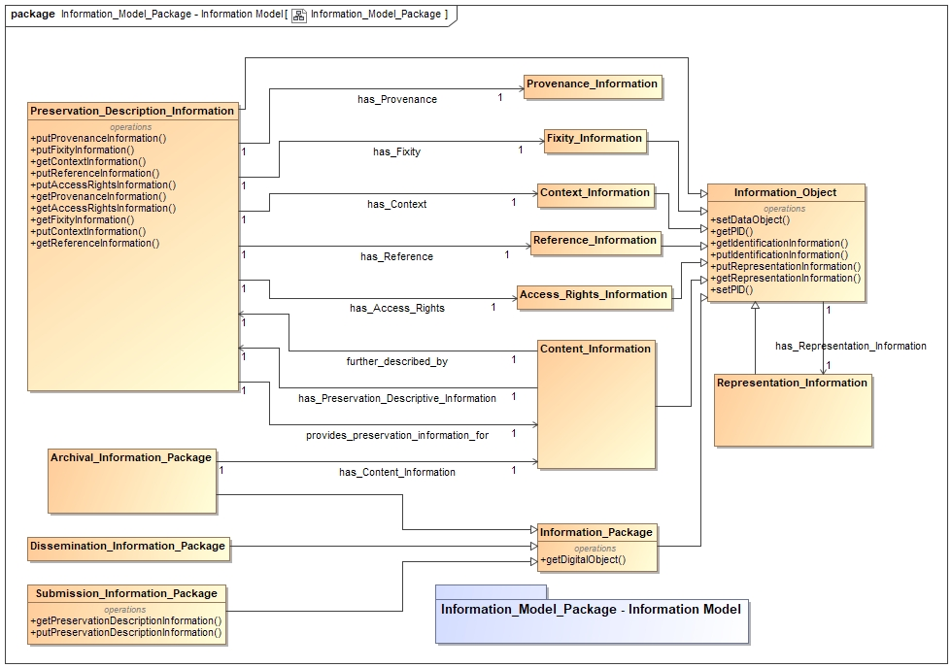
Special Topic: DAI WG’s OAIS-IF (Interoperability Framework) effort
As far as we know, the first standard to be developed using Ontology driven Model Based Engineering
Example of model to right (Info Model portion)
After publication, we expect to make this model available to software developers.
Will allow “fast track” development of CCSDS compliant systems.

Slide 4
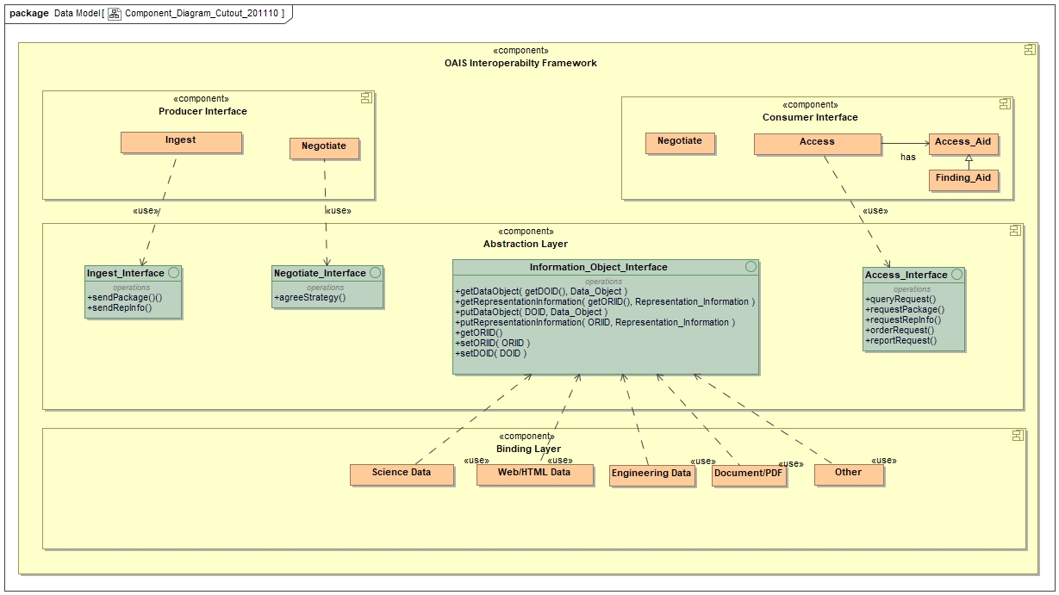
Special Topic: DAI WG’s OAIS-IF (Interoperability Framework) effort

Slide 5
DAI WG Executive Summary
Working Group Status:
GOOD
We continue to hold 60-120+ minute Skype video meetings every week with Bugzilla based web-site to help in reviews.
Good Momentum –projects schedules updated, massive OAIS effort ended, good progress on Audit books looking to complete in next few months, architecture work accelerating
Agency and outside participation in DAI is stable, but support from consistent participants is hard to maintain
Several Agencies (and outside participants) are expressing keen interest in WG activities
Support from remaining Agencies is needed
Interaction with other WGs
Terry Longstreth attended several recent SM&C online meetings as DAI Liaison since Gaithersburg Plenary (in 2018?)
Notes:
JAXA is interested, resources being identified. Possible issues getting resources allocated / schedule.

Slide 6
Additional points for urgent CMC consideration
Working groups cannot currently access these resources – Access is desperately needed – e.g. on CCSDS Management Framework page
CMC Resolutions
CMC Minutes
CCSDS Website download statistics (monthly report)
Also license availability:
Videoconferencing software (Zoom, Teams, WebEx, etc.)
Previously there had been a commitment to give ISO videoconferencing access to WG chairs/deputy-chairs

Slide 7
DAI Executive Summary
Planning:
Area and WG name | CCSDS Ref Nr | Document Title | Status / Comments | Start and / or Target Publication Date
MOIMS DAI | 653.0 | Information Preparation to Enable Long Term Use | Submitted to AD | Start date 03 April 2014 End date 31 Aug 2021
MOIMS DAI | 650.0 | Reference Model for an Open Archival Information System (OAIS) - 5 year review | Under Agency and ISO reviews | Start date 22 Aug 2016 End date 06 June 2022
MOIMS DAI | 652.0 | Audit and Certification of Trustworthy Digital Repositories. (ISO 16363) - 5 year review | Submitted to AD | Start date 22 Aug 2016 End date 30 Oct 2022
MOIMS DAI | 671.0 | Data Archive Architecture Description Document | OK, Good work this past year developing info model and interfaces | Start date 31 July 2017 End date 25 Sept 2023
MOIMS-DAI | 652.1 | Guidelines for Bodies Providing Audit and Certification of Candidate Trustworthy Digital Repositories. (ISO 16919) - 5 year review | Collection suggested changes for review. | Start date 20 Dec 2019 End Date 30 Oct 2022
Notes:
JAXA is interested, resources being identified. Possible issues getting resources allocated / schedule.

Slide 8
MOIMS-DAI Integrated Schedule

