Slide 1
Data Archive Interoperability
DAI WG Report to MOIMS
Virtual Meetings
Fall 2019 – Spring 2020
David Giaretta (WG Chair)
John Garrett (WG Deputy Chair)
Notes:
1
1
1

Slide 2
DAI WG Executive Summary
Achievements for this meeting cycle:
CCSDS 650.0 (ISO 14721) OAIS v Responses completed for comments from Peter Shames 24 March 2020 Delayed waiting for sign-off from Peter Shames | Responded to Deputy Area Director Responded to comments from new ESA participants Received comments from Peter Shames (SEA + others)
CCSDS 652.0 (ISO 16363) Audit Metrics Expect to submit to AD by end of May | Addressing last few submitted comments
CCSDS 652.1 (ISO 169191) Guidelines for Auditing Bodies Expect to submit to AD by end of June | Initiated new project and requested approval Collecting suggested changes
IPELTU Expect to submit to AD by end of June | Continued expansion of annexes, e.g. for Space Mission programs
OAIS-IF Architecture Description document Document generation driven by detailed modelling – UML and Ontologies (see next slide) | Significant Modelling activity Significant clarification of approach Consideration of links to SM&C MAL
Certifications as Trustworthy Digital Repository based on our Standards | Government repositories Large scientific archives
Large number of earlier DAI WG standards were reconfirmed following the last meeting

Slide 3
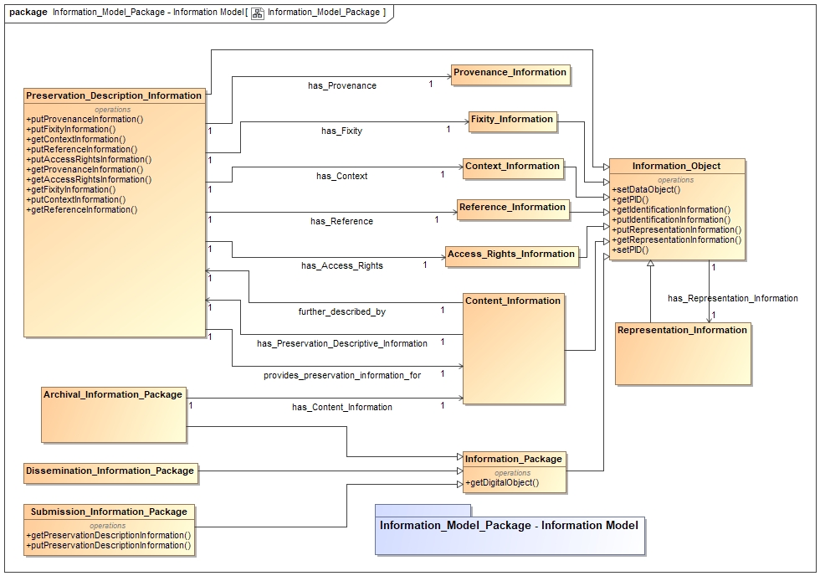
Special Topic: DAI WG’s OAIS-IF (Interoperability Framework) effort
As far as we know, the first standard (anywhere) to be developed using Model Based Engineering
Example of model to right (Info Model portion)
After publication, we expect to make this model available to software developers.
Will allow “fast track” development of CCSDS compliant systems.

Slide 4
DAI WG Executive Summary
Working Group Status:
GOOD
We continue to hold 60-90+ minute video meetings every week with Bugzilla based web-site to help in reviews.
Good Momentum –projects schedules updated, Massive OAIS effort ended, Good progress on Audit books looking to complete in new few months, Architecture work accelerating
Agency and outside participation in DAI is stable, but support from consistent participants is hard to maintain
Several Agencies (and outside participants) are expressing keen interest in WG activities
Support from remaining Agencies is needed
Interaction with other WGs
We did not hold any joint meetings during this meeting cycle
Notes:
JAXA is interested, resources being identified. Possible issues getting resources allocated / schedule.

Slide 5
DAI WG Executive Summary
Resolutions agreed upon this meeting
DAI-1: Publish CCSDS 650.0-M-3 - Reference Model for an OAIS for concurrent CCSDS and ISO reviews following CESG
Notes:
JAXA is interested, resources being identified. Possible issues getting resources allocated / schedule.

Slide 6
DAI WG Executive Summary
Further Resolutions anticipated in the next 6 months
DAI-2: Publish CCSDS 652.0-M-2 - Audit and Certification of Trustworthy Digital Repositories for concurrent CCSDS and ISO reviews
DAI-3: Publish CCSDS 652.1-M-3 - Guidelines for Bodies Providing Audit and Certification of Candidate Trustworthy Digital Repositories for concurrent CCSDS and ISO reviews
Notes:
JAXA is interested, resources being identified. Possible issues getting resources allocated / schedule.

Slide 7
Additional points for urgent CMC consideration
SANA Terminology Registry
If SEA and SSG are still considering a requirement to reduce each term to a single definition, more coordination with all working groups is needed.
Working groups cannot currently access these resources – Access is desperately needed – e.g. on CWE Management Sharepoint
CMC Resolutions
CMC Minutes
CCSDS Website download statistics (monthly report)
Also licence availability:
Videoconferencing software (Zoom, Teams, WebEx, etc.)

Slide 8
DAI Executive Summary
Planning:
Area and WG name | CCSDS Ref Nr | Document Title | Status / Comments | Start and / or Target Publication Date
MOIMS DAI | 653.0 | Information Preparation to Enable Long Term Use | OK, Progress being made after delays. Added other disciplines to annex | Start date 03 April 2014 End date 31 Aug 2021
MOIMS DAI | 650.0 | Reference Model for an Open Archival Information System (OAIS) - 5 year review | OK, Ready for formal review All suggested changes have been addressed | Start date 22 Aug 2016 End date 06 June 2022
MOIMS DAI | 652.0 | Audit and Certification of Trustworthy Digital Repositories. (ISO 16363) - 5 year review | OK, On Schedule Resolved several suggested changes this cycle Changes were required to keep consistency with OAIS updates | Start date 22 Aug 2016 End date 30 Oct 2022
MOIMS DAI | 671.0 | Data Archive Architecture Description Document | OK, Good work this past year developing info model Moved on to interfaces | Start date 31 July 2017 End date 25 Sept 2023
MOIMS-DAI | 652.1 | Guidelines for Bodies Providing Audit and Certification of Candidate Trustworthy Digital Repositories. (ISO 16919) - 5 year review | Collection suggested changes for review. | Start date 20 Dec 2019 End Date 30 Oct 2022
Notes:
JAXA is interested, resources being identified. Possible issues getting resources allocated / schedule.

