Slide 1
1.1 MOIMS Data and Services
CSS-M&C
User Support
Planning & Scheduling
TT&C
MPS
CSS-SM
NAVT
MCS
MPS
MPS
NAVT
MCS
NAVT
Mission Control
Navigation & Timing
MCS
NAVT
MCS
MCS
NAVT
MCS
MCS
MPS
NAVT
OPD
MPS
MPS
Data Storage and Archiving
Operations Preparation
NAVT
MDP
OPD
MDP
MCS
OPD
NAVT
Satellite Dev. & Maint.
Mission Data Processing
MDP
MCS
NAVT
Functions and Data Colour Coded: Data in Rectangles; Services indicated at Provider End by Circle MDP = Mission Data Product
Notes:
The 6 MOIMS Areas are colour coded.
Each application level interaction is annotated with the Data exchanged. At this level all Data generated by each Function is grouped as a single type (the abbreviation reflects the function name).
Potential service interfaces identified by MO are indicated by a colour-coded circle representing the Service Provider
Data formats may be separately defined [NAV, MPS] or specified in the context of the service [MO M&C, MPS].
File Handling is a bit different – there are special services for File Management and File Transfer [the latter delegated to a lower level protocol, such as CFDP or FTP], but the file content my be associated with any of the other Functional Areas. It essentially provides the transport layer for bulk transfer of service messages or data formats. Mission Data Products may also be transferred as files.
Note Planning/Scheduling interactions with the GSTS are greyed out as they are outside the scope of MOIMS standardisation [CSS boundary agreement].

Slide 2
1.1 MOIMS Data and Services - update

Slide 3
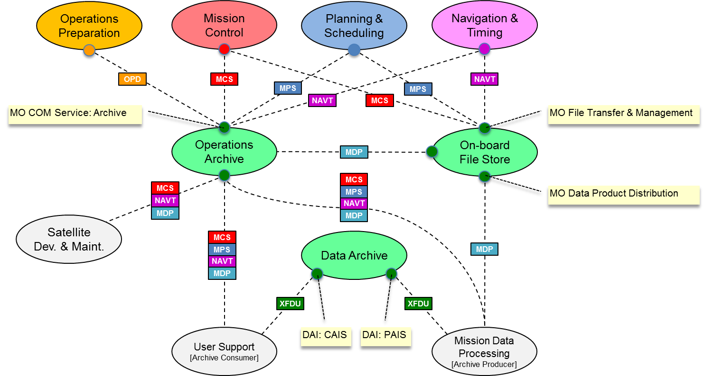
1.11 Data Storage and Archiving - original
Notes:
The 6 MOIMS Areas are colour coded.
Each application level interaction is annotated with the Data exchanged. At this level all Data generated by each Function is grouped as a single type (the abbreviation reflects the function name).
Potential service interfaces identified by MO are indicated by a colour-coded circle representing the Service Provider
Data formats may be separately defined [NAV, MPS] or specified in the context of the service [MO M&C, MPS].
File Handling is a bit different – there are special services for File Management and File Transfer [the latter delegated to a lower level protocol, such as CFDP or FTP], but the file content my be associated with any of the other Functional Areas. It essentially provides the transport layer for bulk transfer of service messages or data formats. Mission Data Products may also be transferred as files.
Note Planning/Scheduling interactions with the GSTS are greyed out as they are outside the scope of MOIMS standardisation [CSS boundary agreement].

Slide 4
1.11 Data Storage and Archiving - update
Operations Preparation
Mission Control
IPELTU helps figure out what metadata to collect for long term usage
IPELTU
Navigation & Timing
Planning & Scheduling
MPS
NAVT
OPD
MCS
MPS
NAVT
MO COM Service Archive
MCS
MO File Transfer & Management
On-board
File Store
Operations
Short term storage Archive
MDP
Data in Short-term storage
MCS
MO Data Product Distribution
NAVT
Mission Data Processing
[Archive Producer]
MDP
Data is kept in Near-term archive for
Access by users and then
Selected and send to long term archive OR
Not selected
MPS
MCS
XFDU
NAVT
MDP
Satellite Dev. & Maint.
MCS
Near-term Data Archive
NAVT
XFDU
MDP
Some data is not selected
MPS
XFDU
DAI:PAIS
Users may include:
Engineers in project
Scientists related to project
Researchers in other areas
Public
User Support
[Archive Consumer]
XFDU
Long-term Data Archive
Long-term archive
DAI:CAIS

