Slide 1
Digital Vellum
Vint Cerf and Richard Whitt
Google
^{April 2016}
¹
Notes:
¹

Slide 2
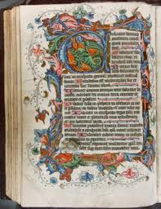
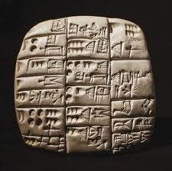
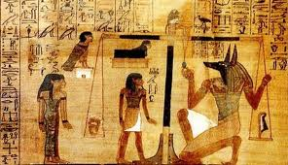
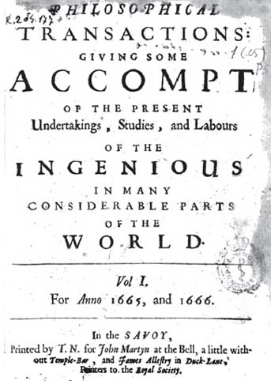
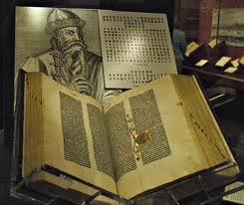
Archiving Static Content
2
Notes:
2

Slide 3
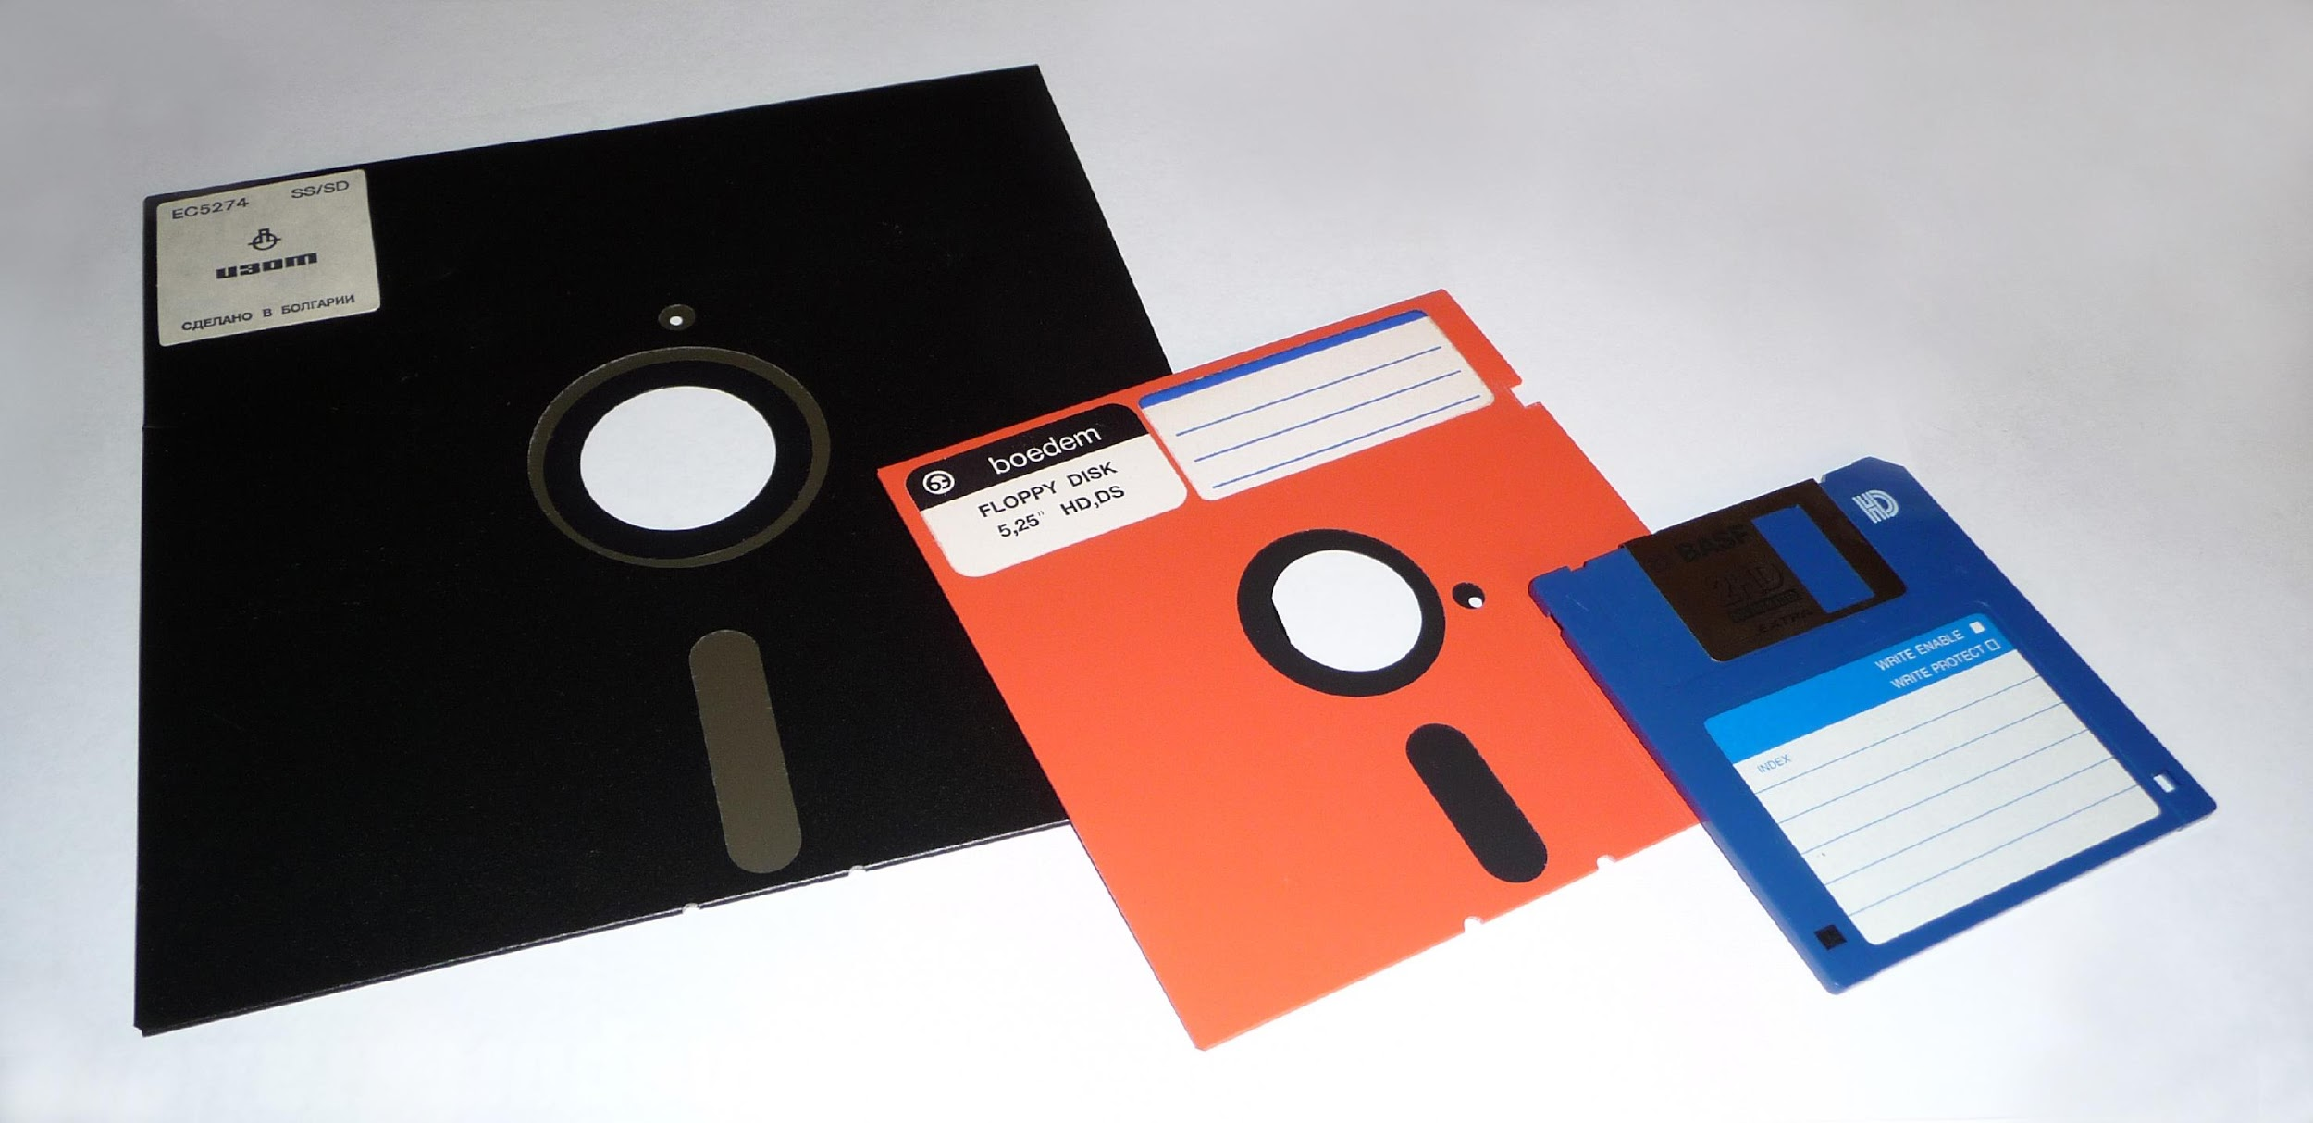
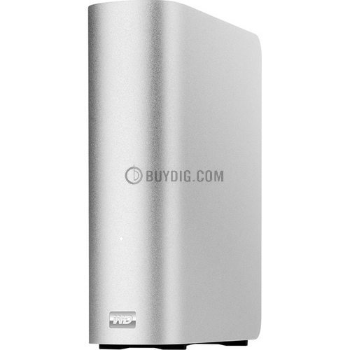
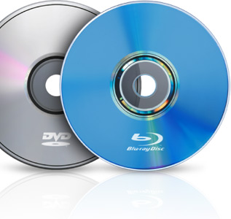
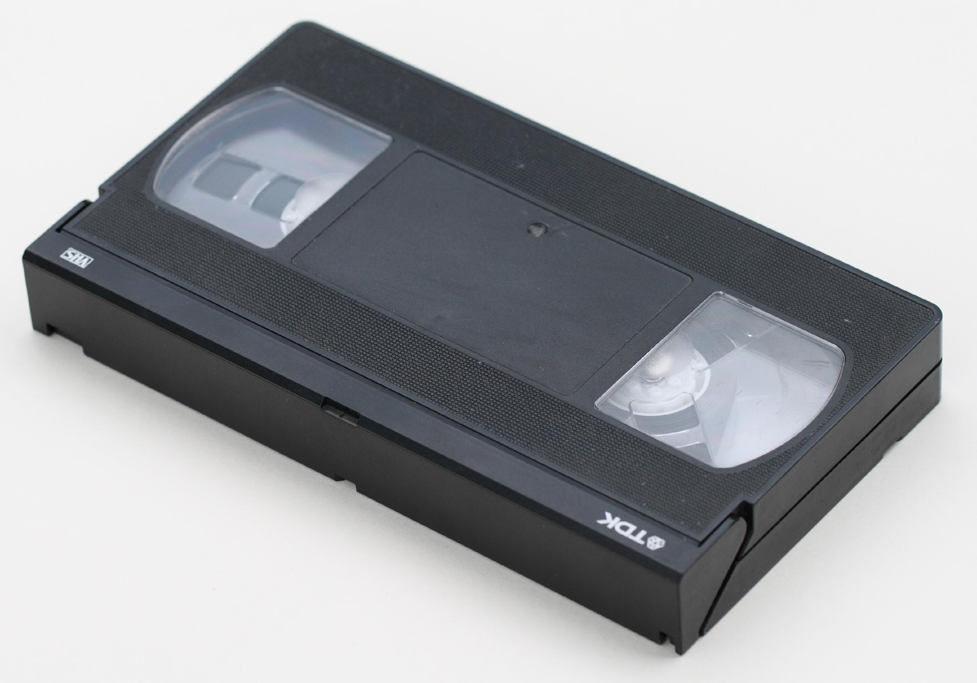
³

Slide 4
It’s not just the medium!
Digital object structures, representations, vocabulary and standard terminology (schema, OWL, …)
Identifier spaces, registries, resolution mechanisms
The irony of WWW, URLs, DNS (TBL was at CERN)
Standard, rigorous ingestion processes
Metadata (about the data, provenance, authenticity, calibration, ....)
Legal frameworks for preservation (copyright, patents, licensing, special treatment for perserving bodies)
Business Models for extended, long term operation

Slide 5
Systematic Approach
NASA (and others) need to adopt a systematic approach to long term archiving and preservation of information (such as the Open Archive Information System [OAIS] methods)
The PCAST and OSTP initiative to include data archiving for all federally-funded research needs practical and affordable solutions
Distributed archiving systems to spread load and risk
Policy frameworks for incentive to implement and maintain solutions
INTEROPERABILITY IS KEY!

Slide 6
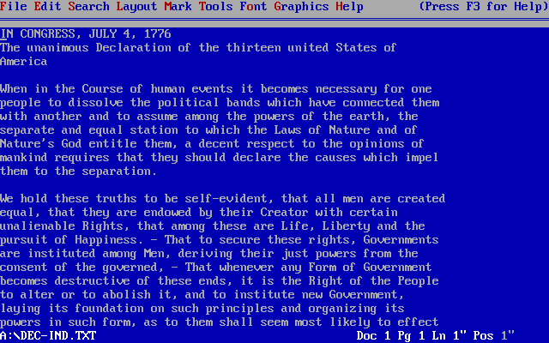
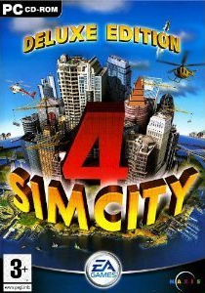
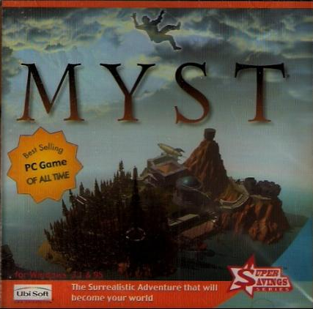
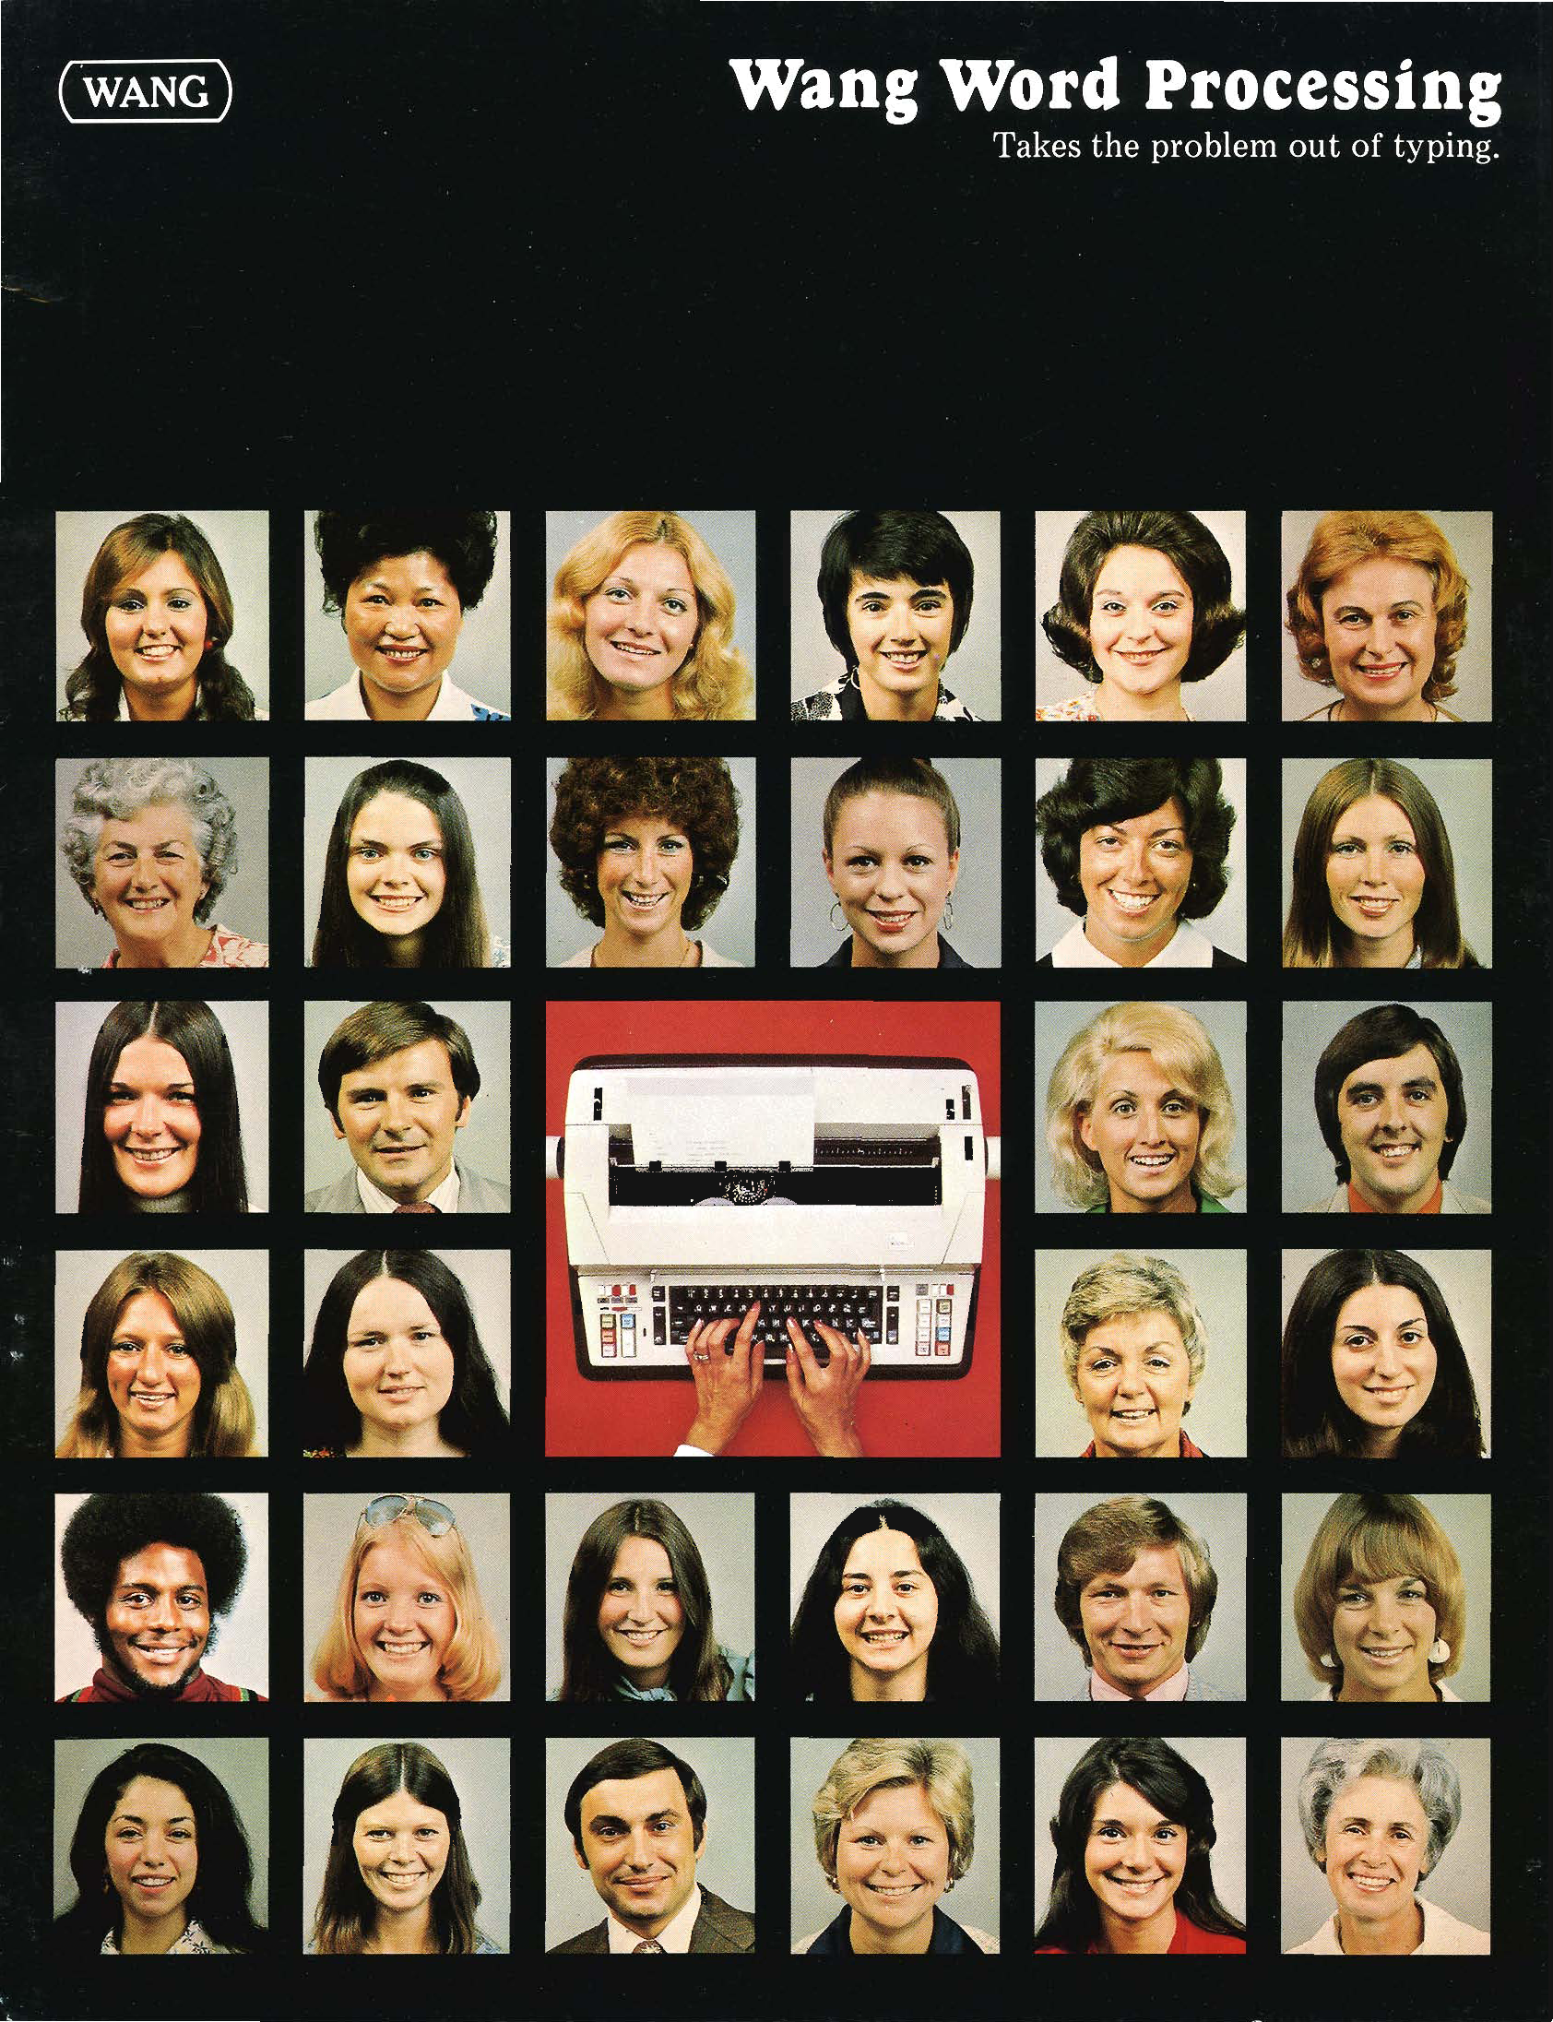
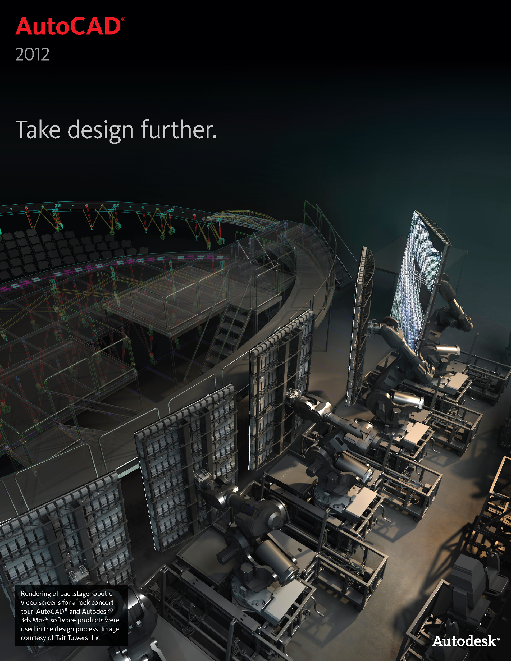
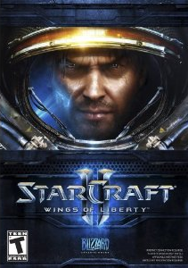
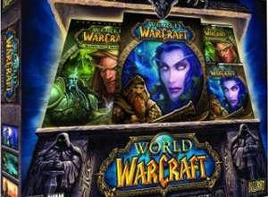
What About Executable Content?
WordPerfect 1.0 doc
Can you read it today?
100 years from now?
Application-specific content
Games
Simulation model
Can you re-run old model with new data?
Original Wang doc
Can you read it today?
100 years from now?

Slide 7
Challenges
Interpretation of bits
Metadata capture
Source or executable code
“Digital X-ray”
Capacity for BIG DATA
Bankruptcies, sunsetting of apps, OS, hardware
Intellectual Property Rights
Legal frameworks, exceptions for preservation
⁷

Slide 8
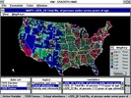
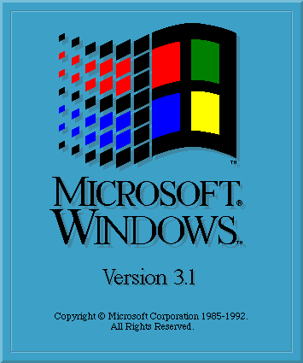
Olive Implementation
Guest App
Unmodified
Web Server
Guest OS
VMNetX client
to Olive server via standard
HTTP range
requests
VMM
KVM / QEMU
Linux
VM Image file
pristine
cache
modified
cache
FUSE

Slide 9
Cloud Execution of Olive
Unmodified
Web Server
VMNetX client
to Olive server via standard
HTTP range
requests
SPICE
Remote
Desktop
Protocol
KVM / QEMU
Linux
VM Image file
FUSE
pristine
cache
modified
cache
low latency and high bandwidth
Olive Execution Server in Cloud or Cloudlet

Slide 10
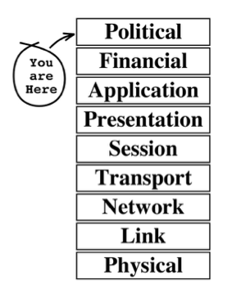
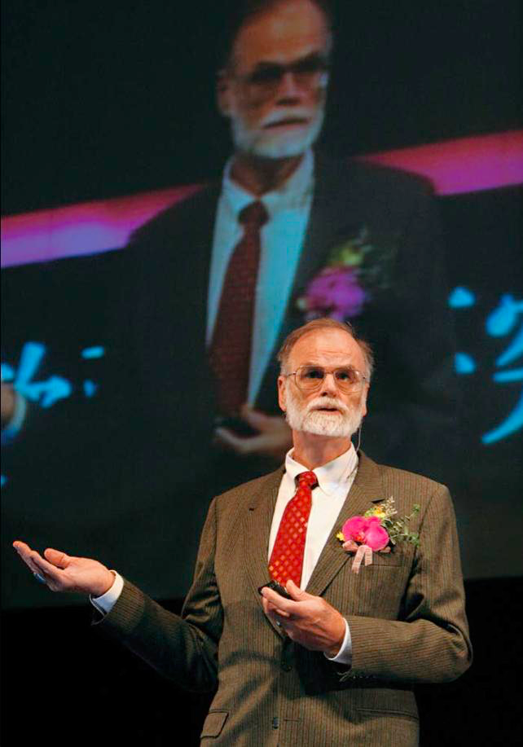
The Indispensable Context
“May all your problems
be technical.” -- Jim Gray
Evi Nemeth

Slide 11
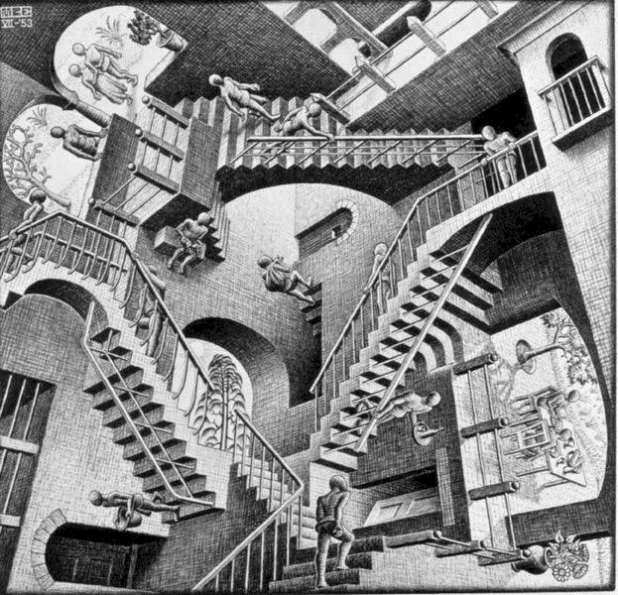
Facing Multi-Dimensional Challenges
Beyond the technical solutions:
-- Public Policy (“Layer 9”): How will they be legally compliant?
-- Financial (“Layer 8”): How will they be paid for?
-- Institutional (“Layers 1-9”): How will they be organized?

Slide 12
Layer 9 -- Public Policy
Required: A policy framework
that encompasses compliance
with all laws and regulations --
both national and international --
applicable to the preservation
lifecycle acts of curating, storing,
accessing, and using digital objects.

Slide 13
Layer 8 -- Financial
Required: A financial framework
that creates appropriate
incentives for viable, long-term,
sustainable funding of all
necessary digital preservation
activities, including use of governmental leveraging and
creative private sector business models.

Slide 14
Layers 1-9 -- Institutional
Required: An institutional framework
that enables greater organizing,
coordinating, collaborating, and
information sharing between and among
all stakeholders, without relying on
heavyweight, top-down “governance” mechanisms of
unilateral and unaccountable decision-making.

