Slide 1
Long-term Information Preservation
CCSDS Contributions

Slide 2
Context Slide
Table of Contents – w/ main thrusts
  Introduction – Who we are
  What we’ve done
  What we’re planning
  We hope you can be our evangelist too
  Your idea of where we are going/what we need to address
  Why we’re approaching digital preservation the way we are
What is problem we are addressing
Replace current 2-4 with OAIS concepts 2-4

Slide 3
OAIS Standard Overview
Provides information model
Provides mandatory requirements
Provides framework for additional standards
Follow-ons
  Auditing and Certification Standards
  Detailed Processes
  Some Protocols
Builds on previous data description standards

Slide 4
Key OAIS concepts regarding data preservation
Claiming “This is being preserved” is untestable
Essentially meaningless
  Except “BIT PRESERVATION”
How can we make it testable?
Claim to be able to continue to “do something” with it
  Understand/use
    Need extra information to help this (Representation Information)
Still meaningless…
Things are too interrelated
  "Representation Information" potentially unlimited
Repository must define a target group (Designated Community) – those the repository guarantees can understand – so we can test
Many other concepts identified - including Authenticity
Finer grained taxonomy than simply saying “metadata”
  Allows one to ask if one has all the required types
Notes:
Check for .ppt slide from David

Slide 5

Preservation Planning
PRODUCER
CONSUMER
Descriptive Information
Descriptive Information
Data
Management
queries
Ingest
Access
query responses
SIP
orders
Archival
Storage
AIP
AIP
DIP
Administration
MANAGEMENT
Notes:
Figure 4-1: OAIS Functional Entities
(20090520 – BS comment – added line between Admin and Archival Storage)

Slide 6
Standards based Repository Audit and Certification (ISO 16363 and ISO 16919)
General requirements for conduct of all ISO/IEC Audits
Requirements For Bodies Providing Audit And Certification of Management Systems
(ISO/IEC 17021 )
Original Standard describing requirement of an ISO defined Open Archival Info System
Specific metrics that must be demonstrated to become a Certified ISO TDR
Specific additional requirements for conduct of ISO Audits of TDRs
Reference Model for an OAIS
(ISO 14721)
Audit and Certification of Trustworthy Digital Repositories
(ISO 16363 )
Requirements For Bodies Providing Audit And Certification of Trustworthy Digital Repositories
(ISO 16919 )
Certification
Notes:
There is a hierarchy of ISO standards concerned with good auditing.
ISO 16919 is positioned within this hierarchy in order to ensure that these good practices can be applied to the evaluation of the trustworthiness of digital repositories using ISO 16363.
It covers principles needed to inspire confidence that third party certification of the management of the digital repository has been performed with impartiality, competence, responsibility, openness, confidentiality, and responsiveness to complaints.
As you all probably know, the OAIS Reference Model (ISO 14721) is the pre-eminent, world-wide standard detailing the required functions for an Open Archival Information System (OAIS) Archives. It also provides a required information model for Archives. Although it is desirable to do so, Archives do not need to use the terminology in the information model and the standard. Repositories just need to be able to map their usage to the OAIS required items. Of course it most modern situations, it is easiest to just use the OAIS terminology to ease the communication process with most up-to-date and technically savvy archivists.
Many Archives have claimed to be OAIS compliant. ISO 16363 expands on OAIS standards and delivers specifically testable metrics that provide a more consistently verifiable situation for self-assessment and that
can lead to third-party certification.
ISO 16363 provides metrics concerning:
Organizational Infrastructure
e.g. The repository shall have a documented history of the changes to its operations, procedures, software, and hardware.
Digital Object Management
e.g. The repository shall have access to necessary tools and resources to provide authoritative Representation Information for all of the digital objects it contains.
Infrastructure and Security Risk Management
e.g.. The repository shall have procedures in place to evaluate when changes are needed to current software.
ISO/IEC 17021 is ISO’s and IEC’s generic auditing standard. Since the underlying organizational infrastructures and processes needed to audit almost any type systems is largely the same, it makes sense to provide a basic single, consistently applied process for all audits. Then specific requirements for specific applications can be layered on top of those generic requirements. We should also tell you that there is a whole suite of standards related to ISO/IEC 17021 that provide more detailed information. An example is ISO/IEC 17022 that provides details of what should be in a Audit Report.
ISO 16919 provides those specific requirements for auditing of candidate Trustworthy Digital Repositories according to the metrics defined in ISO 16363.
This module and the following modules will concentrate on the specific requirements defined in ISO 16919 while also including some discussion of the ISO/IEC 17021 items of relevance to auditors and repository staff. However the emphasis will be on ISO 16919 and how the competencies defined within it are related to the ISO 16363 metrics that the repository will be measured against.

Slide 7
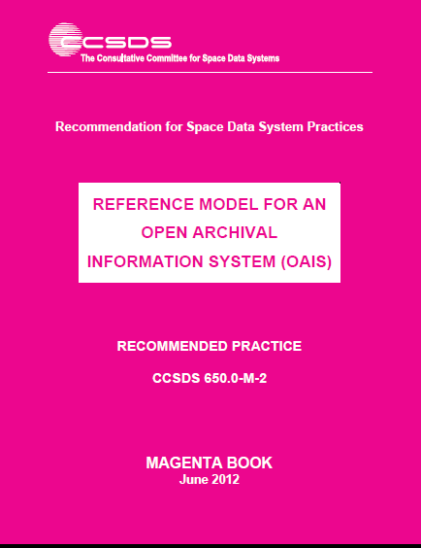
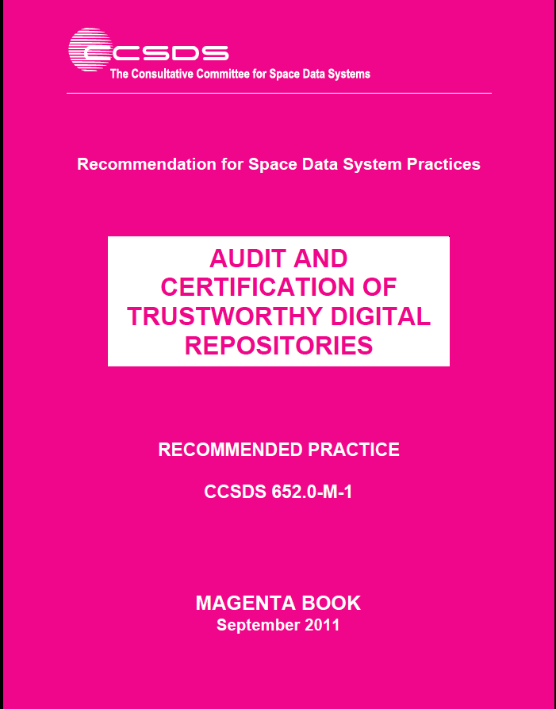
Get Your Standards
You can get all ISO Standards from ISO website at: http://www.iso.org/home/store/catalogue_tc/
You can also download the CCSDS Magenta Book equivalents of the ISO docs for free
  ISO 14721 (OAIS) equivalent here: http://public.ccsds.org/publications/archive/650x0m2.pdf
  ISO 16363 (RAC metrics) equivalent here: http://public.ccsds.org/publications/archive/652x0m1.pdf
  ISO 16919 (RAC process) equivalent here: http://public.ccsds.org/publications/archive/652x1m2.pdf
Notes:
Note: Your National Body may also have a standards store usually priced in your local currency.
The ISO Standards actually have a few pages of ISO boilerplate that are attached to the front of the CCSDS documents

Slide 8
Archive Process and Protocol Standards
(ISO 20652 and ISO 20104)
XML-based package potentially containing binary and/or textual information
XML Formatted Data Unit (XFDU)
(ISO 13527)
Original Standard describing requirement of an ISO defined Open Archival Info System
Process to plan for and execute ingest to an archive - 4 Phases with subphases and checklist of actions in each
Abstract specification and an XML Implementation for describing transfer to an archive and actual SIPs setnt to archive
Reference Model for an OAIS
(ISO 14721)
Producer-Archive Ingest Methodology Abstract Standard
(PAIMAS)
(ISO 20652 )
Producer-Archive Ingest Specification
(ISO 20104 )
Notes:
There is a hierarchy of ISO standards concerned with good auditing.
ISO 16919 is positioned within this hierarchy in order to ensure that these good practices can be applied to the evaluation of the trustworthiness of digital repositories using ISO 16363.
It covers principles needed to inspire confidence that third party certification of the management of the digital repository has been performed with impartiality, competence, responsibility, openness, confidentiality, and responsiveness to complaints.
As you all probably know, the OAIS Reference Model (ISO 14721) is the pre-eminent, world-wide standard detailing the required functions for an Open Archival Information System (OAIS) Archives. It also provides a required information model for Archives. Although it is desirable to do so, Archives do not need to use the terminology in the information model and the standard. Repositories just need to be able to map their usage to the OAIS required items. Of course it most modern situations, it is easiest to just use the OAIS terminology to ease the communication process with most up-to-date and technically savvy archivists.
Many Archives have claimed to be OAIS compliant. ISO 16363 expands on OAIS standards and delivers specifically testable metrics that provide a more consistently verifiable situation for self-assessment and that
can lead to third-party certification.
ISO 16363 provides metrics concerning:
Organizational Infrastructure
e.g. The repository shall have a documented history of the changes to its operations, procedures, software, and hardware.
Digital Object Management
e.g. The repository shall have access to necessary tools and resources to provide authoritative Representation Information for all of the digital objects it contains.
Infrastructure and Security Risk Management
e.g.. The repository shall have procedures in place to evaluate when changes are needed to current software.
ISO/IEC 17021 is ISO’s and IEC’s generic auditing standard. Since the underlying organizational infrastructures and processes needed to audit almost any type systems is largely the same, it makes sense to provide a basic single, consistently applied process for all audits. Then specific requirements for specific applications can be layered on top of those generic requirements. We should also tell you that there is a whole suite of standards related to ISO/IEC 17021 that provide more detailed information. An example is ISO/IEC 17022 that provides details of what should be in a Audit Report.
ISO 16919 provides those specific requirements for auditing of candidate Trustworthy Digital Repositories according to the metrics defined in ISO 16363.
This module and the following modules will concentrate on the specific requirements defined in ISO 16919 while also including some discussion of the ISO/IEC 17021 items of relevance to auditors and repository staff. However the emphasis will be on ISO 16919 and how the competencies defined within it are related to the ISO 16363 metrics that the repository will be measured against.

Slide 9
Get Your Standards
You can get all ISO Standards from ISO website at: http://www.iso.org/home/store/catalogue_tc/
You can also download the CCSDS Book equivalents of the ISO docs for free
  ISO 14721 (OAIS) equivalent here: http://public.ccsds.org/publications/archive/650x0m2.pdf
  ISO 20652 (PAIMAS) equivalent here: http://public.ccsds.org/publications/archive/651x0m1.pdf
  ISO 20104 (PAIS) equivalent here: http://public.ccsds.org/publications/archive/651x1b1.pdf
  ISO 13527 (XFDU) equivalent here: http://public.ccsds.org/publications/archive/661x1b1.pdf
Notes:
Note: Your National Body may also have a standards store usually priced in your local currency.
The ISO Standards actually have a few pages of ISO boilerplate that are attached to the front of the CCSDS documents

Slide 10
Move Bruce’s presentation back out to separate presentation

Slide 11

Who Begat Whom? The Origins and Development of the International Standard for a Trustworthy Digital Repository
Bruce Ambacher,
School of Information Studies
University of Maryland

Slide 12
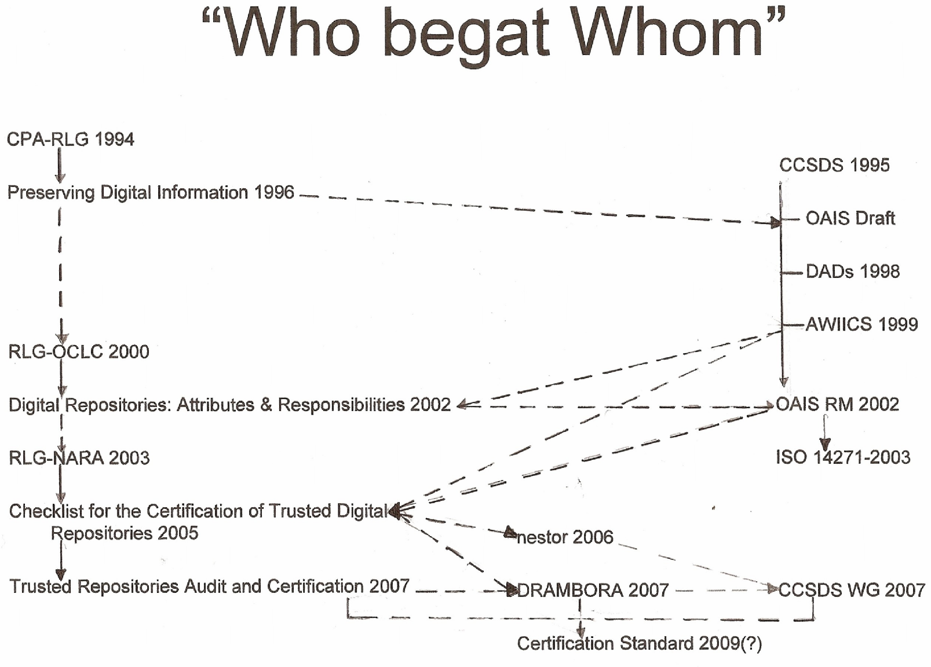

Slide 13
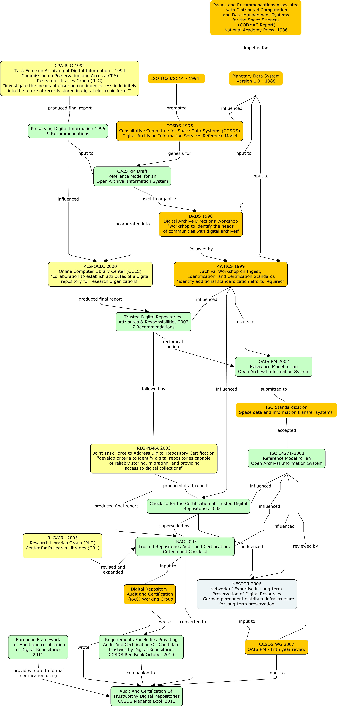
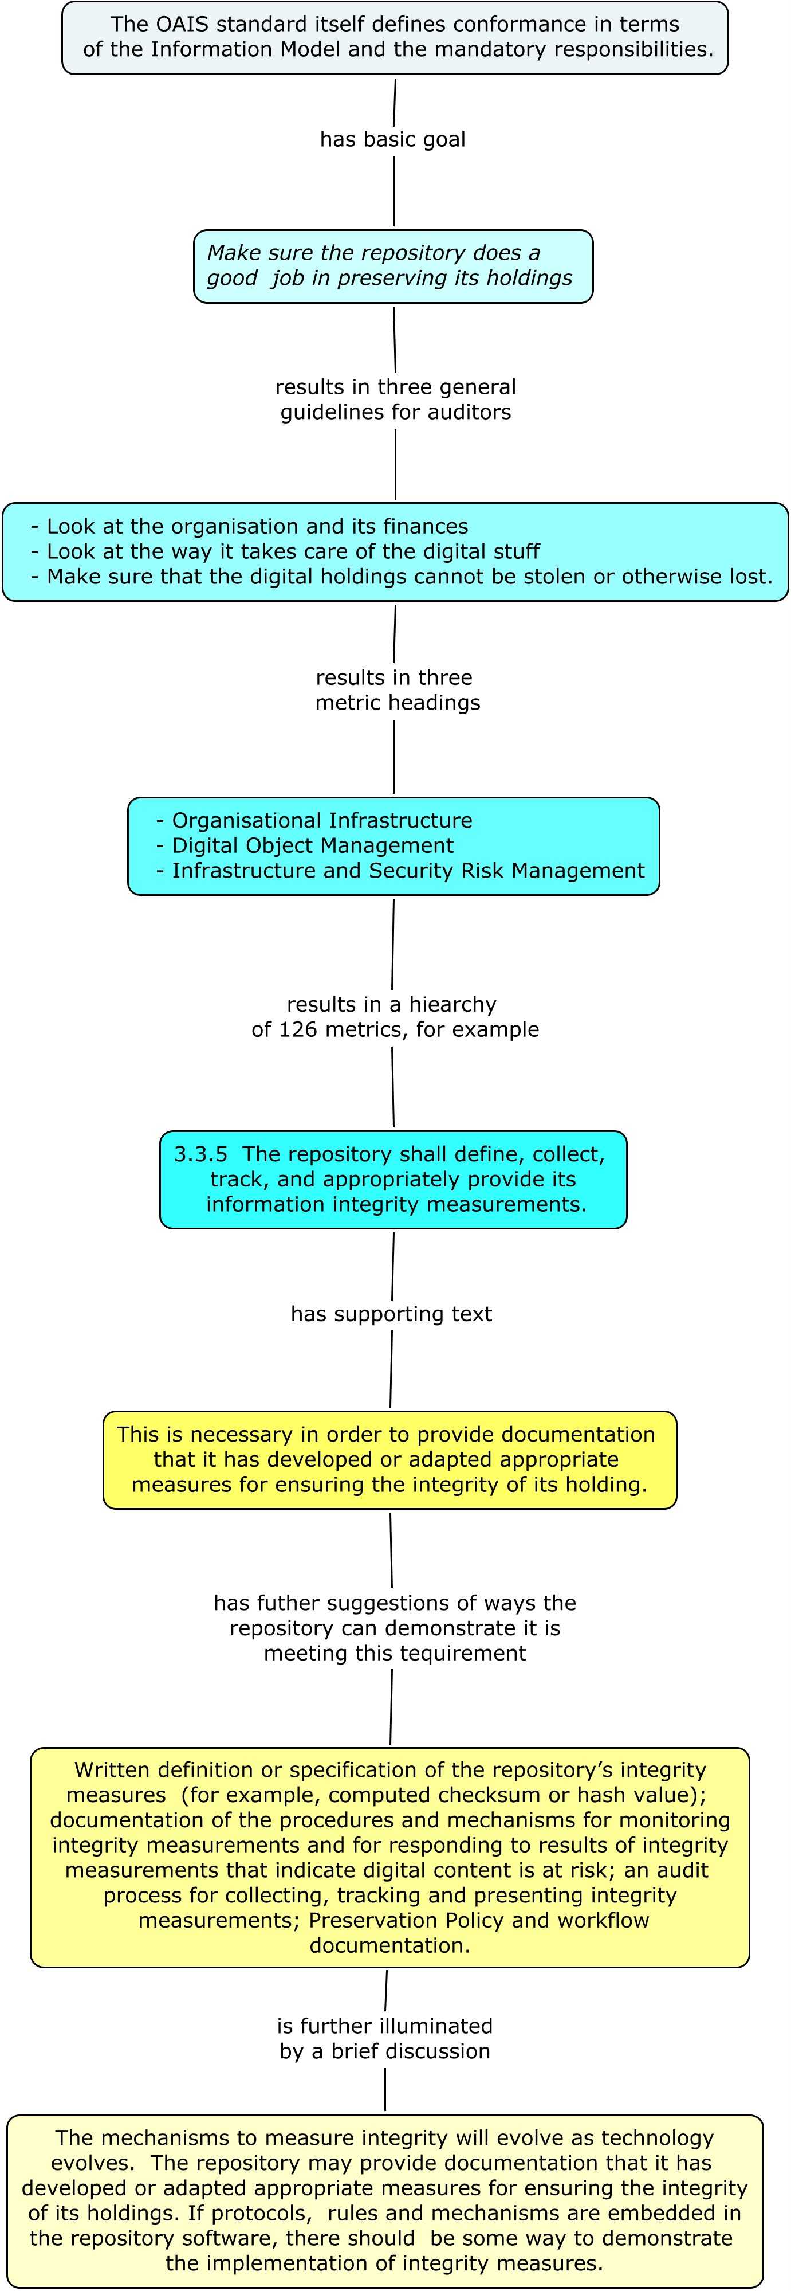
Audit and Certification Process for Science Data Digital Repositories
D. Giaretta¹, B. Ambacher², K. Ashley³, M. Conrad⁴, R. Downs⁵, J. Garrett⁶, M. Guercio⁷,
S. Hughes⁸, S. Lambert⁹, T. Longstreth¹⁰, D. Sawyer¹¹, B. Sierman¹², H. Tibbo¹³, M. Waltz¹⁴
IN53B-1629
¹ STFC/APA
Millers Cottage, Yetminster, Dorset, UK
david@giaretta.org
³ Digital Curation Centre
Edinburgh, UK
kevin@kevinashley.net
⁵ CIESIN, Columbia University
Palisades, NY, USA rdowns@ciesin.columbia.edu
⁷ University of Urbino
Urbino, Italy
m.guercio@mclink.it
⁹ STFC
Rutherford Appleton Lab, Oxon, UK
simon.lambert@stfc.ac.uk
¹¹ VIE, Inc
Columbia, Maryland, USA
Sawyer@acm.org
¹³ Consultant
Chapel Hill, NC, USA
tibbo@email.unc.edu
² University of Maryland
College Park, MD, USA
bambache@umd.edu
⁴ NARA
Rocket Center, WV , USA
mark.conrad@nara.gov
⁶ ADNET Systems / NASA
GSFC, Greenbelt, MD, USA
John.G.Garrett@nasa.gov
⁸ JPL
Pasadena, California , USA
steve.hughes@jpl.nasa.gov
¹⁰ Retired
Laurel, MD, USA
longstreth@acm.org
¹² Koninklijke Bibliotheek
The Hague, The Netherlands
Barbara.Sierman@kb.nl
¹⁴ Center for Research Libraries
Chicago, IL, USA
waltz@crl.edu
Abstract
  Understanding the ISO Trusted
  Digital Repository Metrics
Audit and Certification Process for Digital Repositories
Science data digital repositories are entrusted to ensure that a science community’s data are available and useful to users both today and in the future. Part of the challenge in meeting this responsibility is identifying the standards, policies and procedures required to accomplish effective data preservation. Subsequently a repository should be evaluated on whether or not they are effective in their data preservation efforts.
This poster will outline the process by which digital repositories are being formally evaluated in terms of their ability to preserve the digitally encoded information with which they have been entrusted. The ISO standards on which this is based will be identified and the relationship of these standards to the Open Archive Information System (OAIS) reference model will be shown.
Six test audits have been conducted with three repositories in Europe and three in the USA. An assessment of the possible impact of this type of audit and certification on the practice of preserving digital information will also be provided.
Historical Time Line
  Who are the auditors?
  The auditor must have undertaken an accredited training course, must have appropriate expertise and must have taken part in audits with an existing group of auditors.
  Who audits the auditors?
  An initial body of auditors is defined based on the membership of the body which wrote the metrics document. This is called the Primary TDR Authorisation Body (PTAB). This body accredits training course, undertake the initial audits, and accredits auditors. It also accredits national authorization bodies which will accredit auditors within individual countries, allowing for the creation of an international network of accreditation bodies.
  European Framework
  In July 2010 the EU convened a meeting in which a Memorandum of Understanding was signed.
  The MoU was to define a European Framework for Audit and certification of Digital Repositories.
    The framework consists of a sequence of three levels, in increasing trustworthiness:
      BASIC CERTIFICATION is granted to repositories which obtain DSA certification;
      EXTENDED CERTIFICATION is granted to Basic Certification repositories which in addition perform a structured, externally reviewed and publicly available self- audit based on ISO 16363 or DIN 31644;
      FORMAL CERTIFICATION is granted to repositories which in addition to Basic Certification obtain full external audit and certification based on ISO 16363 or equivalent DIN 31644.
    The advantage of this framework is that it provides an easy route up to full ISO certification.
  Test Audits
  To support the European Framework a number of test audits were planned and undertaken.
    The test audits involved three European and three US repositories.
  The audits were undertaken by PTAB members in June and July 2011.
    A normal audit would be undertaken by two auditors.
  Purpose of Test Audits
    Support the creation of the European Framework – providing evidence of the usefulness of such audits
    Identify metrics which were poorly explained and difficult for repositories to understand.
    Verify that the PTAB members had a common understanding and interpretation of the metrics, and judged evidence in a broadly similar way.
  Next Steps
  The PTAB legal entity is being created, as required by [13]. Available training sessions are being reviewed to see which can be accredited for candidate auditors.
  The European Framework will be promoted and the commercial world will be targeted for information about the audit system.
  Conclusion
  The demand for a way to judge the ability of repositories to preserve digital information has been around for, in digital timescales, a long time. We believe that we have a way to provide this service in a way which fits into the mainstream ISO audit and certification mechanism and which is based on OAIS and the evidence it demands. We further believe that the process and organization we are setting up is scalable and can have the confidence of those who rely on such repositories.
What is a Trustworthy Digital repository
An entity whose mission is to provide reliable, long-term access to managed digital resources to its Designated Community, now and into the future.
Introduction
The Preserving Digital Information report of the Task Force on Archiving of Digital Information [1] declared,
  a critical component of digital archiving infrastructure is the existence of a sufficient number of trusted organizations capable of storing, migrating, and providing access to digital collections.
  a process of certification for digital archives is needed to create an overall climate of trust about the prospects of preserving digital information.
Testability And Key OAIS Concepts
The Reference Model for an Open Archival Information System (OAIS) [2] is “now adopted as the ‘de facto’ standard for building digital archives” [3].
One of the key drivers of OAIS is the need for claims about preservation of digitally encoded information to be testable.
Preservation
Preserving digitally encoded information means that we must ensure that the information to be preserved is Independently Understandable to (and usable by) the Designated Community.
  There is a need to test that the digital object must somehow be useable and understandable in the future.
  A Designated Community is an identified group of potential Consumers who should be able to understand a particular set of information.
  The definition of the Designated Community is left to the repository.
  Those funding the repository, or entrusting their digital objects to the repository, can judge whether the definition of the Designated Community is appropriate for their needs.
  Audit And Certification Process
  The Requirements for bodies providing audit and certification of candidate trustworthy digital repositories specified the way in which the audits were to be carried out.
    This defines the process and also the people.
    It is meant primarily for those setting up and managing the organization performing the auditing and certification of digital repositories.
Audit and Certification Process for Digital Repositories
REFERENCES: All references are available in the following document.
[1] Giaretta, D., et. al., Audit and Certification Process for Digital Repositories, PV 2011, November 2011.
Copyright 2011 Primary Trustworthy Digital Repositories Authorisation Body, LTD.

Slide 14
Preserving Digital Information
Report of the Task Force on Archiving of Digital Information
commissioned
by
The Commission on Preservation and Access
and
The Research Libraries Group
May 1, 1996

Slide 15
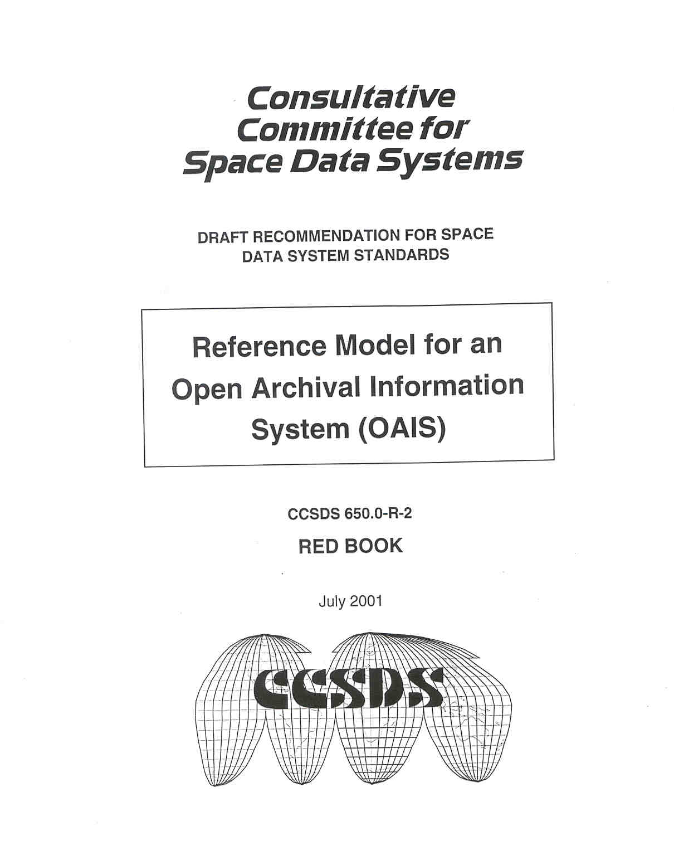

Slide 16
Trusted Digital Repositories:
Attributes and Responsibilities
An RLG-OCLC Report
RLG
Mountain View, CA
May 2002

Slide 19
Interpretation of data
Slide of just a number, discuss what is it’s meaning
  Semantics
  Software
  Format

Slide 20
Influence of OAIS-RM on CIESIN
From Bob Downs

Slide 21
Influence of the OAIS-RM on PDS4
The Planetary Data System (PDS4) is NASA’s official archive for all Solar System Exploration science data.
PDS4 is a major revision and transition to a modern system based on best practices for data system development while leveraging 20 years of lessons learned.
    PDS4 has been operational since 2013.
    PDS4 has been adopted by the international Planetary Science Community and considered to be a first-of-its-kind where a single system and set of standards has been adopted by an entire science community.
The OAIS-RM heavily influenced the architecture and design of PDS4.
  PDS4 complies with the Mandatory Responsibilities required to operate an OAIS archive.
  The PDS4 system and services architecture maps to the OAIS Functional Model.
  The PDS4 Information Model is based on OAIS-RM concepts.
    The Information Object, consisting of a Data Object and its Representation Information, is a foundational concept.
    Preservation Description Information (PDI) is required for all data.
The PDS4 functional infrastructure is designed to respond to the OAIS-RM based PDS4 Information Model.
  The model is independent from the implementation technology allowing both to evolve separately.
  Model extracts are used to design and configure system software and services.
The PDS is well positioned to be accredited against the ISO-16363 standards.

Slide 22
Preservation strategies

Slide 23
Options
EITHER
  Hand on the information to some other custodian
OR
  Keep the information – in which case one can
    EITHER
      Keep the bits unchanged
        In which case one must add what OAIS calls “Representation Information” to ensure the information encoded in the bits can still be understood/used (by the Designated Community)
    OR
      Change the bits
        In which case one must keep evidence about why this new object should be considered “authentic”
        And enable the new bit sequences to be understandable/usable (add appropriate “Representation Information”)
Notes:
Could animate

Slide 24
Information
24

Slide 25
Archival Information Package
Logical package e.g. using pointers
Contains everything needed for long term preservation
  Usability
  Authenticity

Slide 26
Representation Information examples
Emulation support
Documentation
Data Dictionaries
Data descriptions

Slide 27
Emulation – advantages and drawbacks
Advantage
  Can do what was do-able previously e.g.
    display document in an format which is no longer supported by using emulation to enable use of old software. Might need to emulate chip instruction sets, operating systems etc.
    Analyse old data using old analysis software e.g. CERN/LHC analysis software to repeat analyses of data, perhaps tweaking parameters etc
Disadvantage
  Can ONLY do what was do-able previously
  BUT
    Difficult to use OLD data in NEW analysis software
    Difficult to combine OLD data with NEW data

Slide 28
Formal Descriptions of Structure and Semantics
CNES EAST tools (http://east.cnes.f), OASIS, EAST C Library (reference implementation).
Also DEBAT (BEST Tools) http://debat.c-s.fr/
Data Request Broker (DRB) - http://www.gael.fr/drb/site/
JNI Wrapper for EAST C Library (jnieast).
DEDSL Abstract, PVL, and XML(DTD) syntax for defining some simple data semantics. RDF, RDFS and OWL.
Interfaces for a more general data description language and semantics API (DSSIL).
GUI Tools for capturing Object Oriented Semantics (RDF and RDFS) and Code Generation.
DFDL (Data Format Description Language from Open Grid Forum) https://www.ogf.org/ogf/doku.php/standards/dfdl/dfdl
Notes:
jnieast - http://developers.casparpreserves.eu:8080/hudson/job/CASPAR-REPINF/ws/implementation/repinfotoolbox/jnieast/
DSSIL Interfaces - http://developers.casparpreserves.eu:8080/hudson/job/CASPAR-REPINF/ws/interfaces/repinfotoolbox/dssli/
DSSLI Implementations (partial) - http://developers.casparpreserves.eu:8080/hudson/job/CASPAR-REPINF/ws/implementation/repinfotoolbox/dsslieast/
- http://developers.casparpreserves.eu:8080/hudson/job/CASPAR-REPINF/ws/implementation/repinfotoolbox/dsslidrb/

Slide 29
Advantages of Formal Descriptions of Structure
Formal descriptions of structure gives a user the knowledge an ability to map data bits to data values in software.
Gives a common language for syntactic information to describe many different data formats.
One software API for many data formats:
  may increase likelihood of data reuse
Machine readable descriptions.

Slide 30
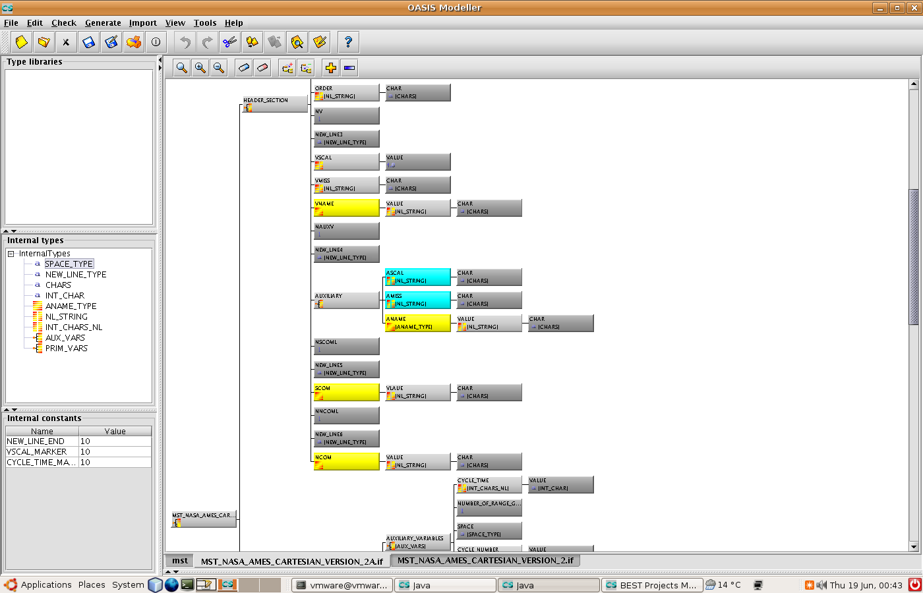
Formal Descriptions of Structure (Examples)
Notes:
This can be ignored if known as it was presented in the second review.
An example of an EAST description of STFC BADC MST data in BEST OASIS Modeller. Will show application as demo. No need to print.

Slide 31
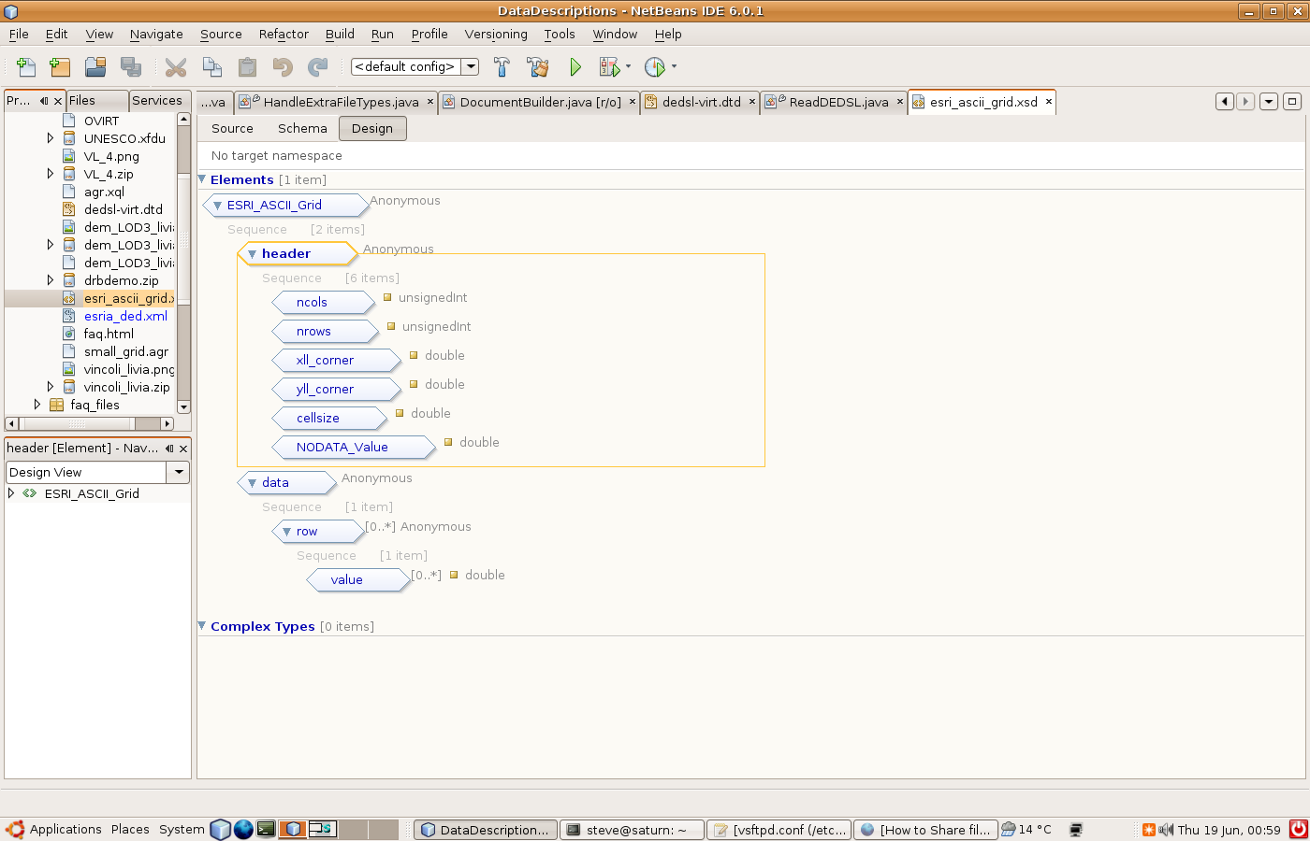
Formal Descriptions of Structure (Examples)
Notes:
This can be ignored if known as it was presented in the second review.
The UNESCO DRB description of their GRID data. Will explain structure. Do not print?

Slide 32
Virtualisation - building up data types…
Spectrum
Earth Observation image
Astronomical image
Additional Representation Information e.g. xquery built on DRB descripion allows one to construct higher level structures
Time Series
Image
Data Value
Vector
3-D data
Data value obtained using Representation Information including
Data Descriptions: e.g. EAST or DRB or ..
Data Dictionaries: e.g. Onologies or DEDSL or ...
Table
Various conceptually tabular data
1001110000
1010100011
Notes:
Building up data types from individual values to complex data structures to specialised domain data types.

Slide 33
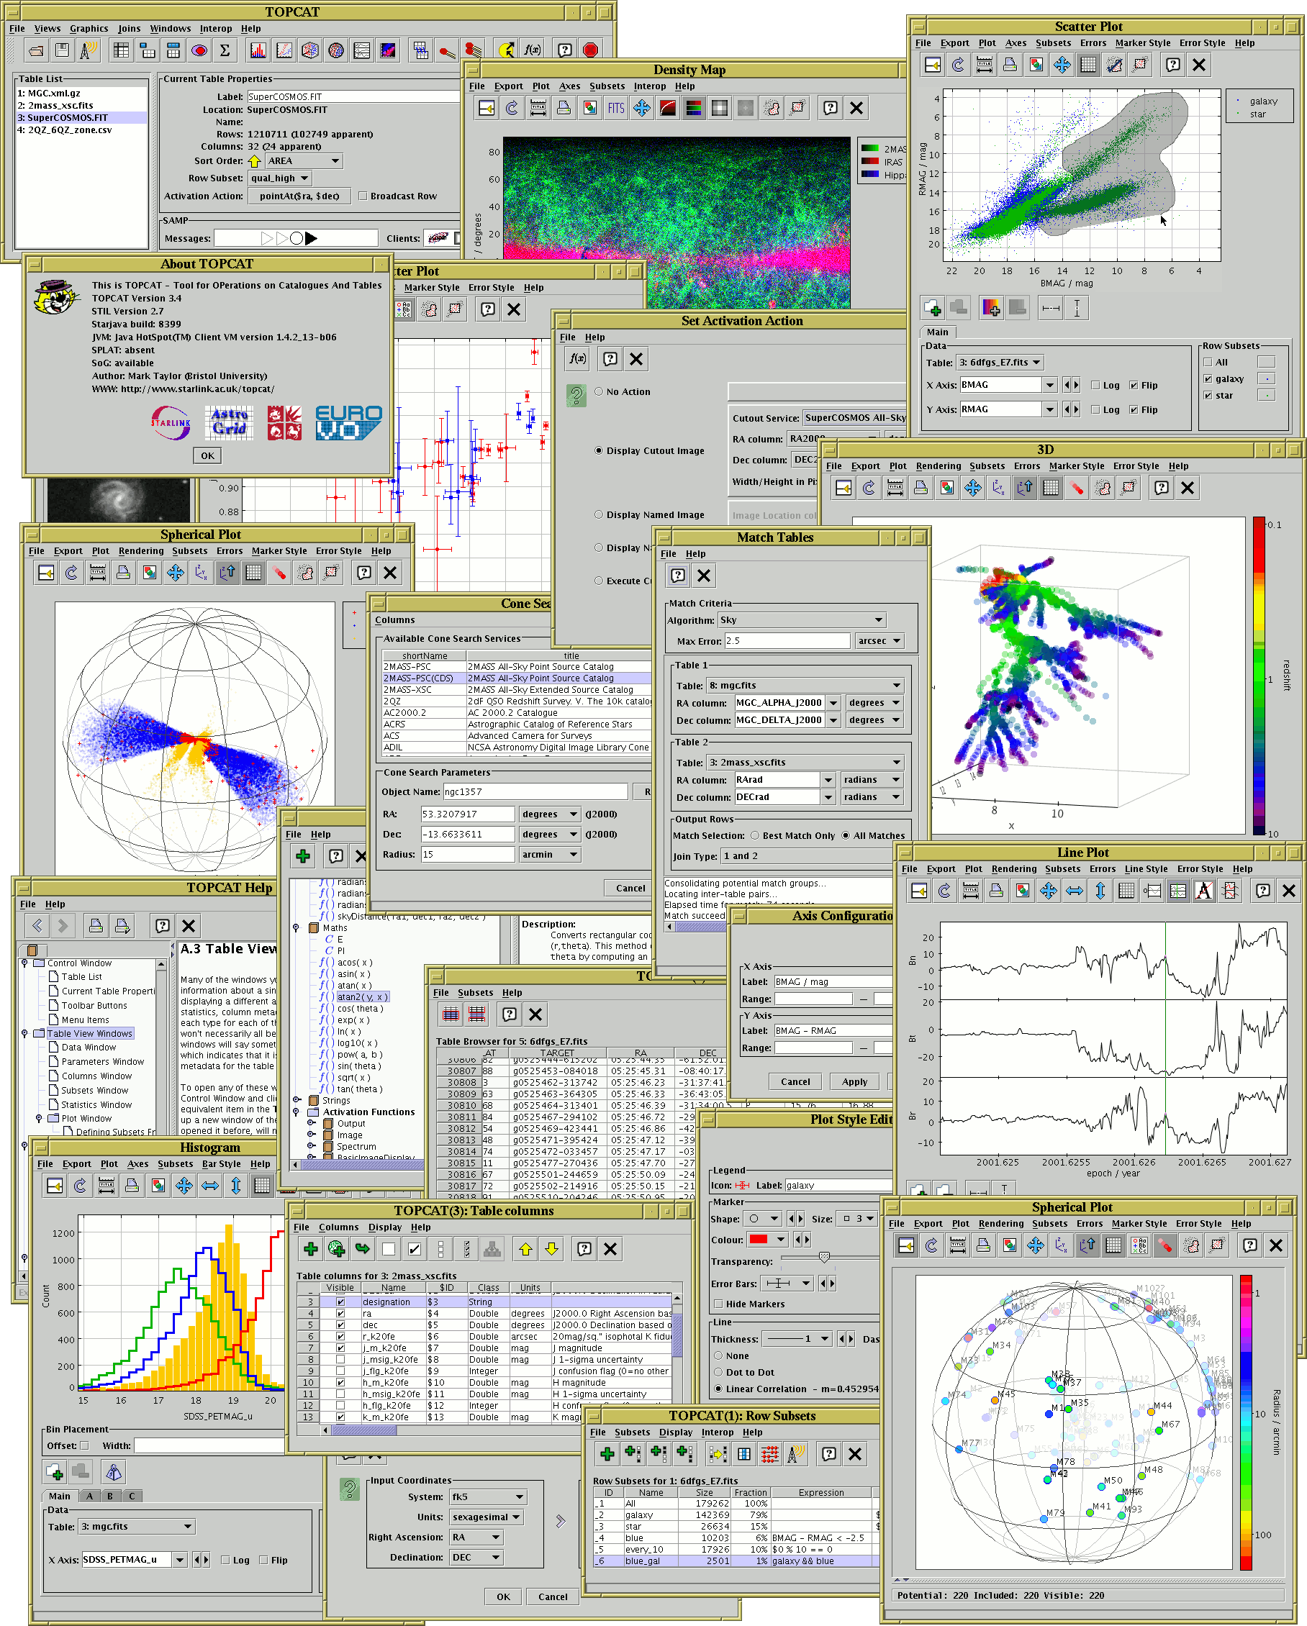
Building on simple virtualisation of tabular data into JTable based application
Can combine data in different formats

Slide 34
Advantages of Formal Descriptions of Semantics
Semantic properties such as name, description and units add meaning to the data values and data objects.
Object oriented view of the data combined with the structure and semantics virtualises the process of going from the bits to a usable data object in software.
Combined with formal structure it encapsulates all the knowledge needed to go from the bits to a data object in software.
Remove the need for data specific Access Software!

Slide 35
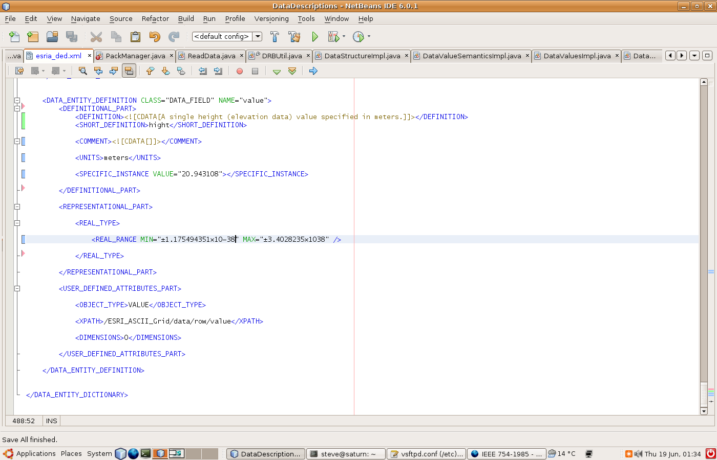
DEDSL Example
Notes:
This can be ignored if known as it was presented in the second review.
Will show as example. Note the XPATH relating the structure and the semantic descriptions.

Slide 36
Brown Dog
Presentation from Mark Conrad

Slide 37
Backup Slides

Slide 38
Relationship between standards
There is a hierarchy of ISO standards concerned with good auditing.
ISO 16919 is positioned within this hierarchy in order to ensure that these good practices can be applied to the evaluation of the trustworthiness of digital repositories using ISO 16363.
It covers principles needed to inspire confidence that third party certification of the management of the digital repository has been performed with impartiality, competence, responsibility, openness, confidentiality, and responsiveness to complaints
OAIS
(ISO 14721)
Requirements For Bodies Providing Audit And Certification
(ISO 16919 )
Trusted Digital Repositories:
Attributes and Responsibilities
TRAC
Audit and Certification of Trustworthy Digital Repositories
(ISO 16363 )
Audit by external, accredited, auditors
Certification
Metrics concerning:
Organizational Infrastructure
  e.g. The repository shall have a documented history of the changes to its operations, procedures, software, and hardware.
Digital Object Management
  e.g. The repository shall have access to necessary tools and resources to provide authoritative Representation Information for all of the digital objects it contains.
Infrastructure and Security Risk Management
  eg. The repository shall have procedures in place to evaluate when changes are needed to current software.
See http://wiki.digitalrepositoryauditandcertification.org and http://www.alliancepermanentaccess.org/membership/member-resources/audit-and-certification
Standards will be available free from http://www.ccsds.org
Notes:
ISO 16363 was derived from OAIS – the technical issues connected with preservation with “Trusted Digital Repositories: Attributes and Responsibilities”
An intermediate version called TRAC was created but that was not a standard and was not designed for audits.
To follow the ISO process, ISO 16919 accompanies 16363 to help define who can audit. ISO/CASCO – concerned with conformity assessment – previously talked in terms of qualifications and experience. However now the idea is to define “competencies” - what an auditor needs to be able to do. This allows us to specify in detail what these competencies are.
The question is who determines that someone can do an audit?

Slide 39
IAF
TC
TC
WG
Regional Group
USA: ANSI
ANAB
UK:
UKAS
INDIA:
NABCB
Regional Group
National Accreditation Body (NAB)
ISO 17011(?)
NAB
NAB
National Accreditation Body appoints ASSESSORS to help decide whether or not to accredit
Certification Body
ISO 17021
(ISO) 16919
Repository
ISO 16363
Notes:
A repository must follow ISO 16363 – check by an auditor
An Certification Body – the auditors -is accredited according to ISO 16919
The National Accreditation Body accredits the Certification body
Since the NAB does not know about digital preservation they appoint assessors who can make the judgement.

