Slide 1
XFDU
<xfdu:XFDU xmlns:xfdu="urn:ccsds:schema:xfdu:1">
<packageHeader ID="COROT-N0-SIP-0021">
[...]
</packageHeader>
<informationPackageMap>
<xfdu:contentUnit>
<xfdu:contentUnit>
[...]
<xfdu:contentUnit>
<dataObjectPointer dataObjectID="DO-COROT-N0-Product-0001"/>
</xfdu:contentUnit>
<xfdu:contentUnit>
<dataObjectPointer dataObjectID="DO-COROT-N0-Product-0002"/>
</xfdu:contentUnit>
[...]
</informationPackageMap>
<dataObjectSection>
<dataObject ID="DO-COROT-N0-Product-0001">
<byteStream size="0">
<fileLocation locatorType="URL" href="file:N0/RUN03_IRA01/AN0_BKGROUND/79.tar.gz"/>
<checksum checksumName="MD5">d41d8cd98f00b204e9800998ecf8427e</checksum>
</byteStream>
</dataObject>
[...]
</dataObjectSection>
</xfdu:XFDU>

Slide 2
SIP XFDU
<xfdu:XFDU xmlns:pais="urn:ccsds:schema:pais:1" xmlns:xfdu="urn:ccsds:schema:xfdu:1">
<packageHeader ID="COROT-N0-SIP-0021">
[...]
<environmentInfo>
<extension>
<pais:sipGlobalInformation>
<pais:sipID>COROT-N0-SIP-0021</pais:sipID>
<pais:producerSourceID>CNES</pais:producerSourceID>
<pais:producerArchiveProjectID>COROT-N0</pais:producerArchiveProjectID>
<pais:sipContentTypeID>SIP-COROT-N0-PRODUCT-SET</pais:sipContentTypeID>
<pais:sipSequenceNumber>21</pais:sipSequenceNumber>
</pais:sipGlobalInformation>
</extension>
</environmentInfo>
</packageHeader>
[...]

Slide 3
SIP XFDU (Cont')
[...]
<informationPackageMap>
<xfdu:contentUnit>
<extension>
<pais:sipTransferObject>
<pais:descriptorID>COROT-N0-RUN-PRODUCT-SET</pais:descriptorID>
<pais:transferObjectID>COROT-N0-RUN-PRODUCT-SET-0001</pais:transferObjectID>
<pais:lastTransferObjectFlag>FALSE</pais:lastTransferObjectFlag>
</pais:sipTransferObject>
</extension>
<xfdu:contentUnit>
<extension>
<pais:sipTransferObjectGroup>
<pais:associatedDescriptorGroupTypeID>COROT-N0-Run</pais:associatedDescriptorGroupTypeID>
<pais:transferObjectGroupInstanceName>N0/RUN03_IRA01</pais:transferObjectGroupInstanceName>
</pais:sipTransferObjectGroup>
</extension>
<xfdu:contentUnit>
<extension>
<pais:sipTransferObjectGroup>
<pais:associatedDescriptorGroupTypeID>COROT-N0-Product-Type</pais:associatedDescriptorGroupTypeID>
<pais:transferObjectGroupInstanceName>AN0_BKGROUND</pais:transferObjectGroupInstanceName>
</pais:sipTransferObjectGroup>
</extension>
[...]

Slide 4
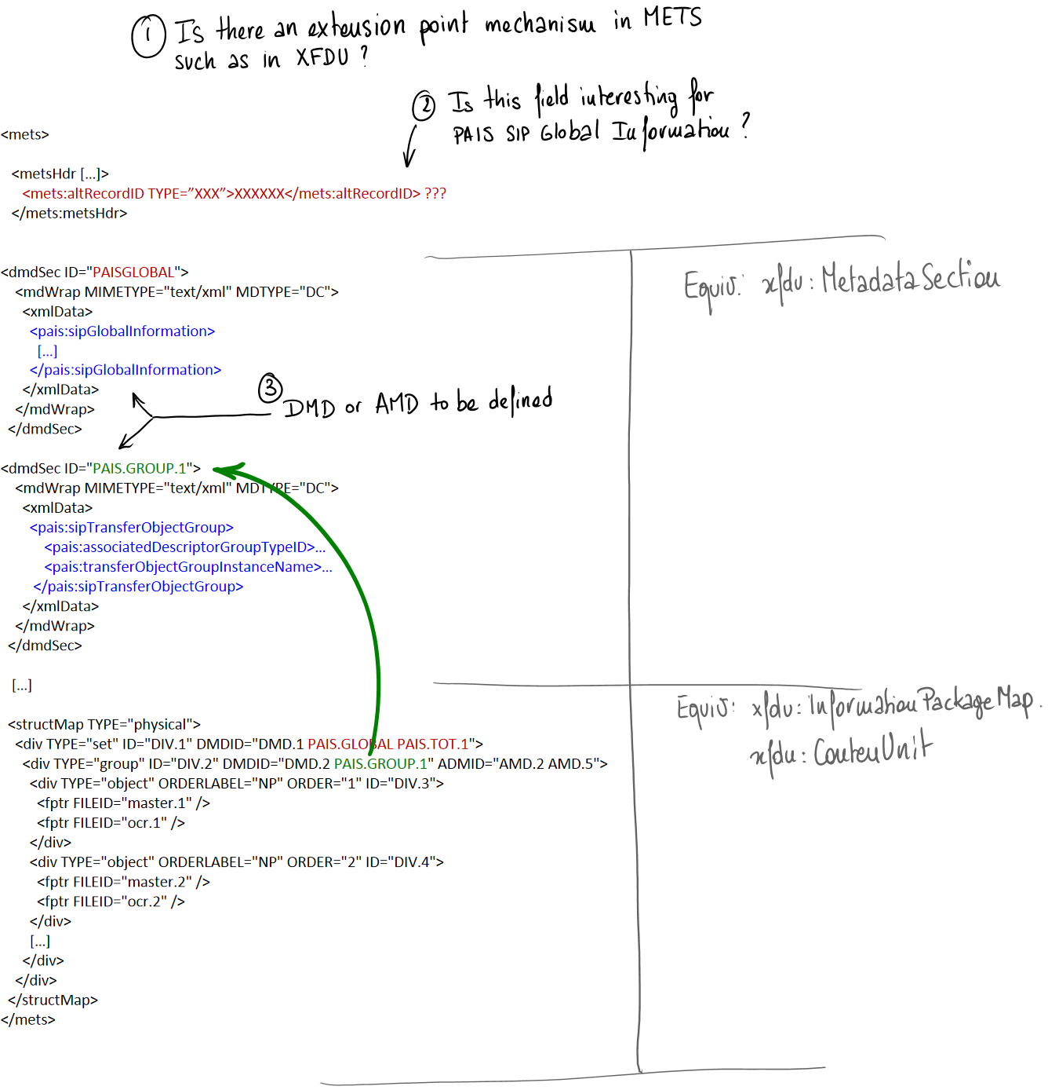
PAIS SIP / METS

Slide 5
CoRoT - Repos Logical View

Slide 6
CoRoT - Repos Physical View

Slide 7
CoRoT - MOT

