Slide 1
Functional Resource Model Magenta Book Status
CSSA Workshop
Cyberspace
25 October 2021
Updated on 28 October 2021
John Pietras
Global Science and Technology, Inc.

Slide 2
FRM Magenta Book Status - Overview
Magenta Book content:
FRM concepts and structure (e.g., FR, FR Strata, FR Sets, configuration categories (SLS, retrieval, forward offline))
SANA FR registry organization and attribute definitions
FR Strata/FR Set/FR definitions for Tier-1 and Tier-2 FRs
Organized by FR Strata (one per section): FR Set: FR
FR behavior (primarily by reference to CCSDS Blue Books)
Deviations from CCSDS Blue Book definitions (where applicable)
Modified behavior (if applicable)
Differences from Blue Book managed parameters (if applicable)
Service Access Point (SAP) and ancillary interfaces between FRs
28 Tier-1 FRs (corresponding SANA registry FRs have already been peer-reviewed by subject matter experts)
13 Tier-2 FRs (corresponding SANA registry FRs have not yet been peer-reviewed by subject matter experts)
Space Data Link Protocol FR Sets contain FRs for only “lower” SDLP functions
The FR Set definitions identify the functionality that will be covered by future versions of the FR Sets (e.g., USLP MAP Multiplexing)
OID offsets for FR Strata and FR Sets (annex A)
Abbreviations for construction of FR and parameter/event/directive (PED) classifiers (annex B) - New
Security, SANA, and patent considerations (annex C)
Acronyms (annex D)
Identified future FR Sets (annex E)

Slide 3
28 Tier-1 FRs
Antenna
CCSDS 401 Space Link Carrier Transmission
Ranging Transmission
CCSDS 401 Space Link Carrier Reception
Range and Doppler Extraction
TC PLOP, Synchronization, and Channel Encoding
Fixed Length Frame Synchronization, Channel Encoding, and Only-Idle-Data Generation
Fixed Length Frame Synchronization and Channel Decoding
TC Master Channel (MC) Multiplexing
TC Virtual Channel (VC) Multiplexing
AOS MC Multiplexing
AOS VC Multiplexing
Fixed Length Frame (FLF) USLP MC Multiplexing
FLF USLP VC Multiplexing
TM/AOS MC Demultiplexing
TM/AOS VC Demultiplexing
Frame Data Sink
TDM Segment Generation
Offline Frame Buffer
TDM Recording Buffer
SLE F-CLTU Transfer Service Provider
Forward Frame CSTS Provider
SLE RAF Transfer Service Provider
SLE RCF Transfer Service Provider
SLE ROCF Transfer Service Provider
Tracking Data CSTS Provider
Monitored Data CSTS Provider
FRs in red will need to be updated in response to recent changes

Slide 4
13 Tier-2 FRs
Delta-DOR Raw Data Collection
Open Loop Data Collection
VLF Synchronization and Channel Decoding
Variable Frame Length (VLF) USLP MC Multiplexing
VLF USLP VC Multiplexing
VLF USLP MC Demultiplexing
VLF USLP VC Demultiplexing
FLF USLP MC Demultiplexing
FLF USLP VC Demultiplexing
Non-validated Radiometric Data Collection
Non-validated Radiometric Data Store
Validated Radiometric Data Store
D-DOR Raw Data Store
FRs in red will need to be updated in response to recent changes

Slide 5
Some parting thoughts on the FRM (1 of 4)
Use of SAP ancillary interface information in the FRM database
Information is in the FRM MB
FRM database has structures for the data but they have not been populated
Information might be used to help construct the “wiring diagram” part of configuration profiles
CCSDS 415 FRs would be needed for NSN support
Recommend that the FRs be based on ICD between Space Network and Customers for Service Management

Slide 6
Some parting thoughts on the FRM (2 of 4)
Data structure definitions in FR definitions
So far, the FRM and associated SANA registry formally define only the management information of the FRs
Specification of behavior and data structures is deferred to text- and graphics-based definitions in the source Blue Books
There is some interest in extending the FR definitions to more-formally address protocol data structures
Transfer Syntax Notation One (TSN.1: http://www.protomatics.com/tsn1.html, http://www.protomatics.com/download/doc/TSN1_Spec.pdf) is a bit-oriented derivation of ASN.1
Used to define Wireshark decoders
Should be investigated for use in formally defining CCSDS protocol data structures (e.g., transfer frames, packets)
Unambiguity and compilability of modules would benefit interoperability testing and implementations
Ideally, TSN.1 definitions would be made part of the source Recommended Standards, but FRM could be a fallback “host”
NOTE - TSN.1 was developed by Protomatics, Inc. for its TSN.1 compiler product. There could be intellectual property issues involved in using TSN.1 for CCSDS

Slide 7
Some parting thoughts on the FRM (3 of 4)
Organization-specific extensions of CCSDS-standard FR definitions
The FRM already supports registration of CSTS-compliant Agency-specific FRs under the agenciesFunctionalities node
There is not currently a formal method for registering Agency/organizational parameters/events/directives (PEDs) to existing CCSDS-standard FRs
Proposed for consideration: subdivide and allocate the range space of each PED, much in the same way that we allocate the FR range space to FR Strata and FR Sets. E.g.,
Allocate 1 – 500 of each PED to CCSDS
Allow Agencies/organizations to be allocated subranges (fixed or variable sized TBD) that they control
Would require some Authorizing Entity (CSSA?) to manage the sub-allocation
Would require some PED naming convention(s) to ensure no overlap in classifiers
E.g., assign each organization an abbreviated identifier that would be concatenated with the FR PED prefix – an ESTRACK-specific parameter of the Antenna FR would have the prefix “antEstrack” or “ant_Estrack_”

Slide 8
Some parting thoughts on the FRM (4 of 4)
Observation: PED Names could be further simplified
CSTS SFW B-1 allowed and defined “generic” parameters and events that could be used by multiple FRs
The generic PEs were registered under separate OID nodes from the individual FR subnodes, resulting in PED “Names” with the construction [{{FRTypeOid}:FRIN} : {PEDOid}]
The classifiers of the generic PEDs were also generic
CSTS SFW B-2 eliminated “generic” parameters and events and required that each FR define it’s own parameters/events for several common parameters and events
Now all PEDs are registered under their FR OID nodes, and all PED classifiers have the same PED prefix as the other PEDs for an FR
Thus the FRTypeOid component if the PED Name is now redundant, and could be eliminated: i.e., the PED Name could be constructed as {{PEDOid}:FRIN}
NOTE: This simplification wouldn’t affect uses of FrNicknames (e.g., in SM entities like configuration profiles, because the FrNickname still must represent the {{FRTypeOid}:FRIN} combination
I am not proposing that this change be made for it’s own sake; I’m merely observing that it would be possible to do
However, if in the future there is some reason that it would be advantageous to do so, it is available

Slide 9
Tier-1 and Tier-2 FR Affected by Issues/Concerns
Tier-1
TC PLOP, Synchronization, and Channel Encoding
Fixed Length Frame Synchronization, Channel Encoding, and Only-Idle-Data Generation (MB and MIB)
Fixed Length Frame Synchronization and Channel Decoding
AOS MC Multiplexing
FLF USLP MC Multiplexing
TM/AOS MC Demultiplexing
TM/AOS VC Demultiplexing
Tier-2
VLF Synchronization and Channel Decoding (MB and MIB)
FLF USLP VC Demultiplexing
VLF USLP MC Demultiplexing (MB and MIB)
VLF USLP VC Demultiplexing (MB and MIB)
Non-validated Radiometric Data Collection (MB only)
Non-validated Radiometric Data Store (MB only)

Slide 10
Issue/Concern – Support for dynamic pseudo-randomization OID frames (1 of 10)
FRM concept before 2021
[TM,] AOS and FLF USLP OID frames could contain a static P-R data field in the Transfer Frame Data Field
FLF Sync, Channel Encoding, and OID Generation FR generates OID Data Units containing fixed content contained in a configuration parameter of the FR
When AOS MC Mux is the source of frames, the OID Data Unit contains an octet string that is configured as a static AOS OID frame
When FLF USLP MC Mux is the source of frames, the OID Data Unit contains an octet string that is configured as a static AOS OID frame
When FF-CSTS is the source of CADUs, the OID Data Unit contains an octet string that is configured as a static OID CADU with the appropriate encoding applied
AOS CADUs
FLF CADUs
Non-CCSDS CADUs
No coding (except optionally convolutional coding) applied to CADUs
CADU mode doesn’t work with SMTF stream slicing
AOS MC Mux and FLF USLP MC Mux do not generate OID frames

Slide 11
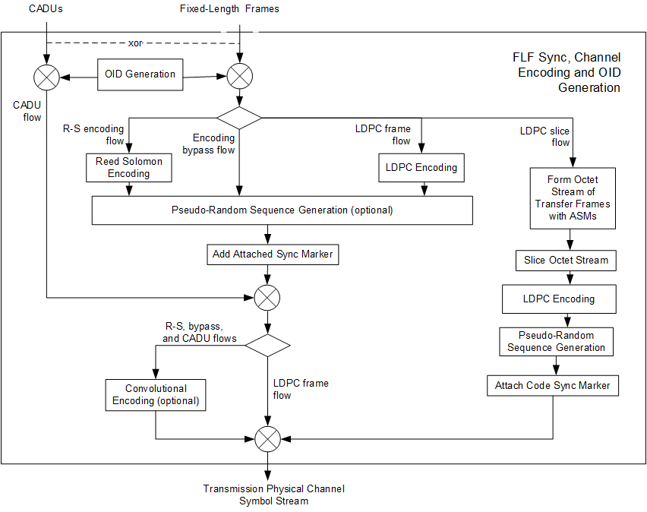
Issue/Concern – Support for dynamic pseudo-randomization OID frames (2 of 10)
FLF Sync, Channel Encoding, and OID Generation – pre-2021
Only user-data-bearing
Transfer frames
Produces OID
Frames or CADUs
with fixed content

Slide 12
Issue/Concern – Support for dynamic pseudo-randomization OID frames (3 of 10)
2021 changes to TM, AOS, and USLP OID frames
[TM,] AOS and FLF USLP OID frames now must contain a changing P-R Transfer Frame Data Field
Purpose is to avoid periodicity that causes receivers to lock onto the wrong frequency
As a consequence, FLF Sync, Channel Encoding, and OID Generation FR can no longer simply generate OID Data Units containing fixed content
P-R-encoded Transfer Frame Data Fields appear in different parts of [TM,] AOS, and USLP frames
I.e., OID frame generation process must be SDLP-aware
3 candidate solutions (there may be more)

Slide 13
Issue/Concern – Support for dynamic pseudo-randomization OID frames (4 of 10)
First candidate solution
Move responsibility for OID frame generation back into AOS and FLF USLP MC Mux FRs
Limit OID CADU generation to non-CCSDS space data link protocols that use static OID CADUs
No coding (except optionally convolutional coding) applied to CADUs
Benefits
Allows SDLP to remain opaque to FLF Sync, Channel Encoding, and OID Generation FR
For OID frame generation, more closely aligns with organization of AOS and USLP Blue Books, which allocates OID frame generation to MC Mux procedures
Has little effect on existing FRM definitions
Shortcomings
Still doesn’t work with SMTF stream slicing
CADU mode has very little worth if it is confined to only non-CCSDS SDLPs that use static OID CADUs

Slide 14
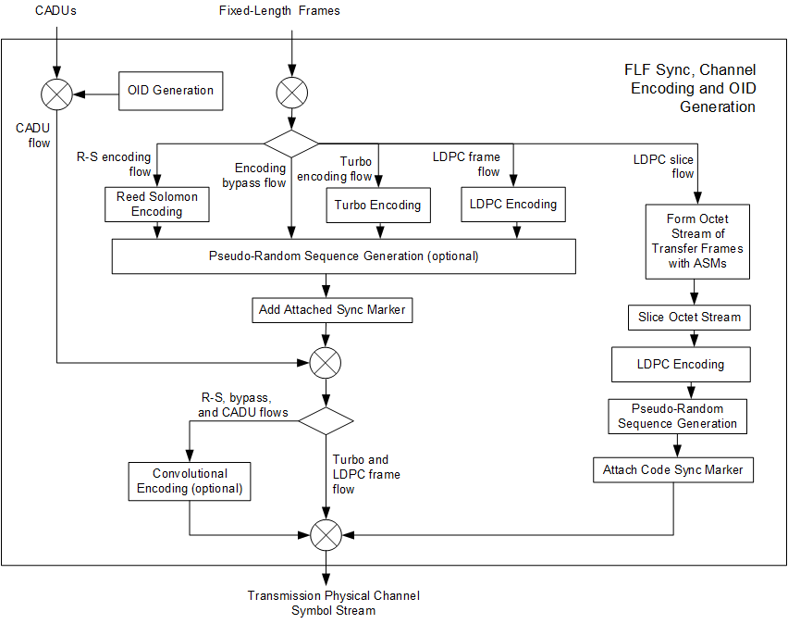
Issue/Concern – Support for dynamic pseudo-randomization OID frames (5 of 10)
FLF Sync, Channel Encoding, and OID Generation – Candidate 1
User-data-bearing
frames and
OID Frames from
MC Mux
Produces OID
CADUs
with fixed content

Slide 15
Issue/Concern – Support for dynamic pseudo-randomization OID frames (6 of 10)
Second candidate solution
Move responsibility for OID frame generation back into AOS and FLF USLP MC Mux FRs
OID generation is limited to OID CADUs carrying CCSDS AOS and USLP OID frames
Octet-string OID Data Unit is replaced by AOS/USLP picklist
Must be configured with SCID to use (and other info?)
In CADU mode, OID frames are generated that are then encoded using the same coding as user-data-bearing frames, including SMTF stream slicing
Benefits
More closely aligns with organization of AOS and USLP Blue Books, which allocates OID frame generation to MC Mux procedures
Transfer frame mode can still support any SDLP, including future CCSDS SDLPs and even non-CCSDS SDLPs
CADU mode supports AOS and USLP CADUs (instead of only non-CCSDS CADUs)
Shortcomings
FLF Sync, Channel Encoding, and OID Generation FR CADU generation becomes specific to AOS and USLP; no ability to support CADU mode for non-standard SDLPs

Slide 16
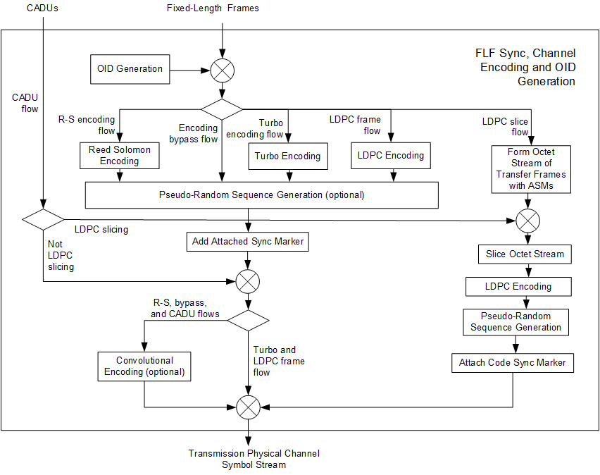
Issue/Concern – Support for dynamic pseudo-randomization OID frames (7 of 10)
FLF Sync, Channel Encoding, and OID Generation – Candidate 2
User-data-bearing
frames and
OID Frames from
MC Mux
Produces AOS or
USLP OID
Frames only in
CADU mode when
User-generated
CADUs are not
availble

Slide 17
Issue/Concern – Support for dynamic pseudo-randomization OID frames (8 of 10)
Third candidate solution
Perform OID frame generation for both transfer frame mode and CADU mode in FLF Sync, Channel Encoding, and OID Generation FR
Octet-string OID Data Unit is replaced by AOS/USLP picklist
Must be configured with SCID to use (and other info?)
In both transfer frame and CADU modes, OID frames are generated that are then encoded using the same coding as user-data-bearing frames, including SMTF stream slicing
Benefits
Keeps all OID generation in one FR
Future CCSDS or non-standard SDLPs can be supported in transfer frame mode if the FRs (i.e., MC Mux FRs) for those
Shortcomings
No ability to generate OID transfer frames or OID CADUs CCSDS or non-standard SDLPs in both transfer frame and CADU modes

Slide 18
Issue/Concern – Support for dynamic pseudo-randomization OID frames (9 of 10)
FLF Sync, Channel Encoding, and OID Generation – Candidate 3
Only user-data-bearing
Transfer frames
Produces AOS or
USLP OID
Frames in both
Transfer Frame and
CADU modes when
User-generated
Transfer frames or
CADUs are not
available

Slide 19
Issue/Concern – Support for dynamic pseudo-randomization OID frames (10 of 10)
Summary of candidates
Candidate 1
Simplicity of changes is outweighed by the loss of CADU mode for AOS and USLP, especially given the fixed-OID-content constraint on the CADU mode
Candidate 2
Supports USLP and AOS P-R OID generation requirements for both transfer frame and CADU mode
In transfer frame mode, OID frames generated by AOS VC Mux and USLP VC Mux
In CADU mode, OID frames generated by FLF Sync, Channel Encoding, and OID Generation
Allows FLF Sync, Channel Encoding, and OID Generation FR to support future CCSDS and non-standard SDLPs in transfer frame mode if the VC Mux FRs for those SDLPs generate their OID frames
Candidate 3
Supports USLP and AOS P-R OID generation requirements for both transfer frame and CADU mode: all OID frames generated by FLF Sync, Channel Encoding, and OID Generation
Allows FLF Sync, Channel Encoding, and OID Generation FR to support future CCSDS and non-standard SDLPs in transfer frame mode if the VC Mux FRs for those SDLPs generate their OID frames
Future CCSDS SDLPs can be accommodated in CADU mode with an update to FLF Sync, Channel Encoding, and OID Generation FR
Non-CCSDS SDLPs can be accommodated in CADU mode Agency-specific FRs
WG Decision: adopt Candidate 3

Slide 20
Issue/Concern – Purpose of Non-validated Radiometric Data Collection and Non-validated Radiometric Data Store FRs
Tier-2 contains Non-validated Radiometric Data Collection and Non-validated Radiometric Data Store FRs
These could be (and have been – by me!) misinterpreted as some sort of file-oriented alternative to TD-CSTS for the delivery of non-validated RM data
There is no IAOG service called for, nor is there a planned CCSDS service
After further consideration, the purpose of these FRs is to capture radiometric data in the initial step of producing validated RM data
The Non-validated Radiometric Data Collection and Non-validated Radiometric Data Store FR definitions in the Magenta Book will be updated to clarify this
automated collection during space link session offline manual process

Slide 21
Issue/Concern – PIDs to remove VLF USLP from RAF, RCF, and ROCF (1 of 2)
(Potentially) affects
VLF Synchronization and Channel Decoding
TM/AOS MC Demultiplexing
TM/AOS VC Demultiplexing
VLF USLP MC Demultiplexing
VLF USLP VC Demultiplexing
FLF USLP VC Demultiplexing
Fixed Length Frame Synchronization and Channel Decoding
No effect on RAF, RCF, ROCF TS Provider FR definitions (MB or MIB) because they just reference Blue Book definitions
Summary of PIDs
Eliminate use of TC Sync and Channel Decoding for VLF USLP on the return link
Simple solution
Remove support for VLF frames (and TC S&CC) from RAF, RCF, and ROCF Blue Books
Remove VLF frames from RAF, RCF, ROCF from FRM (if and as necessary)
Delete VLF Sync and Channel Decoding FR from FRM (but keep the material in the Tech Note version for possible future use in an onboard version of the FR)
Complicating factor – SDLPWG and C&SWG are thinking about adding VLF support to TM S&CC
Multiple issues to be worked out; could take a year or more to sort out
Would affect RAF, RCF, ROCF BBs and associated FRs; FLF Synchronization and Channel Decoding FR
Waiting for that to happen would leave the SLE updates and FRM publication in limbo

Slide 22
Issue/Concern – PIDs to remove VLF USLP from RAF, RCF, and ROCF (2 of 2)
WG decision – ignore possibility of adding VLF to TM S&CC, adopt the “simple solution”
Delete VLF Sync and Channel Decoding FR from FRM
Keep FLF Synchronization and Channel Decoding FR as-is
What to do with VLF USLP MC Demux and VLF USLP VC Demux in Tier-2 and the Magenta Book?
Without VLF Sync and Channel Decoding FR, there is no source of VL frames
WG decision – Delete FRs from Tier-2 and fiorst issue of Magenta Book, keep material for future use
If and when TM S&CC adds VLF support:
Replace FLF Sync and Channel Decoding FR with a new TM Sync and Channel Decoding FR that supports both FLF and VLF frames
Depending on how VLF support is added to TM S&CC, there may be a new SAP type for VLF frames
Replace FLF Sync, Channel Encoding and OID Generation FR with a new TM Sync, Channel Encoding and OID Generation FR
Depending on how VLF support is added to TM S&CC, there may be a new SAP type for VLF frames
Allow VLF USLP MC Mux to access TM Sync, Channel Encoding and OID Generation FR (in addition to TC PLOP, Sync, and Channel Encoding)
Include VLF USLP MC Demux and VLF USLP VC Demux FRs in Magenta Book and SANA Registry
Allow VLF USLP MC Demux to access TM Sync and Channel Decoding FR

Slide 23
Issue/Concern – PIDs to add FSR status as a reason to disable CLTU transmission
(Potentially) affects
TC PLOP, Synchronization, and Channel Encoding
TM/AOS MC Demultiplexing
TM/AOS VC Demultiplexing
FLF USLP VC Demultiplexing
FLF Synchronization, Channel Encoding, and Only-Idle-Data Generation (MB and MIB)
No effect on F-CLTU TS Provider FR MB or MIB definitions because they just reference Blue Book definitions
Summary of PIDs
Use flags in Frame Status Report (FSR) OCFs to disable CLTU transmission, similar to use of No RF Availability and No Bit Lock flags in CLCWs
Complicating factors
CLCW flags report on whole-link availability, while FSRs report on Security Associations in individual VCs: inadvisable to shut down whole link for possible problems on a single link
If PIDs are accepted, significant FRM MB and MIB changes needed to add FSR flag to resource status of TC PLOP, Synchronization, and Channel Encoding and SDLP Demux FRs that currently extract only CLCWs
If PIDs are accepted, resource status of FLF Synchronization, Channel Encoding, and Only-Idle-Data Generation FR should also transition to “interrupted” under the same condition – significant changes to MB and MIB definitions
WG decision – do not disable CLTU transmission on the basis of FSR
Greg Kazz (Space Data Link Protocol WG chair), Craig Biggerstaff (Space Data Link Layer Security WG member), and Gilles Moury (Space Data Link Layer Security WG chair) all concur that FSR status should not be used to disable transmission in the ESLT

Slide 24
Issue/Concern – PIDs to explicitly address FSR content of ROCF transfers
No effect on any FRs because the behavior in question is strictly limited to F-CLTU TS Provider FR, which simply reference Blue Book definitions

