Slide 1
Forward Frame CSTS – CESG Red Book Approval Review – Proposed PID Response
CSTSWG Fall Workshop
Berlin, Germany
October 2018
(updated to reflect results of meeting with Gian Paolo Calzolari)
John Pietras
Global Science and Technology, Inc.

Slide 2
Background
The CSEG review of the candidate Forward Frame Red Book concluded on 11 October
One omnibus PID was submitted to the Secretariat by Gian Paolo Calzolari
922x3r0_CESG_Approval-GPC1.docx
This briefing proposes responses to Gian Paolo’s comments and recommendations
The omnibus PID essentially progresses section by section through the book, but addresses some basic cross-cutting themes
This presentation is organized in term of those themes

Slide 3
Themes
BD as well as AD frames are discarded in sequence-controlled data transfer mode
Too much emphasis on support for non-CCSDS protocols
Unprovable claim for support for “all” future CCSDS space link protocols
Sequence-controlled DP procedure vs. TC sequence-controlled service
Inconsistent treatment of USLP
Ambiguity regarding sync and channel coding standards for fixed-length frames (AOS and USLP)
Coding choices in scenarios
Imprecise/nonstandard terminology

Slide 4
A. BD as well as AD frames are discarded in sequence-controlled data transfer mode
The FF Red Book states:” The principal operational philosophy of the SCFDP procedure is that the sequencing and timing of the transmission of each frame is of critical importance, and that if each frame cannot be transmitted in-sequence and within its permitted time window then the transmission of frames must be suspended until proper sequencing and timing can be restored”
Gian Paolo’s comment: “This means that if a user if queueing AD and BD Frames also the BD Frames would be discarded. This means that FF would not really support a user mixing AD and BD frames (or that the user in such cases shall act with very precise timing). The document completely ignores that in the uplink that could be sequence controlled service (not mode) and expedited service (for TC but also for USLP). I think this concept shall be clarified and addressed in the document”
Is this a flaw in the FF service and/or the SFW Sequence-Controlled DP procedure?
If it is a flaw, how might we correct it?
If it’s NOT a flaw, how do we address it in the book so as to make TC-cognizant readers understand that it’s not a problem?
Resolution: it will be sufficient to include a Note that explains that because the transmission of all frames is suspended upon occurrence of an error condition, when the SCFDP is used to carry Telecommand and USLP AD and BD frames, any BD frames that are behind a rejected AD frame in the Input Queue will also be rejected, even though those frames are technically not constrained by the timing considerations of the AD frames. Users of the Forward Frame service to transfer TC frames and variable-length USLP frames must be aware of this behavior and adjust the use of BD frames accordingly.

Slide 5
B. Too much emphasis on support for non-CCSDS protocols
Multiple statements about ability of FF service to support “Mission-unique” protocols and “partially encoded transfer frames”
PID comments/conditions (multiple)
Core purpose is to support to CCSDS-standard transfer frames and CADUs
“partially encoded transfer frame” concept is confusing
Ability to support non-CCSDS-standard frames and CADUs should be relegated to Notes and/or a “dedicated section on how to cheat the forward frame service”
Proposed resolution
Purpose/definition of the FF service will specifically be to transfer TC transfer frames, AOS transfer frames, USLP transfer frames, and CADUs
Eliminate “partially encoded transfer frames”
Brief notes in the text alluding to the ability to support non-CCSDS frames and CADUs but without elaboration
Informative annex of examples of:
FF transfer of non-CCSDS frames and CADUs
FF transfer of R-S encoded frames (DSN case)

Slide 6
C. Unprovable claim for support for “all” future CCSDS space link protocols
Multiple statements regarding intent to support future CCSDS space link protocols
PID Comment/condition: such ability is unprovable
Normative support is for TC, AOS, and USLP
Proposed response:
Normative support is for TC, AOS, and USLP
Informative note that features of service make it likely to be able to support future space link protocols that meet the (TBS) conditions

Slide 7
D. Sequence-controlled DP procedure vs. TC sequence-controlled service
The use of “sequence-controlled DP procedure” is confusing to those used to the TC sequence-controlled service
Several PIDs advising to make sure that the term is always qualified
PID on nominal use cases questions why AOS frames are nominally excluded from S-C mode, and why TC frames are nominally excluded from the buffered data mode
PID implies a misunderstanding of the basis upon which SC mode does its sequence controlling (frame sequence numbers instead of the PROCESS-DATA invocation data-unit-id)
Possible solutions
Always use the qualifiers to distinguish from TC SC service – yes, if we don’t change the name
Delete/reword the offending nominal uses case statement
On its own, it just avoids the problem but still leaves the misunderstanding
Explain what the SFW SCDP procedure is, how it defines “sequence controlled”, and how that differs from TC SC service
Gets into the weeds early in the FF Overview section
Negates the layering of the Framework approach if we have to repeat definitions
Doesn’t help future services that use the SFW SCDP procedure to avoid the same confusion
Briefly note that SFW SCDP procedure upon which the SCFDP procedure is based has its on definition of “sequence controlled” that’s not related to TC SC service, and point to SFW.

Slide 8
E. Inconsistent treatment of USLP
Sometimes USLP is stated as a core goal, sometimes as “this should also work for USLP”, and sometimes not mentioned at all even when it is appropriate
Note: this is an artifact of the book being written as USLP became progressively more “real”
Multiple PIDs pointing out discrepancies, calling for equal status for USLP
Proposed response: Make USLP co-equal, add it where it is missing, e.g.,
Note that the forward AOS Frames scenario applies equally to fixed-length USLP frames
Change the third scenario from AOS CADU to CADUs, note that they can contain either AOS or USLP fixed-length Transfer Frames

Slide 9
F. Ambiguity regarding sync and channel coding standards for fixed-length frames (AOS and USLP) (1 of 4)
“AOS” Synchronization, Channel Coding, and OID Generation FR applies to fixed-length USLP frames as well as AOS
Inclusion of OID generation in this FR is confusing to readers familiar with CCSDS SDLP and S&CC standards
PID proposal: change the name of the FR to be more inclusive
Alternative?: eliminate reference to FRs in this book. Refer instead to the functions and their source Blue Books only
Rationale
Unlike MD-CSTS and SC-CSTS, functional resources are not central to the operation of the service: no harm done if only their functionality is mentioned
Saves the reader the effort to understand this intermediate concept
Eliminates the need to rationalize why OID Generation is done by and FR named “Sync and Channel Coding” instead of by one named “Space Data Link Protocol”
Caveat: we’ll still have to address the special case of OID generation when CADUs are being transferred, but that is would be specific to the CADU case

Slide 10
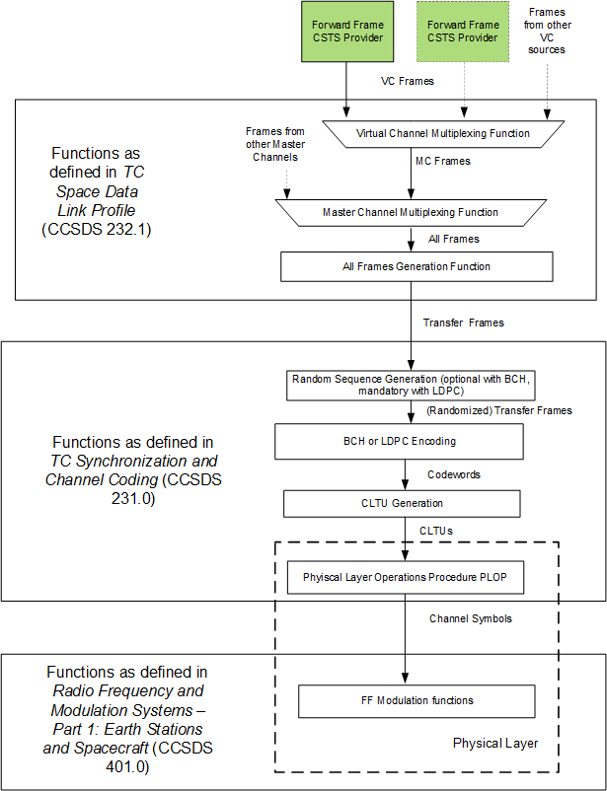
F. Ambiguity regarding sync and channel coding standards for fixed-length frames (AOS and USLP) (2 of 4)
Forward Variable-Length Frame configuration for TC Transfer Frames

Slide 11
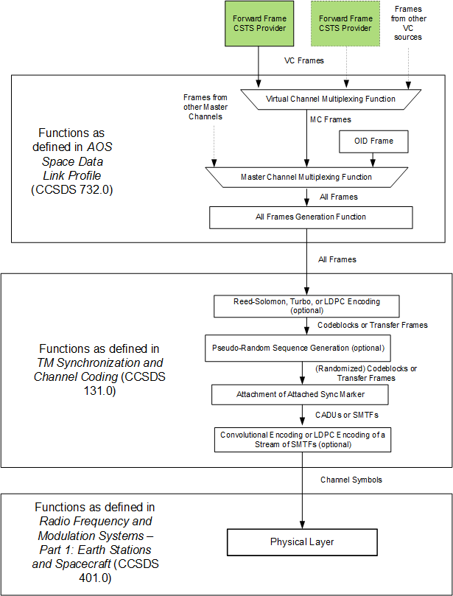
F. Ambiguity regarding sync and channel coding standards for fixed-length frames (AOS and USLP) (3 of 4)
Forward Fixed-Length Frame configuration for AOS Transfer Frames

Slide 12
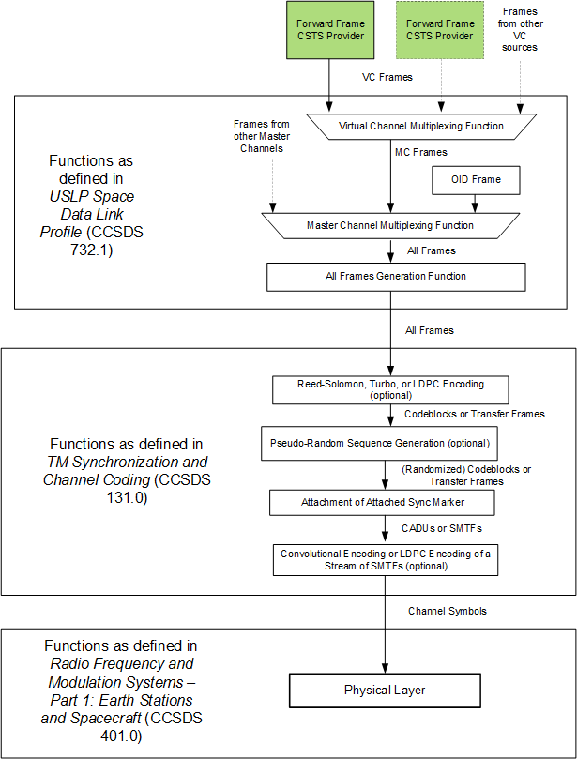
F. Ambiguity regarding sync and channel coding standards for fixed-length frames (AOS and USLP) (4 of 4)
Forward Fixed-Length Frame configuration for USLP Transfer Frames

Slide 13
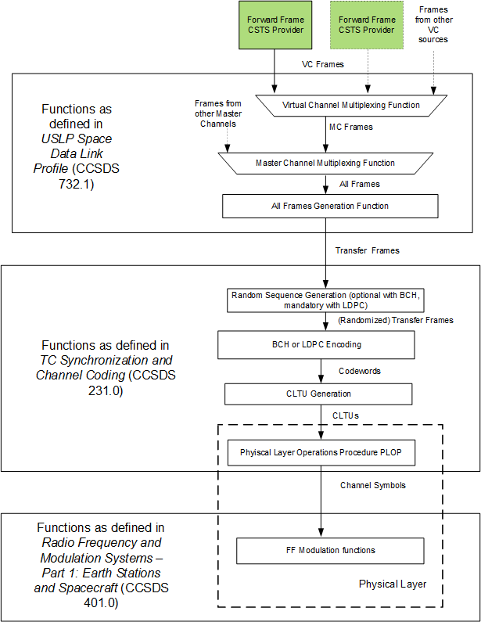
F. Ambiguity regarding sync and channel coding standards for fixed-length frames (AOS and USLP) (5 of 6)
Forward Variable-Length Frame configuration for USLP Transfer Frames

Slide 14
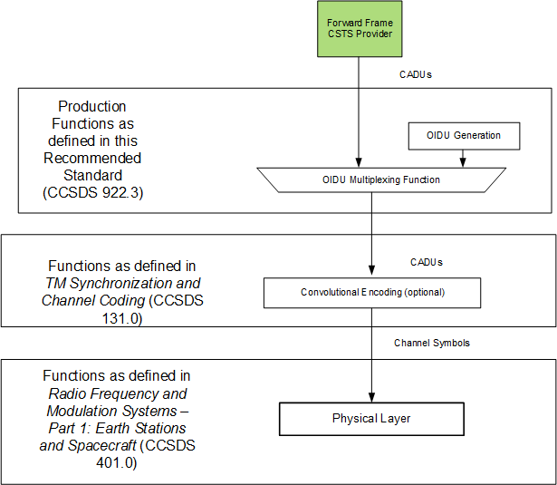
F. Ambiguity regarding sync and channel coding standards for fixed-length frames (AOS and USLP) (6 of 6)
Forward CADU configuration

Slide 15
G. Coding choices in scenarios
The Forward AOS Frames scenario (2.5.2) uses Reed-Solomon and convolutional coding, and the CADU scenario uses CC
PID states that NASA proposes not to include either Reed-Solomon or convolutional encoding, despite the fact that they are being used for ISS
Response:
LDPC remains (as of the end of the Berlin meeting) on the list of included coding schemes for fixed-length frames
R-S and CC will probably still stay in, but probably only for legacy support (i.e., ISS)
LDPC will be used instead of Reed-Solomon in the Forward AOS Frames scenario
Drop CC from both scenarios

Slide 16
H. Imprecise/nonstandard terminology
Multiple undefined and inconsistently/incorrectly-defined terms, e.g.,
OID CADUs
SL-PDUs
Partially-encoded transfer frames
Forward space data link protocols
Unified transfer frames
Mission-unique CADUs
Most of these terms will disappear in the clean-up
The rest will be defined and added to section 1.6.1.5

