Slide 1
JAXA’s Perspective on Implementing CSTSes (from the viewpoint of a service-user side)
Miyano Yoshikazu
miyano.yoshikazu@jaxa.jp
Center for Science-Satellite Operation and Data Archive
ISAS (Institute of Space and Astronautical Science)
JAXA

Slide 2
Outline
JAXA’s current status on implementing CSTSes
JAXA’s scope and planned phases of CSTSes implementation
JAXA’s probable approaches to promote CSTSes to end-users

Slide 3
JAXA’s current status on implementing CSTSes 1-1. Current system overview in respect of CSS services 1-2. Current operational status 1-3 Reference This section shows what JAXA service providers and users will think and do for CSTSes.

Slide 4
1-1. Current system overview in respect of CSS services (1/2)
JAXA Service Users have no interoperability in CSTSes apart from TC/TM in SLE
Standard
JAXA
Legacy
JAXA Service Providers
JAXA Service Users
Service Providers
JAXA DSN
Space and astronautical science
mission Users
Sync/
coding
AOS / TM protocol
NASA/DSN, ESA/Estrack stations
TC/TM(legacy)
Mission
Operations
system
TC/TM
(legacy)
TC/TM
(SLE)
AOS / TM protocol
SLE
provider
SLE
user
SLE
provider
Sync/
coding
From/To
Bepicolombo/ESA
SLE
user
TC/TM(SLE)
No
Interoperability
In CSTSes
(only Usuda64)
JAXA NEN
Sync/
coding
AOS / TM protocol
From/To
Other Agencies
Agency/Comercial
Providers
SLE
provider
Other mission users (eg. EO mission)
SLE
user
TC/TM(SLE)
Mission
Operations
system
SLE
user
TC/TM
(SLE)
AOS / TM protocol
JAXA’s Planning System
(Legacy systems)
SLE
provider
Sync/
coding

Slide 5
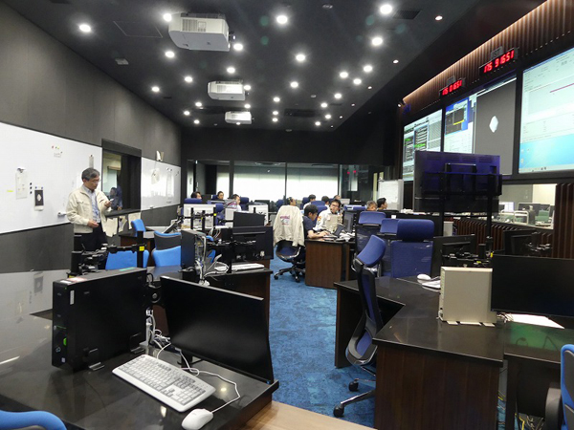
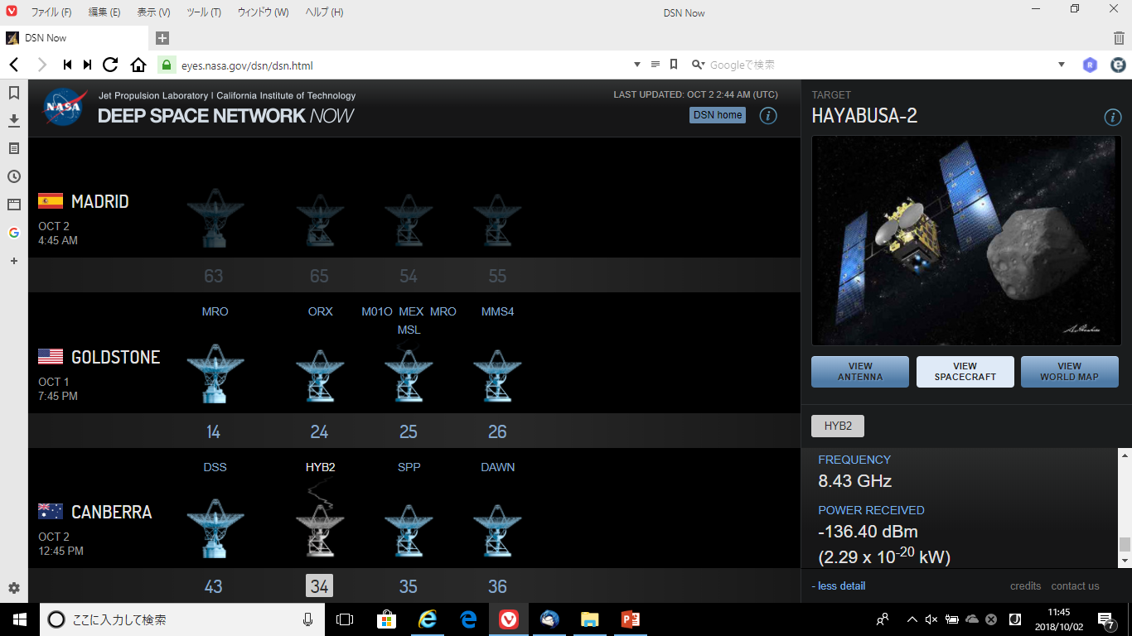
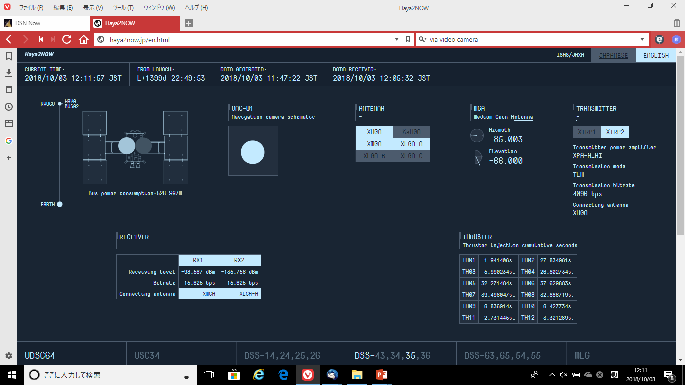
1-1. Current system overview in respect of CSS services (2/2) Current status of monitoring DSN and Estrack:
DSN NOW(https://eyes.nasa.gov/dsn/dsn.html)
Haya2NOW(http://haya2now.jp)
(During operation using Estrack)
Live Streaming via camera is displayed on the screen
JAXA Mission Operations Center
for Space and astronautical science missions

Slide 6
1-2. Current operational status
From the viewpoints of both service providers and service users
JAXA has several joint activities with other agencies including NASA and ESA. JAXA is becoming more and more convinced that the use of standard CSTSes will greatly contribute to feasibility and operability of its future missions and the reduction of development and interface costs.
From the viewpoint of service users
The first service to implement would be Monitored Data. The studies with commercial developers have been already completed, and JAXA service users can request funding to Japanese government as soon as it is certain that other agencies will implement CSTSes to their ground stations as well.
QUESTION: Does your agency have concrete plans to provide MD-CSTSes to your ground stations? By when?
JAXA service providers have also started studying the capability/possibility of implement CSTSes as a part of its future strategic plan, but they do not have any concrete infusion plans.

Slide 7
1-3 Reference
This table shows current status of JAXA for the CSTSes that are describe in IOAG Service Cataloge #1 and the charter of CWE CSTS WG.
CSTSes | JAXA Service Providers | JAXA Service Users | NASA | ESA | DLR | CNES
MD-CSTS | Currently, having no concrete plan. But, starts a study for future capability. Also, having deeply concerned with other agencies’ situation. | Study with developer was finished last year. JAXA service users will request funding as soon as other agencies declare to implement in ground stations. | Yes or No When? | Yes or No When? | Yes or No When? | Yes or No When?
 |  | No plan to implement. JAXA service users will make decisions after implementing MD-CSTS user gateway.
TD-CSTS
FF-CSTS
Service Control |  | No study. Mission Operations Monitor & Control Services BB (522.1-B1) is similar service.
DDOR CSTS (Scope of IOAG catalog #1) | No concrete plan to implement over TGFT. JAXA replied in IOAG this August as follow: JAXA supports the P1 for DDOR services in the ICPA. However, regarding the file exchange mechanism, JAXA confirmed with its partner agencies that DDOR file exchange shall be performed with conventional existing mechanism (e.g. SFTP).
Scope of question

Slide 8
JAXA’s scope and planned phases of CSTSes implementation 2-1. JAXA’s MD-CSTS User Gateway 2-2 Planned Implementation Phases 2-3 Discussions In section 2, JAXA service users will start to develop MD-CSTS user gateway for ground stations outsides JAXA, on the condition that funding be approved.

Slide 9
2-1. JAXA’s MD-CSTS User Gateway
MD-CSTS
Service Provider
 | Documents and Information to implement
1 | MD-CSTS BB 922.1-B-1
2 | Specification Framework BB 921.1-B-1
3 | SANA Registry Functional Resources https://sanaregistry.org/r/functional_resources (In Candidate)
4 | Internet Protocol for Transfer Service (ISP1) 913.1-B-2
5 | Language API for MD-CSTS (No document)
MD-CSTS
MD-CSTS User
Function
Language API for MD-CSTS
GUI
For
MD-CSTS
Legacy
systems
Scope of JAXA’s implementation

Slide 10
2-2 Planned Implementation Phases
Getting Started with small-scale development, and expanding through PDCA cycles
Testing interoperability first within JAXA, then with other agencies
Promoting the MD-CSTS to outside users (developing open-source software, possibly)
Getting started with small scale development
JAXA service users will initiate implementation with mandatory procedures and several numbers of parameters/events. Expansion will be held throughout PDCA cycle.
Service management, especially service package, will be also considered in expansion phase.
2) Interoperability test will be done firstly within JAXA and then with agencies
JAXA service users will also develop a simulator of MD-CSTS Service Provider and will do interoperability test within JAXA and then connect Service Provider by other agencies.
3) Promotion to service users outside JAXA.
My motivation is to release this gateway open source software for service users outsides JAXA, though I need to negotiate license description with developers. Service users, especially in universities, will install the software.

Slide 11
2-3. Discussion (1/2)
When will functional resources of SANA Registry be approved?
The issue on SANA registries will be also discussed in CMC meeting next week
The functional resource types of SANA Registry related to MD-CSTS should be approved before any agency starting implementing CSTSes, while JAXA considers approving all functional resource types will be too time-consuming.
Functional Resource Types used in the operational scenario of MD-CSTS BB (922.1-B-1 )
– Antenna
– Forward Space Link Carrier Transmission
– Forward TC PLOP, Sync, and Channel Encoding
– Forward CLTU Transfer Service Provider
– Return Space Link Carrier Reception
– Return TM Synchronization and Decoding
– Return All Frames Transfer Service Provider
– Monitored Data CSTS Provider
– Monitored Data Collection

Slide 12
2-3. Discussions (2/2)
2) Should CSTS WG make CCSDS books for CSTSes API like SLE API MBs?
JAXA service users consider providing APIs to user gateway to harmonize with legacy systems. If our WG will also have a plan to edit equivalent books of SLE API MB, JAXA will support the APIs based on the books. Otherwise, JAXA will document API book just for JAXA user gateway without standardizing in CCSDS.
3) What programming language should JAXA use in order to promote CSTSes to end-users?
JAXA has developed cross support systems and their GUIs by JAVA programming. Will JAVA keep attracting users even after Oracle will charge for JAVA? My concern is to keep coding in JAVA using OpenJDK or to develop in other programming languages such as C++.

Slide 13
Probable approaches to promote CSTSes to end-users 3-1. My impression towards CCSDS from the viewpoint of service users 3-2. Interoperability Model 3-3 Discussion: how to promote our standards to end-users In final section, I will propose how to promote CCSDS standards especially to end-users.

Slide 14
3-1. My impression towards CCSDS from the viewpoint of service users
1) CCSDS publishes only documents.
I recognize that CCSDS proceeds standardization of a technology through publishing documents to promote interoperability basically from the viewpoints of Service Providers. Additional approaches such as providing open source software are out of scope for CCSDS community so far. IOAG are still discussing the issues on how to promote standards to service users including commercial industry and universities.
2) End-users might feel difficult to implement CCSDS standards especially service level
Therefore, end-users must develop services based on documents unless developers will sell their products compatible with standard. They tend to find it difficult to implement standards in service level, while they can easily adopt systems in data format level such as the ones developed by CCSDS Navigation WG.
To my understandings, end-users expect CCSDS to support implementation as approach of promotion.

Slide 15
Interoperability Levels
3-2. Interoperability Model
(This Pyramid is quoted from Final Report and Roadmap Strategy of MOSSG/IOAG)
4
Difficult
to
implement
Extensive: Data
exchange approaches are routine, incorporated into policy and tools. Assumed for each mission.
Governance
Policy
3
Agencies acquire common systems (executable SW, not just interfaces); Team members have common tools and common training on those tools.
High: Common services and applications;
COTS product support. Developed to
multi-agency requirements/standards.
CCSDS Mission Operations
CCSDS
CSS
Area
Service level
(MO Services)
2
Agencies develop or adapt systems to satisfy standard interfaces
Moderate: Standardized Interfaces,
formats, services. Multi-program; Multi-Agency, standards
developed collaboratively, software may be developed independently..
CCSDS Navigation
Data Format
Level
1
ISS Case (in general): Lead agency specifies exchange data formats
Minimal: Single Agency Interfaces applied to multiple agencies
Program-unique; often not designed for reuse; not developed collaboratively.
Easy
to
implement
Essentially None: Reliance on public infrastructure such as voice calls

Slide 16
3-3. Discussion
How should CSTS WG promote standards to end-users?
I suggest that at least CSS area have sessions related to implement published standards during CCSDS technical meeting in order to promote our standards to end-users. End-users are interested in how to use standards.
Targeted participants are not only end-users but also large service providers such as KSAT and SSC which do not attend CCSDS meetings.
Given that this session be held, I will have the following presentations from a viewpoint of JAXA Service Users.
MD-CSTS user gateway development details such as UML/SysML modeling and API documents. These will be just documented, not standardized.
JAXA exchange tools in data format level between CCSDS Service Management Functions and JAXA formats. JAXA service users can probably implement these tools if standards are in data format level.

