Slide 1
Forward Frame CSTS Discussion Items
28 September 2017
(Updated per Telecon)
John Pietras

Slide 2
Discussion Items
Specification of the prime procedure type(s?)
Normative dependency on Guidelines
VCID validation
VC multiplexing
Access to underlying production process monitored parameters & notifiable events
Specification of production processing
Discussion Item Resolutions
Ability to extend a CSTS specification beyond the provisions of the Guidelines

Slide 3
Specification of the Prime Procedure Type(s?) (1 of 4)
Currently, the Guidelines and Concept specify that each CSTS has one Prime Procedure type, of which there is only one (prime) instance
Although there may be multiple secondary instances of that same procedure type
Issue: because the Forward Frames service will operate exclusively on synchronous (e.g., AOS) frames (and CADUs) in some configurations and exclusively on asynchronous frames (e.g., Telecommand) frames in other configurations, the service must allow two prime procedure types – Buffered Data Processing and Sequence-Controlled DP, respectively
Programmatic and administrative considerations require that a single CSTS handle all forward frame-level services, so these two cases can’t be broken into two separate services
This issue was raised in the CSTS SFW Red-1 review, and the approved resolution was to allow more than one prime procedure type to be declared for a CSTS, with the type to be set by Service Management on a per-service-instance basis (CSTS SFW Red-1 RID NASA-TJR-06, 2011)
The major advantage of this solution was that it wouldn’t affect the Framework itself, only the Guidelines for construction of CSTSes and the Concept (i.e., that a CSTS could have different prime procedure types, depending on the service configuration)

Slide 4
Specification of the Prime Procedure Type(s?) (2 of 4)
Due to resource constraints that led to deferring work on the Guidelines, this resolution was forgotten until 2015
The issue was re-raised, but the subsequent discussion and telecon re-focused on whether the two procedure types were actually needed for Forward Frames, or just one could handle both
The need for two the two types of procedures was subsequently examined by W. Hell, who confirmed the need for the need for the two procedure types to handle sync and async frames
However, as a group we never resolved the initial issue: how to specify the ability to declare that a CSTS can have multiple prime procedure types, and how is the prime procedure set for a given CSTS instance?
J. Pietras assumed that the 2011 RID resolution was re-confirmed, but that assumption was not shared
We must resolve this issue before we can complete the Forward Frames specification

Slide 5
Specification of the Prime Procedure Type(s?) (3 of 4)
Possible alternative to allowing multiple prime procedure types
Define two modes (synchronous and asynchronous) of the FF service, each of which is specified (essentially) as if it were its own service, but sharing the common procedures (Association Control, Cyclic Report, Information Query, and (proposed) Notification)
Each mode would be defined with its single prime procedure type – Buffered DP for synchronous mode and Sequence-Controlled DP for asynchronous mode
For service management/configuration management purposes, the two modes could each be given a unique Functional Resource Type

Slide 6
Normative Dependency on Guidelines (1 of 2)
Original concept for CSTS specifications was to keep them as terse (thin) as possible, relying on Guidelines to supply unwritten definition of normative material
“How to read a CSTS specification” role (in contrast to “how to write a CSTS specification”)
E.g., section 3 of a specification would state “Table 3-1 is the Procedures of the <XYZ service>, as specified in 4.5.3 of [Guidelines].” (full stop)
The table itself would be the normative specification of the component procedures of the service
The reader of the CSTS specification would have to read the Guidelines to know how to read the table, e.g., that “[P]” designates the prime procedure, how to interpret the Number of Instances value for prime vs. secondary procedure, etc.

Slide 7
Normative Dependency on Guidelines (1 of 2)
Terse approach could not be used for MD-CSTS and TD-CSTS because Guidelines would not be in place in time for their release
Those specifications spell out the requirements and stand alone
E.g., the MD-CSTS specification states “The On-Change-Option Cyclic Report procedure shall be the prime procedure…” and “The On-Change-Option Cyclic Report procedure shall be refined and extended from the Cyclic Report procedure defined in reference [<CSTS SFW>]”, and Table 3-1 is merely a summary visual representation of the explicitly-stated requirements
Original plan was to have later CSTS specifications revert to the terse mode once the Guidelines had been published
Issue: Publishing Guidelines as a Yellow Book would prohibit its use as a normative reference for reading CSTS specifications
Can a Magenta Book be normatively referenced in this way?
Concern: Requiring both Guidelines and a CSTS specification to correctly interpret (and implement) that specification may result in misinterpretations or missed requirements that full statement within the specification itself (see MD-CSTS examples above) would minimize

Slide 8
VCID validation
Proposal: have FF-service instance validate GVCID (TFVN:SCID:VCID) instead of only VCID
More complete validation
Each FF service instance should validate that the frames it receives are for the designated VC
Issue: the different space data link protocols have different header structures. Does FF have to “know” all of the different SDLPs header structures?
Implies re-specification & recoding whenever a new SDLP is supported
Proposal: validate (G)VCIDs using a bit mask instead of explicitly calling out space data link protocols
Extensible to new SDLPs: configurable parameter instead of complied code
Normative definition of bit masks in Annex (or Magenta book?)
4-octet address field, 4-octet mask works with Telecommand, AOS, and USDLP (also works for CADU)
Telecommand: TFVN (2), [Flags & Spare] (4), SCID (10), VCID (3)
Mask: 11000011111111111110000000000000
AOS: TFVN (2), SCID (8), VCID (6)
Mask: 11111111111111110000000000000000
USLDP: TFVN (4), SCID (16), [S/D] (1) VCID (6)
Mask: 11111111111111111111011111100000
CADU: don’t care
Mask: 00000000000000000000000000000000; Value: 00000000000000000000000000000000

Slide 9
VC multiplexing
Current concept: FF will use the same VC multiplexing schemes as SLE Forward Space Packet
FIFO
Absolute priority
Polling vector
The SDLP specs define multiplexing as occurring at both the VC level and at the MC level
SDLP specs defer muxing scheme to “project organizations”
FSP defined the aforementioned set of schemes for the VC level
How will FF-CSTS deal with MC-level muxing schemes?
Ignore it (e.g., always FIFO)?
Create a second tier of muxing schemes?
Proposal: use a singe-level muxing scheme based on GCVID, not merely VCID

Slide 10
Access to Underlying Production Process Monitored Parameters
SLE services make various parameters of underlying production monitorable via the GET-PARAMETER operation
E.g., for F-CLTU: acquisition-sequence-length, modulation-frequency, plop-in-effect, rf-available-required
This requires the parameters to be specified within the SLE service itself, specifically within the ASN.1 for the SLE service
FF-CSTS will make the underlying production monitored parameters available via the Information Query and Cyclic Report procedures
FF-CSTS will use the inherent capabilities of the Information Query and Cyclic Report procedures to access underlying parameter values using their Parameter Labels (Functional Resource Type: Parameter Identifier) or Parameter Names (Functional Resource Name: Parameter Identifier)
Framework IQ and CR procedures do not need to be extended!
We may want to define the default list of parameters for FF-CSTS

Slide 11
Access to Underlying Production Process Monitored Notifiable Events
SLE services make various event notifications of underlying production available via the ASYNC-NOTIFY operation
E.g., for F-CLTU: ‘cltu radiated’
This requires the notifications to be specified within the SLE service itself, specifically within the ASN.1 for the SLE service
FF-CSTS should add a Notification procedure to make the underlying production event notifications available
FF-CSTS will use the inherent capabilities of the Notification procedure to subscribe to and be notified of underlying production events using their Event Labels (Functional Resource Type: Event Identifier) or Event Names (Functional Resource Name: Event Identifier)
Framework Notification procedure does not need to be extended!
We may want to define the default list of events for FF-CSTS

Slide 12
Specification of production processing
Production processing is addressed (and illustrated) in the Service Production, Service Provision, and Cross Support View subsections of Section 2 of each CSTS specification
There is a distinction between specification of production that is unique to a CSTS and identification of production processing that is assumed to underlie the CSTS but is otherwise specified elsewhere
Production processing that is unique to the CSTS should be normatively specified as part of the CSTS specification because there is no other place that that specifies it
Functionality
Managed parameters
Mapping to Functional Resource type
Examples: Monitored Data Collection function (MD-CSTS), TDM Segment Generation function (TD-CSTS), TDM Recording Buffer function (TD-CSTS)
NOTE: Normatively specifying service-unique production functions is not (yet) addressed by the Guidelines
There is no production processing that is unique to the FF-CSTS
Underlying production processing that is formally defined elsewhere (e.g., in other CCSDS Blue Books) need only to be informatively identified, not normatively specified, in the CSTS specification
FF-CSTS has a rich set of underlying production functions that are formally defined elsewhere, e.g., Space Data Link Protocol, Sync and Channel Coding
FF-CSTS should have an informative annex that goes deeper into the underlying production

Slide 13
Proposed Figure 2-1: Production and Provision of the Forward Frames Services
FF-CSTS
Provider
Ports

Slide 14
Proposed Figure 2-2: Example of Management and Provision of Forward Frame Service Instances for a Service Package

Slide 15
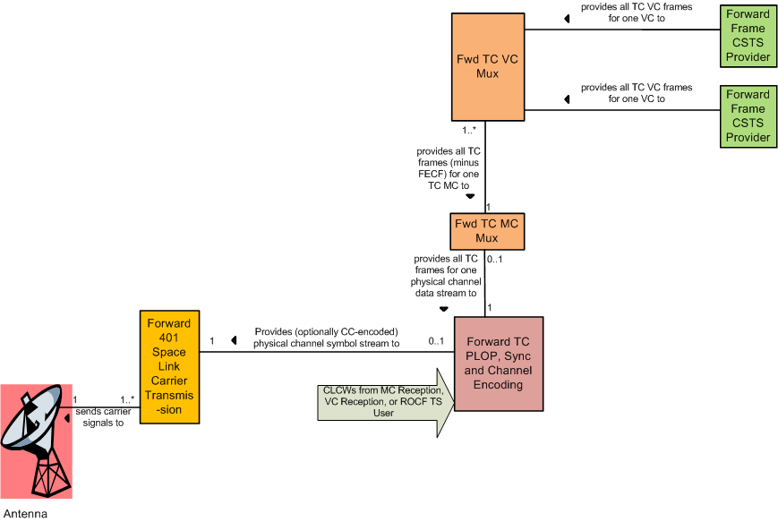
Forward Frames Production Informative Annex: Asynchronous Mode – Telecommand Frames Example
NOTE: FRs could change if multiplexing is performed at the global VC level

Slide 16
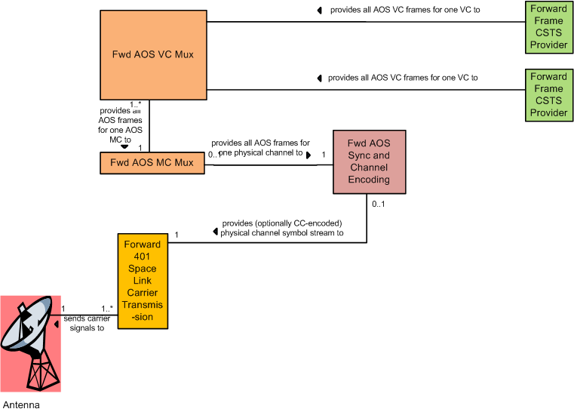
Forward Frames Production Informative Annex: Synchronous Mode – AOS Frames Example
NOTE: FRs could change if multiplexing is performed at the global VC level

Slide 17
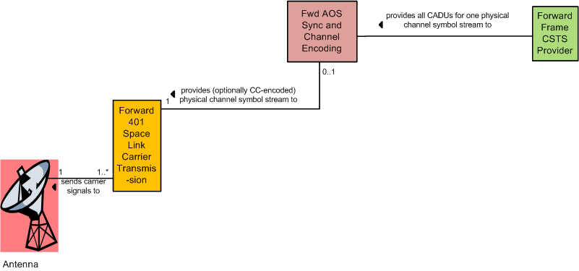
Forward Frames Production Informative Annex: Synchronous Mode – AOS CADUs Example

Slide 18
Discussion Item Resolutions

Slide 19
Ability to Extend a CSTS Specification Beyond the Provisions of the Guidelines
What is the underlying philosophy regarding the comprehensiveness and “normativity” of the Guidelines
One view – the Guidelines are the absolute rules that cover every possible aspect of a CSTS specification
Requires that every possible way of specifying a CSTS be first documented in the Guidelines
Another view – the Guidelines are just that – “guidelines” that provide “recipes” for CSTSes that follow the nominal concepts for CSTSes
Any CSTS should follow the Guidelines to the greatest extent possible and practical, but if a service has circumstances that are not addressed by the Guidelines, that service specification can go beyond the Guidelines as long as those extensions are explicitly identified in the specification
Guidelines document does not have to be amended to cover one-off cases
Analogy to Framework, which provides an “escape mechanism” to create service-original procedures when adoption of or derivation from existing procedures is infeasible
Service-original procedures can be subsequently incorporated into Framework if they prove to be useful for multiple services --> “outside Guidelines” provisions could be included later into Guidelines if they have use in multiple services
It will be the CSTSWG that creates new CSTSes. Review, discussion, and consensus will prevent ridiculous deviations from the Guidelines
RESOLUTION (28 September 2017): Guidelines can be exceeded by a CSTS, subject to the conditions mentioned above
Guidelines may have to have a simple upfront statement to that effect
Significance for FF-CSTS: However, we resolve the multiple prime procedure issue, the Guidelines don’t have to be changed. It will be addressed only in the FF specification

