Slide 1
CCSDS Fall 2022 Toulouse Meetings
CSS Cloud Computing BOF Meeting Summary
03 Nov 2022

Slide 2
Use Case Discussion
Agreed to prioritize for telemetry and tracking data delivery via cloud
Command delivery seen as a lower priority
Noted that data delivery within the cloud is preferred (avoid cloud egress fees to the extent possible)
But need to keep in mind data delivery from the cloud to outside the cloud
Spacecraft engineering and tracking data are good candidates for data stream delivery
For data files, TGFT packaging (TGFT is already a CCSDS standard) could be used
But some discussion that so far TGFT does not appear to be very popular
No agency implementation plans yet that anyone knows about
Noted that Azure (Microsoft) and GCP (Google) operate similarly to AWS (Amazon) re file and streaming data delivery
Discussed client side considerations
See presentation from J. Liao, “Client Side Cloud Computing” (or see CWE, CSS CLOUD → Meeting Materials → 2022 → Fall)

Slide 3
Cybersecurity discussion
Joint session with SE Area Security WG (SWG)
Reviewed the shared security model with which cloud providers tend to operate and noted different implementation models imply differing security considerations
IaaS approach → more onus on cloud customer re cybersecurity responsibility
PaaS approach → more onus on the provider re cybersecurity
Agreed that application level security will be required
I.e., securing content for file or streaming data delivery
Agreed to stay in touch with SWG, especially re reviewing any draft material in the concept paper re security

Slide 4
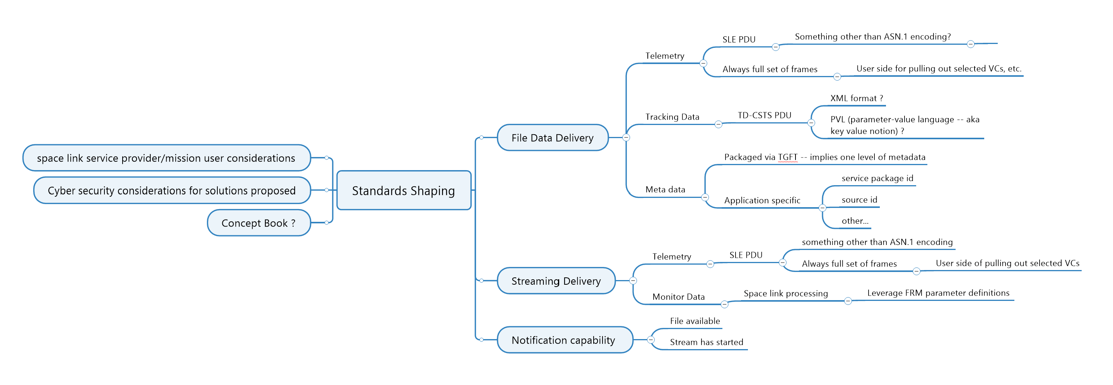
Standards Shaping Discussion
Discussed potential standards to be produced – captured in map image below

Slide 5
Chartering Discussion
Two options
Re-charter existing WGs in CSS Area
Create a new WG
Creation of a new WG is favored so as not to dilute the focus of the CSSM and CSTS WGs

Slide 6
Goal for Spring 2023 Meetings
Finalized concept paper that
Recommends standards to be produced
Recommends WG composition/charter

