Slide 1
CCSDS CSSA Cloud Computing BOF
Preliminary Sketch – Functional Architecture Overview
14 September 2022

Slide 2
Functional Architecture Overview (Preliminary Draft)
Cybersecurity
Data Storage
Data Streaming
Event Notification
Provision/Configuration Management

Slide 3
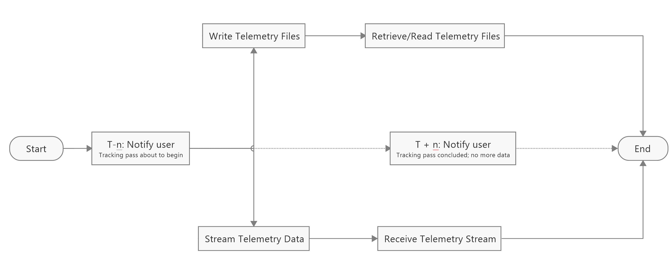
High Level Process Overview (Preliminary Draft)

