Slide 1
CESG Report
CMC Midterm Telecon
Tim Pham - CESG Deputy Chair
Klaus-Juergen Schulz – CESG Chair
8th February 2024

Slide 2
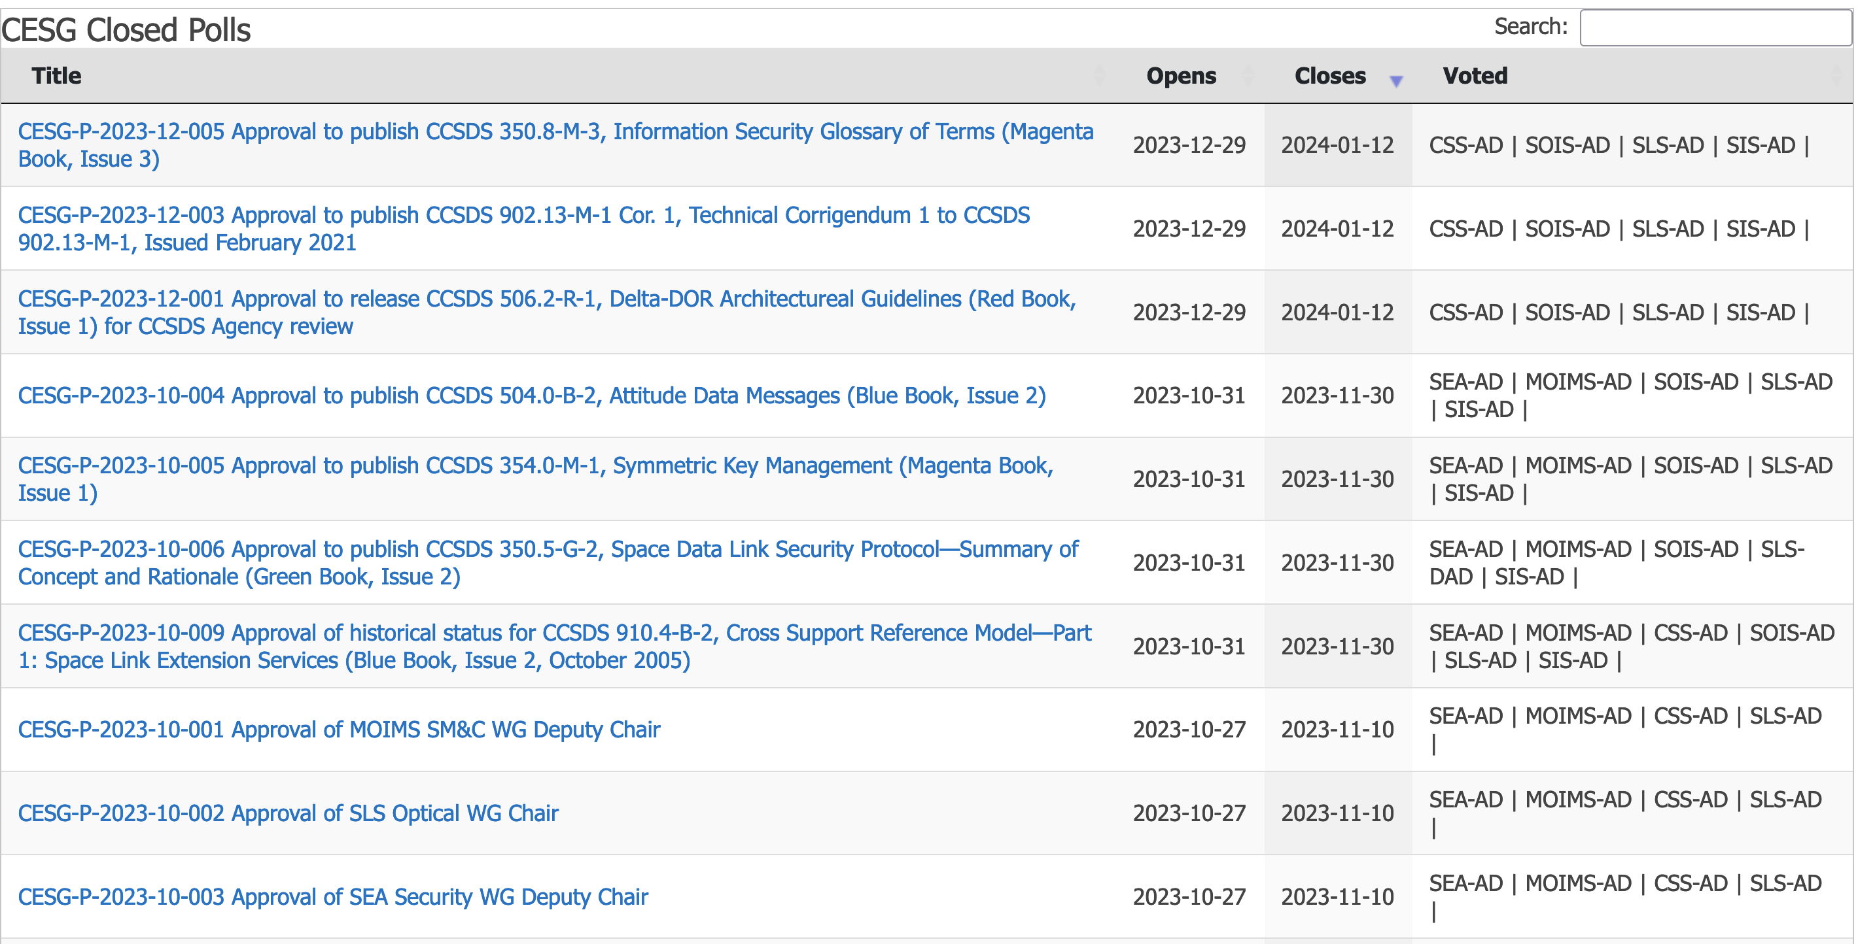
CESG Poll Statistics since last CMC Mtg (Nov. 2023)

Slide 3
CESG Poll Statistics since last CMC Mtg (Nov. 2023)

Slide 4
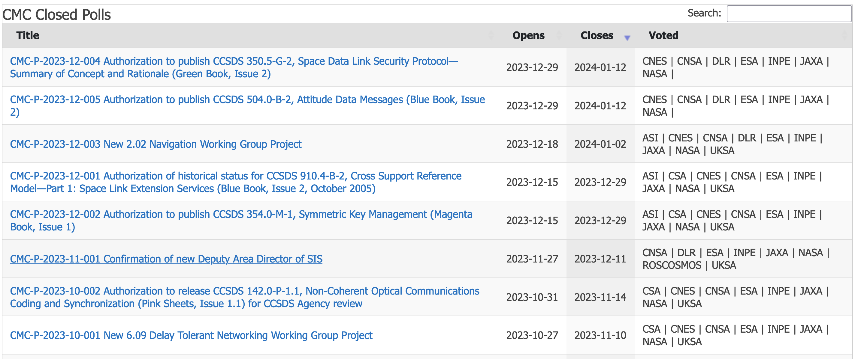
CMC Poll Statistics since CMC Mtg (Nov. 2023)

Slide 5
Book Publication
Blue Books – Recommended Standards
CCSDS 504.0-B-2, Attitude Data Messages (Blue Book, Issue 2), January 2024
Magenta Books – Recommended Practices
CCSDS 354.0-M-1, Symmetric Key Management (Magenta Book, Issue 1), December 2023
Green Books – Informational Reports.
CCSDS 350.5-G-2, Space Data Link Security Protocol—Summary of Concept and Rationale (Green Book, Issue 2), January 2024
Silver Books – Historical
CCSDS 910.4-B-2, Cross Support Reference Model—Part 1: Space Link Extension Services (Blue Book, Issue 2, October 2005)

Slide 6
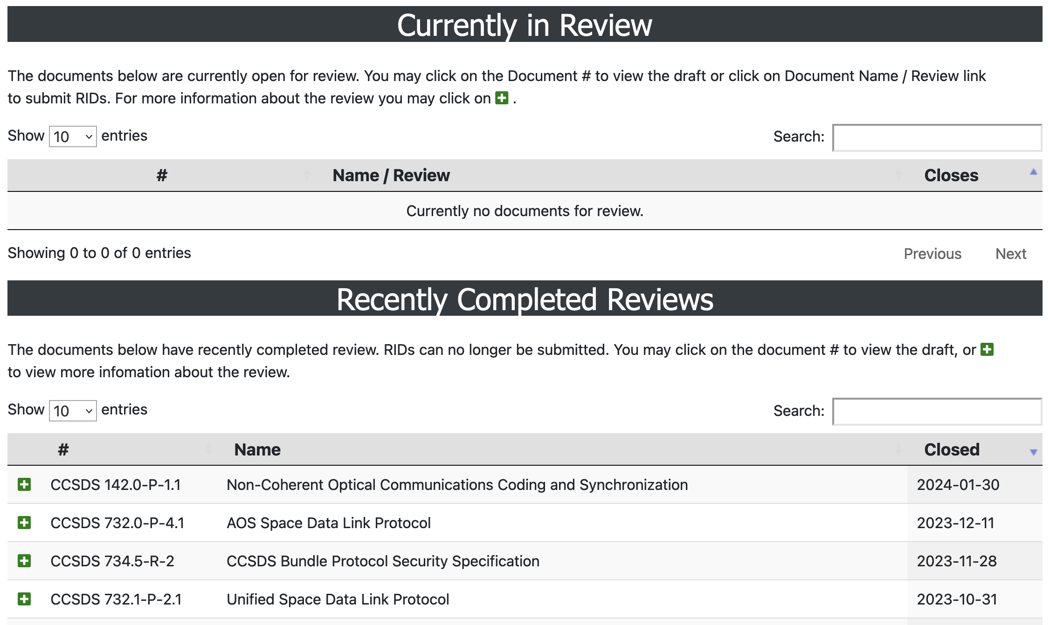
Books Under Review

Slide 7
New Projects
Approval of new Projects
NAV Area
- Fragment Data Message, Blue Book
SIS Area
- High Performance Reliability Protocol (HPRP), Orange Book

Slide 8
CESG Personnel Appointment
New members
SIS Area
- New Deputy Area Director: Ivica Ristovski
SysEng Area - Security WG
- New Deputy WG Chair: Marcus Wallum
SLS Area - Optical WG
- New WG Chair: Jon Hamkins

Slide 9
SOIS Area – Items of Interest
CCSDS 870.0-G-1 Electronic Data Sheets and Dictionary of Terms for Onboard Devices and Components
Completed CESG review. Currently in CMC poll for publication.
Expect publication by end of February.
CCSDS 876.1-M-1, Spacecraft Onboard Interface Services—Specification for Dictionary of Terms for Electronic Data Sheets
Completed CESG review. Currently in CMC poll for publication.
Expect publication by end of February
CCSDS 876.1-M-1 is listed in NASA’s International Deep Space Interoperability Standards used across the Artemis program
White paper on new Magenta Book “SOIS EDS for Containers and Deployment”
Draft completed
Expect to start a new CCSDS project
ESA will provide hours for review and consensus
NASA can complete with existing FY2024 budget
White paper already has bulk of technical detail
This book is being requested by missions, in particular Artemis.
NASA and ESA interoperability testing of CCSDS 876.0-B-1 pink sheets
90% complete. ESA testing complete. Remaining 10% for NASA testing is now scheduled for April 1, 2024 due to staff availability
Met with Blue Origin software leads for Artemis Lunar lander at their request
Desire to use SOIS EDS for Blue Origin programs. Requested discussion of technical details and schedule.

Slide 10
SysEng Area – Items of Interest
Approval of SEA Security WG Deputy Chair
Approval to publish CCSDS 350.5-G-2, Space Data Link Security Protocol—Summary of Concept and Rationale (Green Book, Issue 2)
Approval to publish CCSDS 354.0-M-1, Symmetric Key Management (Magenta Book, Issue 1)
Approval to release CCSDS 506.2-R-1, Delta-DOR Architectural Guidelines (Red Book, Issue 1) for CCSDS Agency review
Approval to publish CCSDS 350.8-M-3, Information Security Glossary of Terms (Magenta Book, Issue 3)

Slide 11
SLS Area – Items of Interest
New publications since Fall 2023
CCSDS 350.5-G-2 Space Data Link Security Protocol-Summary of Concept and Rationale
New Agency Reviews
CCSDS 142.0-P-1.1 Non-Coherent Optical Communications Coding and Synchronization - CLOSED
CCSDS 732.0-P-4.1 AOS Space Data Link Protocol - CLOSED
New SLS Resolutions
Resolution SLS-R-2023-12-001 Publication of CCSDS-140.1-G “Real-time Weather and Atmospheric Characterization Data”, Green Book Issue 2, 11th December 2023
CESG Polls
CESG-P-2024-01-001 Approval to publish CCSDS 140.1-G-2, Real-Time Weather and Atmospheric Characterization Data (Green Book, Issue 2) - OPEN
CESG-P-2023-10-006 Approval to publish CCSDS 350.5-G-2, Space Data Link Security Protocol—Summary of Concept and Rationale (Green Book, Issue 2) – CLOSED
CESG-P-2023-10-002 Approval of SLS Optical WG Chair – CLOSED
CMC Polls
CMC-P-2023-12-004 Authorization to publish CCSDS 350.5-G-2, Space Data Link Security Protocol—Summary of Concept and Rationale (Green Book, Issue 2) – CLOSED
Projects Status
Projects Status was last reported at last CESG/CMC Fall Meeting.
A few new draft projects have been produced since then that need to be revised and endorsed by the SLS AD:
SLP-WG:
Reorganize COP-1/COP-P into one Combined Blue Book
Reorganize Prox-1 Space Data Link Protocol Blue Book
Space Link Protocol Session Control
SDLS-WG:
Revise SDLS Extended Procedures BB to address constellations
Triple Key Encapsulation Mechanisms (KEM) Profile

Slide 12
CSS Area – Items of Interest
Progress since the last meeting
CESG Poll conditions for Functional Resource Model (CCSDS 901.3-M-1) retired
CESG Publication poll for Technical Corrigendum for the Abstract Event Definition (CCSDS 902.13-M-1) concluded with unanimous unconditional approval
Formation of new WG Cloud Data Delivery Standards CDDS, which will be 3.08, in progress – WG chair identified, details as to availability start time being worked
CSSM WG Developer’s Forum (looking at such items as potential inter-agency ReST API standardization re TTC service provision) is helping to inform future work items and priorities for CSSM (Cross Support Service Management) WG
Project status
All projects okay, on track

