Slide 1
LunaNet: The Lunar Internet for Space Communications, Position, Navigation, & Timing (CPNT)
Jim Schier, Chief Architect, Space Communications and Navigation Program
1 June 2023

Slide 2




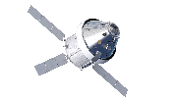
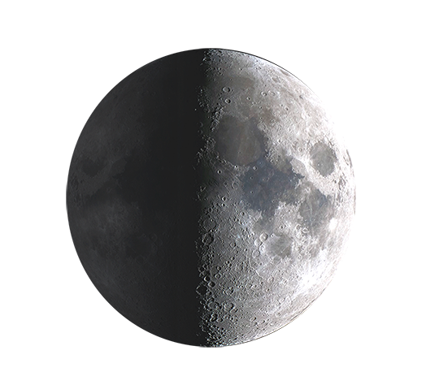




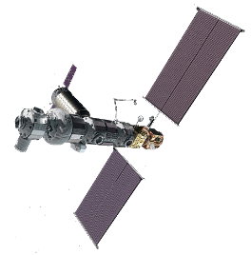





LunaNet, the Lunar Internet
LunaNet is a set of cooperating networks providing interoperable communications and navigation services for users on and around the Moon.
  Based on a framework of mutually agreed-upon standards, protocols, and interface requirements that enable interoperability.
  Allows many lunar mission users to engage the services of diverse commercial and government service providers in an open and evolvable architecture.
  Service-Oriented: LunaNet services can include data transmission and distribution of position, navigation, timing (PNT), and situational awareness information.
  Scalable: LunaNet can be introduced as part of the earliest missions and accommodate expansion as new users and service providers come online.
  Open: LunaNet is based on open international standards like the Internet
  Resilient: As LunaNet grows into many networks and users, it becomes steadily more resilient to individual failures and outages
  Secure: LunaNet protects sensitive and proprietary data while preventing or rapidly recovering from cyber threats
  Extensible: The LunaNet concept is applicable to any planetary body.
NASA/IP/Commercial Ground Stations or Earth Relay
Earth Trunk Links
X-band low-rate uplink/downlink + tracking
Ka-band high-rate unlink/downlink
Optical high-rate uplink/downlink + tracking
Lunar Systems Broadcast Link:
S-band radio navigation service
Lunar Relay
Orbiter
Orion
Crosslink
Visiting Vehicle Link
S-band, Orion and Lander compatible
Radiometric tracking,
Data, Radar
High
Altitude
Orbit
Network
Lander
HAB Module
Comm
Terminal
Elliptical
Orbit
Robotic
Rover
Lander
Area Networks
Mobile EVA
Gateway
EVA Comms
Low
Altitude
Orbit
EVA
Lunar Systems Proximity Links:
S-band low-rate uplink/downlink + tracking
S-band radio navigation service broadcast
Ka-band high rate unlink/downlink
Optical high-rate uplink/downlink + tracking
Descent & ascent coverage

Slide 3
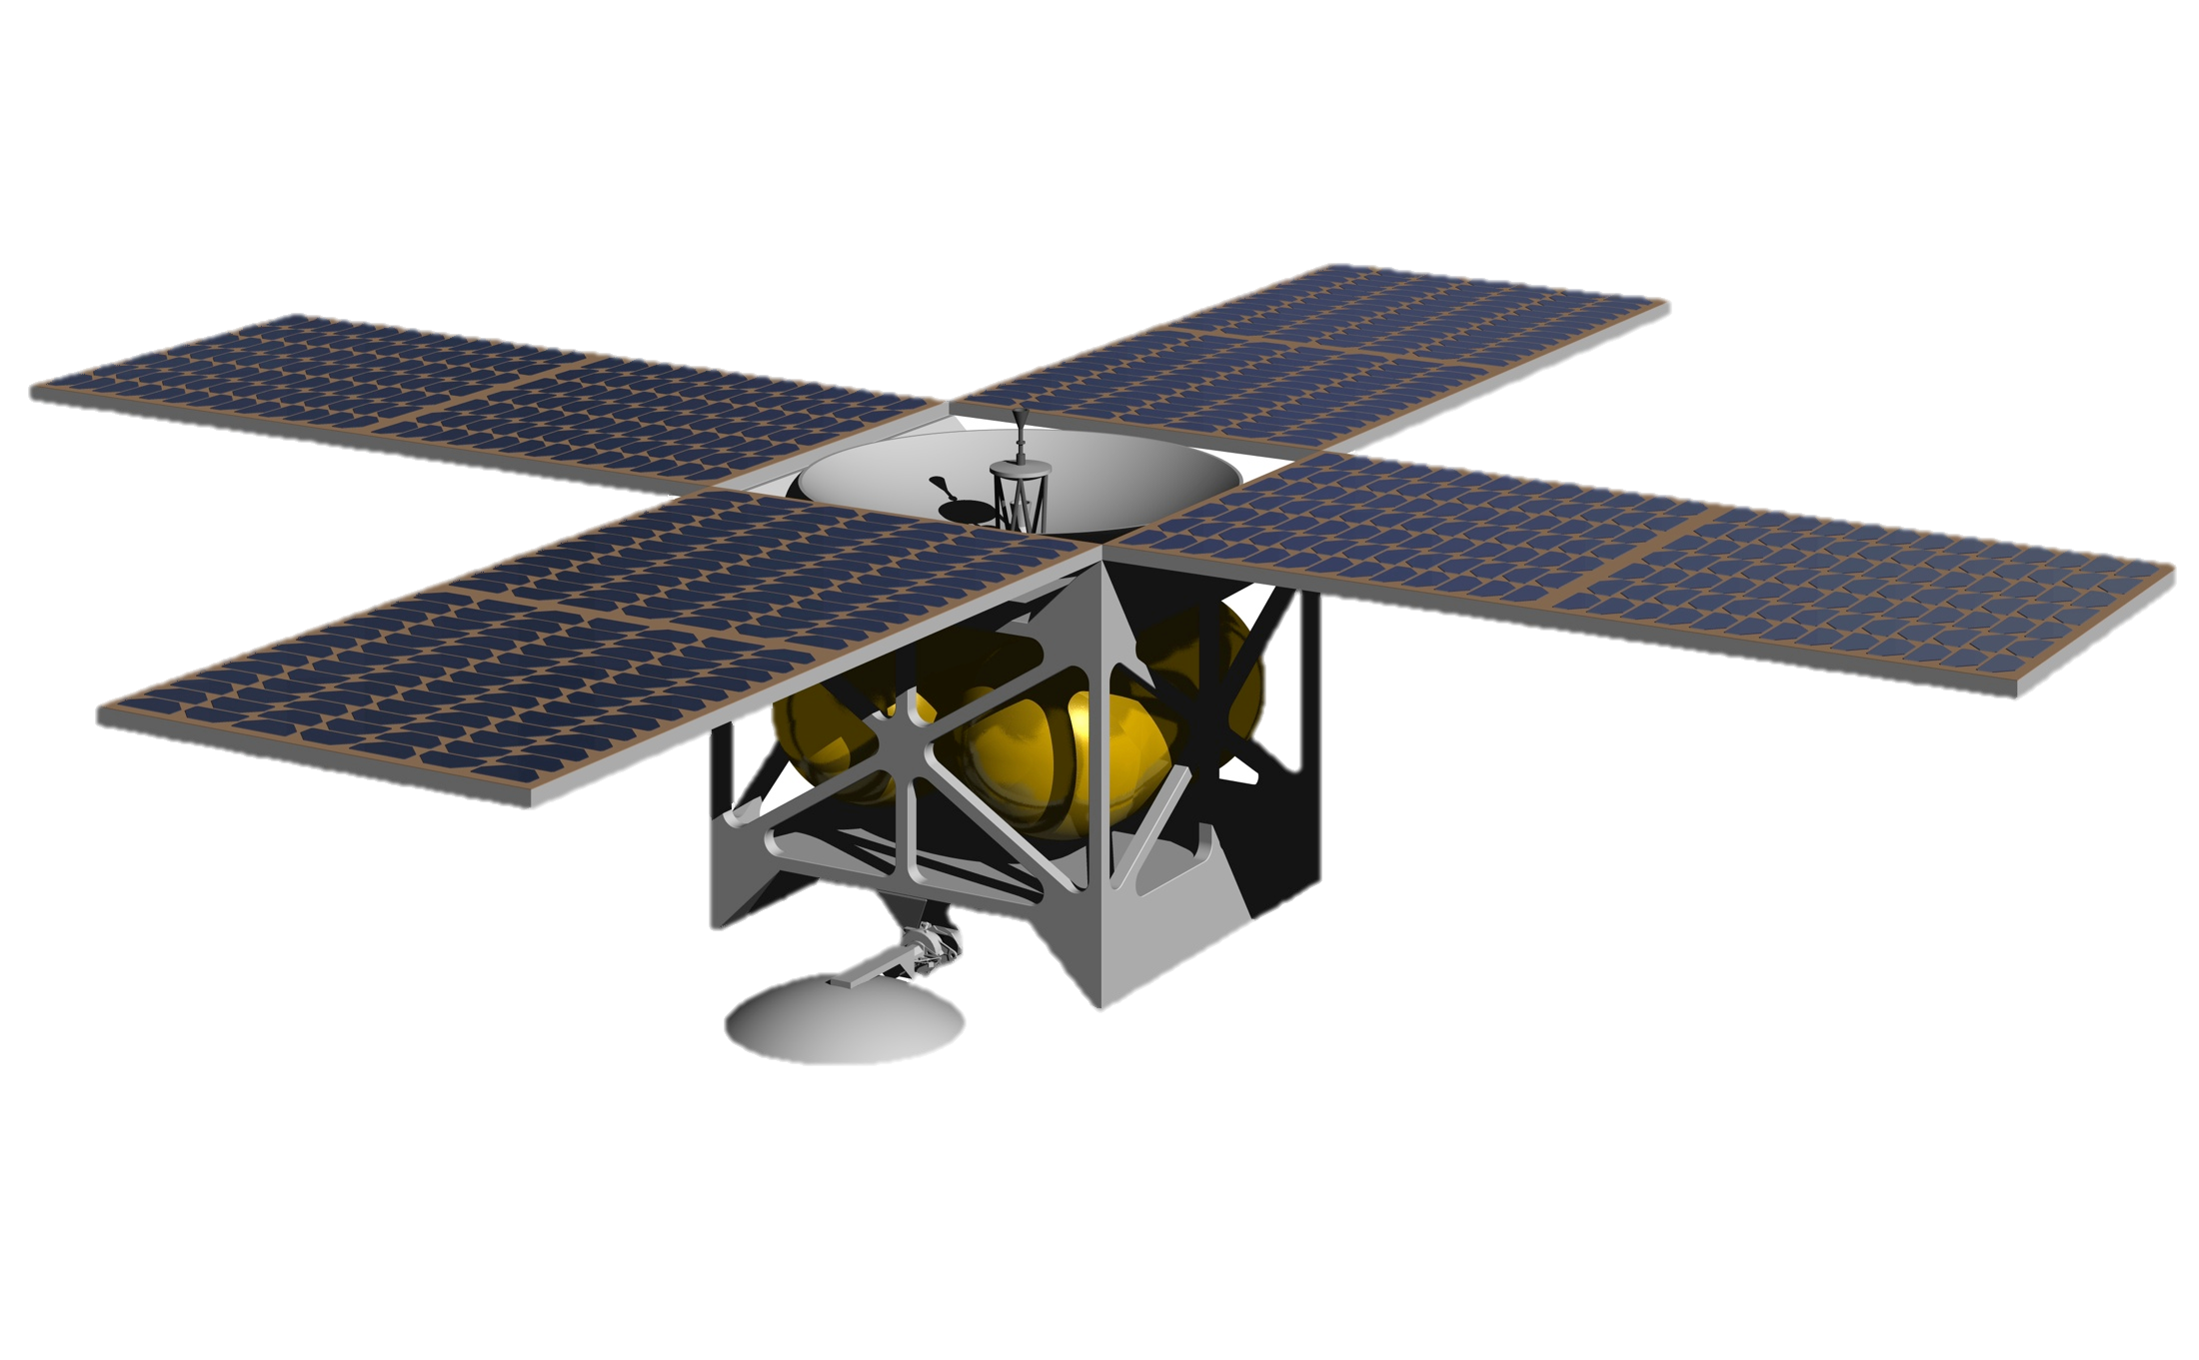



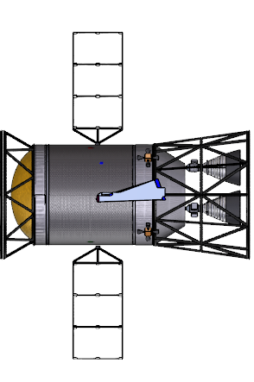



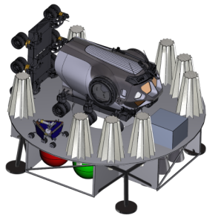
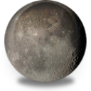




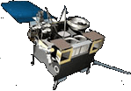

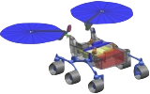

LunaNet and Planetary Networks
Planetary Networks: Earth, Moon and Mars - One Architecture
Lunar Network (LunaNet)
Earth Network
Mars Network (MarsNet)
Lunar Relay
Earth Relay
Mars Relay
Medium Lunar Orbit
High Earth Orbit
Medium Mars Orbit
Proximity Links
Proximity Links
Trunk link
Proximity Links
Near Rectilinear Halo Orbit
Trunk link
Trunk link
Phobos Exploration Vehicle
Science Orbiter
Gateway
Lander
Control System
Lander
Science/ Relay Orbiter
Surface Systems
Science/ Relay Orbiter
Surface Systems
Science Orbiter
Direct With Earth
Deep Space Habitat
Low Lunar Orbit
Low Earth Orbit
Low Mars Orbit
Strategy: Develop a flexible planetary network architecture adaptable to any celestial body to reduce development & operation cost
User-network proximity links (space-space & space-ground/surface) provide standardized services & design for users of planetary networks
Network-network Trunk links are internal network space-ground connections for long distance “back haul”
Notes:
That architecture is similar to space system architectures used around the Earth but for the Moon, it’s planned from the beginning as an international System-of-Systems. The LunaNet architecture is capable of being repeated at Mars to create the MarsNet and elsewhere in the solar system. It’s characterized by two types of links: red-dashed prox links that operate “locally” (within GEO range for Earth and similar range elsewhere that support real-time services such as streaming and low latency demands such as telerobotics. The blue links are trunk links that connect the remote portion of the network with the terrestrial-based part of the network. Earth’s trunk link extends 40,000 km to GEO. The lunar trunk link is 400,000 km and Mars’ trunk link is up to 400M km. It’s the performance over the trunk links that varies.

Slide 4
LunaNet Autonomy Goal
Planetary Network Autonomy from Earth
Semi-autonomous LunaNet
Semi-autonomous MarsNet
Lunar Network (LunaNet)
Earth Network
Mars Network (MarsNet)
Lunar Relay
Earth Relay
Mars Relay
Medium Lunar Orbit
High Earth Orbit
Medium Mars Orbit
Proximity Links
Proximity Links
Proximity Links
Near Rectilinear Halo Orbit
Trunk link (down)
Trunk link
Trunk link (down)
Phobos Exploration Vehicle
Science Orbiter
Gateway
Lander
Control System
Lander
Science/ Relay Orbiter
Surface Systems
Science/ Relay Orbiter
Surface Systems
Science Orbiter
Direct With Earth
Deep Space Habitat
Low Lunar Orbit
Low Earth Orbit
Low Mars Orbit
Strategy: Develop planetary network architecture capable of temporary autonomous operations of the space segment
Develop and test the autonomy strategy at the moon with LunaNet (Earth-Moon latency ~1.2 seconds)
  Few latency requirements cannot be met ‒ Autonomy “mode” can be turned off with little consequence
  Proximity links continue when trunk links are lost ‒ Nav broadcast service continues with slowly decreasing accuracy when GNSS links are lost
Deploy operational autonomous MarsNet for future human exploration of Mars (Earth-Mars latency up to 22 minutes)
Notes:
But from the variety of drivers I just discussed, you can see that the intent over time is to enable the portion of LunaNet that is in lunar orbit or on the lunar surface – that is, the network composed of services delivered over proximity links - will become partially autonomous to meet drivers including latency and resilience. We need to evolve LunaNet to a high enough autonomy level that we can extend it to Mars some day where the difference between 1.2 seconds and 22 minutes of delay make local autonomy essential rather than optional.

Slide 5
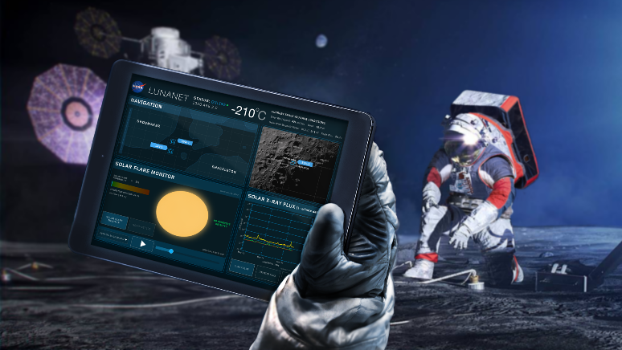
Planetary Network Services
Networked Communication Services
Critical data transmitted in real time.
Data aggregated and transmitted in store-and-forward mode from orbiting and surface relays
Data exchanged among lunar users with no need for transfer to and from Earth
Data sent on demand by user or scheduled to better manage Earth stations loading & spectrum use
PNT Services
Precise position, velocity & time for autonomous nav & collision avoidance
Fusion of multiple data types including radiometrics, optimetrics, celestial nav, optical nav, terrain relative nav, & GNSS
Broadcast service supplies time transfer and metric tracking to synchronize users
Detection & Information Services
Alerts for events such as space weather, collision avoidance, & surface impact predictions sent to all LunaNet subscribers
Mission sensors for space weather and other measurements distribute information services to other users via LunaNet information services
Search and Rescue (SAR) services
Science Services
Use RF & optical assets as (part of) scientific instruments
Supports Radio & Radar Sciences, Radio Astronomy / Very Long Baseline Interferometry (VLBI) & other space sciences

Slide 6
Networked Communication Services
Node 3
Node 4
Conventional link-layer services are still supported but LunaNet networks are built for network-layer service using packets (IP) or bundles (BP)
A) Shows an end-to-end path between User A and User B via several LunaNet nodes
B) Shows the nodes are part of different LunaNet Systems (LNS) operated by providers that interoperate to support that path
  The LNSPs must have an agreed Internetwork Service Management Protocol in place based on the Internetwork Interface standard
A)
Node 1
Node 2
PNT
Com
Det
Sci
User A
User B
Internetwork Service Management Protocol
B)
LNS A
LNS B
Node 3
Node 4
Node 1
Internetwork Communications
Node 2
PNT
Com
Det
Sci
User A
User B

Slide 7
LunaNet PNT Services
 | Service | Description
Positioning | Generate signal for range, Doppler, and time observable | Produces time-synchronized fixed frequency signal with known ranging code for enabling 1-way pseudorange, Doppler, and time by receiver; or 2-way as a relay.
 | Provide measurements via telemetry message | Transmits the LunaNet-created measurements of 1- or 2-way range and Doppler to a receiving vehicle via standard message.
 | Establish onboard navigation using in situ measurements | LunaNet estimates state using onboard sensors, such as optical navigation, weak-signal GNSS, accelerometer, IMU, or pseudorange and Doppler from communication links to autonomously determine state in flight software and disseminate via standard message.
Navigation | Transmit user’s integrated position, velocity, & time (PVT) state to user | Communicates LunaNet’s estimate of user’s position, velocity, and time (“solve-fors”) single-epoch state to another user or LunaNet node to support tracking scenarios. Enables autonomous onboard operations.
 | Transmit LunaNet ephemeris for use in measurement processing | Provides spacecraft time series of position, velocity, and time (“solve-fors”) states to user or LunaNet node to allow autonomous onboard processing of radiometric data for user estimate of state and network access.
Timing | Maintain a stable onboard time reference | Utilizes high-stability onboard oscillators/time source or external measurements to maintain a stable time-base.
 | Provide a coarse time synchronization capability | Broadcasts current time scale in a two- or one-way transmission to update onboard estimates of current global time, e.g., network-layer service such as Network Time Protocol (NTP)
 | Provide fine time synchronization capability | Uses time-synchronized fixed frequency signal with known ranging code on P2P, Broadcast, and Crosslink signals to permit high-accuracy disciplining of clocks within the network.

Slide 8
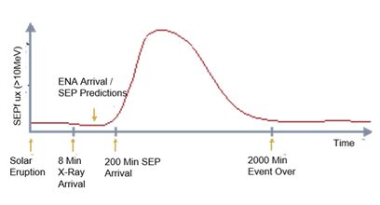
Detection and Information Services
In-space user 2 can subscribe to information stream published by user 1 for point-to-point or broadcast service. Example:
    Space weather sensor located in S-E L1 monitors solar X-rays to sense Solar Energetic Particle (SEP) / Energetic Neutral Atom (ENA) events; broadcasts event & streams data on flux & particle energy
    Crew receives event notice & data stream
    Crew relocates to protective storm shelter within ~30 minutes of event onset

Slide 9
Science Services
Proximity, crosslinks & trunk links can be used to conduct a variety of scientific investigations such as geodesy (e.g., rotational variations including precision & nutation) and atmospheric density and composition (e.g., Mars crosslinks and prox links to rovers; GPS experiments)
    The DSN supports Radio Science, Radio Astronomy / Very Long Baseline Interferometry (VLBI), and Radar Science services
Using these links to support science may impose additional requirements on link performance such as open-loop recording, higher accuracy time source, higher SNR than communication links, & capturing parameters not involved in CPNT services
The incremental cost of improving performance of communications and/or PNT links to support science objectives may be worthwhile
Hence, the LunaNet architecture allows for the potential to perform scientific experiments using LunaNet links
    RF has been used to-date but optical measurements may be added
This service schedules links between cooperating spacecraft (LunaNet-LunaNet or LunaNet-mission user) to capture signals of interest and transmit them to Earth
First radio crosslink occultation experiments were conducted between Mars Odyssey & MRO in 2007 using the MRO Electra transceiver to acquire open-loop recording of UHF signal transmitted by Odyssey.

