Slide 1
Thoughts about CCSDS Security Architecture
Peter Shames
CCSDS Systems Engineering Area Director
8 Dec 21

Slide 2
Background
Most current interoperability is for “single hop” missions, MOS => ground station => spacecraft.
The SCCS-ARD calls these ABA configurations.
Multi-agency, multi-spacecraft, networked (DTN) missions are being planned (and built).
The SCCS-ARD calls these SSI configurations.
The terrestrial “security & threat landscape” is changing quickly and CCSDS (and the member agencies) are not yet completely ready to deal with this, particularly in a multi-agency DTN/SSI environment.
This presentation is intended to briefly explore some of the issues and to frame some solutions for further discussion.
There is this joke about “security through obscurity”
The real laugh is that security approaches, themselves, can be pretty opaque
We’re trying here for a KISS approach, Keep It Simple … details to follow

Slide 3
CCSDS future deployment assumptions
Multiple agencies will operate one or more “space assets”
Space assets may be orbiters, landers, rovers, (attached devices, hosted components, …)
Integrity of space (and ground) assets and data must be protected, and privacy must be provided for certain classes of data and communications (human related)
Agencies may deploy their own “private” networks and use whatever security is satisfactory for them, but …
For communications coverage, cross support, and reliability agencies will likely collaborate among themselves to deploy space networking, using both in space and Earth based assets
Must all use some agreed, interoperable, subset of CCSDS comm link protocols, and …
Must all use DTN for networking, and …
Must have some unambiguous way to identify user, service provider, and service management assets, and …
Must be able to secure their systems, and the network itself, to prevent problems.

Slide 4
CCSDS current link layer security approaches
Current operational posture is very close to “if you are in space, and we have an agreement, we will try to support interoperations”
Many of the protocol architecture security arrangements are rather ad hoc
There is little link layer security in use now, the only available “identity” checks are on CCSDS link layer SCIDs, frequency assignments, and antenna beam patterns
SDLS and key management is available and can be used, but are not yet widely deployed
Uplink data for deep space missions tends to be transmitted in the clear, but many near Earth missions have protected uplinks
Security at service interfaces uses pair-wise agreements and negotiated service provider login credentials and network access
Cross support agreements are documented and managed terrestrially, and use login credentials and firewall rules to validate operational access
Operational coordination involves pair-wise agreements to manage contact scheduling and data volumes, Service Management is still “to be”

Slide 5
Future SSI multi-mission security assumptions
Participating agencies / organizations must agree on a trust framework, a set of roles, policies, and a governance model
Cross support and interoperability at DTN layer are essential for effective SSI deployments and should be as automated as possible
All assets will have identities that can be unambiguously validated
Authentication of communicating assets will be validated as the norm
Uplinked commands should be secured (encrypted), other uplink products may only be authenticated (digitally signed)
Downlink products may be authenticated to provide integrity checks, and encryption may be used, but this will not necessarily be the norm
Network layer authentication, and possibly data encryption, will be preferentially used (DTN/BPSec)
Application layer encryption / authentication may also be adopted where needed
Authentication of the assets that provide and manage the network itself must be secured
These security features all rely on use of security keys and some sort of key management tied to the identities of participating entities

Slide 6
So … assigning and managing identities becomes very important
Link layer SCID is a weak, and non-unique identifier
DTN Node ID, by itself, is also weak and can be “faked” or hijacked (unless optional security mechanisms are used)
For multi-agency trust relationships to work effectively there must be an agreed and adopted trust framework, policies, roles, and governance approaches
All entities/assets (spacecraft, DTN nodes, ground stations, end users) must have assigned and documented identities and roles
Interoperating / cooperating agencies need some way to catalog, manage, verify and cross-check identities of assets
Each identity is associated with sets of keys used for authentication and/or encryption, and with roles they may be assigned
NOTE: DTN, and BPSec, can operate with keys that include (but are not limited to):
Pre-placed keys selected based on local policy.
Keys extracted from material carried in the Bundle security blocks.
Session keys negotiated via a mechanisms external to the Bundle security blocks.

Slide 7
Propose a phased approach
Agree on basic security framework for multi-agency interoperability
Develop agreed set(s) of policies, roles, and governance approaches
Assume use of BPSec and simple, pre-placed keys for initial deployments
Agree on how to assign unambiguous, unimpeachable, identities to all participating assets
All communicating entities should have a certificate to provide identity
Certificates may be pre-placed onboard
Consider adoption of a new, trusted, InterGovernmental Certificate Authority (IGCA)
Leverages existing terrestrial PKI framework
Agree to federated approach that allows agency autonomy and also interoperability
NOTE: The SANA operator runs the IANA CA for the Internet DNS system, it has expressed willingness to run the IGCA for CCSDS
Develop plan and protocols for secure DTN / space interoperability
Document policies, roles, and governance procedures
Use identities and certificates for space interoperability
Define, implement, and deploy more advanced BPSec and network management features
Define necessary secure network management and key management standards

Slide 8
CCSDS implementation IGCA (CCSDS Sec WG, Chuck Sheehe)

Slide 9
A “Modest Proposal”
Use this presentation, and all the available supporting materials, to initiate discussions of the motivations, assumptions, and consequences of agency missions and different deployment choices
Involve the security and mission experts in each agency, and in CCSDS and the IOAG, in this discussion
Identify the common ground, shared assumptions, shared goals, and acceptable shared policies
Develop an agreed trust framework, policies, and governance approaches that can make this interoperable, multi-agency / organization venture work effectively and securely
Identify and develop, jointly, the necessary standards, protocols, technical framework and infrastructure that will support this venture as missions are deployed

Slide 10
BACKUP

Slide 11
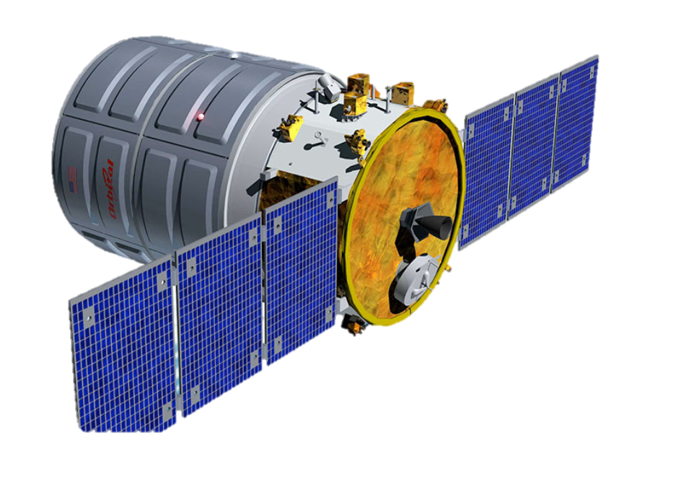
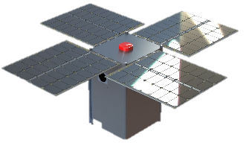
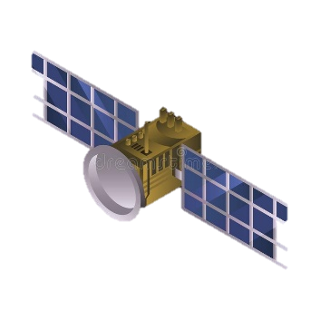
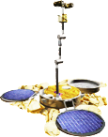
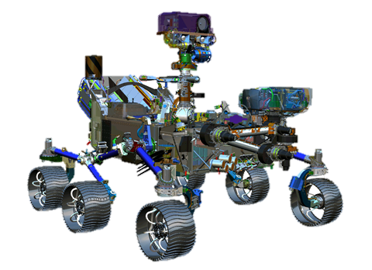
Mars Network (MarsNet) – Authentication/Confidentiality
Mission Operations
Centers (MOC)
Earth Networks
Mars Relay Network
• • •
• •
• •
CA Mirror Registration Authority
• • •
Orbital User Spacecraft
• • •
Mars Surface Network
CA Mirror Registration Authority
• • •
Inter Governmental Certification Authority (IGCA)
Surface User Landers/ Rovers/Platforms/Facilities
And a Certification Authority Trust Anchor (CA) per agency
Mars-to/from-Earth trunk link:
Between relay orbiter and Earth station
Proximity link:
Between relay orbiter and landed vehicle/orbital vehicle
Mars surface-to-surface link:
Wireless link between surface elements
Mars-to/from-Earth link:
Between Mars orbiter/landed vehicle and Earth station
Cross link:
Between two relay orbiters
Earth Network

Slide 12
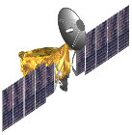
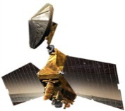
User applications
Authentication/Data Encryption
Authentication/Data Encryption
User applications
CCSDS Space
Packet
Asynchronous
Messaging
Service (AMS)
CCSDS File
Delivery
Protocol (CFDP)
CCSDS File
Delivery
Protocol (CFDP)
Asynchronous
Messaging
Service (AMS)
CCSDS Space
Packet
• • •
• • •
Certificate
CCSDS Bundle Security Protocol (BPSec)
CCSDS Bundle Security Protocol (BPSec)
Certificate
CCSDS Bundle Protocol (BP)
CCSDS Bundle Protocol (BP)
Licklider Transmission Protocol (LTP)
Transmission Control Protocol (TCP)
CCSDS Encapsulation Packet (ENCAP)
Internet Security Protocol (IPsec)
CCSDS Space Data Link Security Protocol (SDLS)
Internet Protocol (IP)
CCSDS Unified Space Link Protocol (USLP)
Wide-area link, e.g. fiberoptic link, and local end-point connection via WiFi, Ethernet, or others.
Radio Frequency Links – Near Earth K-, X-Bands;
Mars orbiter
Mars surface vehicle
Mission Operations Center
Certificate
Bundle Security Protocol (BPSec)
CCSDS Bundle Security Protocol (BPSec)
CCSDS Bundle Protocol (BP)
Certificate
Terrestrial link
Licklider Transmission Protocol (LTP)
CCSDS Bundle Protocol (BP)
Licklider Transmission Protocol (LTP)
TCP
Encapsulation Packet (ENCAP)
Encapsulation Packet (ENCAP)
IPSec
Mars Proximity link
Space Data Link Security Protocol (SDLS)
Space Data Link Security Protocol (SDLS)
Internet Protocol (IP)
CCSDS Unified Space Link Protocol (USLP)
Wide-area link, e.g. fiberoptic link, and local end-point connection via WiFi, Ethernet, or others.
CCSDS Unified Space Link Protocol (USLP)
RF - Near Earth K-, X-Bands
RF – deep space Ka-, X-Bands
RF – deep space Ka-, X-Bands
Earth-Mars link
Mars Relay Orbiter
Earth Station
Notes:
7/12: Again, I pasted in a fuzzy version of the Space User Node since it’s all I could get from one of the figures in the Word file; otherwise, there was just an empty placeholder for the graphic. //cys

Slide 13
Notes:
This protocol stack diagram shows too much “security” unless it is trying to show all possible options at once
Choose:
user data auth / encrypt, or …
BPSec, or …
SDLS.
NOT all three.
BPSec says:
Sec 2.2.1 “When the integrity mechanism incorporates signatures, this service can also provide authentication for the relevant data.” The operative word is “when”, it does not say not “how”.
Sec B1.2.4: Authentication of Communicating Entities “BPSec does not provide a service for authentication of communicating entities. This authentication can be accomplished by combining BPSec services with other components, such as encapsulation [or use of signatures].”
There “security context” mechanisms defined as an adjunct to BPv7 and BPSec. They depend upon “security contexts” where the “identities” of the participants may be associated with pre-loaded keys, or keys carried within Bundle security blocks, or by session keys negotiated outside the security blocks.
Keys may be symmetric or asymmetric using adapted PKI(X) mechanisms.

Slide 14
Adapted “Zero Trust” Security Approach (Derived from: NIST 800-207: Zero Trust Architecture)
Inter Governmental Certification Authority (IGCA)
Cached
Certificates
CA Mirror Registration Authority
Agreed Data Access Policies
Cert
Certificate
Verification
Policy Engine
Certificate
Request
Cert
Control Plane
PDP
Policy Administrator
User Agency
ID Management
Cert
Identifying
Info
Untrusted
Request
Policy
Enforcement
Point (PEP)
Router or
Service I/F
User
Trusted
Network or
Service Access
Cert
Cert
Data Plane

