Slide 1
Proposed Location and Dates for the Spring 2020 CCSDS Technical and CESG Meetings
27 June 2019
Notes:
1
1
1

Slide 2
CCSDS 2020 Meeting
The 2020 meeting will be hosted by Marshall Space Flight Center in Huntsville, AL.
  Proposed dates 4-8 May 2020
  Followed by the CESG Meeting on 11 May 2020, venue still to be arranged
Venue for the technical meetings is proposed to be The Westin Hotel at Bridge Street Town Center
  Bridge Street offers multiple options for dining and shopping and is a great central location in the Huntsville area

Slide 3
Venue Amenities
Bridge Street Town Center info:
  https://www.bridgestreethuntsville.com/

Slide 4
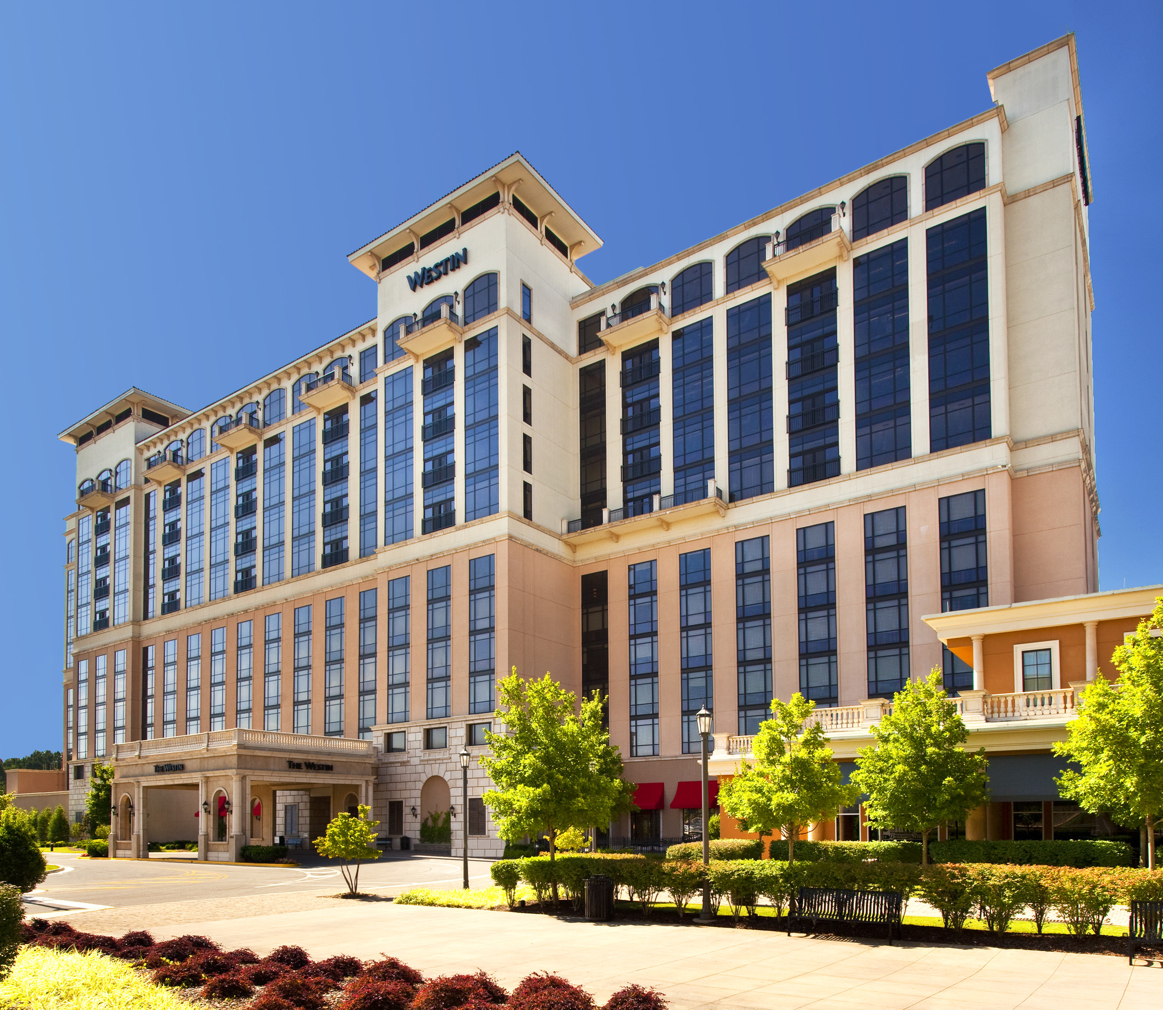
Venue

Slide 5
Venue Logistics
HUNTSVILLE INTERNATIONAL AIRPORT
  HSV has nonstop service to ten destinations, including: Atlanta, Charlotte, Chicago, Dallas, Denver, Detroit, Houston, and two airports in Washington D.C. – Dulles and National. The airport is quick and easy to navigate, and very convenient to all the attractions and businesses located in North Alabama. HSV offers nonstop service to ten destinations through our carriers: American Airlines, Delta Air Lines, Frontier Airlines and United Airlines.
TRANSPORTATION
  The Westin Huntsville is located 15 minutes from Huntsville International Airport and offers transportation service to the hotel for a fee of $35.00 one-way & $5.00 additional for each extra person.
  Huntsville also has active Uber and Lyft drivers
PARKING FACILITIES – Complimentary self-parking.

Slide 6
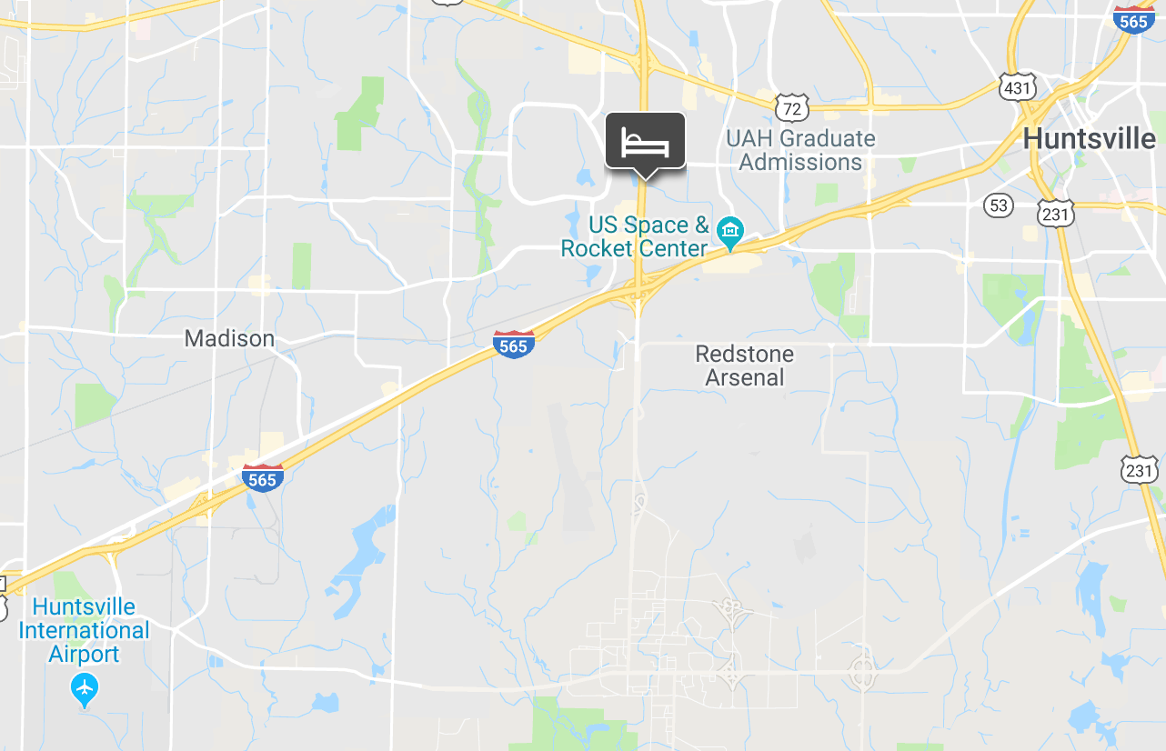
Venue Location
Westin info:
  https://www.marriott.com/hotels/travel/hsvwi-the-westin-huntsville/

Slide 7
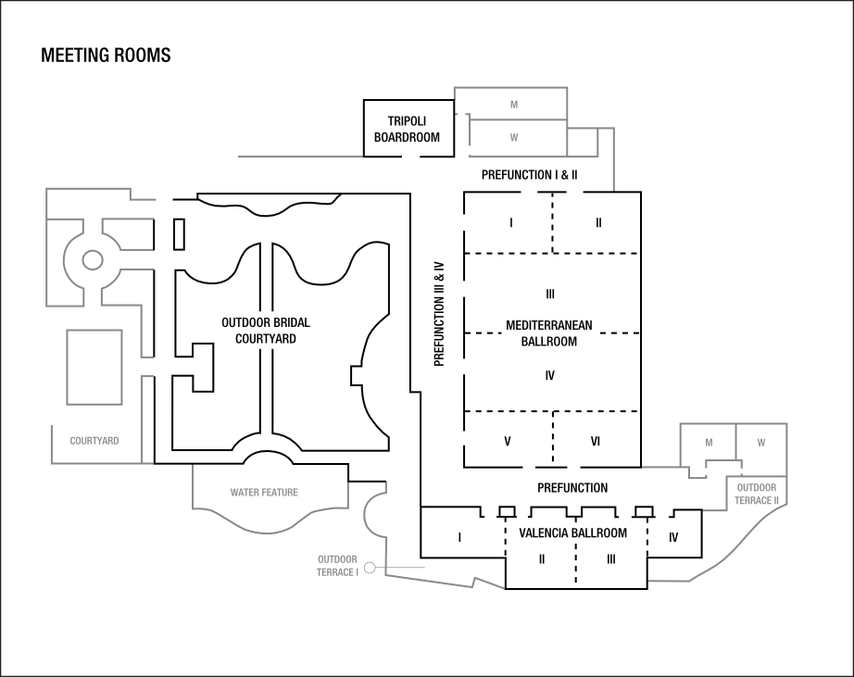
Meeting Room Configuration

Slide 8
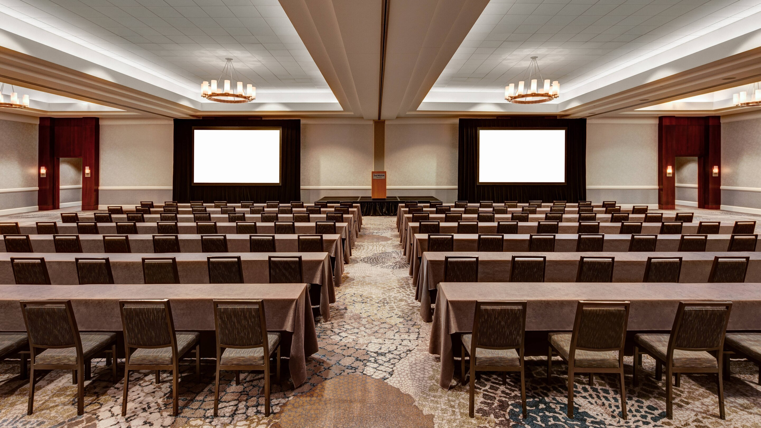

Rooms
Main Ballroom
The Boardroom

Slide 9
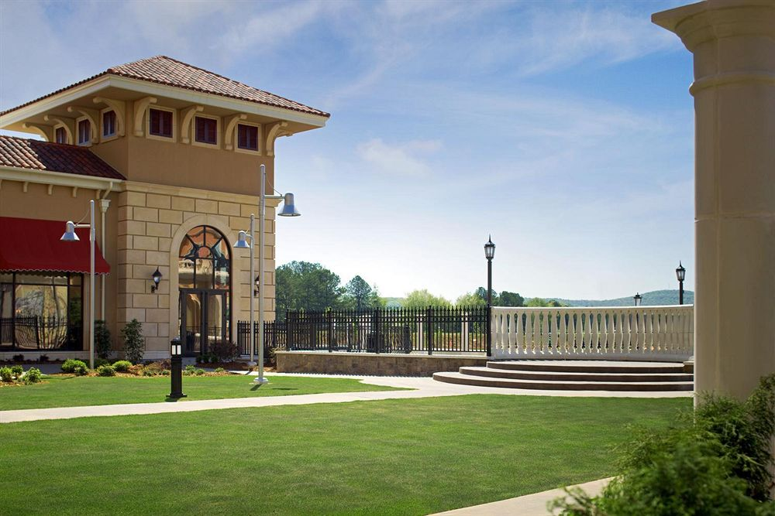
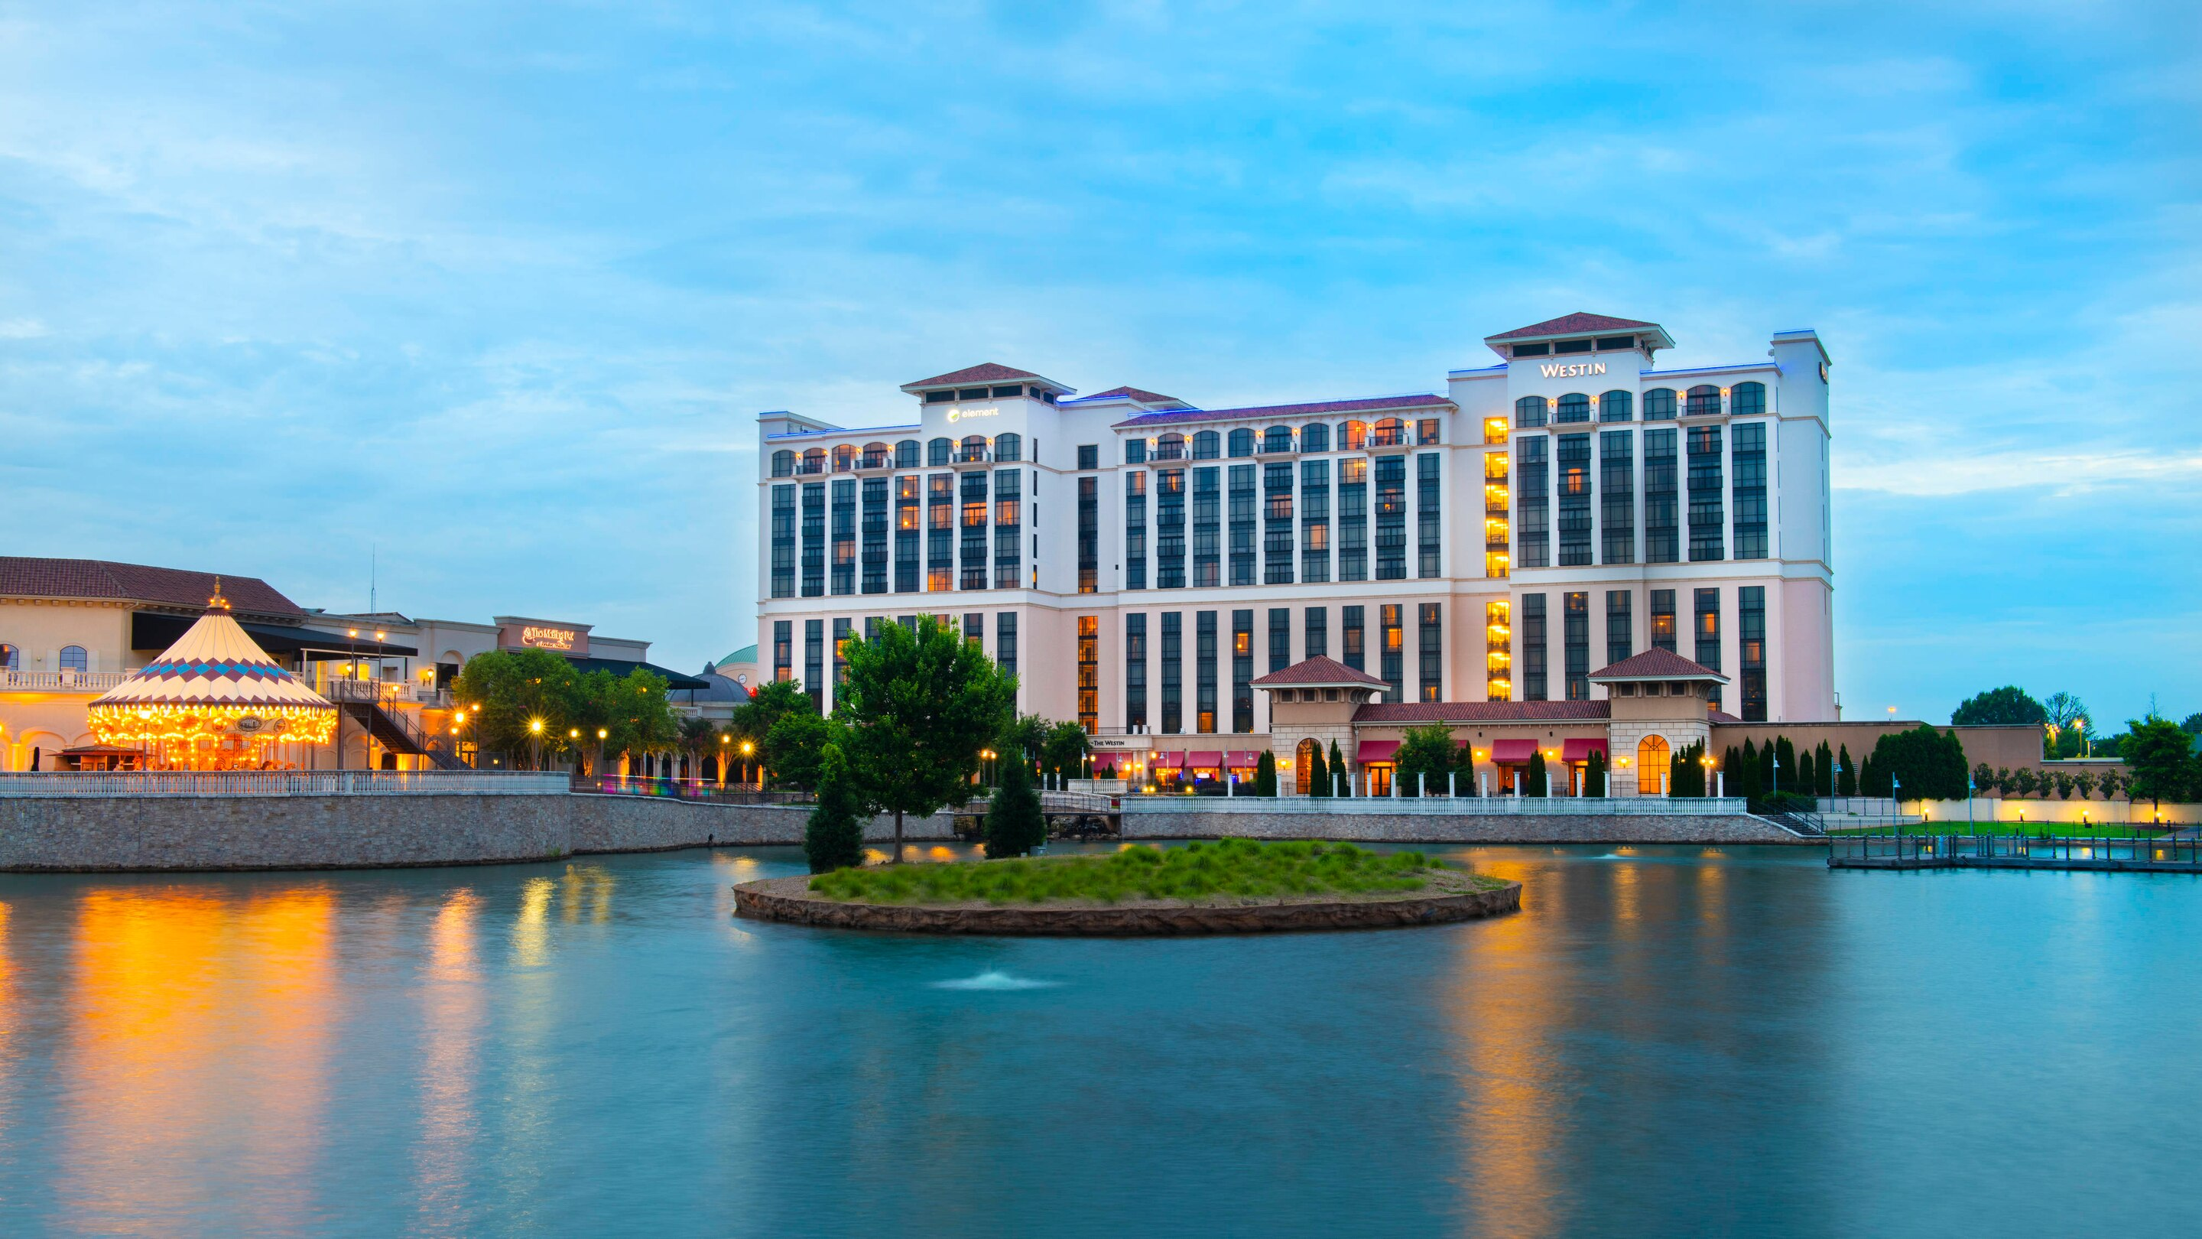
Venue Exterior
Outdoor Garden Space
Lake View

