Slide 1
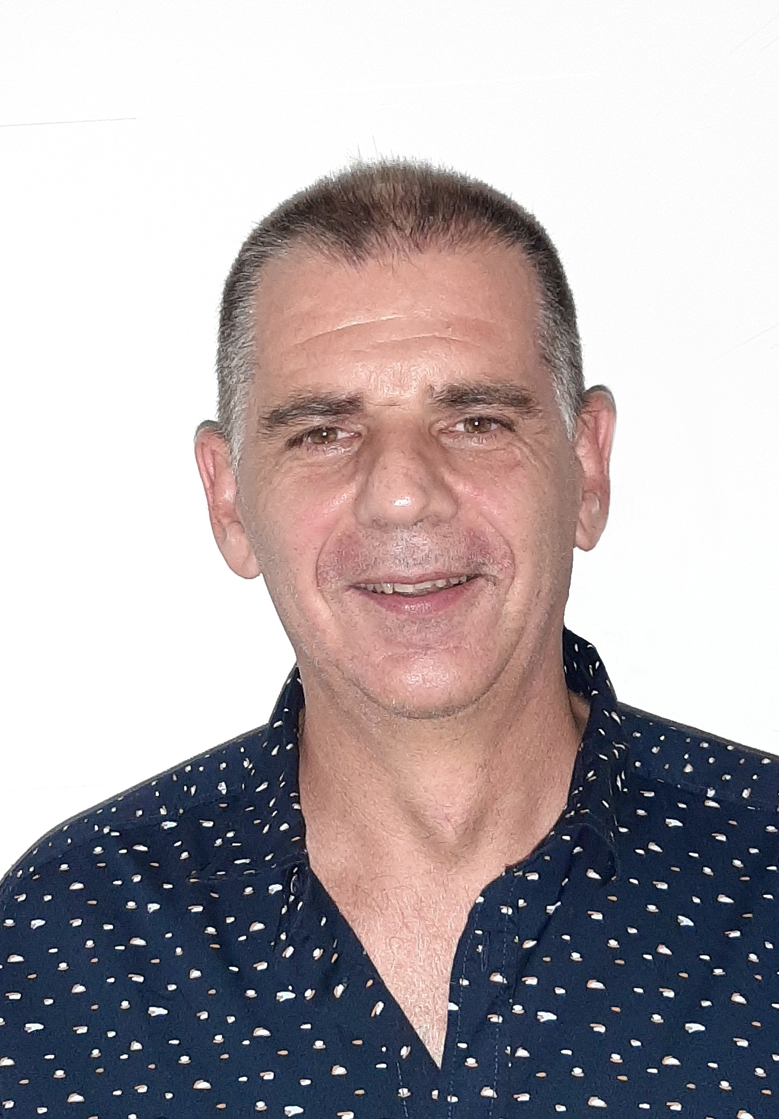
Marc Duhaze – Nominated by CNES for the position of MOIMS/DAD,
CCSDS
Since 2009 : MOIMS/SM&C WG member
2014-2018 : MOIMS/MP&S WG member
Since 2018 : MOIMS/MP&S WG deputy chair
IOAG :
2011-2012 : Mission Operations Systems Coordination Group (MOSCG) member
Since 2013 : Mission Operations Systems Strategy Group (MOSSG) member
CNES Lead for the IOAG demonstration of Service Catalog #3 between JPL/ESOC/CNES
CNES :
Since 1998 :
Operation manager for several missions (TELECOM2, COROT, JASON, SMOS, …),
Expert for end of life operations definition and implementation of PROTEUS platform family
Since 2012 :
Responsible of the new Control Command Center (CCC called ISIS CCC) operational concept definition
Member of the system team in charge of following ISIS CCC development using SM&C standards
Responsible of the ISIS operational concept implementation on new CNES mission (CERES, SWOT, …)

