Slide 1
Bootcamp Overview
Jim Lux, who took over for Peter Shames, who did the training and bootcamp for decades
Process and getting new docs out
New Editing Team!
Consensus
All those colors
Iteration at multiple levels
Things to remember

Slide 2
We need deliberate, but rapid progress
A night to remember, 15 April 1912, The Titanic
  CQD (1904, Marconi, General Call, Distress) – “Industry standard” and de facto universal because Marconi provided all commercial ship’s radios and required its use
  SOS (1905, German standard Notzeichen) – proposed 1906 International Radiotelegraph Conference, finally effective in 1908
  Took some years to be used universally (resistance from entrenched users)
  CQD essentially became unused after Titanic
And the messages didn’t get through
  Shut down for night
  Too much other commercial traffic to handle on board Titanic, so they didn’t get message (a CDM?) from SS Californian, warning of icebergs
Led to International Convention for the Safety of Life at Sea (SOLAS) in 1914
10 years in development, final 2 years after a disaster

Slide 3
The Colors
Working Group
Internal
Development
“the bible”: CCSDS A02.1-Y-4
(Apr 2014)
Also yellow books:
Test procedures, Test Plans, Reports
Pink sheets are kind of a “red-book-lite”
Secretariat
Processing and
Configuration Control
Important, and needs work!

Slide 4
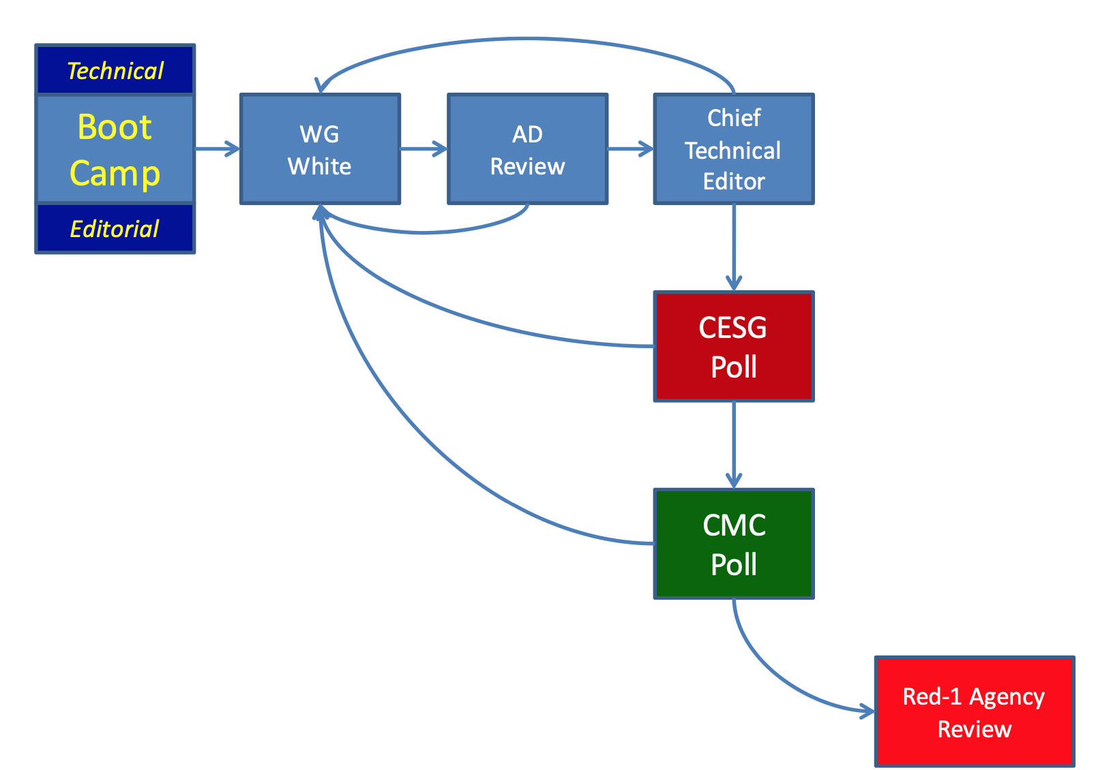
Process – up to Agency Review
Format, language
Tech Editor sets the poll – go out for review
Conditions need to be
resolved (this might hold the doc)
The big process book is
Organization and Processes for the Consultative Committee for Space Data Systems”. CCSDS A02.1-Y-4
(Apr 2014)

Slide 5
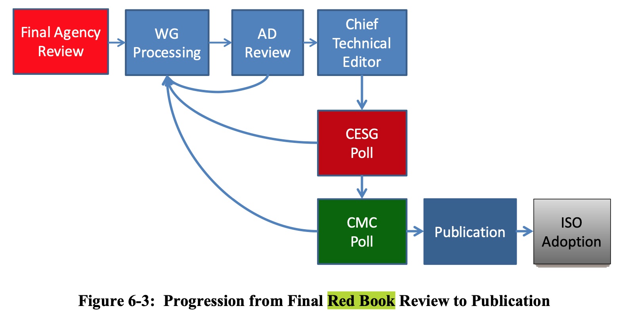
After Agency Review
Inevitably, there are changes requested,
So the same process is followed
And then the cycle begins again

Slide 6
IT Updates – Tech Writer Support
The CCSDS CWE was migrated to SharePoint Online on December 30, 2024.
All working group draft documents should be hosted in the CWE in their appropriate areas.
New SharePoint features are now being developed to assist the Technical Editor processes.
  Online Archive of Historical Technical Editor Work (Completed)
    The previous Tech Writer’s Database has been migrated to the CWE Framework
    Preserve legacy editorial work in a structured, searchable format
    Enable Secretariat, CESG, and CMC members to reference historical publication data
  New Request & Tracking System for Technical Editor Support (In-Progress)
    Enhance transparency in the request process
    Standardize the information submitted for review/publication
    Enable real-time status updates and notifications
    Provide stakeholders with up-to-date progress tracking and reporting
  Enhancements to CMC & CESG Polling Systems (Coming Soon)
    Automate poll notifications and reminders
    Simplify communication by decoupling alerts
    Improve result compilation and export options
    Reduce confusion and manual workload for the Secretariat and poll participants.

Slide 7
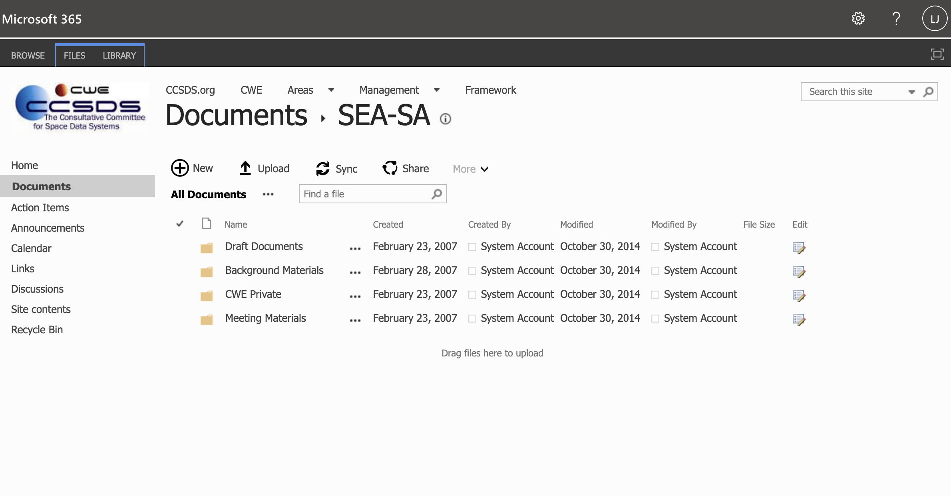

Slide 8
Parting comments
Style
  Be careful about distinguishing “normative” (shall, will, ”do this”) from non normative (explanations, rationale)
Drafts can be anything (put them in CWE!)
  Need *original* artwork in scalable form (think about this early)
  SVG, vector formats, PPT, Visio
  Don’t draw pictures in MS Word! (they auto scale poorly)
When it comes to “getting ready to submit”
  Text, figures, etc. go to the secretariat (e.g. editing team)
  Don’t obsess on formatting – it inevitably will change anyway

