Slide 1
How CCSDS can contribute to Cislunar PNT interoperability
Daniel Fischer, Ignacio Aguilar
ICG-IOAG Cislunar PNT Workshop
13th February 2025

Slide 2






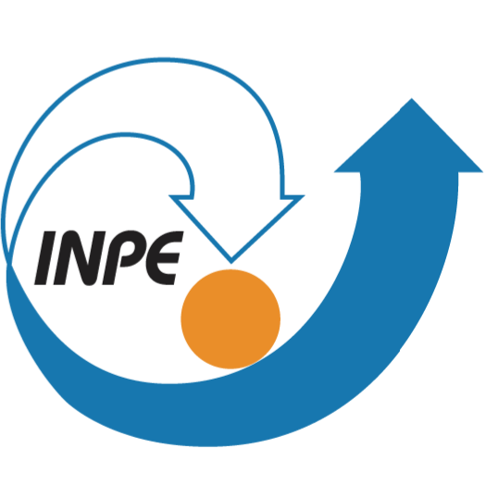




CCSDS in a nutshell
CCSDS = Consultative Committee for Space Data Systems
CCSDS is an international standardisation committee tasked with developing and maintaining interoperable standards for space systems
  11 Member Agencies
  33 Observer Agencies, 139 Commercial Associates
  Huge outreach → > 1000 missions are flying with CCSDS standards
  CCSDS acts as ISO/TC20 (Aircraft and Space)/SC13 (Space Data and Transformation Systems) → All CCSDS standards are also ISO standards!
  Primary Focus of CCSDS standards: Interoperability!, Secondary: Reducing cost and risk, boosting the industrial ecosystem
  CCSDS drives innovation (e.g., adoption novel technologies such as DTN, optical communication, CFDP, and others)
  CCSDS “implements” the operational requirements coming from the IOAG

Slide 3
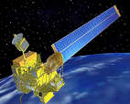
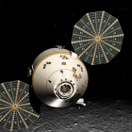
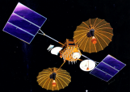
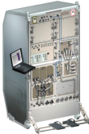
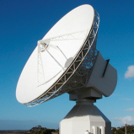
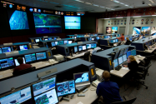

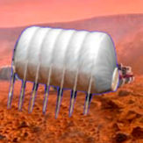
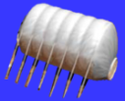
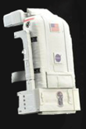



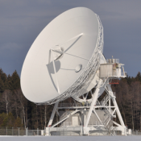
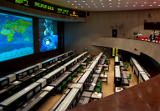

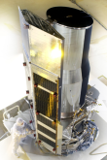
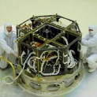
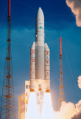
CCSDS Technical Areas
Time Management WG
Systems Engineering
Security WG
Typical Mission Profile
One Organization’s Assets
MISSION CONTROL
CENTER
End Users
Applications/Archives
MISSION CONTROL
CENTER
End Users
Another Organization’s Assets
Spacecraft Onboard
Interface Services
Space Link
Services
Cross Support
Services
Space Internetworking
Services
Mission Ops &
Info Mgt Services
RF Modulation WG
Navigation WG
Space Link Coding & Synchronisation WG
SC Monitoring & Control WG

Slide 4
Cislunar PNT Interoperability and CCSDS
Many entities have been actively working on Cislunar PNT technical specifications
CCSDS can offer a formal, well-established, and well recognised framework to support international standardisation of these specifications
  Outreach to all major space agencies, and many observers and commercial associates, including multi-agency reviews
  Decades of experience in space standards production
  Ability to fast-track development of high-priority standards
  Ability to address supporting standards to facilitate complete PNT systems needs
  Access to cross-domain expertise and to ISO
Possible model of collaboration
  Expansion of CCSDS Time Management WG to become a Cislunar PNT WG with direct involvement of the relevant experts from the ICG, LunaNet, and Space Agencies without creating duplication
  Contribution from other relevant CCSDS WGs and part of the system engineering area

Slide 5
Discussion

