Slide 1
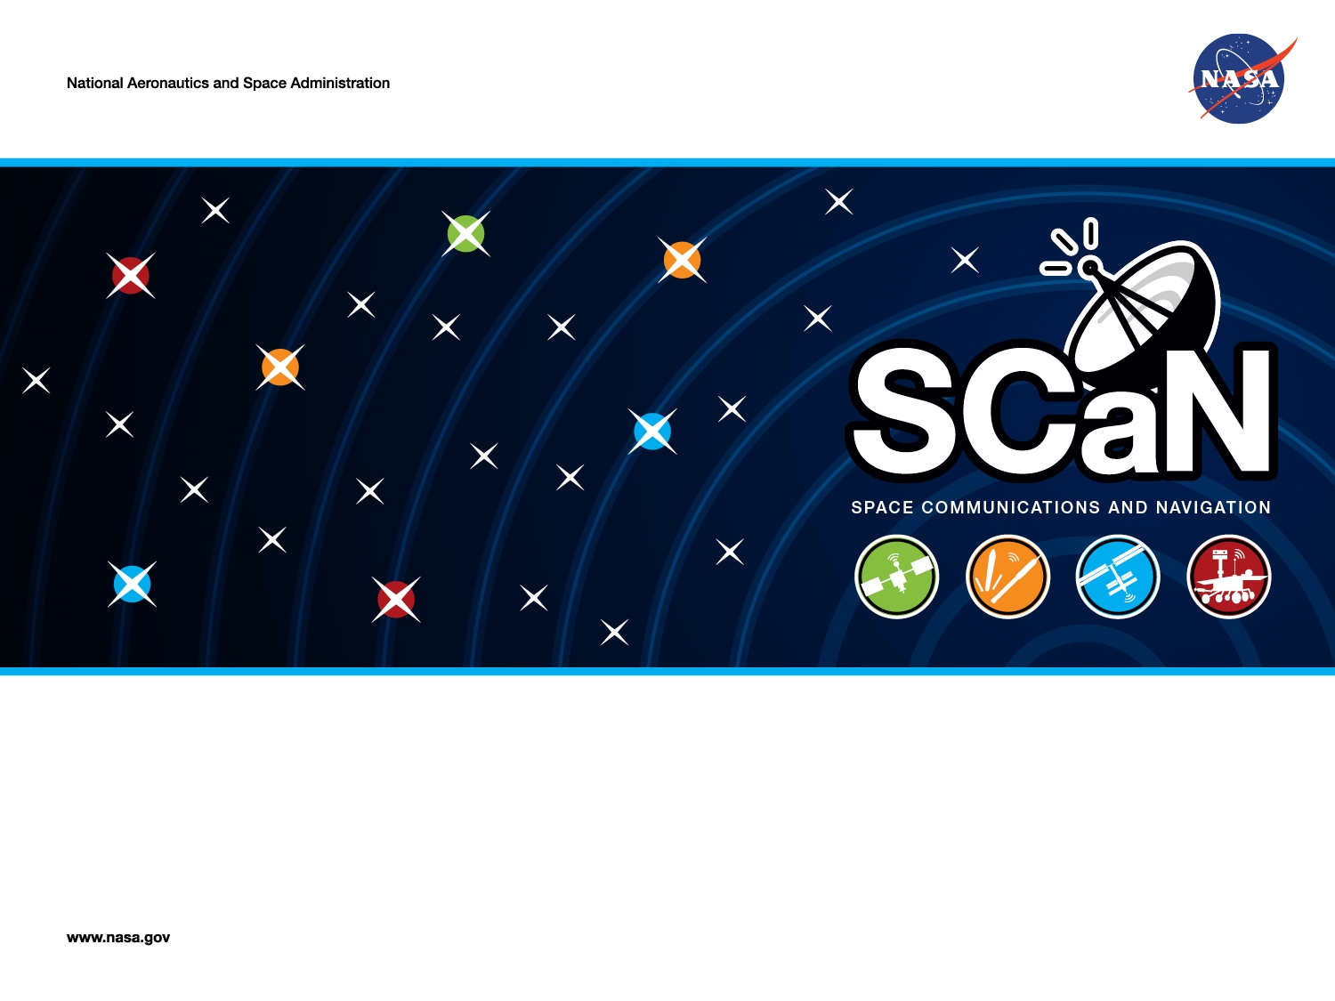
Extract for RASDSv2 Annex C, 25Nov24 updates
SCaN Integrated Network
Monitor & Control Software Architecture
SysML Model of Trade Space Options
Peter Shames, Mike Anderson, Steve Kowal
Mike Levesque, Oleg Sindiy, Kenny Donahue, Patrick Barnes

Slide 2
EBRE PoD Architecture Model
The SN is doing a major upgrade called the Space Network Ground System Sustainment (SGSS) project
  This is assumed to provide the primary viable approach for implementing the whole of the next generation SCaN architecture
  Other options are also being studied
The SGSS design (pre-PDR) has the following characteristics:
  SGSS has the following elements: Space ground Link (SGL), User Services gateway (USG), Digital Signal Processor (DSP), Service Management (SM), Fleet Ground Management (FGM), Enterprise Infrastructure (EI)
  The SGSS architecture is a quite modern concept, using a pool of shared, programmable servers 9including blades and FPGAs), a high speed set of networks, and an message bus based enterprise infrastructure
  Service Management (SM) orchestrates the delivery of SGSS TT&C and User services. It provides the remote SN user service management interfaces and local SN operator interfaces for managing SN services.
  The Fleet Ground Management (FGM) element manages and controls the TDRS Fleet, and manages the Ground Segment. Management and Control is isolated from user or TTC bearer data wherever possible. The element provides distinct capabilities in an integrated element – Fleet Management, Fleet Control, Ground Management, and Ground Control.
  SGL, DSP & USG all have Control Test & Monitor functions. “Control, Test, & Monitor (CTM) functions manage, control and test each element. CTM functions accept service requests and provide service status on the control plane. CTM functions load software, load configurations, report detected faults, and provide performance information on the management plane.”
A primary purpose of the Cycle 2 studies is to assess whether the SGSS architecture is suitable for use in the other two network elements (DSE & NEE) or if some other alternatives are more functional, lower risk, or more cost effective

Slide 3
Model Color Palette & System Stereotpyes
Fig C-1

Slide 4
NCS-1 EBRE Level 2 System Composition Model
Fig C-2

Slide 5
EBRE Level 2 Architecture
Fig C-3

Slide 6
EBRE Level 3 Service Management (SM)
Software Architecture
Fig C-4

Slide 7
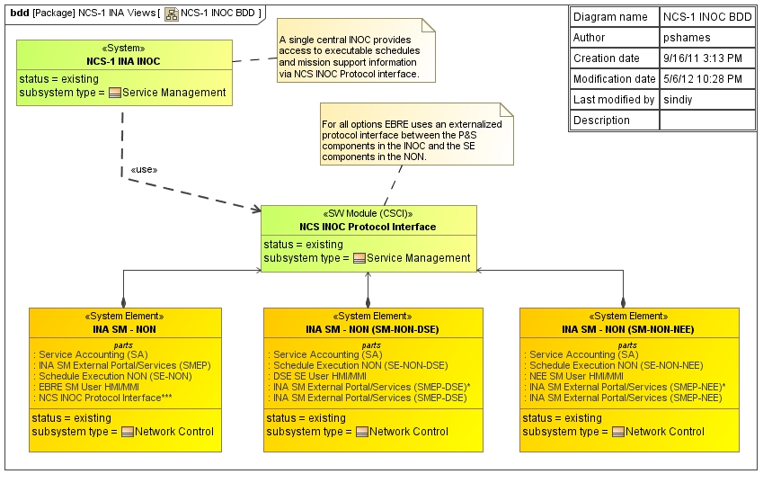
NCS-1 Integrated Overview
Not Used

Slide 8
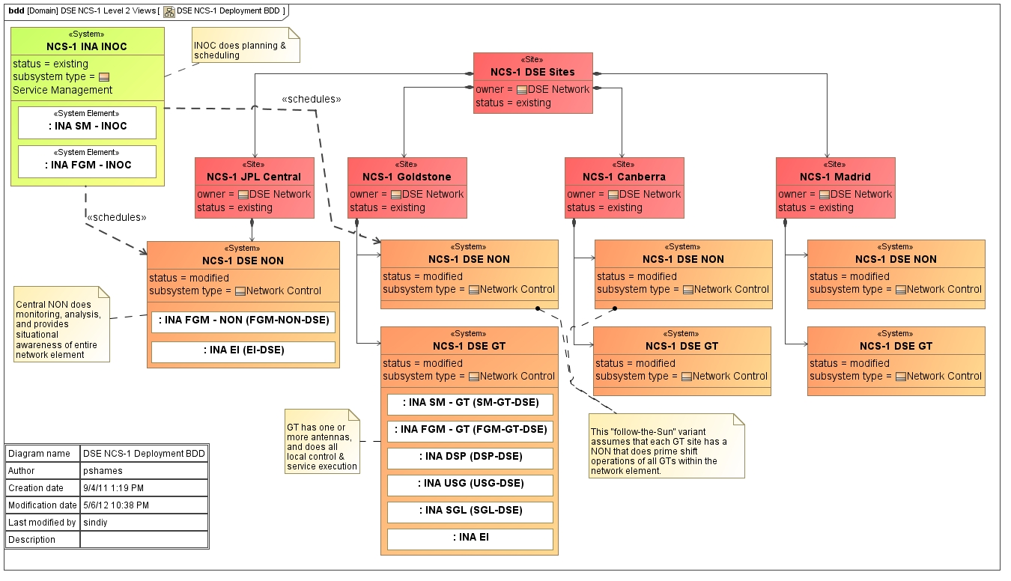
NCS-1 DSE Level 2 Deployment Model
Fig C-5

