Slide 1
ENTITIES
function
Functional Entity
Special Information
Notes:
Fig 1-1 Examples of Diagram Conventions

Slide 2

OAIS
(archive)
Consumer
Producer
Management
Notes:
Fig 2-1 Environmental Model of an OAIS
Still TBD – I thought we were going to make Producer, Consumer, and Management a different shape (rounded) throughout the document.

Slide 3
Interpreted
using its
Data
Object
Representation
Information
Yields
Information Object
Notes:
Figure 2-2: Obtaining Information from Data

Slide 4
Information Object
Data Object
Representation
Information
Information
Package
Packaging
Information
About Information Package
Descriptive
Information
About Information Package
Notes:
Figure 2-3: Information Package Concepts and Relationships
Replaced with the one in sc21
Rationale: Packaging Information is external to Package
20190823 – changed Content Information to Information Object in this general Information Package
20240206 Bug 365 - ISO-DE-012 Add label in Fig 2-3 and Bug 362 - ISO-NL-009 Update fig 2-3 – changed to show the Data Object and RepInfo Object in the Info Object to ensure consistency with the text.

Slide 5
Producer
Submission
Information
Packages
OAIS
queries
Archival
Information
Packages
Legend
query responses
orders
= Entity
= Information Package Data Object
= Role
= Data Flow
Dissemination
Information
Packages
Consumer
Notes:
Figure 2-4: OAIS Archive External Data
Make Producer, Consumer, and Management a different shape (rounded) throughout the document.
20190326: Changed “Archive Information Packages” to “Archival Information Packages” to be consistent

Slide 6
Preservation Planning
P
r
o
d
u
c
e
r
Consume
r
Descriptive Information
Descriptive Information
Data
Management
queries
Ingest
Access
query responses
SIP
orders
Archival
Storage
AIP
AIP
DIP
Administration
Management
Notes:
Figure 4-1: OAIS Functional Entities
Still TBD (Editorial) – JGG added a filled box around Management
Still TBD (Editorial) – JGG made font size the same (24) for Producer, Consumer, Management and all Functional Areas.
Still TBD – I thought we were going to make Producer, Consumer, and Management a different shape (rounded) throughout the document.
Still TBD – I thought we were going to make each OAIS functional area a different colour though out all the figures. Results in each functional area being a different colour when all the figures are combined together in A-1.
SEA-650x0-011 – agreed to make the thin lines as double ended arrows. Add text saying these flows are shown in more detail in figures in section 4.

Slide 7
INGEST
A
d
m
i
n
i
s
t
r
a
t
i
o
n
Submission report
Generate AIP
Report
SIP, AIP [for audit]
Format stds & Doc. stds
[Updated] SIP
SIP
AIP
Receive Submission
Generate Descriptive Info
SIP
QA results
Report
request
SIP
Descriptive Info
AIP
Data Management
Quality Assurance
Co-ordinate Updates
Descriptive Info
Database update
request
Database
update response
Receipt confirmation
Resubmit request
Storage confirmation
Storage request
AIP
Producer
Archival Storage
Notes:
Figure 4-2: Functions of the Ingest Functional Entity
SC#110: Change “audit report” to “Submission report”
Still TBD (Editorial) – JGG slightly adjusted location of some text on data flows (AIP, Storage confirmation, Storage Request)
Still TBD – I thought we were going to make Producer, Consumer, and Management a different shape (rounded) throughout the document.
Still TBD – I thought we were going to make each OAIS functional area a different colour though out all the figures. Results in each functional area being a different colour when all the figures are combined together in A-1.

Slide 8
ARCHIVAL STORAGE
I
n
g
e
s
t
Storage request
Receive Data
A
c
c
e
s
s
AIP
AIP
Storage confirmation
Provide
Data
AIP
request
Notice of data transfer
AIP
A
d
m
i
n
i
s
t
r
a
t
i
o
n
Storage mgmt policies
Manage Storage Hierarchy
Error Checking
Operational statistics
Error
logs
Error notification
Replace Media
Disaster recovery policies
Disaster Recovery
Duplicate
AIP
Commands
AIP
AIP
media
media
Notes:
Figure 4 3: Functions of the Archival Storage Functional Entity
SC#205 "It simplifies the work of this function if all hardware and software within the Archive provide notification of detected errors and that these errors are routed to standard error logs that are checked by the Archival Storage staff."
Also update diagram 4-3 to be consistent
Change “Potential error notification“ to “error notification”
Still TBD (Editorial) – JGG adjusted functions and functional areas text to same size (18)
Still TBD (Editorial) – JGG adjusted location of text on some data flows to be nearer arrowhead
Still TBD – Missing label on flow to/from Disaster Recovery and left media (original had Duplicate AIP between the two flows there. Should it be Duplicate AIP?
Still TBD – I thought we were going to make Producer, Consumer, and Management a different shape (rounded) throughout the document.
Still TBD – I thought we were going to make each OAIS functional area a different colour though out all the figures. Results in each functional area being a different colour when all the figures are combined together in A-1.

Slide 9
DATA MANAGEMEMNT
Report request
I
n
g
e
s
t
Report
Generate Report
Report request
A
c
c
e
s
s
Report
Database update response
Report request
Response
Query
request
A
d
m
i
n
i
s
t
r
a
t
i
o
n
Report
Perform Queries
Query
response
Policies
Administer Database
Response
Update
request
Descriptive info
Response
Status of updates
Receive Database Updates
System updates
Review updates
Response
Commands
Query
Query
Update
database
Notes:
Figure 4-4: Functions of the Data Management Functional Entity
SC#1 The figure will be updated to remove Descriptive Information from the arrow between Generate Report and Access
Still TBD (Editorial) – JGG adjusted functions and functional areas text to same size (18)
Still TBD (Editorial) – JGG adjusted location of text on some data flows to be nearer arrowhead
Still TBD – I thought we were going to make Producer, Consumer, and Management a different shape (rounded) throughout the document.
Still TBD – I thought we were going to make each OAIS functional area a different colour though out all the figures. Results in each functional area being a different colour when all the figures are combined together in A-1.
20190328 – added “Commands” and Responses” to arrow between Administer Database and database

Slide 10
System updates
Review updates
Status of updates
Management
Manage System Configuration
Preservation plans
Recommendations for system evolution
Data Management
Physical Access Control
Report request
Report
Plans for approval
Reports
Policies
System evolution policies
Operational
statistics
Budget,
Policies,
Approvals
Policies
Operating policies, procedures, standards; inventory reports; performance info; consumer comments
Performance info
Inventory reports
Establish Standards and Policies
AIP/SIP templates, Customisation advice
I
n
g
e
s
t
Arch.storage
policies
Format stds. Documentation stds.
Procedures
AIP/SIP templates
Archival Storage
SIP designs, Customised AIP designs
Recommendations,
Proposals, Risk analysis reports
Preservation Planning
Change requests, Procedures, Tools
Approved stds
Preservation Objectives
Customer comments
Archival Information Update
[Updated] SIP
DIP
Submission Report
SIP, AIP
Check Submission
AIP/SIP AIP/SIP reviews
P
r
o
d
u
c
e
r
Lien
Appeal
Dissemination request
Special request
Access
SIP designs, Customised AIP designs, example SIPs
Dissemination request
Final ingest report
Order agreement
Billing info
Activate Requests
Final
ingest
report
Customer Service
Submission/schedule agreement
Payment
Bill
Consumer
Negotiate Submission Agreement
Special service request
Special request response
AIP/SIP templates
Customization advice
Notes:
Figure 4-5: Functions of the Administration Functional Entity
SC#105 Fig 4-5 Does this need any change to the diagram? Is it not just a description of the functionality of Manage System Configuration?
On second thoughts this perhaps it would be better to add a label "plans for system evolution" to the arrow from Manage System Configuration to Preservation Planning.
Preservation planning then (see 4.1.1.6) send recommendations to Administration.
SC#110 MC DG
Type: Update needed for clarification
Status: Resolved – Change Agreed
Status: Resolved – Awaiting Diagram Update
Change Ausit Submission box to Check Submissions
Change Audir report to Submission Report on line to Ingest
by DAI WG on 20180717
SC#106 Fig 4-5 Yes arrow between the Manage System Config and Establish Standards and Policies should also show "Performance info and inventory reports" (which also goes to Preservation Planning)
SC#111 Should there be an arrow from Consumer to Activate Requests function in Figure 4-5 to reflect, "This function can also generate orders on a periodic basis where the length of the period is defined by the Consumers or on the occurrence of an event (e.g., a database update).“ Added “line with “Periodic order”
SC#206 Agreed at DAI virtual meeting 24 Jan 2017
Update Fig 4-5 to make it clear that different blocks can be distinguished.
Hard to see difference of Functional Areas & Functions & Other Entities in Figure 4-5 (and possibly other figures).
Also DIP is inside one of the boxes.
Also color and shadow of Management
Still TBD – What is stuff off side of slide?
Still TBD – Arrowheads different sizes, some very large
Still TBD (Editorial) – JGG adjusted location of text on some data flows to be nearer arrowhead
Still TBD – I thought we were going to make Producer, Consumer, and Management a different shape (rounded) throughout the document.
Still TBD – I thought we were going to make each OAIS functional area a different colour though out all the figures. Results in each functional area being a different colour when all the figures are combined together in A-1.

Slide 11
Administration
AIP/SIP templates
AIP/SIP reviews
Preservation plans
Customization advice
Proposals; Rec. for system evolution; Risk analysis reports
Operating policies, procedures, standards
Inventory reports; Performance info
Consumer comments
PRESERVATION PLANNING
Approved standards
Preservation reqmts
Preservation objectives
Develop Preservation Strategies and Standards
Collated info
about changes
in environment
Preservation Watch
Develop Packaging Designs & Preservation Plans
Issues
Advice
Reports
Requirement alerts
Emerging standards
Technology alerts
External data stds
Results
Reports
Results
Preservation requirements
Monitor Designated Community
Requests
Surveys
Monitor Technology
Service requirements
Product technologies
Surveys
Consumer
Producer
Requests
Notes:
Figure 4-6: Functions of the Preservation Planning Functional Entity
SC#220: * replace all mentions of "migration plans" and "migration packages" and "migration strategy" by "preservation plans".
* replace "migration goals" and " migration policies" by "Preservation Objectives“
Change “Migration Plans” to “Preservation Plans”
Still TBD – I thought we were going to make Producer, Consumer, and Management a different shape (rounded) throughout the document.
Still TBD – I thought we were going to make each OAIS functional area a different colour though out all the figures. Results in each functional area being a different colour when all the figures are combined together in A-1.

Slide 12
Order
Assistance request
Query request
Report request
Co-ordinate Access Activities
D
a
t
a
M
a
n
a
g
e
m
e
n
t
Consumer
Query request
Administration
Query response
Dissemination request
Special request
Billing info
DIP
Notice of shipped order
Deliver Response
DIP
Intended recipient
Transmission method
Query response
Report
Assistance
DIP (on-line &
off-line)
Query response
Report
Assistance
DIP
Notification that DIP is ready
DIP
request
Request
Descriptive Info.
Generate
DIP
AIP request
Archival Storage
Descriptive Info.
AIP
Notice of transfer
ACCESS
Notes:
Figure 4-7: Functions of the Access Functional Entity
SC#131: Generate DIP to Data Management - change the name of this latter "report request" to "request descriptive info" to avoid confusion.
SC#157: Add “Notification that DIP is ready“ to arrow from Generate DIP to Co-ordinate Access Activities
NOTE: did NOT add “Temporary Storage”
SC#158: Add (on-line & off-line) to arrow between Deliver response and Consumer
Add “Intended recipient” and “Transmission method” to line from Co-ordinate Access Activities to Deliver Response
SC#217: Arrow from Generate DIP to DM should say "Request Descriptive Info" and returns "Descriptive Info“
Still TBD – I thought we were going to make Producer, Consumer, and Management a different shape (rounded) throughout the document.
Still TBD – I thought we were going to make each OAIS functional area a different colour though out all the figures. Results in each functional area being a different colour when all the figures are combined together in A-1.

Slide 13
Producer
Administration
Receipt confirmation
Resubmit request
Surveys
SIP
Ingest
To/from all entities
See Fig 4-9
AIP
Storage request
Report request
Descriptive info
Database update request
Database update response
Report
Product technology
Storage confirmation
Data Management
Archival Storage
Query response
Report
Descriptive info
Preservation Planning
AIP request
Query request
Report request
Service requirements
Access
AIP
Notice of data transfer
Order
- ad-hoc
- event-driven
Query request
Report request
Assistance req.
DIP
Query response
Report
Assistance
-- order
- software
-- other
To/from all entities
Common Services
Consumer
Surveys
Notes:
Figure 4-8: OAIS Data Flow Diagram
SC#217 – unclear what changes needed
SC#159: rearranged boxes to reduce the width of the figure so that figure can be expanded on the page
Still TBD (Editorial) – JGG adjusted location of text on some data flows to be nearer arrowhead
Still TBD – I thought we were going to make Producer, Consumer, and Management a different shape (rounded) throughout the document.
Still TBD – I thought we were going to make each OAIS functional area a different colour though out all the figures. Results in each functional area being a different colour when all the figures are combined together in A-1.
20190114: Remove numbers in boxes

Slide 14
Producer
Common Services
Submission/schedule agreement
Appeal
Data formatting & doc stds
Submission report
[Updated] SIP
Ingest
Submission/schedule agreement
Lien
Final ingest report
Budget Policies
Approvals
SIP or AIP [for audit]
Storage mgmt. policies
Archival Storage
Management
Administration
Reports
Plans for approval
Operational statistics
Report
Status of updates
Info requests
Bill
DIP
Billing Info
Payment
Info responses
AIP/SIP template
AIP/SIP review
Customization advice
Preservation plans
Proposals
Recommendations
Risk analysis report
Consumer
Approved stds
Preservation reqmts
Preservation objectives
Inventory reports
Performance reports
Consumer comment
Policies
Report request
System updates
Review updates
Dissemination request
Data Management
Access
Preservation Planning
Notes:
Figure 4-9: Administration Context Diagram
SC#110: change “audit report” to Submission report
SC#217 – unclear what changes needed (check with Felix)
SC#159: rearranged boxes to reduce the width of the figure so that figure can be expanded on the page
SC#160: reversed arrows between Administration and Preservatyion Planning
Still TBD (Editorial) – JGG adjusted location of boxes and text on some data flows to be nearer arrowhead
Still TBD – I thought we were going to make Producer, Consumer, and Management a different shape (rounded) throughout the document.
Still TBD – I thought we were going to make each OAIS functional area a different colour though out all the figures. Results in each functional area being a different colour when all the figures are combined together in A-1.
SC#220: * replace all mentions of "migration plans" and "migration packages" and "migration strategy" by "preservation plans".
* replace "migration goals" and " migration policies" by "Preservation Objectives"
20190114: Remove numbers in boxes

Slide 15
Information Object
Interpreted using
*
Data
Object
Interpreted using
Representation
Information
1
Physical
Object
Digital
Object
1
1..*
Bit
Notes:
Figure 4-10: Information Object

Slide 16
Interpreted using
*
Representation
Information
1
1
*
Structure Representation
Information
Semantic Representation
Information
Other
Representation
Information
adds meaning to
Notes:
Figure 4-11: Representation Information Object

Slide 17
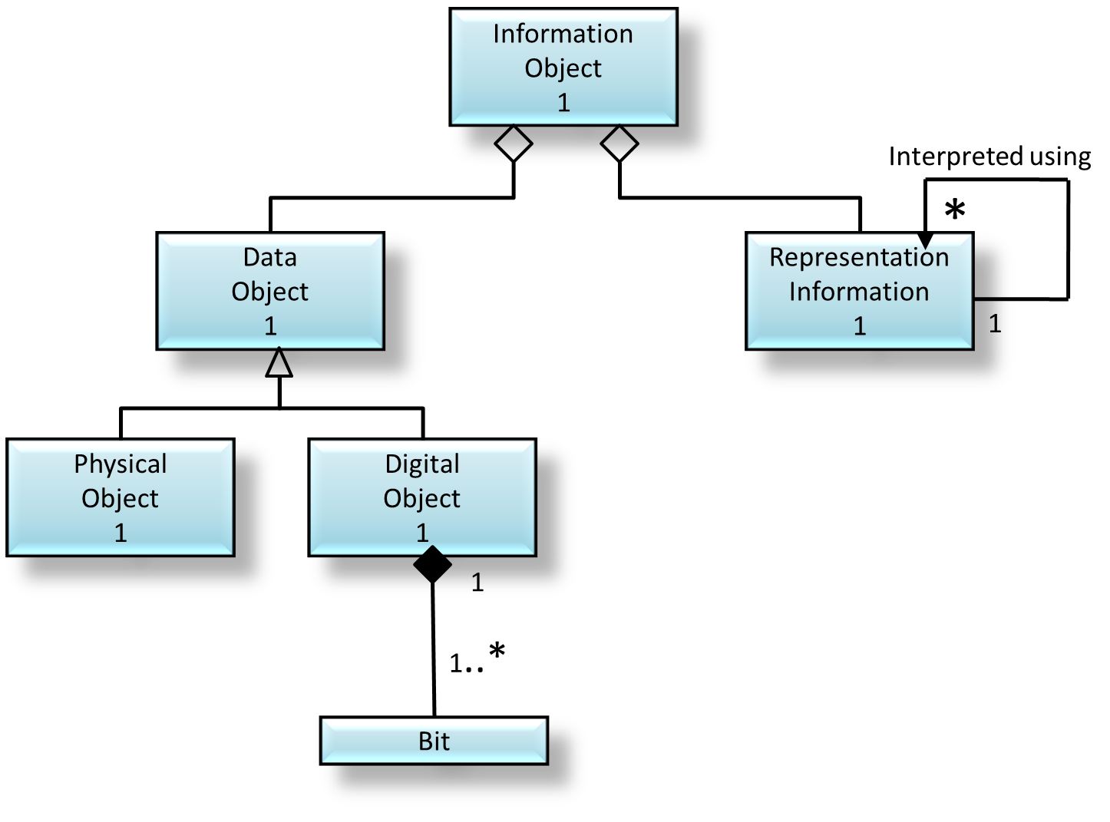
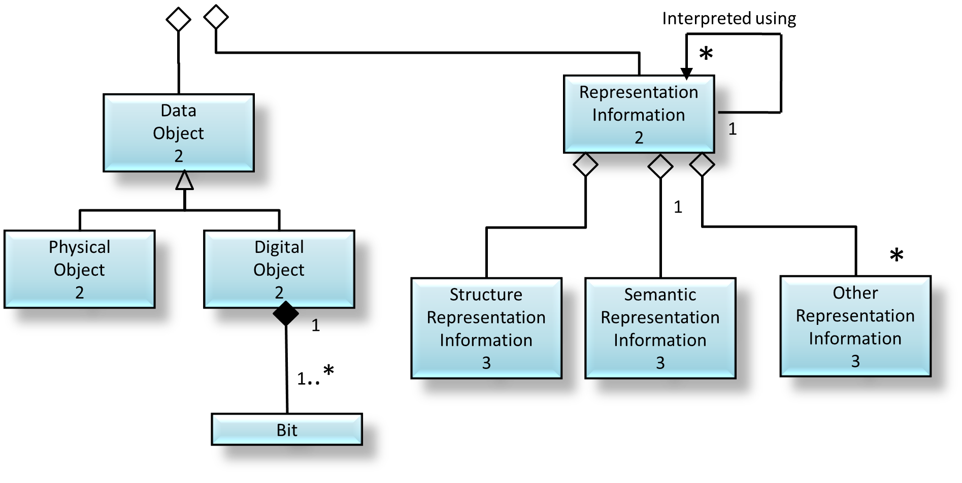
Representation Information
is an
Information Object
Information Object
Notes:
Figure 4 12: PARTIAL GENERAL RIN

Slide 18

FITS
DICTIONARY
*
FITS
STANDARD
FITS JAVA SOFTWARE
Structure Representation
Information
Semantic Representation
Information
Other
Representation
Information
Notes:
Figure 4 13: EXAMPLE OF A SIMPLIFIED RIN FOR A FITS FILE

Slide 19
Information
Object
Content Information
Preservation Description
Information
Packaging
Information
Descriptive
Information
Representation Information
....
(Indicates that the list is not exhaustive)
Notes:
Figure 4-14: Information Object Taxonomy

Slide 20
described
by
1
delimited
by
Package Description
Information Package
Packaging Information
*
1
*
derived
from
identifies
Information Object
*
Notes:
Figure 4-15: Information Package Contents and Its Associated Package Description and Packaging Information
20190823 – changed Content Information to Information Object in this general Information Package
20190830 – Replaced CI plus PDI by a general Information Object
20190903 – change cardinality of IO to 1..* and remove « 1 » on line to IP

Slide 21
Information Object
Content Information
Preservation Description
Information
further described by
Interpreted using
*
Interpreted using
Data
Object
Representation
Information
1
Notes:
Figure 4-16 Example of an Information Object made up of Content Information and PDI

Slide 22
Information
Package
Submission Information Package
Archival Information Package
Dissemination Information Package
Notes:
Figure 4-17: Information Package Taxonomy

Slide 23
described
by
delimited
by
Package Description
Archival Information Package
Packaging Information
derived
from
identifies
Content Information
further described by
Preservation Description
Information
Notes:
Figure 4-18: Archival Information Package (AIP) and its associated Package Description and Packaging Information
Figure 4-15: Archival Information Package (AIP)

Slide 24
Preservation
Description
Information
Reference
Information
Provenance
Information
Context
Information
Fixity
Information
Access Rights
Information
Notes:
Figure 4-19: Preservation Description Information (PDI)
20190402 re-drew lines to avoid overlaps

Slide 25
Archival Information
Package
Package
Description
1
1
1
1..*
Associated Description
derived
from
1..*
1..*
1
*
Access
Aid
described by
provide data for
Finding
Aid
Ordering
Aid
Retrieval Aid
...
(Indicates that the list is not exhaustive)
Notes:
Figure 4-20: Package Description and its associated AIP
Figure 4-17: Package Description

Slide 26
described
by
delimited
by
Package Description
Archival Information Package
Packaging Information
derived
from
identifies
Content Information
Preservation Description
Information
further described by
Interpreted using
*
Interpreted using
Data
Object
Representation
Information
1
Physical Object
Digital Object
Reference Information
Provenance Information
Context Information
Fixity Information
Access Rights Information
Structure Representation Information
Semantic Representation Information
Other Representation Information
adds meaning to
1
1...*
Bit
Notes:
Figure 4 21: Archival Information Package (Detailed View ) and its associated Package Description and Packaging Information
Figure 4-18: Archival Information Package (Detailed View)
Updated so PDI linked to Content Data Object

Slide 27
Archival
Information
Package
Archival
Information
Unit
Archival
Information Collection
Notes:
Figure 4-22: Specialization of the AIP

Slide 28
Package
Description
Unit
Description
Collection Description
Notes:
Figure 4-23: Specialization of the Package

Slide 29
described
by
delimited
by
Unit
Description
Archival Information
Unit
Packaging Information
derived
from
identifies
Content Information
further described by
Preservation Description
Information
Notes:
Figure 4-24: Archival Information Unit (AIU) and its associated Unit Description and Packaging Information
Figure 4-21: Archival Information Unit (AIU)
Still TBD (Editorial) – JGG shifted data flow text to be near arrowhead as in other figures.

Slide 30
Archival Information
Unit
Unit
Description
1
1
1
1..*
Associated Description
derived
from
1..*
1..*
1
*
Access
Aid
described by
provide data for
Finding
Aid
Ordering
Aid
Retrieval Aid
...
(Indicates that the list is not exhaustive)
Notes:
Figure 4-25: Unit Description and its associated Archival Information Unit
Figure 4-22: Unit Description
Still TBD (Editorial) – JGG shifted data flow text to be near arrowhead as in other figures.

Slide 31
described
by
delimited
by
Collection
Description
Archival Information Collection
Packaging Information
derived
from
identifies
Content Information
further described by
Preservation Description
Information
1
*
Archival Information Package
Notes:
Figure 4-26: Archival Information Collection and its associated Collection Description and Packaging Information Logical View
Figure 4-23: Archive Information Collections Logical View
Still TBD (Editorial) – JGG shifted data flow text to be near arrowhead as in other figures.

Slide 32
Archival Information Collection
0..1
may be derived from
Collection
Description
described by
1
1
1
*
1
Archival Information Package
1..*
Associated
Description
provide data for
Package
Description
*
1
1
1
1..*
*
*
Member
Description
Overview
Description
Access
Aids
derived from
*
described by
described by
Notes:
Figure 4-27: Collection Description and its associated Archival Information Collection
Figure 4-24: Collection Descriptions
SC#233 MC DG
Type: Update needed for clarification
Status: Resolved – Change Agreed (Figure Title)
By DAI WG on 20180213
SC#177 : Change annotation on line connecting AIC and Collection Description
From: Derived From
To: May Be Derived From
Change cardinality (AIC to Collection Description)
From: 1 to 1 (implied)
To: 0..1 to 1

Slide 33
Data
Management
Data
stored in
database
Package
Description
Archive Administrative
Data
Collection
Description
Unit
Description
Policy
Subscription
Customer
Profile
Preservation
Process
History
Request
Tracking
Security
Statistics
Accounting
Data
...
(Indicates that the list is not exhaustive)
Notes:
Figure 4-28: Data Management Information

Slide 34
Producer
Submission Information Package (SIP)
Ingest
Package Descriptions
Database Updates
AIPs
Data
Management
Archival
Storage
Queries
Access
Package Descriptions
Query responses
AIP
Queries
Order Requests
Query responses
Dissemination Information Packages (DIP)
Consumer
Notes:
Figure 4-29: High-Level Data Flows in an OAIS
SC#144 and SC#143 Following basic flowchart symbology, we will represent Functional Entities as rectangles, the functions internal to the Functional Entities will be represented as rounded rectangles. The actors (Producer, Consumer and Management) will be shown as stick figures.
DAI 20181030 agreed NOT to use stick figures.
SC#217 – unclear what changes needed

Slide 35
Content Information Identifier
Descriptive Information Mapping
Data Management and Access View
AIP Identifier
Archival Storage View
Archival Storage Mapping
Packaging Information
Preservation Description
Information
Content Information
Notes:
Figure 5-1: Conceptual View of Relationships Among Names and AIP Components

Slide 36
Ing
Acc
Ing
Acc
OAIS
OAIS
Admin
Admin
Notes:
Fig 6-1 Cooperating Archives with Mutual Exchange Agreement

Slide 37
Method B
Method A
Ing
Acc
OAIS
Admin
Producer
Consumer
Method B
Method A
Ing
Acc
OAIS
Admin
Notes:
Figure 6‑2 Cooperating Archives with Standard Ingest and Access Methods

Slide 38
Local
Consumer
Dissemination Information Package (Optional)
Ing
Acc
Global
Consumer
OAIS 1
Acc
Acc
Adm
DM
Acc
DIPs with Finding Aids
Ing
Common Catalog
Adm
DM
Acc
OAIS 2
Acc
Adm
Ing
Acc
Dissemination Information Package (Optional)
Local
Consumer
Notes:
Figure 6-3: An OAIS Federation Employing a Common Catalog

Slide 39
Management
- OAIS 1
Administration
Producer
Ingest
Archival
Storage
&
Data Management
Access
Consumer
Producer
Ingest
Access
Consumer
- OAIS 2
Administration
Management
Notes:
Figure 6-4: Archives with Shared Storage
SC#145: Functional Entities shown as rectangles, following decision on SC#144 and SC#143: Following basic flowchart symbology, we will represent Functional Entities as rectangles, the functions internal to the Functional Entities will be represented as rounded rectangles.

Slide 40
(primary) OAIS 1
p
r
ima
r
y
OA
I
S
P
r
o
d
u
c
e
r
Preservation Planning
p
r
ima
r
y
OA
I
S
Consume
r
Data Management
Archival Storage
Archival Storage
(supporting) OAIS 4
distributed part of Archival Storage)
I
n
g
e
s
t
(supporting) OAIS 3
(distributed part of Archival Storage)
A
c
c
e
s
s
Preservation Planning
(supporting) OAIS 2
(distributed part of Archival Storage)
Preservation Planning
Data Management
Ingest
Access
Preservation Planning
Data Management
Ingest
Archival Storage
Access
Data Management
Archival Storage
Administration
Access
Provide
Data
Receive Data
Ingest
Archival Storage
Administration
Administration
Disaster Recovery
Manage Storage Hierarchy
Error Checking
Administration
primary OAIS Management
supporting OAIS Management
Notes:
Figure 6-5: Example of a Distributed OAIS Archive for Archival Storage

Slide 41
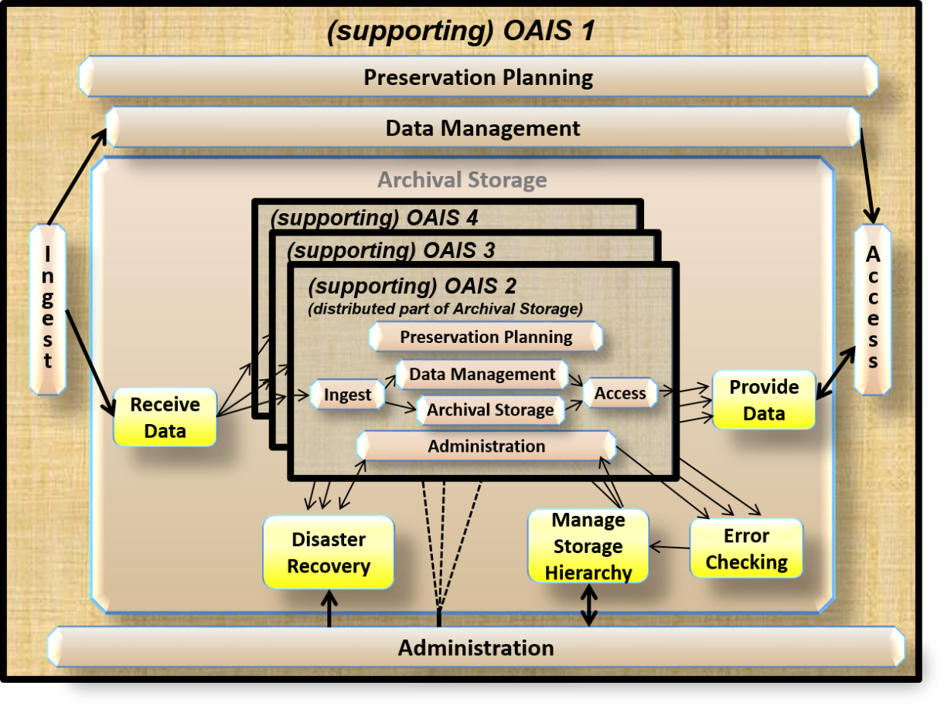
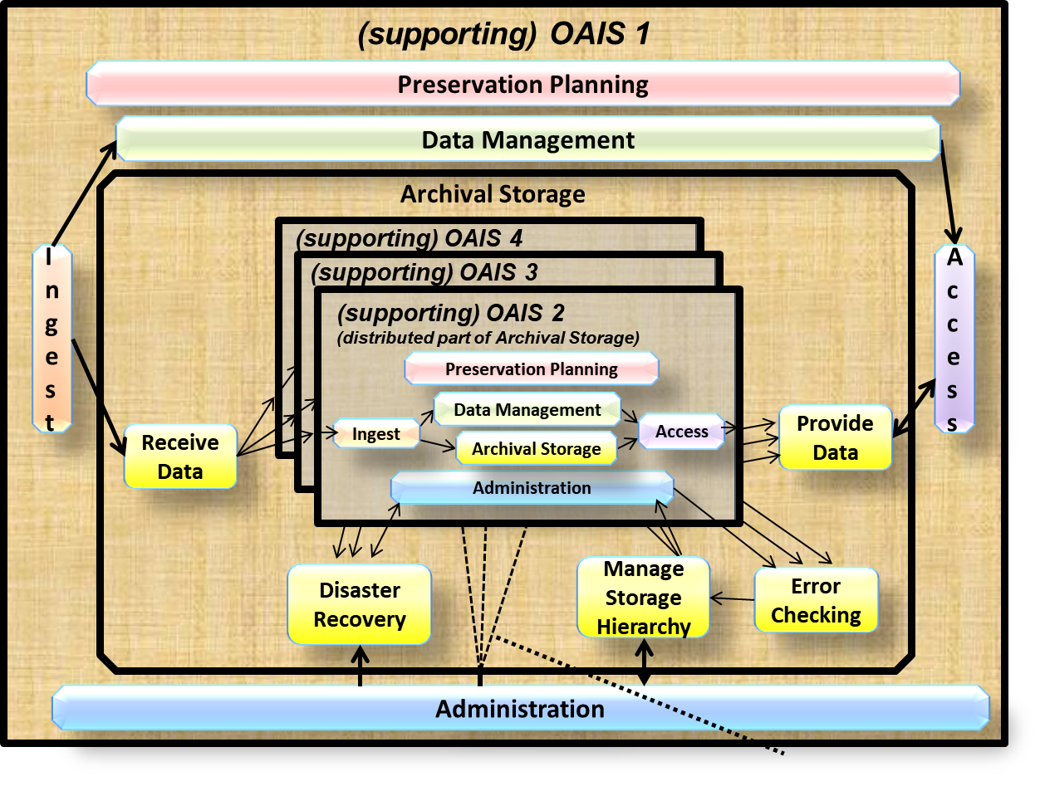
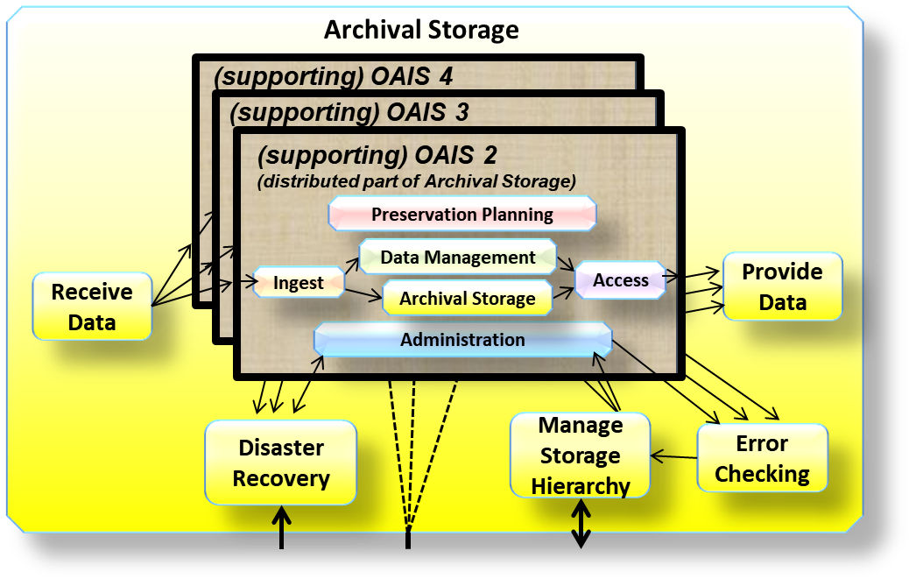
(primary) OAIS 6
(primary) OAIS 5
Preservation Planning
Data Management
p
r
ima
r
y
OA
I
S
6
P
r
oduce
r
p
r
ima
r
y
OA
I
S
6
Consume
r
p
r
ima
r
y
OA
I
S
5
P
r
oduce
r
Archival Storage
p
r
ima
r
y
OA
I
S
5
Consume
r
I
n
g
e
s
t
A
c
c
e
s
s
Administration
Primary OAIS 5 Management
Primary OAIS 6 Management
Notes:
Figure 6-6: Another example of a Distributed OAIS Archive for Archival Storage
Still TBD – (Inner) OAIS 1 should be (supporting) OAIS 1 - Done

Slide 42
Preservation Planning
Monitor Designated
Product technologies
Community
Service requirements
Surveys
Prototype
Monitor
Prototype
Reports; requ. alerts;
emerging stds
Preservation Watch
Surveys
Prototype
requests
Technology
requests
Tech. alerts; ext. data stds;
Prototype results; reports
Collated info.
about changes in
environment
Preservation
results
Advice
Issues
requirements
Develop Packaging Designs
Develop Preservation Strategies
and Preservation Plans
Operating policies,
procedures and stanards
and Standards
Consumer comments
Approved standards
Inventory reports
Preservation objectives; Preservation requ.
Performance info
Data Management
Report request
Report request
Generate Report
Report request
Access
Order
Assistance request
Report
Response
Query
Query
Query request
Ingest
Submission report
Policies
Administer
Perform
request
response
Report request
Generate
Descriptive Info
Database
Queries
Notice of
Dformat stds & Doc. stds
AIP
Database update request
Receive Database
Response
Co
-
ordinate
Shipped
Receipt
AIP
Update
Responses
Access
order
Query
-
DIP
confirmation,
SIP
System updates
Response
Query
Activities
responses
Deliver
DIP
Resubmit
Generate
Review updates
Update
Commands
Query
Report
Response
Query
-
request
SIP
Receive
Descriptive
database
Special request
Assistance
responses
P
Submission
Info
Report
C
R
[Updated]
QA results
Descriptive
Dissemination
Assistance
O
O
SIP
SIP
AIP
Info
Archival Storage
DIP
DIP
request
N
D
Co
-
ordinate
Database
Report
request
S
U
Quality
Updates
update response
Storage request
AIP
Receive
AIP
Provide
AIP request
AIP
Generate DIP
U
C
Assurance
Storage
Data
Data
Notice of
M
E
confirmation
Error logs
Disaster
recovery
policies
data
E
R
Manage
Replace
Error
Disaster
transfer
R
Storage
Media
Checking
Recovery
Storage
Hierarchy
Error
Duplicate
mgmt
Commands
AIP
AIP
notification
AIP
AIP/SIP
policies
media
media
templates,
standards
p
roposals;
Customization
Recommendations;
Administration
advice
Risk analysis reports
Rec. for
system evolution
SIP, AIP [for audit]
Establish
Standards and Policies
Preservation
plans
Status of
Operational
AIP/SIP reviews
Check
updates
statistics
Activate
Lien
Appeal
Submission
SIP designs,
Budget
System
Manage
Report
Requests
Customised
Policies
Approvals
evolution
System
Final ingest
SIP designs,
AIP designs
policies
Configuration
report
Final ingest
Customised AIP, designs
Customer
Billing info
Submission/
report
Negotiate
Service
Payment
Bill
schedule
Submission
Physical
Special service request
Special service
agreement
Agreement
Policies
Access
Change requests,
response
AIP/SIP templates, Customization advice
Control
Procedures, Tools
Archival
Information
DIP
Reports
Plans for approval
Update
MANAGEMENT
Notes:
Figure A 1: Composite of Functional Entities

Slide 43
Notes:
Figure C‑1: Key to UML Relationships

Slide 44
Application Layer (Analysis and Display Programs)
Objective Interface Message
Named Aggregates
Named Bit Streams
...
Object Layer
Data Objects
Container Objects
Data Description Objects
Named Aggregate
...
Structure Layer
Primitive data types
List/Array types
Records
Names Aggregates
Named Bit Stream
...
Named Bit Stream
Stream Layer
Delimited Byte Streams
Media Layer (Disks, Tapes and Network)
Notes:
Figure E‑1: Layered Information Model
Annex

