Slide 1
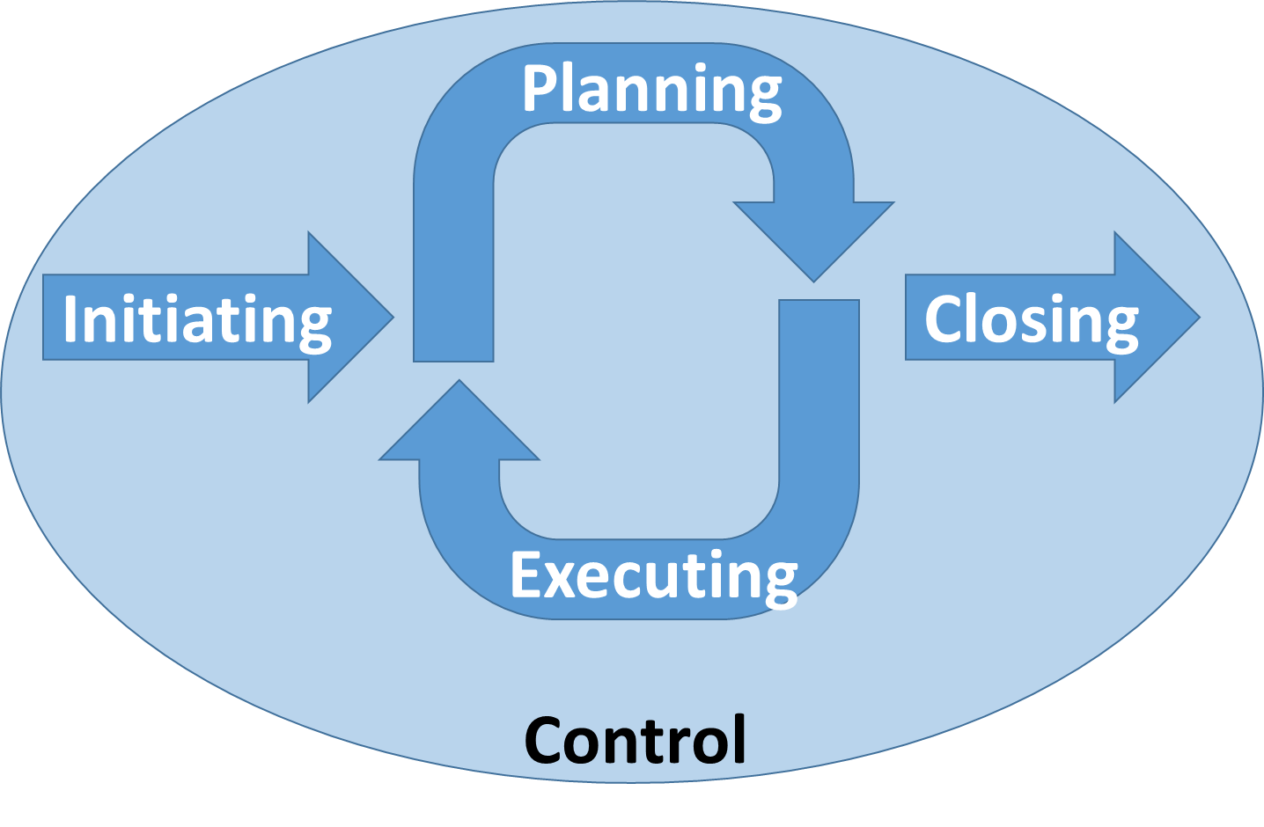
Project Phase 1
Project Phase 2
Project Phase 3
Notes:
FIGURE 3-1

