Slide 1

CCSDS SPRING 2024 TECHNICAL PLENARY

Slide 2
AGENDA
Time (UTC) | Duration | Topic | Presenter
09:30-09:45 | 15 minutes | Introduction | Sami Asmar - NASA/JPL – CCSDS Chair Klaus-Juergen Schultz – CCSDS Engineering Steering Group (CESG) Chair
09:45-09:50 | 5 minutes | SEA Workplan | Peter Shames – Systems Engineering Area (SEA) Director
09:50-10:00 | 10 minutes | MOIMS Workplan | Daniel Fisher – Mission Operations and Information Management Services (MOIMS) Director
10:00-10:05 | 5 minutes | CSS Workplan | Erik Barkley – Cross Support Services (CSS) Area Director
10:05-10:10 | 5 minutes | SOIS Workplan | Jonathan Wilmot – Spacecraft Onboard Interface Service (SOIS) Area Director
10:10-10:15 | 5 minutes | SLS Workplan | Ignacio Aguilar – Space Link Services (SLS) Area Director
10:15-10:20 | 5 minutes | SIS Workplan | Ivica Ristovski– Space Internetworking Services (SIS) Deputy Area Director
10:20-10:30 | 10 minutes | Adjournment | Klaus-Juergen Schultz – CESG Chair Sami Asmar- NASA/JPL – CCSDS Chair Amber Massaquoi - NASA – CCSDS Secretariat

Slide 3




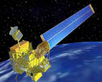
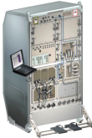
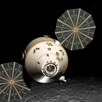
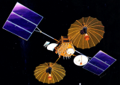



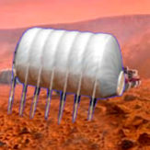

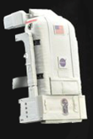






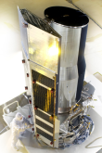
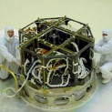



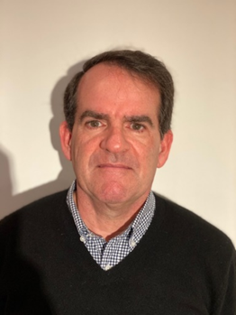




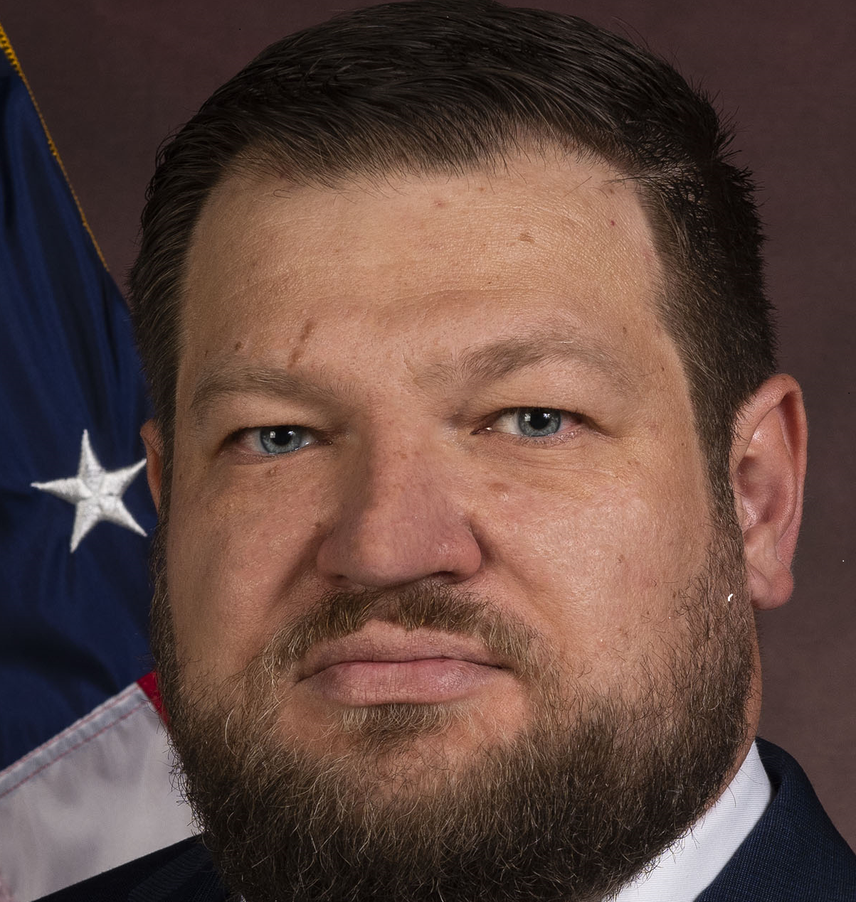

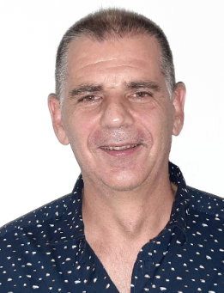
Members of the CESG
6 Areas
23 WGs +1 BoF
CESG Chairs
CESG Chair Klaus-Juergen Schulz
Deputy Timothy Pham
SEA Area Director Peter M. Shames
Deputy Hiroshi Takeuchi
MOIMS Area Director Daniel Fischer
Deputy Marc Duhaze
CSS Area Director Erik Barkley
Deputy Holger Dreihahn
SLS Area Director Ignacio Aguilar Sanchez
Deputy Gilles Moury
SIS Area Director Tomaso de Cola
Deputy 'Vinny' Ivica Ristovski
SOIS Area Director Jonathan Wilmot
Deputy Xiongwen He
Systems Engineering
Security
Delta-DOR
System Architecture
MISSION CONTROL
CENTER
End Users
Applications/Archives
MISSION CONTROL
CENTER
End Users
Spacecraft Onboard
Interface Services
Space Link
Services
Cross Support
Services
Space Internetworking
Services
Mission Ops &
Info Mgt Services
Onboard Wireless WG
Application Supt Services
Subnetwork Services
RF & Modulation
Coding & Sync.
Multi/Hyper Data Comp.
Space Link Protocols
Space Data Link Security
Optical Communications
CS Service Management
CS Transfer Services
Cloud Computing
Motion Imagery & Apps
Delay Tolerant Networking
Voice
CFDP Revisions
Data Archive Ingestion
Navigation
Spacecraft Monitor & Control
Telerobotics
Planning & Scheduling

Slide 4
CCSDS Publications since CCSDS Fall Meetings 2023
Blue Books – Recommended Standards
CCSDS 521.0-B-3 : Mission Operations Message Abstraction Layer (March 2024)
CCSDS 504.0-B-2 : Attitude Data Messages (January 2024)
Magenta Books – Recommended Practices
CCSDS 876.1-M-1 : Spacecraft Onboard Interface Services-Specification for Dictionary of Terms for Electronic Data Sheets (March 2024)
CCSDS 902.13-M-1 Cor. 1 : Technical Corrigendum 1 to CCSDS 902.13-M-1, Abstract Event Definition Issued February 2021 (February 2024)
CCSDS 350.8-M-3 : Information Security Glossary of Terms (February 2024)
CCSDS 354.0-M-1 : Symmetric Key Management (December 2023)
Orange Books
Green Books – Informational Reports
CCSDS 140.1-G-2 : Real-Time Weather and Atmospheric Characterization Data (April 2024)
CCSDS 870.0-G-1 : Electronic Data Sheets and Dictionary of Terms for Onboard Devices and Components (March 2024)
CCSDS 350.5-G-2 : Space Data Link Security Protocol-Summary of Concept and Rationale (Jan 2024)
Yellow Books
-

Slide 5
CMC Poll Statistics since CCSDS Fall Meetings 2023
Approval to publish:
CCSDS 140.1-G-2, Real-Time Weather and Atmospheric Characterization Data (Green Book, Issue 2)
CCSDS 521.0-B-3, Mission Operations Message Abstraction Layer (Blue Book, Issue 3)
CCSDS 870.0-G-1, Electronic Data Sheets and Dictionary of Terms for Onboard Devices and Components (Green Book, Issue 1)
CCSDS 876.1-M-1, Spacecraft Onboard Interface Services—Specification for Dictionary of Terms for Electronic Data Sheets (Magenta Book, Issue 1)
CCSDS 350.8-M-3, Information Security Glossary of Terms (Magenta Book, Issue 3)
CCSDS 901.3-M-1, Functional Resource Model (Magenta Book, Issue 1)
CCSDS 902.13-M-1 Cor. 1, Technical Corrigendum 1 to CCSDS 902.13-M-1, Issued February 2021
CCSDS 350.5-G-2, Space Data Link Security Protocol—Summary of Concept and Rationale (Green Book, Issue 2)
CCSDS 504.0-B-2, Attitude Data Messages (Blue Book, Issue 2)
CCSDS 354.0-M-1, Symmetric Key Management (Magenta Book, Issue 1)
Agency Reviews:
CCSDS 508.0-P-1.1, Conjunction Data Message (Pink Book, Issue 1.1) for CCSDS Agency review
CCSDS 506.2-R-1, Delta-DOR Architect ureal Guidelines (Red Book, Issue 1) for CCSDS Agency review

Slide 6
CMC Poll Statistics since CCSDS Fall Meetings 2023
Approval of new Projects
New Projects of the SEA Area
CMC-P-2024-03-001 New 1.02 Security Working Group Project – Magenta Book
CMC-P-2024-03-011 New 1.02 Security Working Group Project – Magenta Book
New Projects of the MOIMS Area
CMC-P-2024-03-010 New 4.03 Onboard Wireless Working Group Project – Green Book
CMC-P-2023-12-003 New 2.02 Navigation Working Group Project – Blue Book
New Projects of the SLS Area
CMC-P-2024-03-008 New 5.09 Space Data Link Security Working Group Project – Blue Book
CMC-P-2024-03-009 New 5.04 Space Link Protocols Working Group Projects – Blue Book
New Projects of the SIS Area
CMC-P-2024-03-007 New 6.09 Delay Tolerant Networking Working Group Projects - Orange

Slide 7
CMC Poll Statistics since CCSDS Fall Meetings 2023
New Appointments:
SPACE INTERNETWORKING SERVICES AREA (SIS) Deputy Area Director - 'Vinny' Ivica Ristovski
Request for Nominations:

Slide 8
CESG Topics Since Fall Meetings 2023
Lunar Communication:
Comment to LunaNet Interoperability specification V5 (30 November 2023) based on Technical discussions in Working Groups, Areas and CESG.
2. Lunar Interoperability Forum :
Preparation for event on 07 May 2024 between projects, standardisation community and industry/academia.

Slide 9
CCSDS Resources

Slide 10
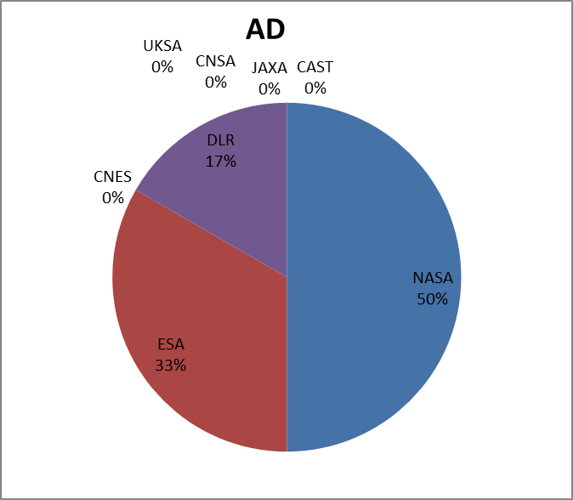
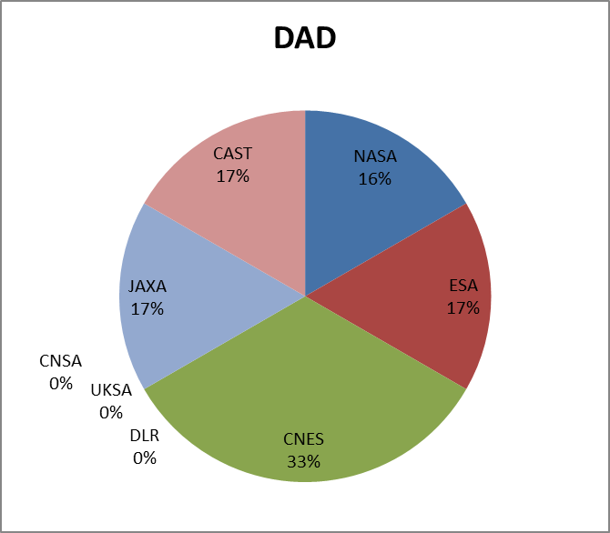
Area Directors / Area Directors Overview

Slide 11
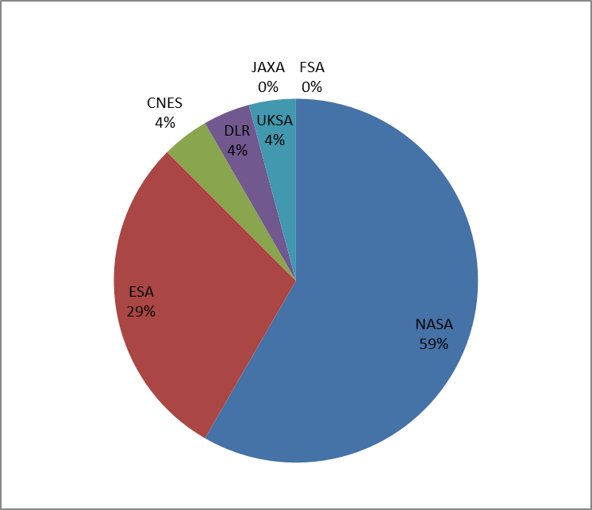
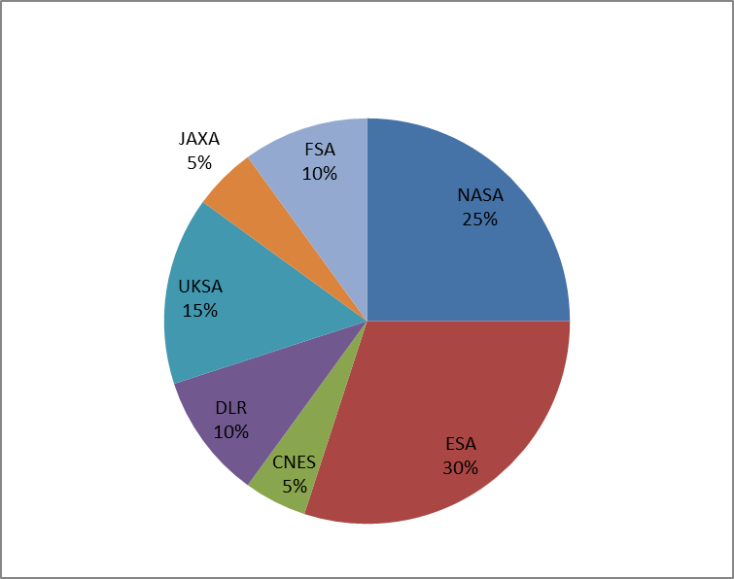
WG Chair / Deputy Chair Overview
WG CHAIR
WG DEPUTY CHAIR

Slide 12
CCSDS Opening Plenary Spring 2024
Systems Engineering Area
(SEA)
Peter Shames, Area Director
Hiroshi Takeuchi, Deputy Area Director

Slide 13
Systems Engineering Area Status (1/2)
Security Working Group
  Plans
    On-going work on Key Management GB, DTN/BPSec, and Intergov Cloud Certificate Authority (IGCA). Progress on new work items for Secure SW Engineering and new Space ATT&CK framework. New Deputy WG Chair.
    Problems / Issues: Design of security architecture for DTN multi-mission space deployments needs attention for SSI Stage 2(a/b).
Systems Architecture Working Group
  Plans
    RASDS++ draft, with integrated TC20/SC14 revisions, new ontology & representation views has been sent to Chief Technical Editor. External review with Agencies is next, including Systems Architecture experts.
    SCCS-ARD revisions nearly complete, both ABA and SSI now quite well in hand. New, more compact, tabular format by Nodes types. New standards, including optical comm, USLP, SM, and many other revised documents included.
  Problems / Issues: We have a coherent group but very limited resources. NASA is the only agency actively supporting this CCSDS-wide Architecture work.
Delta-DOR Working Group
    Plans
    MB on Architecture is under Agency Review. Raw Data Exchange File BB is under AD review. Work continues on Operations MB update. About to start GB revision. Considering updates to new Quasar flux database, as part of upcoming revision of DDOR Quasar catalogue MB.
    PN DOR work: The related testing and YB reports have been generated, as required for the next RFM update.
  Problems / Issues: Small but effective working group.

Slide 14
Systems Engineering Area Status (2/2)
Time Management Working Group
Plans
  Working group has produced GB, at Tech Writer. Time Code Formats BB revised, updated and submitted to AD. Progress on the new project BB for time transfer, clock correlation, clock synchronization. Active participation by five agencies. New WG Chair, Deputy position is open.
Problems / Issues
  The LunaNet CPNT work, and other IOAG network requirements, are more extensive than the new BB, it may not be ready in time to be useful.
  SANA and SANA Steering Group (SSG)
Plans
  BETA website incorporating ISO TC20/SC14 terms has been updated, being evaluated by SC14. Many new process and feature improvements, increased ease of use.
Problems / Issues
  AOS SCIDs are now all used. No more identical S & X band SCIDs are available. Agency HOD must assign Agency Representation (AR) to update their agency data in “Enterprise” registries. Service Site and Aperture (SS&A) registry access supports direct AR updates to apertures.

Slide 15
CCSDS Opening Plenary Spring 2024
Mission Operations and Information Management Area
(MOIMS)
Daniel Fischer
29th April 2024

Slide 16
MOIMS Area Spring 2024 Status (1/2)
MOIMS Dep. AD – Candidate identified
Data Archive Interoperability WG (DAI)
  CCSDS → ISO process is working fine
  Issues: None, Good progress
  MB: 650.0 Open Archival Information System (OAIS): 5y revision Awaiting publication by CCSDS and ISO
  MB: 652.0 Audit and Certification of Trustworthy Digital Repositories: 5y revision Awaiting publication by CCSDS and ISO
  MB: 653.0 Information Preparation to Enable Long Term Use (IPELTU) Awaiting publication by CCSDS and ISO
  MB: 652.1 Requirements for Bodies Providing Audit and Certification of
  Trustworthy Digital Repository: 5y revision Awaiting publication by CCSDS and ISO
  MB: 671.0 Open Archive Information Systems Interoperability
  Framework (OAIS-IF) Architecture Description Drafting
  BB: OAIS-IF Core Specification Drafting
  GB: OAIS-IF Rationale, Scenarios and Requirements Drafting
Mission Planning & Scheduling WG (MP&S)
  Issues: No deputy chair! , Good progress
  BB: 529.1 Mission Planning and Scheduling Services (ESA, DLR) AR ongoing, prototyping ongoing
  MB: 529.2 Mission Planning and Scheduling Information Model New project
  GB: 529.0 Mission Planning and Scheduling (Issue 2): 5y revision New project

Slide 17
MOIMS Area Spring 2024 Status (2/2)
Navigation WG (NAV)
  Issues: None, Good progress
  Specific discussions: Potential LunaNet standardisation support
  BB: 503.0 Tracking Data Message (TDM - NASA, ESA): 5y revision P-2.0.2 in preparation, ready for review soon
  BB: 504.0 Attitude Data Message (ADM - CNES, ESA): 5y revision Blue Book 2.0 Published Jan 2024
  BB: 505.0 Navigation Data Message XML Specs (NDM - no prototype): 5y revision Version 4 AR in progress
  BB: 507.0 Navigation Events Message (NEM – CNES, ESA) White Book 1.0 Drafting in progress
  BB: 508.0 Conjunction Data Message (CDM): 5y revision AR poll closed, AR to commence soon
  BB: 509.0 Pointing Request Message (PRM) Reconfirmation.
  BB: 507.1 Launch Data Message White Book 1.0 Drafting in progress
  BB: 508.2 Fragmentation Data Message White Book 1.0 Drafting in progress
  GB: 500.0 Navigation Data – Definitions and Conventions Clarification to be issued
Spacecraft Monitor & Control WG (SM&C)
  Issues: None, Good progress
  New deputy chair: Costin Radulescu (NASA)
  BB: 521.0 Mission Operations - Message Abstraction Layer (MAL) (ESA, CNES) Publication approved, in publication pipeline
  GB: 520.0 MO Services Concept (ESA): 5y revision On hold waiting for MAL
  MB: 520.1 Mission Operations Reference Model (DLR): 5y revision In publication pipeline
  BB: 522.2 Mission Product Data Distribution Services (ESA, CNES) Red-1 completed, poll to start AR
  BB: 522.x File Management Services (ESA, ?) Drafting
  New project envisaged for CCSDS Delivery Agent – Joint meeting with DTN this week

Slide 18
CCSDS Opening Plenary Spring 2024
Cross Support Transfer Services Area
(CSS)
Erik Barkley, Area Director
Holger Dreihahn, Deputy Area Director

Slide 19
CSS Area Spring 2024 Status + Meeting Objectives (1/2)
Cross Support Transfer Services WG
  Functional Resource Model (MB) Published
  Functional Resource Model (SANA+) Completed Tier 2 resource definitions; CCSDS review pending; Tier 3 resource definitions first draft definitions completed
  Service Control – SC-CSTS 1st complete draft (WB) produced
  Cross Support Reference Model Retired
Cross Support Service Management WG
  Abstract Event Definition (MB) Technical Corrigendum published
  Service Management Concept (GB) Survey for refresh
  Simple Schedule Format (SSF) Survey for refresh
  Common Data Entities (MB-2) Updated; final check for publication resolution
  Service Management Utilization Request Format (BB) Final check for publication resolution
  Service Package Data Format (BB) Review prototype plan to enable publication
  Configuration Profile, Service Agreement (BB) Review draft so far
  Event Sequence (BB) Review draft material developed; discuss project creation
  Management Service Review results form Developer’s Forum discussions; plan book development

Slide 20
CSS Area Spring 2024 Status + Meeting Objectives (2/2)
Cloud Data Delivery Standards WG (Forming)
  Draft Charter, deliverables Review, approve
  Workplan/assignments Develop, concur
CSS (Area Level)
  Plenary Coordinate use of FRM in a managed service context
  Consolidate usage of GitHub repositories
  Review input for Lunar Interoperability Plenary
  Joint session SIS-DTN/CSSM/CSTS Review/discuss CSS Area standards that support DTN Network Management
  Joint session SLS-OPT/CSTS Discuss Optical Comm functional resource definitions

Slide 21
CCSDS Opening Plenary Spring 2024
Spacecraft Onboard Interface Services Area
(SOIS)
Jonathan Wilmot, Area Director
Xiongwen He, Deputy Area Director

Slide 22
SOIS Area Spring 2024 Status + Meeting Objectives (1/2)
Application Support WG
  CMC approval (03/29/2024) to publish CCSDS 870.0-G-1, Electronic Data Sheets and Dictionary of Terms for Onboard Devices and Components (Green Book, Issue 1)
  CMC approval (03/29/2024) to publish CCSDS 876.1-M-1, Spacecraft Onboard Interface Services—Specification for Dictionary of Terms for Electronic Data Sheets
  Ongoing and productive discussions with agency and industry mission engineers to promote infusion of SOIS standards
  Meeting Objectives
    Final review of interoperability tests and documentation for 876.0-P-1.1 XML Specification for Electronic Data Sheets (Magenta Book, Issue 1)
      Book was updated incorporate feedback from mission users
    Support meetings with SEA, DTN, and CSS area
    Discuss and update SOIS project schedules in CWE based on resource availability
    Expect resolution to submit 876.0-P-1.1 for publication
    Discussion and completion of SEDS container white paper for new magenta book. Good engagement with agency and industry mission engineers on use cases and infusion
Subnet WG Joint meeting with Subnet WG
  WG has been stalled with minimal agency participation
  Short meeting to discuss path forward on Sub-network Synchronization and Device Discovery Service
    Updates to SOIS device discovery/enumeration with focus on use cases for crewed systems (in orbit and surface)

Slide 23
SOIS Area Spring 2024 Status + Meeting Objectives (2/2)
Wireless WG
  CESG approval (3/27/2024) to publish CCSDS 883.0-B-2, Spacecraft Onboard Interface Services—High Data Rate Wireless Proximity Network Communications (Blue Book, Issue 2)
  All meetings virtual
  Establishing interoperability test capability at NASA-JSC
  Discuss updates on relevant agency wireless activities
    NASA
    CSA
    DLR:
    Roscosmos
    CNES
  Discuss new Projects
    CCSDS-883 BBv3 (Include additional material on 5G)

Slide 24
CCSDS Opening Plenary Spring 2024
Space Link Services Area
(SLS)
Ignacio Aguilar Sánchez, Area Director
Gilles Moury, Deputy Area Director

Slide 25
SLS Area Spring 2024 Status + Meeting Objectives (1/2)
RF & Modulation WG (D. Lee & G. Sessler)
  415.0-B 2 GHz CDMA Links for Data Relay Satellites
    Pink sheets to add on-regenerative PN ranging and lunar relay Achieve consensus on updates
  401.0-B Pink Sheets
    Amplitude and Phase Imbalance Recommendation for High Order Modulations Achieve consensus
    Possible reorganization of 401.0 Part 2 with data relay recommendations Discussion
  211.1-B Proximity-1 Physical Layer
  Open points (e.g., phase noise on hailing channel) Discussion (Joint RFM/SLP/C&S Meeting)
Space Link Code/Sync WG (A. Modenini & K. Andrews) – meeting already held
  131.0-B, TM synchronization & coding
  Update of 131.0-B for TF slicing Achieve consensus on technical updates
  Update of 131.0-B for Turbo interleaver Achieve consensus on technical and editorial updates
  231.0-B, TC synchronization & coding
  Performance analysis of LDPC tail sequence Discussion of possible technical issue on LDPC TC tail sequence
  Joint topics
  VCM Green Book (C&S, RFM) Proposing new project
  Link budget digital format Proposing new project
  Proximity-1 (SLP, C&S, RFM) Status check of projects on S-Band proximity-1 extension
  Status of Slicing for potential use of Variable Length Frames (SLP, C&S, OPT) Status check, for possible harmonization in 131.x-B, 431.1-B, 142.0-B
  Use of LDPC optical codes for RF links Introduction of new topic
  New link budget processing method Introduction of new topic
Space Link Protocols WG (G. Kazz & M. Cosby)
  211.0-B Proximity-1 SDLP – Update for Lunar Operations
    Type 4 SPDU directives for Lunar in Annex B Discussion, achieve consensus on updates
    Default session control parameters for link establishment (new Annex) Discussion, achieve consensus on updates
  211.0-B split into 3 components Discussion
    COP blue book for both COP-1 and COP-P Discussion
    Generic link layer Session Control Blue Book Discussion
    Remainder Discussion
  5-year Due Diligence Status check
  Joint topics
    Proximity-1 (SLP, C&S, RFM) Discussion

Slide 26
SLS Area Spring 2024 Status + Meeting Objectives (2/2)
Space Data Link Security (SDLS) WG (G. Moury & H. Weiss)
  350.11-G SDLS Extended Procedures
    Review of final edits, WG/areas resolution to publish Review
  Triple Key Encapsulation Mechanisms (KEM) Profile Discussion and initialization of the project
  Revise SDLS Extended Procedures BB to adress constellations Discussion and initialization of the project
Data Compression (DC) WG (M. Wong & L. Santos)
  124.0-G Robust Compression of Fixed-length Housekeeping Data Review and achieve consensus for Agency Review
  123.0-B3 Low-Complexity Lossless and Near-Lossless Multispectral and
Hyperspectral Image Compression Review draft, cross-verification and provide final draft.
  125.0- B Raw SAR Compression Review and resolve technical issues within WG
Optical Communications WG (J. Hamkins & C. Heese)
  Coherent Blue Book Discussion
    Requirements Discussion
    Channel model Discussion
    Erasure coding Discussion
    Analysis of ARQ, erasure coding, and interleaving Discussion
    Interleaver Discussion
    Code selection Discussion
    DTN WG Presentation
    In-band signaling Discussion
  MVP for functional Resource Model (with other WGs) Discussion
  Presentation from Agencies (NASA,ESA, CNES, DLR) Discussion
  Joint meeting with C&S and SLP WGs Discussion

Slide 27
CCSDS Opening Plenary Spring 2024
Space Internetworking Services Area
(SIS)
Tomaso de Cola, Area Director
Ivica (Vinny) Ristovski, Deputy Area Director

Slide 28
SIS Area Spring 2024 Status + Meeting Objectives (1/2)
Voice WG
  Dormant, not meeting
CFDP Revision WG
  CFDP 727.0-B-5 Pink Sheets Finalisation of CFDP-B5 updates prior to Agency review;
  main focus of the update is to make more features optional to allow
  mimalistic implementations, e.g. for use over Bundle Protocol
  CCSDS 722.1-M-1 (CFDP over Encap) Finalisation of extensions to include CFDP over BP, LTP, UDP, and TCP prior to Agency review
MIA WG
  766.3-B-1 (RTP over DTN) Discussion on the way forward on the basis of agency experience
  about streaming over DTN
  Video Quality Assessment for Space Applications Review of the draft and progress in editing

Slide 29
SIS Area Fall 2023 Status + Meeting Objectives (2/2)
DTN WG
  BPv7 Finalisation plan
  BPsec Finalisation plan
  DTN Multipoint Delivery (orange book) Discussion of the content based on the already available material
  DTN Network Management
  (orange book) Discussion and consolidation of the content
  Compressed Bundle Status Reporting
  (Orange book) Review of the current content and next steps
  LTP reaffirmation Discussion about SANA-related issues
  HPRP book Discussion about the draft and its consolidation
  (Orange book)
  Bundle Protocol Quality of Service Extensions Preliminary content of the book for discussion
  (Orange book)
  Bundle in Bundle Encapsulation Preliminary content of the book for discussion
  (Orange book)
  WG Discussion DTN and Internet Integration
  Joint DTN/SEA-SEC DTN/BPSec role in mission security architecture
  Joint DTN/MOIMS-SM&C First-hop/last-hop discussion
  Joint DTN/CSS Area Discuss CSS products relevant to DTN & DTN Network Management

Slide 30


Fall 2024 Technical Plenary
Hosted by the UK Space Agency.
Fall Technical Plenary scheduled for 4-8 November.
CESG & CMC meetings scheduled for 11-14 November.
Location and further logistics to be announced.

Slide 31
Spring 2024 Technical Plenary Logistics
Security Expectations/Building Conduct
  Security screening required each time entering HCHB, please plan arrival accordingly.
  Escorts required at all times – you will be assigned an escort today that remains with your WG for the week.
Coffee/Lunch are self paid for the week
  There is a mini food market located on the 5th floor.
  Use the Fooda app to order ahead for pop-up restaurants located on the ground level floor.
  There are dozens of food trucks just outside and surrounding the National Mall to choose from.
  Regan Building adjacent to HCHB has a food court accessible via tunnel from the ground level floor – security screening upon re-entry required.
WiFi
  SSID: SpacePlenary
  PWD: CCSDS!NISTspring@24 (case-sensitive)
Surprise! We will capture our group photo here in the auditorium, get ready to ‘say cheese!’
We will dismiss from the back of the auditorium to the front, please find the escort holding a sign associated with your first WG of the day.

