Slide 1
CCSDS
Systems Engineering Area (SEA)
Overview for Lunar Interoperability Forum
Peter Shames
SEA Area Director
peter.m.shames@jpl.nasa.gov
7 May 2024

Slide 2
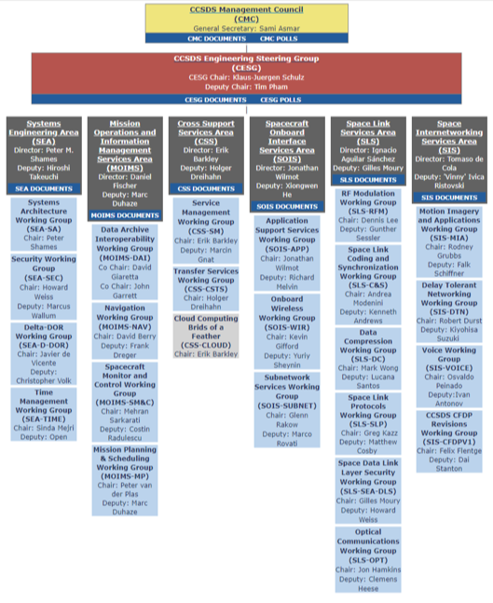
CCSDS Organization
Structures
CCSDS Member Space Agencies: NASA, ESA, CNES, DLR, JAXA, ISA, CSA, CNSA, INPE, ROSCOSMOS, UKSA
CCSDS Management Council (CMC), members are the Heads of Delegation of the 11 civilian space agencies. Sami Asmar (NASA/JPL) is the General Secretary.
CCSDS Engineering Steering Group (CESG), members consist of the six Area Directors and their Deputies. Klaus-Juergen Schulz (ESA) is the Chair, Tim Pham (NASA/JPL) is the Deputy Chair.
Area Directors: Systems Engineering Area, Peter Shames (NASA/JPL); Mission Operations and Information Management Area, Daniel Fischer; (ESA), Cross Support Services Area, Erik Barkley (NASA/JPL), Spacecraft Onboard Services Area, Jonathan Wilmot (NASA); Space Link Services Area, Ignacio Sanchez (ESA); Space Internetworking Services Area, Tomaso de Cola (DLR).
Participants: Member & Observer space agencies, Associate organizations (research & commercial), and Liaisons with other standards bodies (ISO, AIAA, ECSS, OMG, etc)

Slide 3
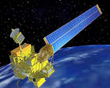
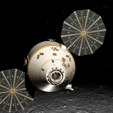
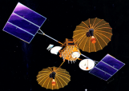
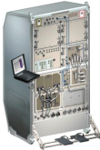
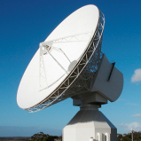


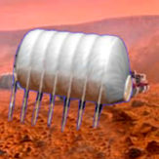
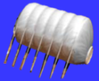
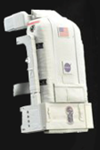



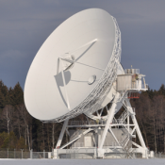


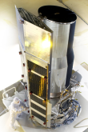
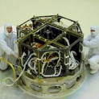

CCSDS Overview
End-to-End Architecture
Six Technical Areas,
Twenty-Four Teams
Systems Engineering
Working Group (producing standards)
Birds-Of-a-Feather stage (pre-approval)
Special Interest Group (integration forum)
Security
Delta-DOR
Systems Architecture
Time Management
One Organization’s Assets
MISSION CONTROL
CENTER
End Users
Applications/Archives
MISSION CONTROL
CENTER
End Users
Another Organization’s Assets
Spacecraft Onboard
Interface Services
Space Link
Services
Cross Support
Services
Space Internetworking
Services
Mission Ops &
Info Mgt Services
Onboard Wireless WG
Application Supt Services (incl. Plug-n-Play)
Subnetwork Services WG
RF & Modulation
Space Link Coding & Sync
Data Compression
Space Link Protocols
Space Data Link Layer Security
Optical Communications
Service Management
Transfer Services
Cloud Computing
Motion Imagery & Apps
Delay Tolerant Networking
Voice
CFDP Revisions
Data Archive Interoperability
Navigation
Spacecraft Monitor & Control
Mission Planning & Scheduling

Slide 4
Systems Engineering Area
Working Group Products
Systems Architecture WG
  Systems Architecture methodology
  CCSDS end-to-end architecture description documents
Security WG
  Security Architecture document and implementation guidelines
  Security standards for link & network layer, encryption & authentication, certificates, and key management
Delta-DOR WG
  High precision plane-of-sky spacecraft position measurements using quasaars
Time Management WG
  Standards for time exchange, clock correlation, and clock synchronization

Slide 5
CCSDS End-to-End Architecture
Delay Tolerant Network (DTN)
(From SCCS-ARD Cross Support Architecture)
Interoperability Points
Space
User Node
Space
Routing Node
Ground Station
Space Routing Node MOC
Earth
User Node
Space File Application
From
VC X
CFDP
Bundle Agent
(Router/S&F)
Space File Application
BP
BP
Bundle Agent
(Router/S&F)
LTP
To
VC X&Z
To
VC X
To
VC Z
CFDP
ENCAP
BP
BP
BP
USLP
User File Application
User File Application
From
VC Z
LTP
CSTS F-Frame
Production
ENCAP
ENCAP
ENCAP
CFDP
CFDP
USLP
USLP
USLP
CSTS-FF
BP
BP
Prox-1
Prox-1
C & S
C & S
TCP
TCP
TCP
S-Band
S-Band
X-band
X-band
IP
IP
IP
CCSDS
Inter Spacecraft
Protocols
CCSDS Space-Ground
Protocols
Terrestrial
WAN
IP-based Network
Terrestrial
WAN
CCSDS Ground-Ground Protocols

Slide 6
CCSDS End-to-End Architecture
Delay Tolerant Network (DTN)
(with Optical Comm)
Space
User Node
Space
Routing Node
Ground Station
Space Routing Node MOC
Earth
User Node
Space File Application
From
VC X
CFDP
Bundle Agent
(Router/S&F)
Space File Application
BP
BP
Bundle Agent
(Router/S&F)
LTP
To
VC X&Z
To
VC X
To
VC Z
CFDP
ENCAP
BP
BP
BP
USLP
User File Application
User File Application
From
VC Z
LTP
CSTS F-Frame
Production
ENCAP
ENCAP
ENCAP
CFDP
CFDP
USLP
USLP
USLP
CSTS-FF
BP
BP
Prox-1
Prox-1
Optical C & S
Optical C & S
TCP
TCP
TCP
S-Band
S-Band
Optical
Optical
IP
IP
IP
CCSDS
Inter Spacecraft
Protocols
CCSDS Space-Ground
Protocols
Terrestrial
WAN
IP-based Network
Terrestrial
WAN
CCSDS Ground-Ground Protocols
Optical Comm instead of RF

Slide 7
CCSDS End-to-End Architecture
Delay Tolerant Network (DTN)
(With Commercial Service Providers)
Interoperability Points
Space
User Node
Space
Routing Node
Ground Station
Space Routing Node MOC
Earth
User Node
Space File Application
From
VC X
CFDP
Bundle Agent
(Router/S&F)
Space File Application
BP
BP
Bundle Agent
(Router/S&F)
LTP
To
VC X&Z
To
VC X
To
VC Z
CFDP
ENCAP
Bundle Agent
(Router/S&F)
BP
BP
BP
USLP
User File Application
User File Application
From
VC Z
LTP
Custom / Private DTN Network
Implementation
ENCAP
ENCAP
ENCAP
CSTS F-Frame
Production
CFDP
CFDP
CFDP
USLP
USLP
USLP
CSTS-FF
BP
BP
BP
Prox-1
Prox-1
C & S
C & S
TCP
TCP
TCP
TCP
S-Band
S-Band
X-band
X-band
IP
IP
IP
IP
CCSDS
Inter Spacecraft
Protocols
CCSDS Space-Ground
Protocols
Terrestrial
WAN
IP-based Network
Terrestrial
WAN
CCSDS Ground-Ground Protocols
Commercial Service Provider

Slide 8
BACKUP

Slide 9
Key SEA Standards that support Lunar
Interoperability and DTN (1/2)
Standard | CCSDS# | Status | Synopsis | Comments
Reference Architecture for Space Data Systems | CCSDS 311.0-M-1 | Published (update in progress) | Formal methodology for describing space systems architectures | Leverages ISO 42010, SysML, and other best practices
Cross Support - Architecture Description Document | CCSDS 901.1-M-1 | Published (update in progress) | Pragmatic guide re how to use more than 50 CCSDS standards to build interoperable systems | CCSDS WGs produce “bricks”, this tells you how to build a wall out of them
CCSDS Guide for Secure System Interconnection | CCSDS 350.4-G-2 | Published | Guidelines for interconnecting space agency networks and IT systems, specifically to enable secure cross support | Leverages NIST 800-47 and tailors it for space systems, provides interconnect templates
Security Architecture for Space Data Systems | CCSDS 351.0-M-1 | Published (update in planning) | Define overall CCSDS conceptual framework for the broad incorporation of security into space data systems | Uses RASDS framework, leverages other CCSDS standards & IETF RFCs

Slide 10
Key SEA Standards that support Lunar
Interoperability and DTN (2/2)
Standard | CCSDS# | Status | Synopsis | Comments
CCSDS Cryptographic Algorithms | CCSDS 352.0-B-2 | Published | Recommendations for providing space mission information confidentiality, authentication, or authenticated confidentiality | Leverages FIPS, NIST, and ISO Standards
CCSDS Authentication Credentials | CCSDS 357.0-B-1 | Published | Provides specifications for credentials to be used for authentication by CCSDS missions and ground systems | Leverages IETF X.509, PKI, other RFCs & ISO standards
Delta-Differential One Way Ranging (Delta-DOR) Operations | CCSDS 506.0-M-2 | Published | A VLBI technique used with Doppler and ranging data to enhance spacecraft navigation by improving spacecraft angular position in the plane of sky | Leverages VLBI techniques along with a Quasar catalog that provides a celestial reference frame
Time Management | CCSDS 300.1-G-0 | Draft (to be published) | Document existing frequency and timing standards, including GNSS, clock correlation, and time synchronization methods, used in space missions | Leverages NIST, GPS, IETF RFCs, CCSDS, and other reference & mission sources

Slide 11
CCSDS Overview
End-to-End Architecture - Static
Six Technical Areas,
Twenty-Four Teams
Systems Engineering
Working Group (producing standards)
Birds-Of-a-Feather stage (pre-approval)
Special Interest Group (integration forum)
Security
Delta-DOR
Systems Architecture
Time Management
One Organization’s Assets
MISSION CONTROL
CENTER
End Users
Applications/Archives
MISSION CONTROL
CENTER
End Users
Another Organization’s Assets
Spacecraft Onboard
Interface Services
Space Link
Services
Cross Support
Services
Space Internetworking
Services
Mission Ops &
Info Mgt Services
Onboard Wireless WG
Application Supt Services (incl. Plug-n-Play)
Subnetwork Services WG
RF & Modulation
Space Link Coding & Sync
Data Compression
Space Link Protocols
Space Data Link Layer Security
Optical Communications
Service Management
Transfer Services
Cloud Computing
Motion Imagery & Apps
Delay Tolerant Networking
Voice
CFDP Revisions
Data Archive Interoperability
Navigation
Spacecraft Monitor & Control
Mission Planning & Scheduling

Slide 12
CCSDS Overview
End-to-End Architecture - SIS
Six Technical Areas,
Twenty-Four Teams
Systems Engineering
Working Group (producing standards)
Birds-Of-a-Feather stage (pre-approval)
Special Interest Group (integration forum)
Security
Delta-DOR
Systems Architecture
Time Management
One Organization’s Assets
MISSION CONTROL
CENTER
End Users
Applications/Archives
MISSION CONTROL
CENTER
End Users
Another Organization’s Assets
Spacecraft Onboard
Interface Services
Space Link
Services
Cross Support
Services
Space Internetworking
Services
Mission Ops &
Info Mgt Services
Onboard Wireless WG
Application Supt Services (incl. Plug-n-Play)
Subnetwork Services WG
RF & Modulation
Space Link Coding & Sync
Data Compression
Space Link Protocols
Space Data Link Layer Security
Optical Communications
Service Management
Transfer Services
Cloud Computing
Motion Imagery & Apps
Delay Tolerant Networking
Voice
CFDP Revisions
Data Archive Interoperability
Navigation
Spacecraft Monitor & Control
Mission Planning & Scheduling

Slide 13
CCSDS Overview
End-to-End Architecture - CSS
Six Technical Areas,
Twenty-Four Teams
Systems Engineering
Working Group (producing standards)
Birds-Of-a-Feather stage (pre-approval)
Special Interest Group (integration forum)
Security
Delta-DOR
Systems Architecture
Time Management
One Organization’s Assets
MISSION CONTROL
CENTER
End Users
Applications/Archives
MISSION CONTROL
CENTER
End Users
Another Organization’s Assets
Spacecraft Onboard
Interface Services
Space Link
Services
Cross Support
Services
Space Internetworking
Services
Mission Ops &
Info Mgt Services
Onboard Wireless WG
Application Supt Services (incl. Plug-n-Play)
Subnetwork Services WG
RF & Modulation
Space Link Coding & Sync
Data Compression
Space Link Protocols
Space Data Link Layer Security
Optical Communications
Service Management
Transfer Services
Cloud Computing
Motion Imagery & Apps
Delay Tolerant Networking
Voice
CFDP Revisions
Data Archive Interoperability
Navigation
Spacecraft Monitor & Control
Mission Planning & Scheduling

