Slide 1
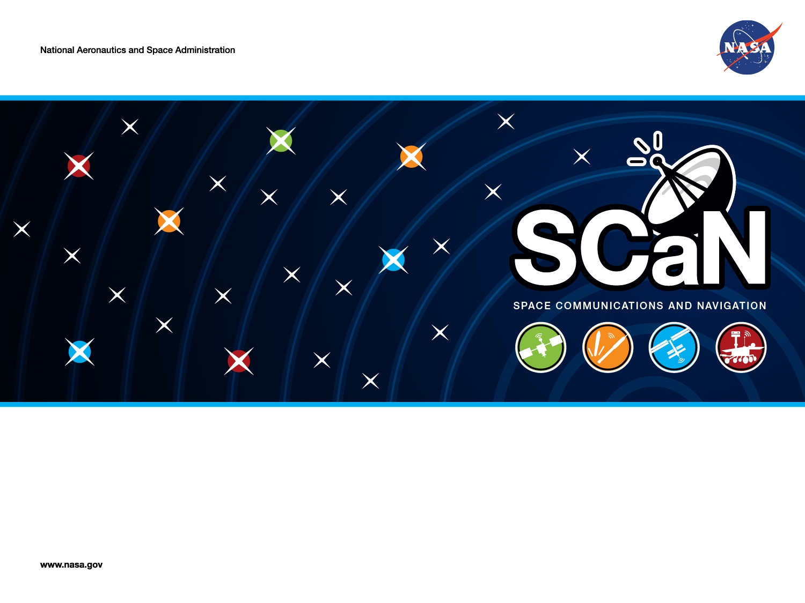
Extract for RASDS++ Annex C
SCaN Integrated Network
Monitor & Control Software Architecture
SysML Model of Trade Space Options
Peter Shames, Mike Anderson, Steve Kowal
Mike Levesque, Oleg Sindiy, Kenny Donahue, Patrick Barnes

Slide 2
EBRE PoD Architecture Model
The SN is doing a major upgrade called the Space Network Ground System Sustainment (SGSS) project
  This is assumed to provide the primary viable approach for implementing the whole of the next generation SCaN architecture
  Other options are also being studied
The SGSS design (pre-PDR) has the following characteristics:
  SGSS has the following elements: Space ground Link (SGL), User Services gateway (USG), Digital Signal Processor (DSP), Service Management (SM), Fleet Ground Management (FGM), Enterprise Infrastructure (EI)
  The SGSS architecture is a quite modern concept, using a pool of shared, programmable servers 9including blades and FPGAs), a high speed set of networks, and an message bus based enterprise infrastructure
  Service Management (SM) orchestrates the delivery of SGSS TT&C and User services. It provides the remote SN user service management interfaces and local SN operator interfaces for managing SN services.
  The Fleet Ground Management (FGM) element manages and controls the TDRS Fleet, and manages the Ground Segment. Management and Control is isolated from user or TTC bearer data wherever possible. The element provides distinct capabilities in an integrated element – Fleet Management, Fleet Control, Ground Management, and Ground Control.
  SGL, DSP & USG all have Control Test & Monitor functions. “Control, Test, & Monitor (CTM) functions manage, control and test each element. CTM functions accept service requests and provide service status on the control plane. CTM functions load software, load configurations, report detected faults, and provide performance information on the management plane.”
A primary purpose of the Cycle 2 studies is to assess whether the SGSS architecture is suitable for use in the other two network elements (DSE & NEE) or if some other alternatives are more functional, lower risk, or more cost effective

Slide 3
Model Color Palette & System Stereotpyes
Fig C-1

Slide 4
NCS-1 EBRE Level 2 System Composition Model
Fig C-2

Slide 5
EBRE Level 2 Architecture
Fig C-3

Slide 6
EBRE Level 3 Service Management (SM)
Software Architecture
Fig C-4

Slide 7
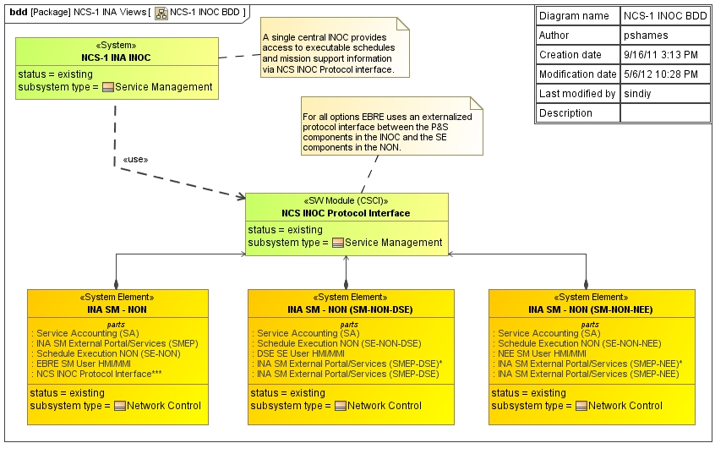
NCS-1 Integrated Overview
Not Used

Slide 8
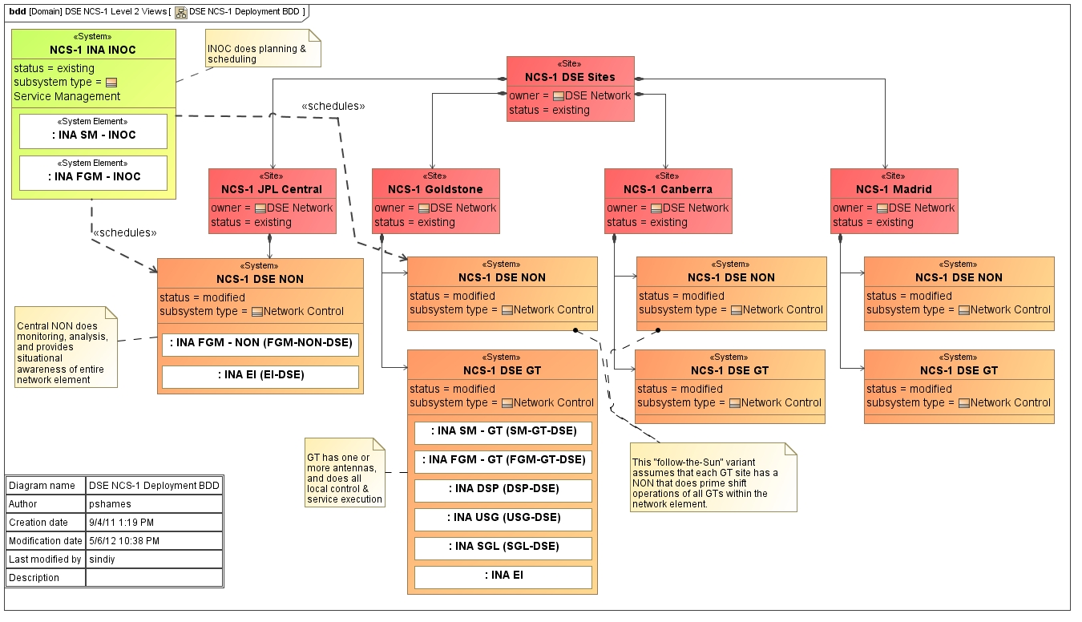
NCS-1 DSE Level 2 Deployment Model
Fig C-5

Slide 9
Problem Space
SCaN System of Systems Architecture Model
NASA’s Space Communications and Navigation (SCaN) office has responsibility for the DSN, SN and NEN communications networks
These three networks are each 35-50 years old and have been evolving on their own for much of that time
SCaN has been directed, by NASA HQ, to:
  develop a unified space communications and navigation network infrastructure capable of meeting both robotic and human exploration mission needs
  implement a networked communication and navigation infrastructure across space
  assure data communication protocols for Space Exploration missions are internationally interoperable
A multi-center team (JPL, GSFC, GRC, HQ) has been studying how to accomplish this using an AoA / tradespace method since March 2008
Formal modeling of the architecture options has been in work since March 2011

Slide 10
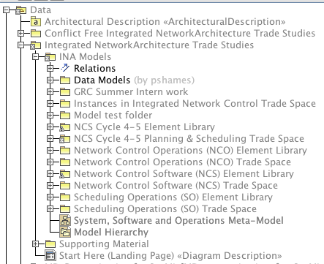
Modeling Methods for SoS & Trade Studies
Develop containment hierarchy with slots for:
  Global terminology, stereotypes, and overview
  Data model
  Libraries of components (software, hardware, facilities, staff)
  Point of Departure (PoD) and trade space elements
  Common views and specialized views as needed

Slide 11
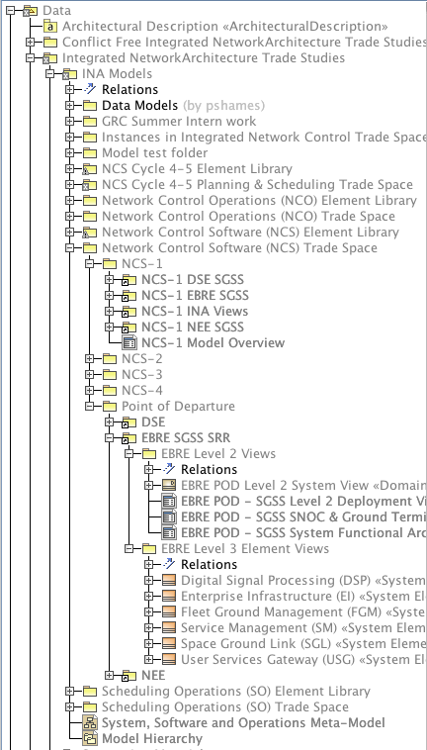
Sub-set of Trade Study Model Hierarchy
Data Models
Separate sections for each trade study cycle
Separate sections for re-use libraries and model options
Separate sections for each trade study option
PoD models for reference and re-use
Views of different types at multiple levels of detail for each element

Slide 12
Summary of Modeling Process
The fundamental steps are:
Define the problem space and scope, per stakeholder concerns
Clarify the set of designs and artifacts to be produced at a high level
Define the overall modeling framework approach to be used
Identify the kinds of design artifacts needed to answer the questions being posed by the key stakeholders
Select the set of viewpoints to be used – e.g. functional, physical, logical, information, organizational, deployment, etc, and the set of views to be produced
Define the trade space and element library model hierarchy and at least the top two levels of decomposition of the hierarchy
Develop any necessary stereotypes, element types, color codes to mark model elements and for visual indication of element properties
Define the major types of elements to be used in the views and create the necessary libraries of composable objects
Define and refine the major elements that will be used to produce the trade space models
Compose the trade space models
Analyze the trade space models
Do not be afraid to go back to earlier steps, even step 2 or 3, and refine the framework and the models until they are adequate to the task

Slide 13
Considerations for Trade Space Modeling
Using SysML & UML to model single systems is becoming better understood
  It has a significant learning curve for the tools and the methods
  Attention to viewpoints and views is important to produce readable models
Trade space and System of Systems modeling appears to be less well understood
  There is little support for it or literature on how to do it
  The level of detail and completeness must be balanced with how models are to be expanded in future cycle
  It appears to have a real value in helping teams document and understand complex system interactions and to explore a multi-dimensional trade space
  It requires a different approach to modeling than single system models, and we are still learning how to do it
It would probably be of use to document the method and some guidelines for doing SoS and trade space modeling
Libraries of viewpoint specifications and “model parts” for re-use would also be a huge benefit where that is possible

Slide 14
Observations on Model Based System Engineering
UML & SysML permit a lot of flexibility, both a blessing and a curse
  Casual uses of modeling methods are quicker, but do not necessarily lend themselves to easy re-use
  Drawings (PPT or other) do not equal models
  Rigor takes more time (define views & viewpoints, libraries, stereotypes, modeling approach, terminology), but better supports re-use and refinement of model elements
  Training in the methods & the tools is almost indispensable
Adopting common approaches (SysML vs DoDAF vs ad hoc) and agreeing on common terminology is essential (and hard)
Formal models take some getting used to: guides, tutorials, “Start here” and overview pages help a lot
Distributed teams are tough to organize, partitioning the problem and allocating responsibility along obvious lines helps a lot
Use of QVTO can assist in model analysis and metrics, even if model is not fully formed, i.e. size & complexity measures, completeness and connectivity measures
Institutional security policies may make shared modeling complicated (firewalls, RSA token, full tunnel, user credentials)

